Slide 1

Topic 5:Comparing two religions:
Christianity and Judaism
Lesson 3: What is the Messiah?

Slide 2
Lesson Objectives
To understand what is meant by the word Messiah in Judaism.
To explore the idea of a Messianic Age.

Slide 3
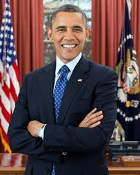
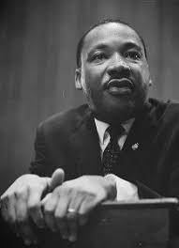
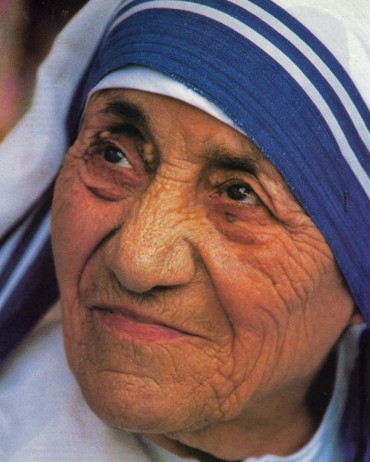
Starter Activity
On a post-it note record your ideas on what makes a good leader.

Slide 4
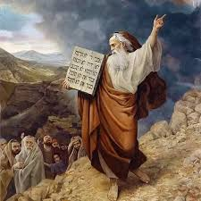
Key Terms
Messiah – means anointed one and the deliverer of the Jewish nation.
Messianic Age – a golden age of peace when the Messiah will rule.
Torah – The Jewish holy book.

Slide 5
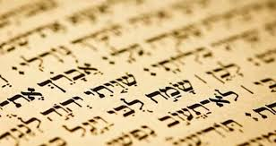
Main Activity 1 – What are the characteristics of the Messiah?
Throughout history Jews have been persecuted. The belief in a coming Messiah has always offered hope that one day peace will come. Claims of Messiahs have continued to the present day but , for most Jews, the Messiah is someone that they are still waiting for and who will establish the Golden Messianic Age.
‘Messiah’ means ‘Anointed One’ and people such as kings. Priests and prophets where anointed in Jewish scriptures.
The ancient practice of anointing with holy oil, signified being chosen for a task (particularly divinely chosen).
Four characteristics of the Messiah.
1) He will be born and have the authority of G-d.
2) He will be a peaceful ruler and introduce a time of peace that will last forever.
3) He will sit on a throne in Jerusalem.
4) He will rule justly over the world.
Task: Record the four characteristics of the Messiah and summarise the above information in at least twenty-five words.

Slide 6
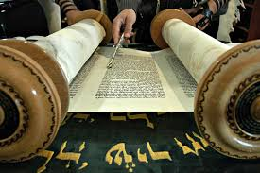
Main Activity 2 – Where is the Messiah mentioned in the Torah?
You have been provided with a sheet with sections from the Torah which is the Jewish Holy book. Work together in pairs and highlight any sentences or phrases that link to the four characteristics of the Messiah.
You have 8 minutes.
Extension activity: Choose a quote record it in your exercise book and explain what it means in at least twenty-five words.

Slide 7
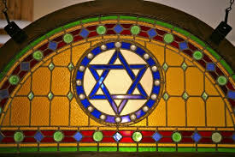
Review Activity
FREEZE FRAME THE FOUR CHARACTERISTICS OF THE MESSIAH.

Slide 8
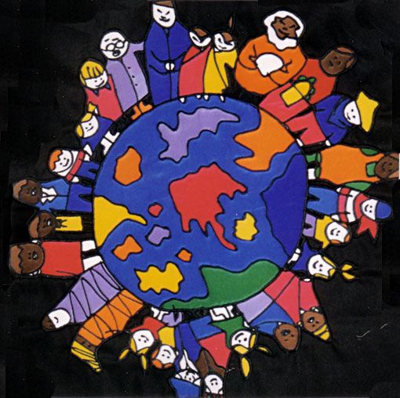
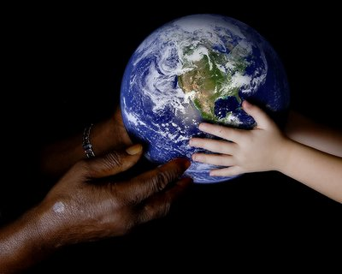

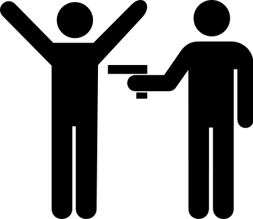
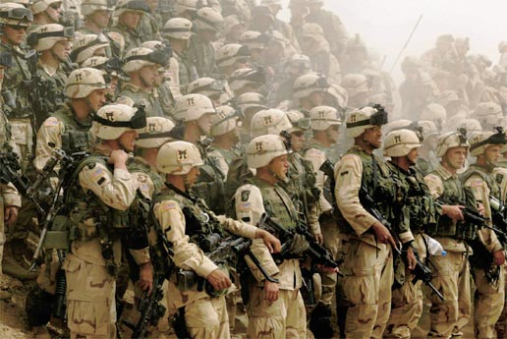
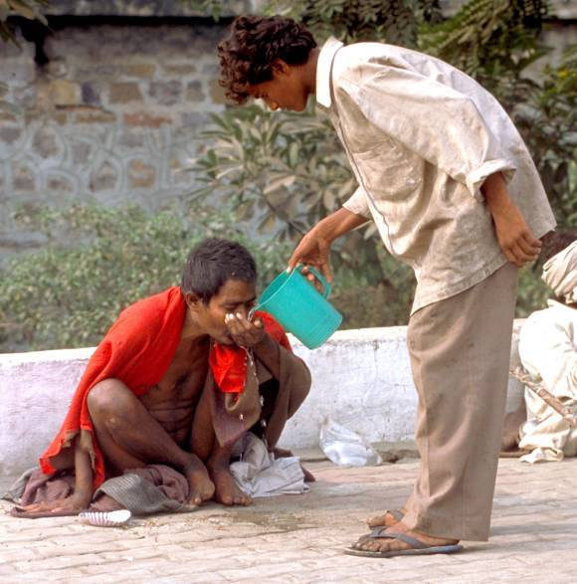
Main Activity 3: The Messianic Age – Golden Age
The Messianic age is a term used by Jewish people to describe a future time on earth.
A time of peace on earth without crime, war and poverty.
Think back to Scripture. What might a ‘Golden age’ in Judaism be like and how might it be achieved ?
In groups brainstorm at least eight ideas. You have eight minutes.

Slide 9
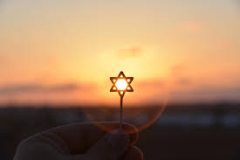
Extension Activity
Do you think a Messianic Age is possible?
Provide at least two detailed reasons for your view.
Provide at least two detailed reasons why someone may disagree with you.

Slide 10
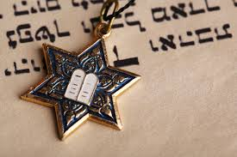
Plenary
What have you learn about the Messiah in this lesson?
In pairs label yourselves A and B.
A explain for thirty seconds everything you know about the Messiah.
B explain for thirty seconds everything you know about the Messianic Age.
Your teacher will time you. Good luck.

