Slide 1
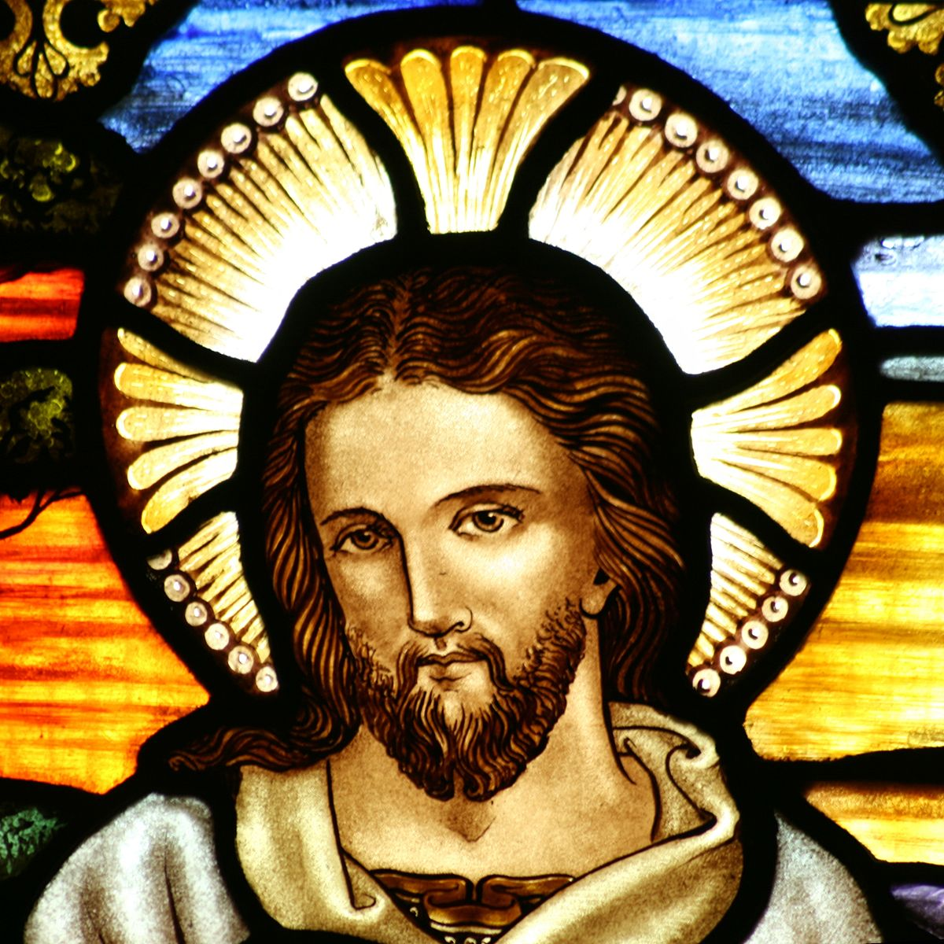
CHRISTIANITY REVISION (2)
Religious beliefs, Values and teachings Nature of God as personal / Creator The Trinity Nature of the Church Key Moral Principles | (2)Sources of Wisdom and Authority The Bible The nature and role of Jesus (Arius vs Athanasius) The Reformation (Luther and Calvin) Does God suffer? (Moltmann / Weinandy) | (3) Practices that shape and express religious identity Diversity of practice in the Eucharist Diversity of creative expressions
(4) Social and historical developments Science (2) Secularisation New movements in theology | (5) Works of Scholars Comparison of Barth and Hick (3 & 4) Atonement (Anselm and Aulen) | (6) Religion and Society Pluralism and Diversity Equality and discrimination (gender)

Slide 2
CHRISTIANITY REVISION (2)
Religious beliefs, Values and teachings Nature of God as personal / Creator The Trinity Nature of the Church Key Moral Principles | (2)Sources of Wisdom and Authority The Bible The nature and role of Jesus (Arius vs Athanasius) The Reformation (Luther and Calvin) Does God suffer? (Moltmann / Weinandy) | (3) Practices that shape and express religious identity Diversity of practice in the Eucharist Diversity of creative expressions
(4) Social and historical developments Science (2) Secularisation New movements in theology | (5) Works of Scholars Comparison of Barth and Hick (3 & 4) Atonement (Anselm and Aulen) | (6) Religion and Society Pluralism and Diversity Equality and discrimination (gender)

Slide 3
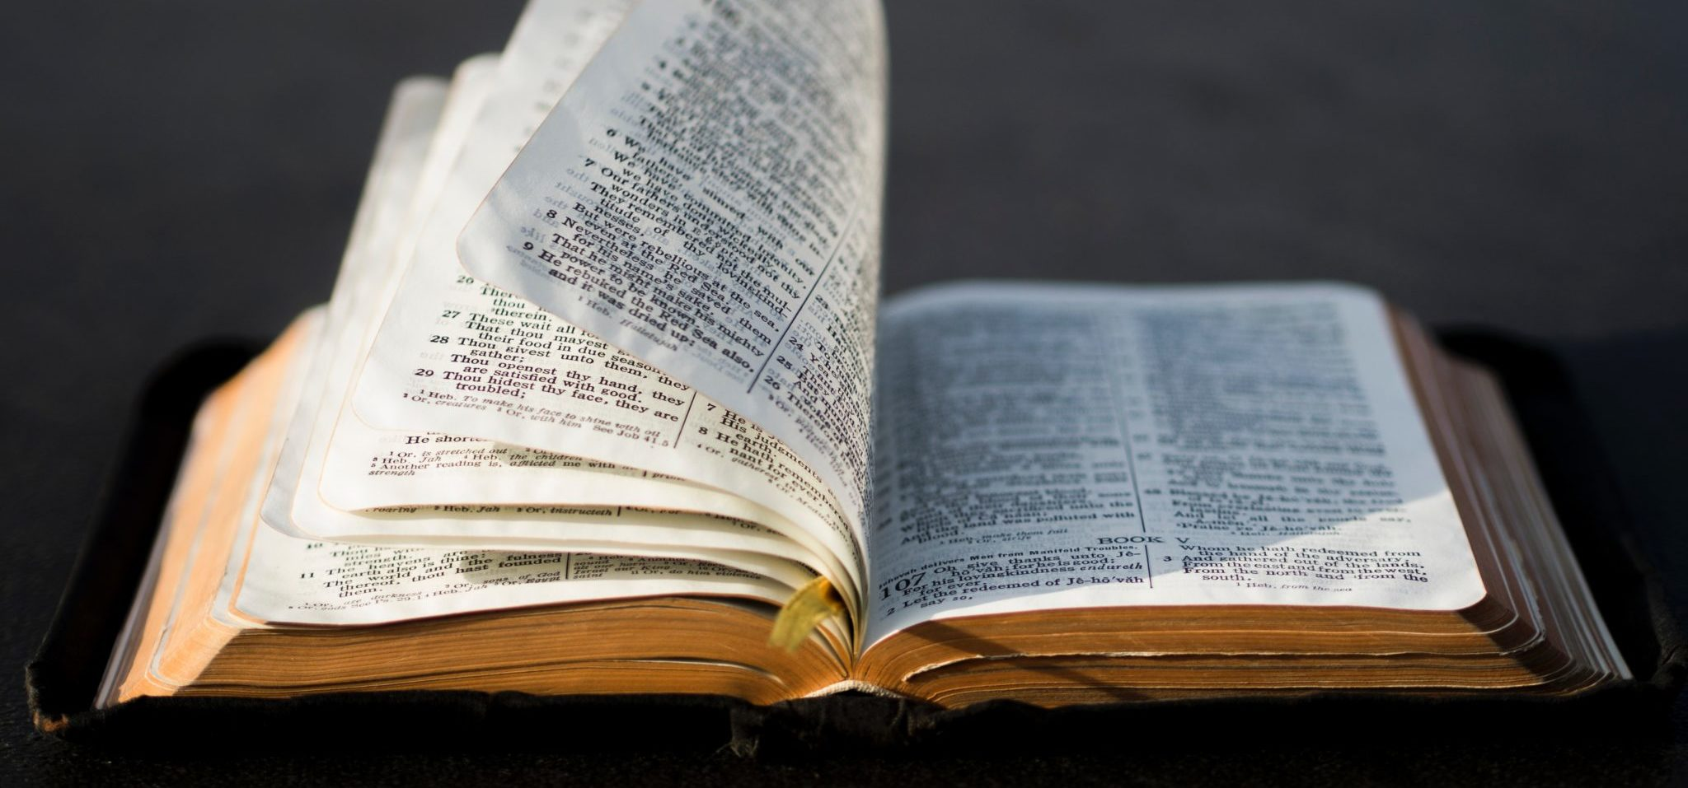
Different ways of interpreting scripture
The Bible is Inerrant – this means it is incapable of being wrong
The Bible is the actual word of God
It is spoken by God to humans
Evidence is the O.T points to Jesus in the N.T and this would not be possible if it had just been written by humans
The Bible is Inspired – the writers had experiences of God
The writers interpreted the message and wrote it down
This means the Bible could have some human error and so must be interpreted through the Church
Our language is limited and so God cannot fully be known (Barth)
Liberal view – the Bible is a human document. The Bible reflects the world of the writers
This explains why there are contradictions

Slide 4
Different ways of interpreting scripture
Strength | Inerrant, Inspired or liberal
Karl Barth believed it is impossible that human language can fully reveal God’s Word, therefore the Bible must be inspired and need interpretation. | Inspired
Augustine and Aquinas believed in the importance of interpretation of scripture, and dedicated much time to the interpretation of the Bible. | Inspired
This view allows humans to use their reason, the teachings and accounts of humans are still important today. | Liberal
Luther stressed the importance of using your own reason and did not trust the role of the Church. | Liberal
This view means that there can be no argument when making decisions, it is clear and straightforward. You cannot misinterpret the 10 commandments. | Inerrant
This view means that you are not at risk of misinterpretations and human error. It recognises the divine authority of the Bible. | Inerrant

Slide 5
Different ways of interpreting scripture
Weakness | Inerrant, Inspired or Liberal
The Bible conflicts with modern ethical beliefs in society this is a problem for this view of scripture. | Inerrant
This view of scripture can lead to contradictions between science and religion, for example creation. | Inerrant
This view of scripture is problematic and it takes away from the authority of the Bible, it hardly seems worth using it as a source of wisdom and authority. | Liberal
This view can lead to misinterpretations, how do we know which modern interpretation is correct? | Liberal
According to this view too much authority is placed in the hands of the Church as Martin Luther acknowledged. | Inspired
This view still makes it difficult to decide which parts need to be interpreted and which do not. | Inspired

Slide 6
Role of the Church in Bible interpretation
If the Bible is inerrant then it must be interpreted correctly
This is the function of the Church
The Church uses the Bible to inform on ethical decisions such as:
10 Commandments
Conscience should be used with the Bible
Augustine and Aquinas who believed the Bible should justify Church teachings
The Catechism teaches the Bible is the word of God where truths are revealed. The role of the Church is to provide authentic interpretation of the Bible
Problems – Martin Luther pointed out that the Church had abused it role in interpreting scripture. Luther wanted Christians to reflect more and use their own reason.
Fundamentalists believe the Bible is inerrant and so there is no need to interpret it

Slide 7

Special and Natural Revelation
Special Revelation – religious truth comes from God’s revelation to humans, provides an awareness of God, is divided into propositional and non-propositional. Does the Bible directly or indirectly reveal things about God?
Natural revelation – clues in the world about God, requires humans reason and philosophy
FOR SPECIAL
Aquinas emphasized man’s ability to comprehend certain truths about God from nature alone. However, Aquinas maintained that human reason was still secondary to God’s revelation, as taught by the Church and based on scripture.
Luther, like Calvin, believed that Natural Knowledge without Revealed Knowledge is a danger. He says that idolatry arises when people make up their own ways of worshiping God.
Barth (1886-1968) – Special revelation (the bible) is the only way to know God; all general revelation (natural theology) creates a false, anthropomorphic God (God in man’s image).

Slide 8
Special and Natural Revelation
Special Revelation – religious truth comes from God’s revelation to humans, provides an awareness of God, is divided into propositional and non-propositional. Does the Bible directly or indirectly reveal things about God?
Natural revelation – clues in the world about God, requires humans reason and philosophy
FOR NATURAL
Other writers emphasizing natural theology were Samuel Clarke, William Paley, and Immanuel Kant. They believed that understanding of God can be achieved more clearly through rational thought inspired by the world around us.
The deists relied solely on natural theology for their knowledge of God, to the complete exclusion of special revelation. To the deist, God is unknowable except through nature, and the Bible is unnecessary.
The Romantic poets, as a whole, were proponents of natural theology. Although they stressed man’s emotion over his intellect, they were constantly extolling the virtue and transcendence of nature.

Slide 9

Role of the Holy Spirit
The role of the Holy Spirit is that of a helper, the Holy Spirit guides Christians in making correct interpretations of the Bible. Paul wrote, "We have... the Spirit who is from God, that we may understand what God has freely given us.“
Although Catholics and Protestants disagree over the role of the Bible and the Church, both agree that the Bible is a text set apart due to its apostolic origins and inspiration of the Holy Spirit. The Holy Spirit is therefore central to the revelation of God.
Furthermore many Christians believe the Holy Spirit seals an individuals faith. Most Christian theologians believe that faith is a result of the Holy Spirit. John Calvin was a theologian that wrote on this and believed that the Holy Spirit was pivotal in revealing God’s nature.
Finally mysticism and mystical experience are for some evidence of the Holy Spirit revealing the nature of God, the power of the Holy Spirit allows in moments of mysticism for Christians to experience the wholly other.

Slide 10
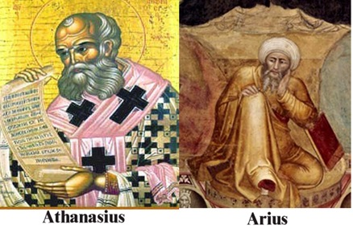
The Arian Heresy
Arius believed that Jesus (the Son) and God (The Father) were not of the same essence.
Arius believed that God created Jesus out of nothing before the creation of the world. Therefore there was a time when Jesus did not exist.
Arius believed that Jesus was an agent of creation of the world.
Arius believed that Jesus was distinct from other creatures, i.e humans. Jesus as “supreme among beings” and thus has a special and distinct relationship with God.
Athanasius wrote a treatise called On the Incarnation
Jesus was both God and Man
325 – Council of Nicaea produced the creed that all Catholics follow
The council confirmed that there was unity of God and Jesus

Slide 11
The Arian Heresy
Why were people against the Arian view of the nature of Jesus?
It could suggest a belief in polytheism.
It suggests that Jesus’ existence is finite and God is infinite.
It takes away from Jesus’ truly divine nature as the incarnation of God.
It is directly against Catholic Church teaching.
Why might some people support the Arian view of the nature of Jesus?
Jehovah Witnesses are closely associated with having Arian views however they are not directly inspired by Arius. Like the ancient Arians, these modern-day Witnesses believe that Jesus is a created being who is therefore not eternal and not God.
The word Trinity is not directly used anywhere in the Bible.
“Divinity” passages are really just speaking of Jesus in an honorific way. God is still quite different from the Son.

Slide 12
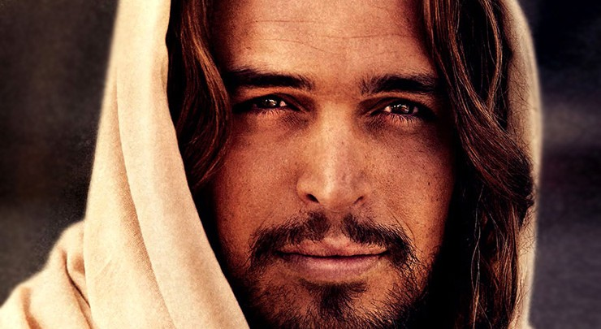
The Nature of Christ
Justification - in Christian theology, is God's act of removing the guilt and penalty of sin while at the same time declaring a sinner righteous through Christ's atoning sacrifice.
Salvation - deliverance from sin and its consequences, believed by Christians to be brought about by faith in Christ
Jesus as a Mediator – the belief that God’s presence in Christ has a role of mediation, bridging the gap between Humans and God as a result of the Fall. In this sense Jesus acts as Priest.
Revelation of God – the belief that through Christ God is revealed. This is witnessed in the teachings, actions and resurrection of Christ.
Jesus as a King - A king is a person who has supreme authority over a territory. When the Jewish people were ruled by kings, they became a nation. They longed for a Messiah who would again make them great.
Prophet - A prophet is a messenger sent by God, a person who speaks for God. He or she witnesses to God, calls people to conversion, and may also foretell the future. Prophets often are killed for their message. Jesus fits this description. He is none other than the Word of God in the flesh. He called the world to turn from sin and return to the Father and was put to death for it.

Slide 13

Salvation
Justification is primarily focussed on what a person has to do to be saved and how a person can enter into a relationship with Christ.
Martin Luther obviously had huge distrust of the Catholic Church and justification was a huge aspect of Luther’s beliefs and theory. Martin Luther coined the term justification by faith alone. Luther believes that God provides everything for sinners to be saved. Luther believed that justification is not received simply because he or she believes, but that God’s presence is active in the world and people receive justification from Christ. Faith unites a person with God and that it is God who actively graces humans with justification.
John Calvin
Calvin developed the theory. Calvin believed that faith unites a believer with Christ in a mystic union. The union with Christ has a two-fold effect. First the faith and union with Christ leads to justification. Second on an account of the union with Christ the believer begins a process of being like Christ through regeneration.

Slide 14
Salvation
What is the Catholic View?
Justification is more centred on the actions of the believer as opposed the receiving of God’s grace and salvation. Justification is achieved through actions and the sacraments. The Catholic Church teaches that faith with works is dead.
Points in favour of Luther and Calvin
Justification is one-time event we are justified when we believe in Christ as personal Lord and Saviour or when we become “born-again” Christians. It is totally reliant and God’s Grace.
Justification is achieved through faith alone which is therefore not reliant on the Church and therefore not open to potential error and deception of the Church.
Justification according to Calvin and Luther rests on the mercy of God and leads people to be certain of salvation. This is a very appealing as it guarantees salvation.

Slide 15
Salvation
Points against Luther and Calvin
The Council of Trent in 1545 created a careful and detailed response to Luther’s view on justification. The Council confirmed the Catholic position and criticised Luther on various grounds including believing that Luther was stating that justification was nothing more than relying on the mercy of God.
Another key criticism is in the idea that justification is not a process. In order to grow and develop a relationship with God this must involve a process. The Catholic Church aids this process through the sacramental nature of the Church.
Also scripture consistently teaches of the importance of actions in order to gain salvation. Jesus outlines this is various parables including the Parable of the Sheep and Goats. Faith requires action.

Slide 16
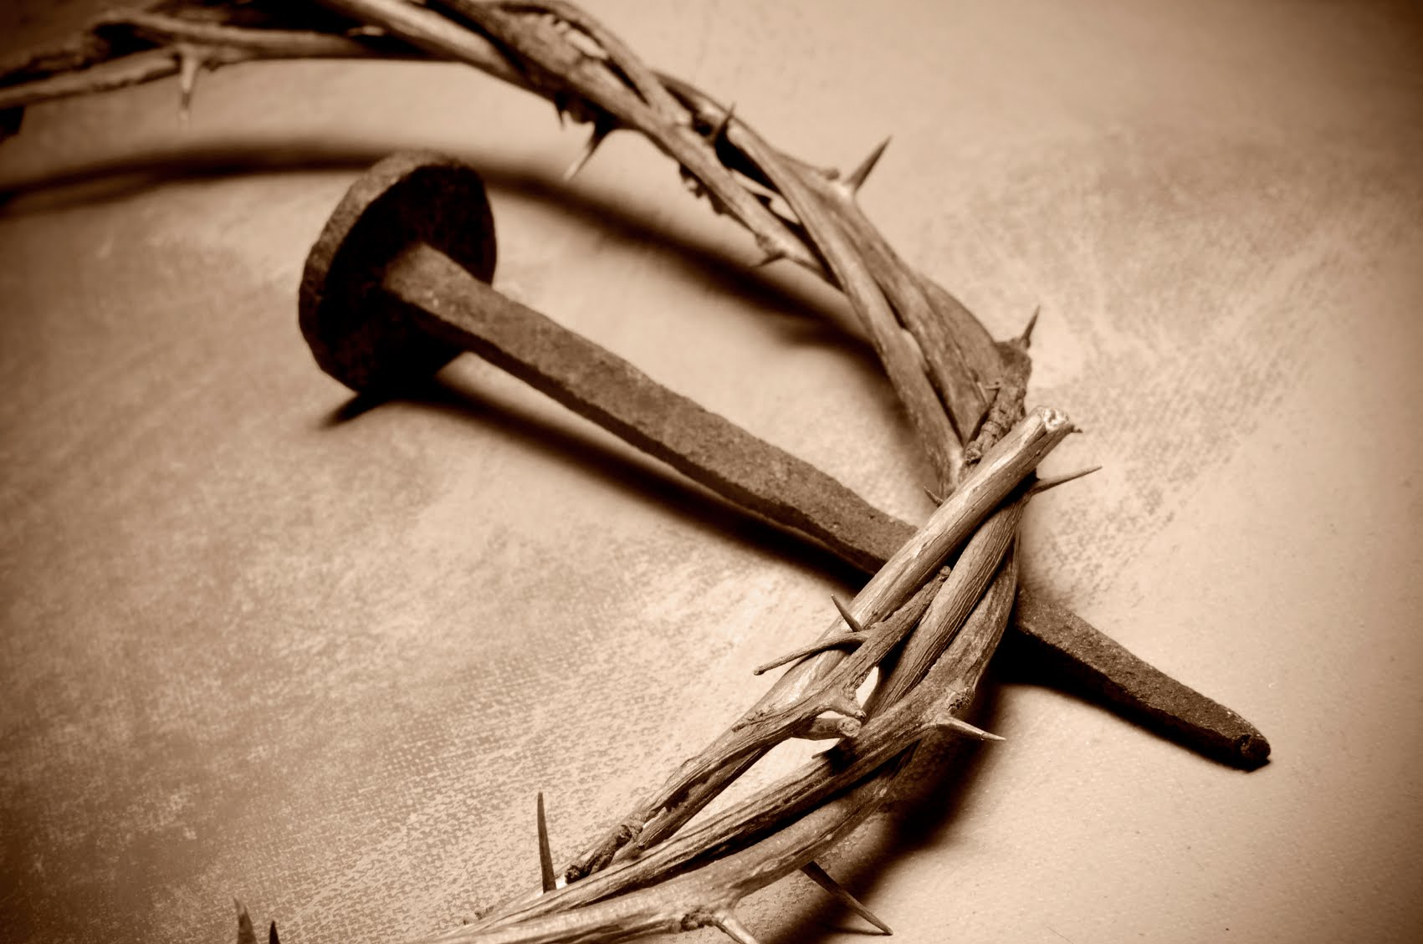
Modern views of Jesus’ suffering
Some people teach that God is impassible and by this we mean that God does not experience different emotional states and therefore God does not suffer.
Moltmann focusses on a very real idea of Jesus’ therefore God’s crucifixion
"The cross is not and cannot be loved.
Jesus on the cross is central to Christian faith according to Moltmann as ultimately in the act of crucifixion salvation and realisation of God is at its most.
On the cross Jesus cries out to God, for some this is a contradiction to the Trinity. However Moltmann really emphasises that in the contradiction rests in the ultimate truth about God’s nature. It is a contradiction but God is beyond the rules of our logical experiences.
Many question how can God suffer? Surely God can not suffer as a perfect being. Jesus did suffer and therefore God must also suffer if we believe in the Trinity
God does suffer and all persons of the Trinity are wound up in the suffering on the cross. Moltmann emphasises the realness of God’s suffering as an actual historical event and one that was freely chosen by God for humanity. The Trinity is so tightly woven into the passion of Christ, it is necessary. It is necessary that God suffers.
Ultimately God suffers in union with humanity’s suffering.

Slide 17
Modern views of Jesus’ suffering
Weinandy
On the issue of suffering, Weinandy identifies that modern theologians confuse the ideas of love and mercy, and the God’s suffering: “It is love and not suffering that ultimately is at the heart of compassion, for it is love that brings true healing and comfort.”
Weinandy points out that it has only been of the last 200 years that theologians have come to the view that God does suffer. Previously God had to be impassible and if God did suffer and therefore could change, God would not be the supreme and perfect being.
In summary, Weinandy sees confusion in modern theology between the idea of suffering as we know it, and what God offers, which is eternal love and salvation if we follow His teachings. God will ultimately save us from the root of all suffering – sin.

Slide 18
Modern views of Jesus’ suffering
Points in favour of God’s suffering
Process Theodicy – Whitehead believes that God does suffer and this is crucial in explaining evil in the world.
In the Bible it appears that God is not impassible. Some people teach that God is impassible and by this we mean that God does not experience different emotional states and therefore God does not suffer. However many theologians more recently have come the beliefs that suffering is integral to God.
Jesus is God incarnate and suffers on behalf of humanity; theologians have placed this suffering as central to their faith in God.

Slide 19
Modern views of Jesus’ suffering
Points against God’s suffering.
Weinandy – the belief that God suffers is confusion from modern theologians between our idea of suffering and God’s love and mercy.
Suffering of God leads to a view that God is imperfect and capable of change. A God who has changing emotions is not in line with a supremely perfect being.
Traditional Christian views of God held that God is transcendent and unaffected by the world. These views were influenced by Greek philosophical ideas of a perfect God.

Slide 20

Review of information and test your knowledge
You will be given a sheet with some general questions.
Have a go at answering them.

Slide 21
Review of information and test your knowledge
Now have a look at some exam style questions
Make notes on how you would answer them.

