Slide 1

CHRISTIANITY REVISION (3)
Religious beliefs, Values and teachings Nature of God as personal / Creator The Trinity Nature of the Church Key Moral Principles | (2)Sources of Wisdom and Authority The Bible The nature and role of Jesus (Arius vs Athanasius) The Reformation (Luther and Calvin) Does God suffer? (Moltmann / Weinandy) | (3) Practices that shape and express religious identity Diversity of practice in the Eucharist Diversity of creative expressions
(4) Social and historical developments Science (2) Secularisation New movements in theology | (5) Works of Scholars Comparison of Barth and Hick (3 & 4) Atonement (Anselm and Aulen) | (6) Religion and Society Pluralism and Diversity Equality and discrimination (gender)

Slide 2
CHRISTIANITY REVISION (3)
Religious beliefs, Values and teachings Nature of God as personal / Creator The Trinity Nature of the Church Key Moral Principles | (2)Sources of Wisdom and Authority The Bible The nature and role of Jesus (Arius vs Athanasius) The Reformation (Luther and Calvin) Does God suffer? (Moltmann / Weinandy) | (3) Practices that shape and express religious identity Diversity of practice in the Eucharist Diversity of creative expressions
(4) Social and historical developments Science (2) Secularisation New movements in theology | (5) Works of Scholars Comparison of Barth and Hick (3 & 4) Atonement (Anselm and Aulen) | (6) Religion and Society Pluralism and Diversity Equality and discrimination (gender)

Slide 3
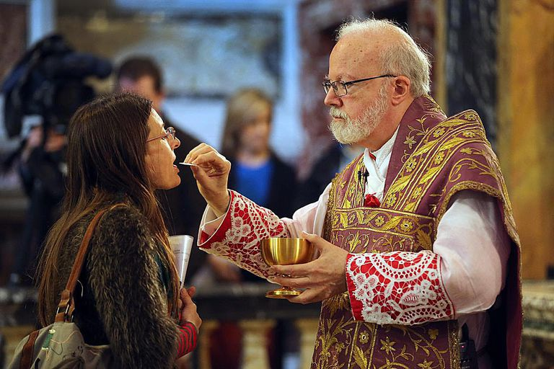
Bread and Wine at Mass
“Take this all of you and eat it. This is my body…This is the blood of the new and everlasting covenant which will be poured out for you and all people so that sins may be forgiven. Do this in memory of me.”
Jesus was anticipating his death
Jesus was showing that his whole being was present, by saying the bread was his body and the wine was his blood.
The actions of breaking the bread and pouring the wine symbolise the death of Jesus, which he accepted for the sake of humanity. Both actions reflect the idea of the body and life force being destroyed.
Jesus’ command to eat and drink makes his followers sharers in the offering that he made to the Father on the cross.

Slide 4
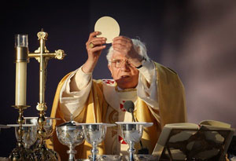
Different attitudes on the Eucharist
Catholic understanding of the Eucharist - transubstantiation. This means that once the priest has blessed the bread and wine, despite retaining the physical appearance of bread and wine they are transformed into the actual body and blood of Christ. Catholics argue this doctrine is supported by John 6:55: For my flesh is real food and my blood is real drink and Matthew 26:26: Take and eat; this is my body.
Transignification - Transignification is based on the idea that there are two kinds of presence: local and personal.
You may be ‘locally present’ in this class (your body is here) but if your thoughts are far away, then you are not ‘personally present’. When the priest consecrates the bread and wine of the Eucharist they take on the real significance of Christ’s body and blood, but they are not chemically changed
Transfinalization - Proposed by Karl Rahner - When the priest consecrates the bread and wine their purpose and finality are changed, but not their substance They do not become Christ’s body and blood but serve a new function, which is to stir up faith in the mystery of Christ’s redemptive love
Protestant understanding of the Eucharist - Consubstantiation
Consubstantiation is a doctrine put forward by Protestant Reformers to challenge the Catholic idea of transubstantiation
The bread and the wine of the Eucharist do not change into the actual body and blood of Christ. They remain bread and wine
However, Christ is spiritually present.
Memorialism - Zwingli denied the real presence of Christ in the sacrament and taught that the bread and wine do not communicate him to the recipient They are symbolic representations of his body and blood
Virtualism - John Calvin - Taught that Christ’s body cannot be present in the Eucharist, because Christ’s body has ascended into heaven -However, Christ’s unique power (Latin = virtus) is present in the bread and wine

Slide 5
Different attitudes on the Eucharist
What is transubstantiation and who believes it?
What is transignification?
What is transfinalization and who believed it?
What is consubstantiation and who believes it?
What is memorialism and who believes it?
What is virtualism and who believes it?

Slide 6

Private and Public worship
Types of prayer
Private prayer
PRAISE / ADORATION – being joyful and loving God and His abundant bounty.
THANKSGIVING - appreciation for God and His immeasurable gifts of love and goodness
CONFESSION - contrition for our sins against God and others
INTERCESSION – praying on behalf of someone else, being concerned about the plight and need of others
PETITION – asking God for something
Public prayer
Mass – receiving the sacrament, giving thanks for the Lord’s life and strength
Coming together for weekly prayers
Silent prayer / Contemplation
Using meditation or contemplation as prayer. Focusing on God and being conscious of Him. Sometimes an icon is used to focus the wandering mind such as a crucifix or statue. Meditation can help give insight into daily lives and spiritual journey.
The Lord’s Prayer
The oldest Christian prayer taught by Jesus to his disciples. Teaches forgiveness so that God will forgive believers. It is a way to salvation and freedom.
Purpose of prayer
Focus on God and get closer to him
To learn not to be selfish and to realise not to be dependent on others
Improve their life and help them come to terms with things they’ve done
Help others who suffer, and to inspire them to do something practical to help others too
Bring inner peace

Slide 7
Private and Public worship
What are the five types of prayer?
Provide examples of public prayer?
Provide 4 reasons for the purpose of prayer?

Slide 8
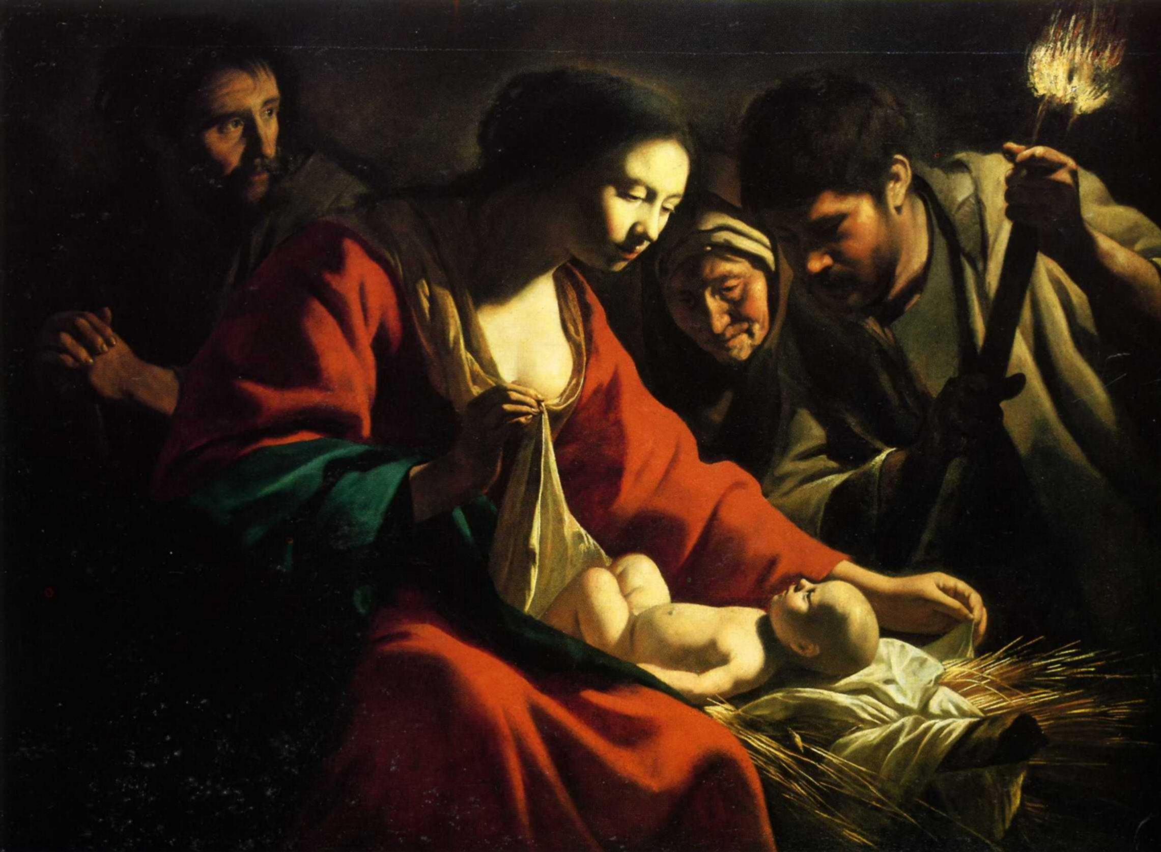
ART
Read and highlight the notes and copy and create the following table in your books.

Slide 9
ART
Early Christian art
The beginnings of Christian art can be traced to the end of the second century. The Old Testament prohibited graven images yet the use of images became increasingly important after the death of Christ, partly due to the important role played by images in Greco-Roman culture.
In the third century, there was very little imagery of the nativity, crucifixion or resurrection of Christ. This is perhaps best explained by the status of Christianity as a mystic religion.
The theme of death and resurrection was common in early Christian art.

Slide 10
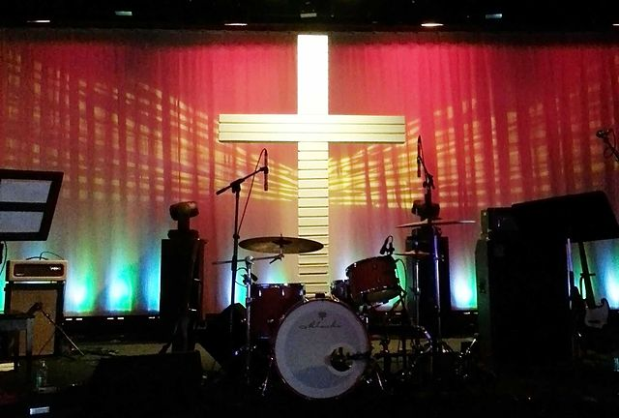
MUSIC
Hymns – these can be traditional or modern. Using well known hymns can unit people of all ages and they can join in their worship of God together. Being able to join in with a hymn and sing is an uplifting experience as the whole person is being used. (Used by Catholics, Methodists, Anglican)

Slide 11
MUSIC
Modern hymns – these can engage the young but leave out the older people. There is a need for different styles of music to be played so that all ages are catered for but, what is more important – the praising of God or that we enjoy the music? Some would say that one can come from the other. (Used by all denominations)

Slide 12
MUSIC
Live music – some churches have bands who play live and so lead the worship. This can sometimes lead to a concert style of service which some people like but others may not. Where does it become focused on the band rather than God? Is it more important that we are there worshipping God rather than jumping to modern music? (Mainly used by evangelical)

Slide 13
MUSIC
Plainchant – this is a type of music that is used in monasteries or in certain services during the day. It is a very spiritual type of music. It is very reflective and provides the opportunity for individual, private prayer. The music follows the same pattern in how it is sung and so has a mesmorising way of being listened to. The problems with this is that it can be difficult to understand what is being sung as sometimes it is in Latin. Also, for the younger generation it is very old fashioned. (Mainly used by Catholic and Anglican in certain services)

Slide 14
MUSIC
The role of music is to do the following:
Bring heart and mind together when thinking about God
Praise God through the whole person – “He who sings prays twice”
Lift the spirits of the person
Provide some time for reflection of the work of God for us
Unite people in their faith through their singing
People are lifting their voices and so are lifting themselves to God

Slide 15
MUSIC
Problems
Some people may not like the style of music being played and so cannot engage with the worship of God
The music may overtake the focus of the service
Some people do not like singing as they believe that they do not have a good voice
To sing is embarrassing for some people

Slide 16
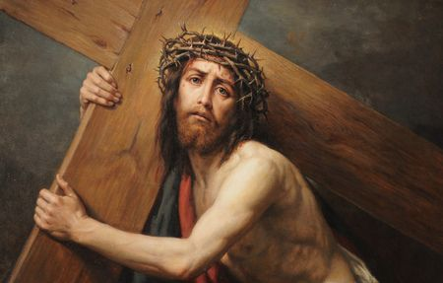
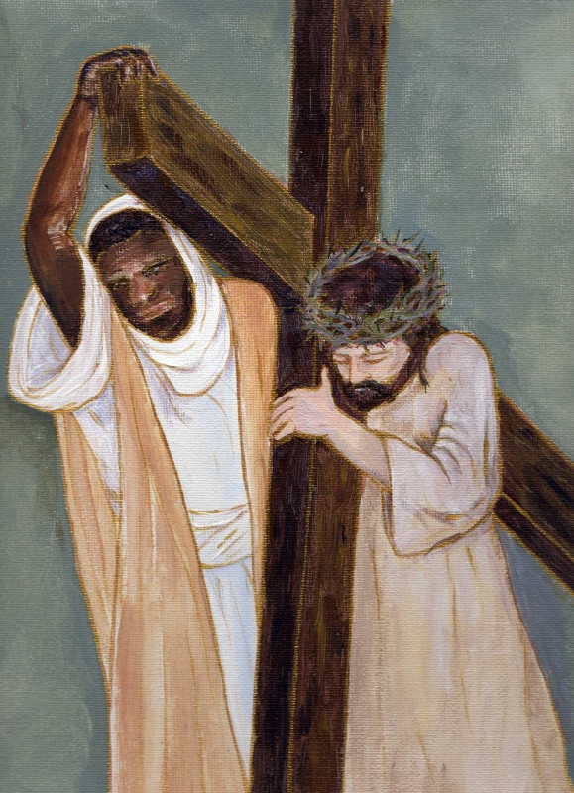
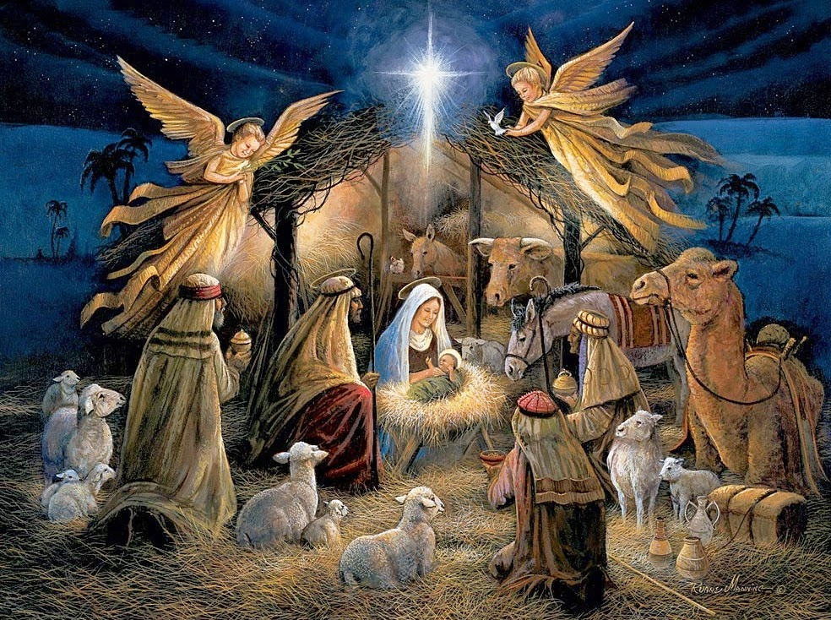

Slide 17

Review of information and test your knowledge
You will be given a sheet with some general questions.
Have a go at answering them.

Slide 18
Review of information and test your knowledge
Now have a look at some exam style questions
Make notes on how you would answer them.

