Slide 1

CHRISTIANITY REVISION (4)
Religious beliefs, Values and teachings Nature of God as personal / Creator The Trinity Nature of the Church Key Moral Principles | (2)Sources of Wisdom and Authority The Bible The nature and role of Jesus (Arius vs Athanasius) The Reformation (Luther and Calvin) Does God suffer? (Moltmann / Weinandy) | (3) Practices that shape and express religious identity Diversity of practice in the Eucharist Diversity of creative expressions
(4) Social and historical developments Science (2) Secularisation New movements in theology | (5) Works of Scholars Comparison of Barth and Hick (3 & 4) Atonement (Anselm and Aulen) | (6) Religion and Society Pluralism and Diversity Equality and discrimination (gender)

Slide 2
CHRISTIANITY REVISION (4)
Religious beliefs, Values and teachings Nature of God as personal / Creator The Trinity Nature of the Church Key Moral Principles | (2)Sources of Wisdom and Authority The Bible The nature and role of Jesus (Arius vs Athanasius) The Reformation (Luther and Calvin) Does God suffer? (Moltmann / Weinandy) | (3) Practices that shape and express religious identity Diversity of practice in the Eucharist Diversity of creative expressions
(4) Social and historical developments Science (2) Secularisation New movements in theology | (5) Works of Scholars Comparison of Barth and Hick (3 & 4) Atonement (Anselm and Aulen) | (6) Religion and Society Pluralism and Diversity Equality and discrimination (gender)

Slide 3

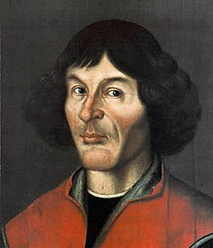
Scientific challenges to Religion
Copernican heliocentrism 1543
The Sun was near the centre of the universe and NOT the Earth
The Sun was motionless and the other planets rotated around it
This was against the view that had been in existence for a long time!
The Earth was placed at the centre of the Universe for two reasons
Observations of the night sky in early astronomy made the Universe appear to be rotating around the earth
The Earth at the centre of the Universe is more in line with Biblical teaching. It places humanity at the centre of all God had made.

Slide 4
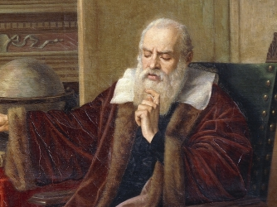
Scientific Challenges to Religion – Galileo
1610 Galileo published his Starry Messenger
This was about his observations of the planets Venus and Jupiter
He promoted Copernicus’ view of Heliocentricism
1616 Catholic Church declared Heliocentricism to be heretical and it was banned
1616 Galileo proposed the Theory of Tides. He argued the tides were evidence for the motion of the earth
1633 Galileo was tried for heresy and was found guilty
1835 the Church had dropped all opposition to heliocentrism and in 1992 JPII gave an official apology for his treatment

Slide 5
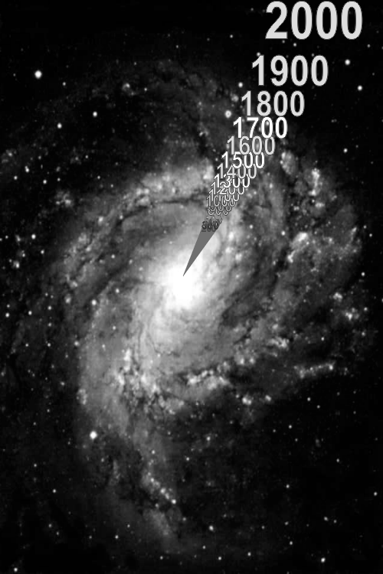
Scientific Challenges to Religion – Age of the Universe
Bible scholars have attempted to work out the age of the Universe using the dates and ages of people in the Bible
There is some confusion after Solomon
The Venerable Bede suggested the earth was created in 3952BC
1650 the Ussher Chronology was put forward. He claimed the moment of Creation was in the evening of 22nd Oct 4004BC
Radio dating using lead ores suggests the Earth is around 4.54 billion years old while the Universe is about 13.7 billion years

Slide 6

Scientific Challenges to Religion – Creation and Evolution
1859 The Origin of Species by Darwin was published
The idea that man evolved from an ape and was not created in God’s image caused divisions
Very few people question evolution today due to the evidence that is available
Some people say that God could have begun the evolutionary process
The Church of England issued a posthumous apology to Darwin saying it was too against evolution when his book was published

Slide 7
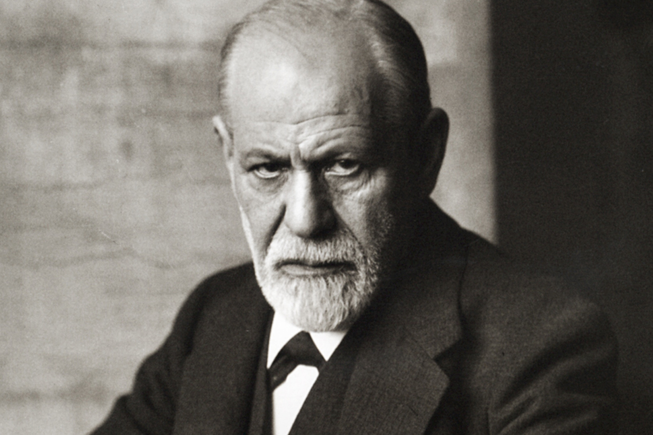
Scientific Challenges to Religion – Sigmund Freud
Philosophy stated that the mind and body were distinct entities
This suggested Dualism
Psychology brought the mind and body together in union
The mind and body affect each other
This challenged earlier religious beliefs about the soul
For Freud, religion was wishful thinking.
Religion is an obsessional neurosis
Religion is something man created to project its guilt onto
Oedipus Complex

Slide 8
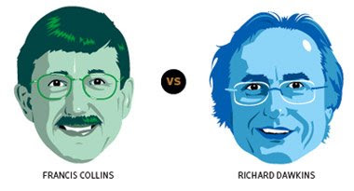
Scientific Challenges to Religion – Collins and Dawkins
Richard Dawkins
Does not believe that there is a God
You cannot separate Religion and Science
Argument from Design was the most powerful argument for the existence of God but Darwin provided a simpler argument. His argument is more elegant.
The process of evolution is intricate and when looking at it over a large period of time it seems impossible. This should tell us that we should not assume that just because something is complex, it could only have been done by God.
If God did create life, why did he wait so long for life to begin and then wait longer for humans to appear?
In order to explain something we say, “God did it” but the God we believe in has to be improbable too.
Why does God not have any explanation? There could be more than one God.
From the perspective of faith, people lose their rational side

Slide 9
Scientific Challenges to Religion – Collins and Dawkins
Francis Collins
Either God exists or he does not. God cannot be contained in nature and so he is outside the range of Science.
Observing and studying the natural world is a way to see God’s presence and work.
Evolution does not remove the view that creation was the act of God. God could have activated evolution. God is able to see the future and give us freewill.
Everything was so perfect for the Big Bang to happen that this could not just be chance.
Ockham’s razor says “the simplest explanation is the most likely”. Therefore, the simplest explanation for the universe is that there is God.
God is beyond our human understanding.
What the Bible describes is very consistent with the Big Bang.
It is possible for God to perform miracles. God created the laws of nature and so he can choose when to violate them.
If we are all just biological, where does the sense of helping others come from? The moral law that exists is evidence that there is a God.
Faith is not the opposite of reason.

Slide 10

Secularisation
Arguments for
Statistical trends - Decline in church attendance, therefore there is no longer a place for religion.
Postmodernism and Pluralism: multi faith countries cause no one truth to exist, questioning one religion against another. Therefore, there is no real place for a religion that claims ultimate truth.
Rationalism: scientific explanations have replaced and clashed with religious explanations.
Disengagement theory: Sects and diverse and more spiritual religious groups have become more interesting than organised religion and in is replacing these religions.

Slide 11
Secularisation
Arguments against
Change in place of worship: Just because footfall has declined, does not confirm people are not praying etc. elsewhere like at home.
Pluralism: more diversity can chose a change of religions. If secularisation is happening we lose our moral fabric
People do believe in God or a deity, the religious climate has changed. New Age Religions and spiritual explorations. Religion is simply just different and therefore is certainly existent.
Just because religion has lost its authority in law does not mean it has lost its spiritual influence and place in the world.

Slide 12
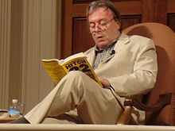
Secularisation – Christopher Hitchens
Advocated the separation of the Church and State
Described himself as an anti-theist
Belief in God impedes freedom
Argued that free expression and scientific discovery should replace religion
Pointed out that God did not send his Son for such a long time and what was the point? God had watched so much suffering take place and why should he bother 2000 years ago and why not earlier?

Slide 13
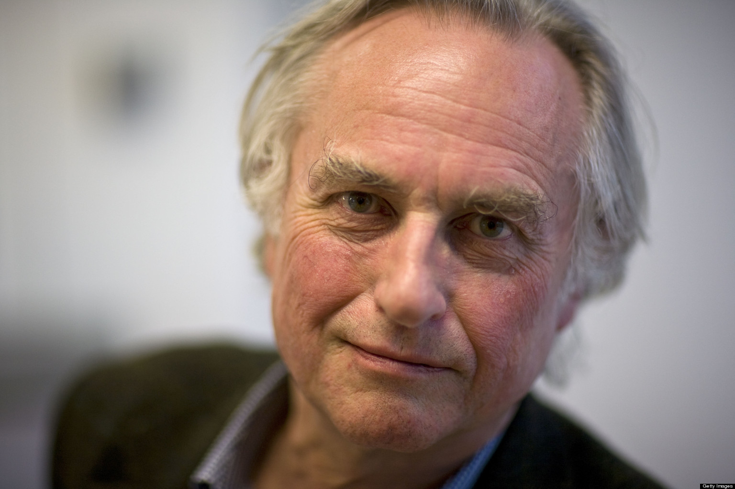
Anthology Extract – McGrath and Richard Dawkins
The God Hypothesis – that a God exists is a scientific question. To believe that a God exists is a delusion.
No Design, No God – Evolution gives us evidence to reject design as well as creation by chance.
Why are there religions? – It is a by-product of how children are raised.
Do we need religion in order to be good? – Genes are selfish. We do not need God or religion to have good morals.
What is wrong with religion? – It teaches us not to change our minds. Religious faith motivates terror. Explanations and inspiration come from science.

Slide 14
Anthology Extract – McGrath and Richard Dawkins
God is a Delusion
Belief is not grounded in evidence. It is “blind – trust”
Belief is a “process of non-thinking”
Delusions need to be removed
Beliefs should be examined to make sure they have a firm basis.
Religious people should question their faith
McGrath agrees that beliefs are used to shape our lives

Slide 15
Anthology Extract – McGrath and Richard Dawkins
Faith is infantile
Children are prone to believe what their parents tell them
Belief in Santa will eventually cease as a child gets older
Religious belief is the same but what about those who believe when they are older?
Dawkins says that bringing children up in a faith is a form of abuse. McGrath argues that bringing a child up in atheism would also be abuse?
McGrath suggests that Dawkins has shown a need for the RE Curriculum in schools to be taught to broaden the minds of young people

Slide 16
Anthology Extract – McGrath and Richard Dawkins
Faith is irrational
Dawkins feels there is enough evidence to disprove religious beliefs
Dawkins’ research is poor as he is using information from the internet and not thinking about his sources
McGrath calls the God Delusion “propaganda”
McGrath shows how Dawkins misquotes Tertullian
Dawkins quotes Luther but McGrath says that Luther is misquoted. Luther was arguing that human reason can never take a central role in faith
McGrath feels that Dawkins abandons rigorous scholarship

Slide 17
Anthology Extract – McGrath and Richard Dawkins
Arguments for God’s existence
McGrath says the “Blind Watchmaker is the best in print” about design and evolution
McGrath does argue that Dawkins is out of his depth with religion. He skims the surface and lacks total knowledge to really engage with the topics
Aquinas uses empirical evidence to show evidence of God and this is what scientists would use also
The theory of evolution is the best we have for now. It may change in the future but for now, it answers the questions we have

Slide 18
Anthology Extract – McGrath and Richard Dawkins
The improbability of God
McGrath suggests that this is a loose argument by Dawkins. The main question he is looking at is about “Who designed God?”
Dawkins suggests that to say there is something more complex than the universe is improbable
McGrath suggests that improbability does not mean non-existence
The question is not whether God is improbable, but is God actual?
McGrath argues that Dawkins has “loosely collated a series of assertions”

Slide 19
Anthology Extract – McGrath and Richard Dawkins
God of the Gaps
Dawkins suggests that God is always used to fill something people cannot explain
Dawkins is making a very general assumption that religion / religious people need satisfaction and so use God to give it
The mind is too limited to fully understand God and the same can be said about understanding science

Slide 20
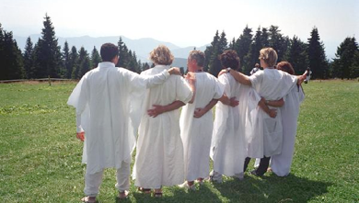
New Religious Movements
New religious movement (NRM), the generally accepted term for what is sometimes called, often with pejorative connotations, a “cult.”
These religions are, by definition, “new”; they offer innovative religious responses to the conditions of the modern world, despite the fact that most NRMs represent themselves as rooted in ancient traditions.
NRMs are also usually regarded as “countercultural”; that is, they are perceived (by others and by themselves) to be alternatives to the mainstream religions of Western society, especially Christianity in its normative forms.
These movements are often highly eclectic, pluralistic, and syncretistic; they freely combine doctrines and practices from diverse sources within their belief systems.
The new movement is usually founded by a charismatic and sometimes highly authoritarian leader who is thought to have extraordinary powers or insights.
Many NRMs are tightly organized. In light of their often self-proclaimed “alternative” or “outsider” status, these groups often make great demands on the loyalty and commitment of their followers and sometimes establish themselves as substitutes for the family and other conventional social groupings.

Slide 21
Types of New Religious Movements
World Rejecting Movements | World Accommodating Movements | World Affirming Religions
Highly critical of the outside world so tend to withdraw and adopt a communal lifestyle. They vary in size but most are small, local groups which often have charismatic leaders. However, some are international in size such as the Unification Church (The Moonies). They are politically radical. They cut off former ties – friends, relatives, possessions, and members have to hand over all assets and are forced to live an ascetic lifestyle. | Members of such groups (e.g. “born again Christian” groups) usually live “normal” lives. These are often offshoots of existing churches. They resemble denominations and are far more politically conservative than world rejecting NRMs. They are a breakaway from a church which they feel has lost its religious purity. | Scientology is an example. The world is one of opportunity (acceptance of society’s norms). We can be more successful and become ‘better’ people. Many involve expensive training programmes. Members live in the ‘normal world.’

Slide 22

Types of New Religious Movements
Arguments for NRM’s
Seen to go against the norm
Not traditional and so more exciting
A person is wanting to see that they can make a difference
Idea that they are having the truth revealed to them and the rest of the world is in ignorance
More euphoric and uplifting
Wanting to please the leader and continue to be a chosen person

Slide 23
Types of New Religious Movements
Arguments against NRM’s
Often led by one person who is controlling
Possessions are often handed over which means that the person owns nothing of their own
Hard to leave the group as no possessions and all ties are cut. This means a person who leaves can have no contact with family or friends
Often what is done takes place behind closed doors and so is hidden
The group have no contact with the outside world and so losing track of worldly events and even maybe reality

Slide 24
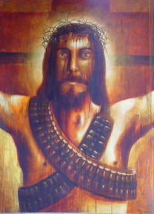
Liberation Theology
Began in Latin America in the 1960s
Claims over the years the Church has supported ideological power structures that have oppressed the weakest members of society
Christian faith is looked at from the view of the poor and oppressed
The founder believed that such suffering was against the will of God and against the teachings of Christ

Slide 25
The Impact of Liberation Theology
Looks at conditions of the world and how God is manifested in human history
Vatican II examined the social and economic situations of the world and so opened up new dialogue of the Church in Latin America
Medellin Conference 1968 – the Catholic Church admitted it had sided with oppressive governments
Bonino “Theology has to stop explaining the world and start transforming it”
The Church is suspicious of the movement and its links to Marxism
Bonino “God is clearly on the side of the poor”

Slide 26
The Impact of Liberation Theology
There has been a growth of “base ecclesial communities”
Gutierrez uses the language of ordinary people
Theology is something to be done and not learned. This is the concept of “praxis”
“Structural Sin” which means it is society rather than individuals which are corrupt and need redemption
Critics say this is too simplistic
They say it has reduced salvation to a worldly problem and ignores the spiritual dimension

Slide 27
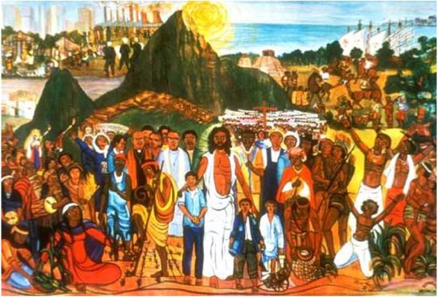
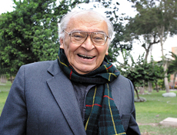
The Impact of Liberation Theology
A Theology of Liberation
View that a Christians first duty was to fight against oppression and theology should come second to this
“The starting point of liberation theology is commitment to the poor, the non-person. Its ideas come from the victim”
Oppressed masses were “non-human beings” (cactus people)
Message of Christianity is solidarity with the poor
Announcing the coming of the Kingdom of God meant working in solidarity with the poor. This action, the “praxis of solidarity” he called the “option for the poor”
“We are on the side of the poor ….because they are poor”

Slide 28
Strengths of Liberation Theology
Gives the Church back to the people and for the people
Highlights the poverty that people are enduring
Gives people hope that they are not suffering in vain
Showed the flaws of the Catholic Church and how they can even be led astray
Gives a new outlook on religion and the purpose of religion
Reminds people that everyone is equal and is to be treated as such

Slide 29
Weaknesses of Liberation Theology
Does it really work? People are still in poverty and so not a lot has changed
Is it not simply a way of making people feel they should put up with their suffering?
It has to be a collective from the Church to want to change things for the poor as some people on their own cannot do this
Is the approach too simple?

Slide 30

Feminist Theology
Has emerged in response to male bias in religion
In the past three to four decades it has emerged as something with its own literature
The difference between men and women permeates all aspects of life
God is associated with the male and male characteristics and so this overshadows the female
Most theology has been done from the perspective of the man and so theology has been “gender-blind”
It must be orientated to the transformation of society
Elizabeth Cady Stanton “The Bible is not a neutral book”. It is a political weapon against women’s struggle for liberation

Slide 31
Feminist Theology
Types of Feminist Theology
Exclusive – sexism is the key to all oppression
Inclusive – Sexism is one of the structures of oppression
Revolutionary Feminism
The Judaeo – Christian God has been created by men for men
This God speaks to men and not women
Religious symbols and language are so much focused on the male that they should be abandoned
Types of Revolutionary Feminism
“Goddess Religion” – A female deity is necessary if women’s experiences are to be included
A problem with this is that it has existed before but has not survived. It is also anachronistic which means it is old fashioned and belongs to a time in the past.

Slide 32
Feminist Theology
Reformist Feminist Theology
According to McFague, reformist theologicans “believe that the root-metaphor of Christianity is human liberation, not patriarchy, and that liberation for women can occur within the Christian paradigm.”
For McFague this is a “bold faith” as it does have much to support it at first glance
The heart of the Christian Gospel is seen as containing within it the need for human liberation which will be manifested in a new human – divine relationship

Slide 33

Feminist Theology
Sallie McFague
Focus is on inclusive language through metaphorical analogy
Experiences with God are described through images and metaphors
Replacing the metaphor “God the Father”, a more inclusive metaphor could be used, such as, “God as Mother, Friend and Lover”
Such inclusive language we can find in the Bible. In the Trinity, the oneness of God is expressed beautifully preserving the overall unity
What the Trinity is is at the heart of McFague’s thinking. She is looking for plurality without removing the unity

Slide 34
Impact of Feminist Theology
People have been frightened of Feminist Theology and so it has grown in numbers
Looking towards replacing the patriarchal church with a more sympathetic structure
For some people simplifying worship and involving a She-God has begun
The empowerment of women in the Church has worried some Priests who are also fearful of the increased role of the laity in the life of the Church
The Association of Catholic Women has been formed and publishes documents regularly
The Bishops have had to think about women and the Church as a lot of women felt they were overlooked by the Church
Women have raised awareness of liturgical reform with regards to the language used

Slide 35
Impact of Feminist Theology
People have been frightened of Feminist Theology and so it has grown in numbers
Looking towards replacing the patriarchal church with a more sympathetic structure
For some people simplifying worship and involving a She-God has begun
The empowerment of women in the Church has worried some Priests who are also fearful of the increased role of the laity in the life of the Church
The Association of Catholic Women has been formed and publishes documents regularly
The Bishops have had to think about women and the Church as a lot of women felt they were overlooked by the Church
Women have raised awareness of liturgical reform with regards to the language used

Slide 36
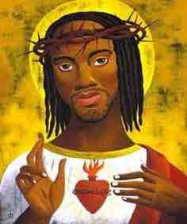
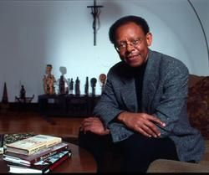
Black Theology
Philosophy for Cone had no meaning for people from the cotton fields. These people had been marginalised and what Barth was telling them was meaningless
Cone believed that Black Christians should not follow the “white Church” on the grounds that it was a willing part of the system that had oppressed black people
Cone believed that scripture should be returned to especially the elements that show liberation
Scripture is not the only source of information. Cone would also use the resources native to the African American Christian Community including Slave Spirituals, the blues and writings
Cone believed, like Tillich, that theology is not universal but tied to specific historical contexts
Cone interprets the centre of the Gospels, which is Jesus’ identification with poor and oppressed. The resurrection is the ultimate act of liberation.
Cone argues for God’s own identification with “blackness”.
Either God is identified with the oppressed to the point that their experience becomes God’s experience or God is a God of racism

Slide 37
Strengths of Black Theology
He did modify the language in his books so that it was more inclusive
Cone has brought a new view to the oppression of black people
Cone is highlighting the lack of empathy from the Church
His theology focuses on the struggle for liberation and is consistent with the Gospel
Black theology remains relevant and necessary
Delores Williams challenged Cone for both male-centred language and for not including the experiences of black women in his sources
Cone’s work is viewed as sexist
Cone is criticised for not emphasising reconciliation within the context of liberation

Slide 38

Review of information and test your knowledge
You will be given a sheet with some general questions.
Have a go at answering them.

Slide 39
Review of information and test your knowledge
Now have a look at some exam style questions
Make notes on how you would answer them.

