Slide 1

CHRISTIANITY REVISION (5)
Religious beliefs, Values and teachings Nature of God as personal / Creator The Trinity Nature of the Church Key Moral Principles | (2)Sources of Wisdom and Authority The Bible The nature and role of Jesus (Arius vs Athanasius) The Reformation (Luther and Calvin) Does God suffer? (Moltmann / Weinandy) | (3) Practices that shape and express religious identity Diversity of practice in the Eucharist Diversity of creative expressions
(4) Social and historical developments Science (2) Secularisation New movements in theology | (5) Works of Scholars Comparison of Barth and Hick (3 & 4) Atonement (Anselm and Aulen) | (6) Religion and Society Pluralism and Diversity Equality and discrimination (gender)

Slide 2
CHRISTIANITY REVISION (5)
Religious beliefs, Values and teachings Nature of God as personal / Creator The Trinity Nature of the Church Key Moral Principles | (2)Sources of Wisdom and Authority The Bible The nature and role of Jesus (Arius vs Athanasius) The Reformation (Luther and Calvin) Does God suffer? (Moltmann / Weinandy) | (3) Practices that shape and express religious identity Diversity of practice in the Eucharist Diversity of creative expressions
(4) Social and historical developments Science (2) Secularisation New movements in theology | (5) Works of Scholars Comparison of Barth and Hick (3 & 4) Atonement (Anselm and Aulen) | (6) Religion and Society Pluralism and Diversity Equality and discrimination (gender)

Slide 3
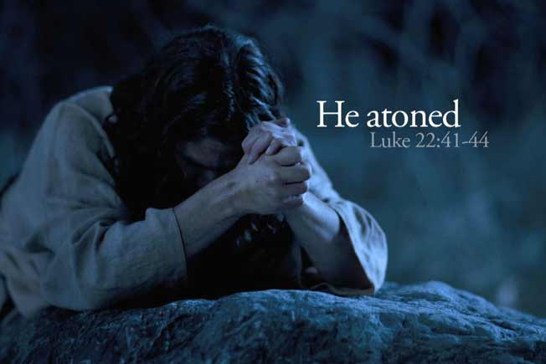
Atonement
Christology is the study of the person of Jesus
It is concerned with the spiritual and theological significance
It is concerned with how people have responded to a specific series of events that centred n the work of Jesus Christ, namely his death and Resurrection

Slide 4
Issues arising from Jesus’ death and resurrection
Jesus makes God known. Jesus is God in human form and so God is able to show himself to humanity. Jesus says, “I am in the Father and the Father is in me” (John’s Gospel)
Jesus brings salvation. Salvation comes from the life, death and resurrection. The N.T shows that Christ makes life possible and that he can redeem humanity
Jesus is the Messiah and has been anointed
Jesus is the Son of God. This term means belonging to God but at his trial Jesus admits that he is the Son of God (Luke’s Gospel)
Jesus is God. Jesus never claims this but the Gospels do portray this. “The Word was with God and the Word was God” “My Lord and my God” (John)
Paul uses the term “Son of God” when referring to Jesus by drawing a distinction between what he saw as the “sonship” of believers who can become children of God by adoption and Jesus himself, who is God’s own son

Slide 5
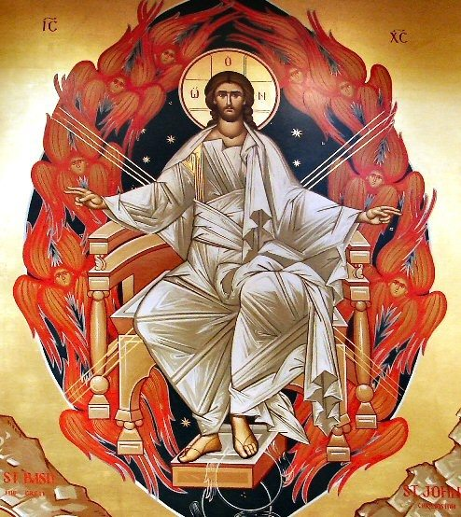
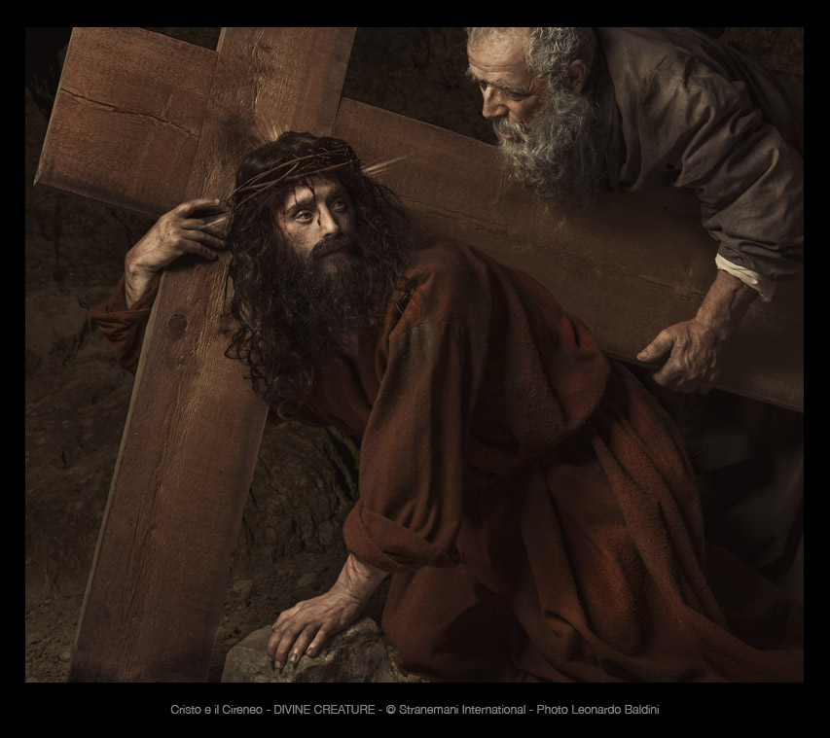
The link between the human and divine Christ
The Council of Chalcedon (451 CE) declared that Christ was both truly human and divine.
Christ has two natures – God and human
Christ is an example – Christ acts as a living example of how to life the godly life – Christ is a moral teacher and in his death he shows self-giving love. Jesus also has a deep relationship with God that the believer should also seek
Christ is a symbolic presence – Tillich said that the symbolic significance of the work of Christ was that he brings new life and saves humanity from its old, sinful existence. Christ is a symbol of how humanity can truly achieve salvation
Christ as mediator. Christ is the mediator between God the Father and humanity. Christ was a unique channel or focus through which God’s redeeming work could be made available to humanity. True knowledge of God and salvation comes from Christ

Slide 6
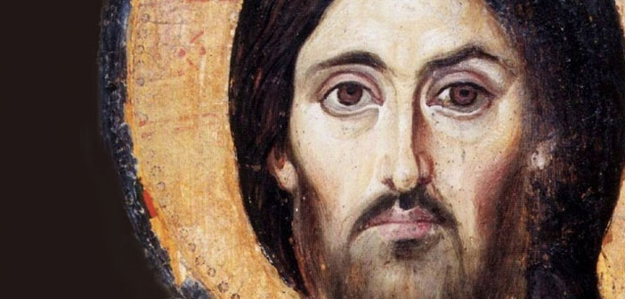
Theories of Atonement and Salvation
Atonement is a central doctrine of Christianity
Humanity is sinful and sin prevents humanity from receiving God’s blessing
Atonement is about God’s love, justice and mercy
Humanity cannot be freed from sin without divine help.
God sent Christ to die as a sacrifice and a ransom to pay the price of sin so that humanity could be forgiven and set free
Christ dies in the place of sinners. He is “at-one” with them
“God presented him as a sacrifice of atonement, through faith in his blood” (Romans)

Slide 7
Questions of Atonement and Salvation
Who did Christ die for?
Did Christ only die for those who had been chosen? The elect?
Did Christ die for all humanity and so are all humans saved? This is Universal Atonement
Salvation is available for ALL who believe in him
“For God so loved the World that he gave his only Son” (John)
However Salvation takes place, the most important thing is that it does take place.
When does it happen? Some say it has already happened or is happening now. Some say that the act of salvation is an on-going act by God
For others, it is something to happen in the future

Slide 8
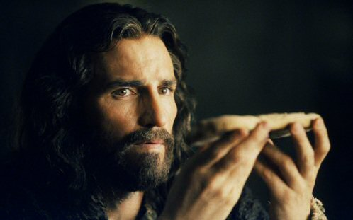
Is Atonement in the Present or the Future?
Robert Kysar argues in favour of futuristic eschatology. This is the view that salvation is in the future and judgement will come on the last day. Tribulations will happen but Satan will be defeated and Christ will return – the Parousia
Others favour present eschatology. This is the view that the expectations of the future are realised in the person’s present relationship with Christ. Salvation is them something to be enjoyed in the present and it will not be destroyed by our physical death
Heavenly eschatology – this is the view that there is a heavenly home waiting for Christians which Jesus has gone ahead to prepare for them. Here, the person will become ONE with the Father and the Son
The Bible does not clarify present or future but there is a reference to it being something that has happened – “You were washed and sanctified”
The Bible does also say that salvation takes place past, present and future through a belief in Christ

Slide 9
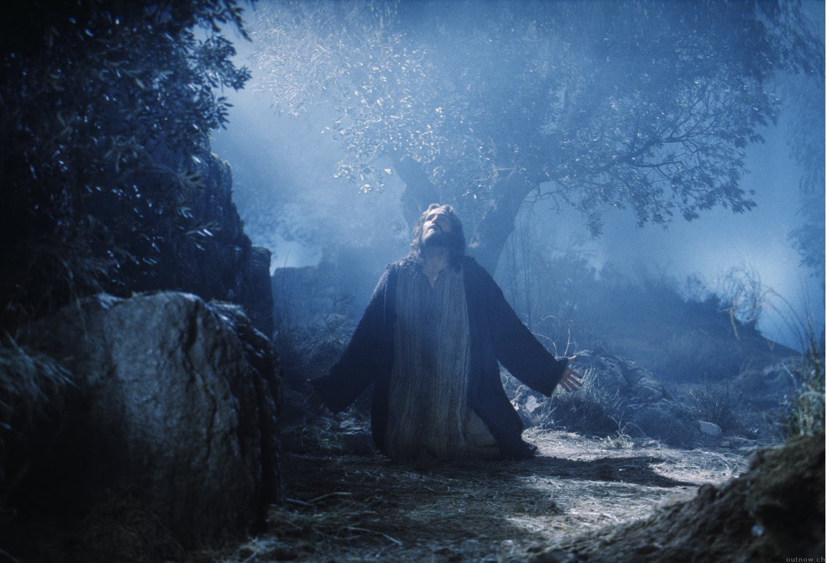
The Foundation of Salvation
Theories of salvation and Atonement are called SOTERIOLOGY
This is the study of what salvation is, what it means and how it relates to Christ
Christ is the sacrifice. Athanasius noted “Christ offers a sacrifice which is trustworthy of permanent effect and which is unfailing in its nature…Christ, being truly of God the Father beame incarnate for our sakes so that he might offer himself to the Father in our place and redeem us through his offering and sacrifice”
John Locke – “The reasonableness of Christianity” – the most important factor in salvation was the Messiahship of Christ. “Faith required was to believe Jesus to be the Messiah…I do not remember that Christ anywhere assumes to himself the title of Priest”
Joseph Butler – Analogy of Religion – the issue of Christ’s sacrifice is unclear – “We seem to be very much in the dark concerning the manner in which the ancients understood atonements to be made.”
The idea of Christ being a sacrifice became difficult to accept especially after the two World Wars and the number of people who died

Slide 10
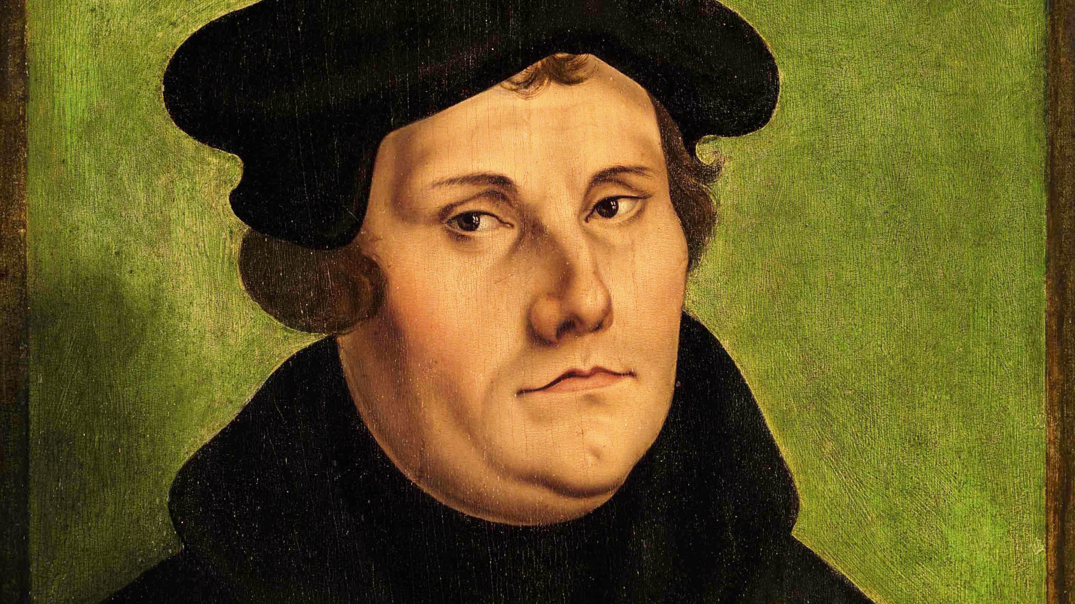
Justification By Faith
“The reason why some people do not understand why faith alone justifies is that they do not know what faith is.”
“Justification” is a legalistic word: a judge decides in favour of one party against the other and the winner is “justified” in his argument. Justification by faith is the way in which humanity is freed from the guilt and condemnation of sin
The Doctrine of Justification was put forward by St Paul – “For all have sinned and fall short of the glory of God and are justified freely by his grace through the redemption that came by Christ Jesus.” (Romans)
Hans Kung and Moorna Hooker have argued that it is possible to be saved by believing in Christ, a believer need not have actually heard of justification by faith

Slide 11
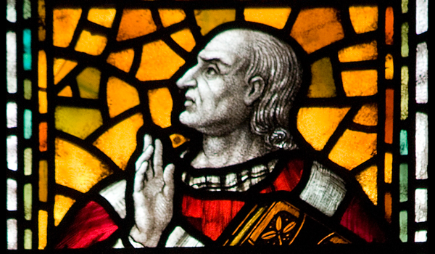
Anselm and Salvation
Christ’s death allowed God to forgive human sin.
Anselm does not accept the idea of Christ’s ransom believing that there were no “rights of the devil” which needed to be paid off by God
Rather, Anselm spoke of God’s righteousness and in his work “Why God became Man” he analysed salvation as follows:
God created humanity in a state of original righteousness
God’s aim was to bring humanity eternal blessedness
This required humanity to obey God
Sin prevented humanity from obeying God
To get rid of sin “a satisfaction” had to be made to purge sin
Humanity could not provide this satisfaction
Only God could provide it
A “God-Man” would possess the ability (as God) and the obligation (as a human) to pay the satisfaction
Therefore, God became incarnate, paid the satisfaction through the Cross and humanity was saved

Slide 12
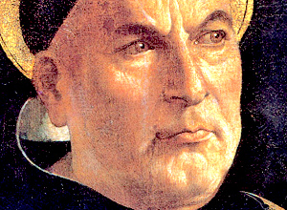
Aquinas and Salvation
Aquinas suggests that there are three considerations to be made in understanding the adequacy of the “satisfaction of Christ” to compensate for human sin
The greatness of Christ’s love for humanity
The supreme worth of Christ’s life that he laid down
The great sorrow and passion that Christ endured for humanity
For Aquinas, Christ’s death was the ultimate offering or satisfaction
“The worth of Christ’s flesh is to be reckoned, not just according to the nature of the flesh, but according to the person who assumed it, in that it was the flesh of God, from whom it gained infinite worth”

Slide 13
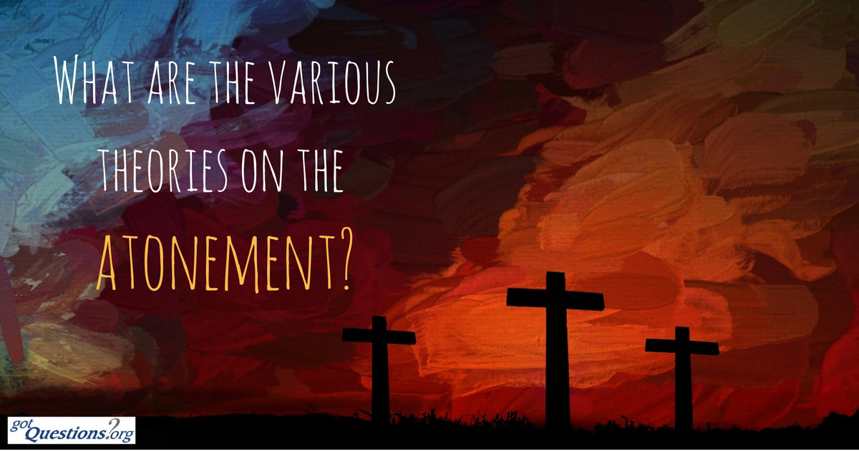
Three models of Atonement
REPRESENATION
God entered into a covenant, or agreement, with the people if Israel and now has entered into a covenant with all the people of the Christian Church. Christ is humanity’s representative who acts in obedience to the terms of the covenant, and, in his death, offers them forgiveness and salvation
PARTICIPATION
Through faith, believers participate in the risen Christ and therefore share all the benefits of his death and risen life
SUBSTITUTION – Christ dies on the Cross in the place of sinful humanity. By his obedience and righteousness humanity is saved

Slide 14
Issues with the models of Atonement
Substitution rests on the idea of Original Sin and that humans were sinful
Some people are uncomfortable with the view that Christ was able to bear the guilt and the punishment that should have been given to sinners. Was this the right thing to do morally?
Modern writers have questioned the ideas of original sin and guilt. Freud regarded these aspects as “psychological projections” that existed only in people’s minds rather than in scripture
In Justification of God P.T. Forsyth argued that the Cross was linked to “the whole moral fabric and movement of the universe” in which God acted to restore “the rightness of things”

Slide 15
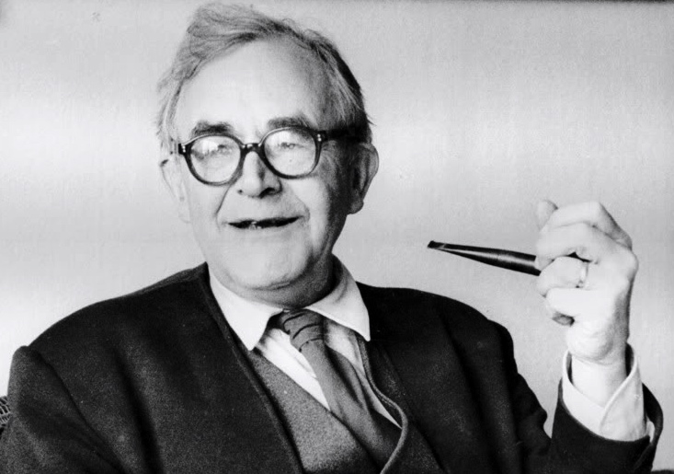
Modern teachings on Salvation and Atonement – KARL BARTH
Sin is defined as “nothingness” and an “impossible possibility” – the contradiction of God’s will
Salvation comes from the Greek word meaning to “make safe”
It is the idea that by believing in Jesus, a person can be saved from the power of sin and gain eternal life
Jesus is the One and Only way to salvation as no other way can lead to God
With salvation comes eternal life as a gift from God. This is given to the believer through Jesus.
Eternal life is only possible in so far as it derives from God through Christ by the Spirit
Salvation means that humanity can pass from darkness into light and from death to life
Humanity’s natural tendency until touched by the Spirit, is to remain in the darkness, preferring it to the light
A man needs to admit their spiritual need and then they can claim salvation
In Church Dogmatics, Barth says that Christ is the judge who has represented me before God and has taken all condemnation away from me

Slide 16
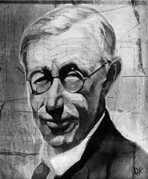
Salvation and Atonement – GUSTAV AULEN
Christus Victor (1931) offered a new slant on the doctrine of salvation.
Christ fought and defeated the “evil powers of the world” and freed humanity from the bondage of sin. Christ then reconciled God and humanity – he had atoned for the sins of humanity and restored the divine relationship.
The difference with Aulen’s view was his emphasis on spiritual, rather than physical bondage.
As Alistair McGrath observed: “Aulen’s approach seemed to resonate with a growing awareness of the darker side of human nature. It had become intellectually respectable to talk about the “forces of evil”
Critics of Aulen claimed that he failed to explain exactly how, through the Cross, Christ had defeated the forces of evil, but modern writers generally have been supportive of Aulen’s position.
Bultmann argued that the victory of the Cross could be seen as a victory over “inauthentic existence and unbelief.” While Tillich saw is as a “victory over existential forces which threaten to deprive us of authentic existence.”

Slide 17
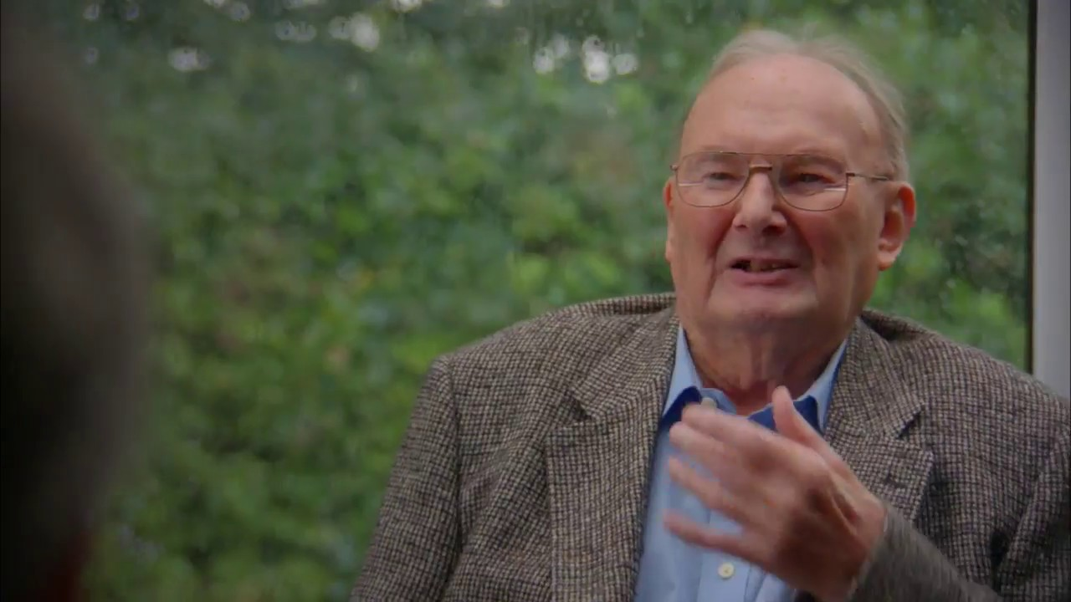
Atonement by the Blood of Jesus– JOHN HICK
At-one-ment signifies becoming one with God. Not in the sense of being but of entering into a right relationship with God which is our salvation
In a narrower sense Atonement refers to a specific way of receiving salvation of which the barrier is guilt
Therefore sacrifice, satisfaction, justification, ransom and remission of sins are essential
In the narrower sense, Jesus’ crucifixion was an act of atoning or making up for human sin
In the broader sense Jesus’ death may or may not be separated off from his self-giving life as a whole as having a special significance of its own

Slide 18
Atonement by the Blood of Jesus– JOHN HICK
Hick focuses on the narrower term. The basic notion is that salvation requires God’s forgiveness and that this in turn needs atonement to satisfy divine righteousness
The atoning act is a transaction. It is a sense of wiping out a debt or cancelling an impending judgement
Humans disrupted the order by sinning and it is this that needs to be repaid
Hick argues that atonement is a narrow sense is a mistake but in a broad sense it is important

Slide 19
History of the Doctrine of Atonement
Early Christian community was of a living spirit which was the spirit of the risen Jesus within them both individually and together as a community. This spirit was setting them free from the world and liberating them
This new liberated life with hope and meaning was the religious reality which was to be expressed in various doctrines. It became known as Transactional Atonement
Western Church may have the view that these ideas are not plausible and that instead we should turn to the eastern church and their development of its understanding
Latin theology has the view that justification won by Jesus’ death leads to sanctification which is the transformation of the sinner into saint
Orthodox theology holds that Jesus’ death was crucial in bringing about his divinity
Eastern church has the view of transformational and the Western Church is about transactional atonement
Before the division of the Churches the earliest comment about liberation and new life comes from the Gospel of Mark, “the Son of man also came not to be served but to serve and to give his life as a ransom for many”
The word “Ransom” means to be made free

Slide 20
History of the Doctrine of Atonement
There is a challenge in taking metaphorical language literally. The early Christians asked themselves to whom was Jesus paying the ransom? The inevitable answer was the devil
Origen asked to whom did Jesus pay the ransom to? It had to be the devil who held out until the soul of Christ was paid to him
For a long time, it was thought that humans had fallen under the devil’s power until the cross of Christ was part of the bargain
There is also another idea that God outwitted the devil. The devil believed he had a claim over humanity and so he ended up putting himself in the wrong by taking a greater ransom, God the Son.
Gregory of Nyssa said, “in order to secure that the ransom would be accepted by the devil, the Deity was hidden under the veil of our nature so that the hook of the deity would be gulped down with the bait of the flesh”
St Augustine – “As our price, he held out his cross to him like a mouse-trap and as a bait set on it his own blood.”
The ransom theory never made it into the Creed
Anselm points out a difficulty with this approach which is, why would the Devil have any authority over God?
Other theories that came about through the years were based on the idea that original sin was inherited guilt and affected the whole human race requiring adequate atonement to expunge it

Slide 21
History of the Doctrine of Atonement
Original sin presupposes the wilful fall from grace of the first humans and the genetic inheritance by the whole species of a guilty and sinful nature
The Council of Trent stated, “If anyone does not profess that the first man Adam immediately lost the justice and holiness in which he was made when he disobeyed the command of God in the Garden of Eden, and that through this sin he brought about the wrath of God and also brought about death. If anyone believes that Adam’s sin was harmful only to Adam and not to the rest of humanity, let him be an anathema” (He should be hated / excommunicated)
Today the idea of an actual human fall resulting in a guilt for all humanity is unbelievable for educated Christians
Instead of the human race being descended from a single created pair, we see the species as having evolved out of lower forms of life over a long period of time
To say the first humans fell from a state needs to be abandoned because surely that state never existed
Anselm put forward another way of thinking about atonement. In his Cur Deus Homo, he proposes the idea that disobedience to your God was a slight upon God’s honour and required some from of penance to be done. This then rebalanced the order
Anselm states sin is “nothing else than not to render to God his due” What is due to God is absolute obedience
“Even God cannot raise to happiness any being bound at all by the debt of sin, because he ought not to”
It is impossible for humans to make the necessary satisfaction as they cannot give something greater than God

Slide 22
History of the Doctrine of Atonement
Since it is humanity that has offended God, it must be humanity to make the satisfaction but this is a problem (see point above)
The needed satisfaction is, “none but God can make and none but man ought to make, it is necessary for the God-man to make it”
The God-man can give something that was not already owing to God, his own life. Christ’s death on the cross provided a full satisfaction for the sins of the world
The penal-substitutionary theory then was developed
Are we suggesting that God punished Godself in order to forgive sinners? Does this mean that God deliberately put in place an innocent person to save the guilty?

Slide 23
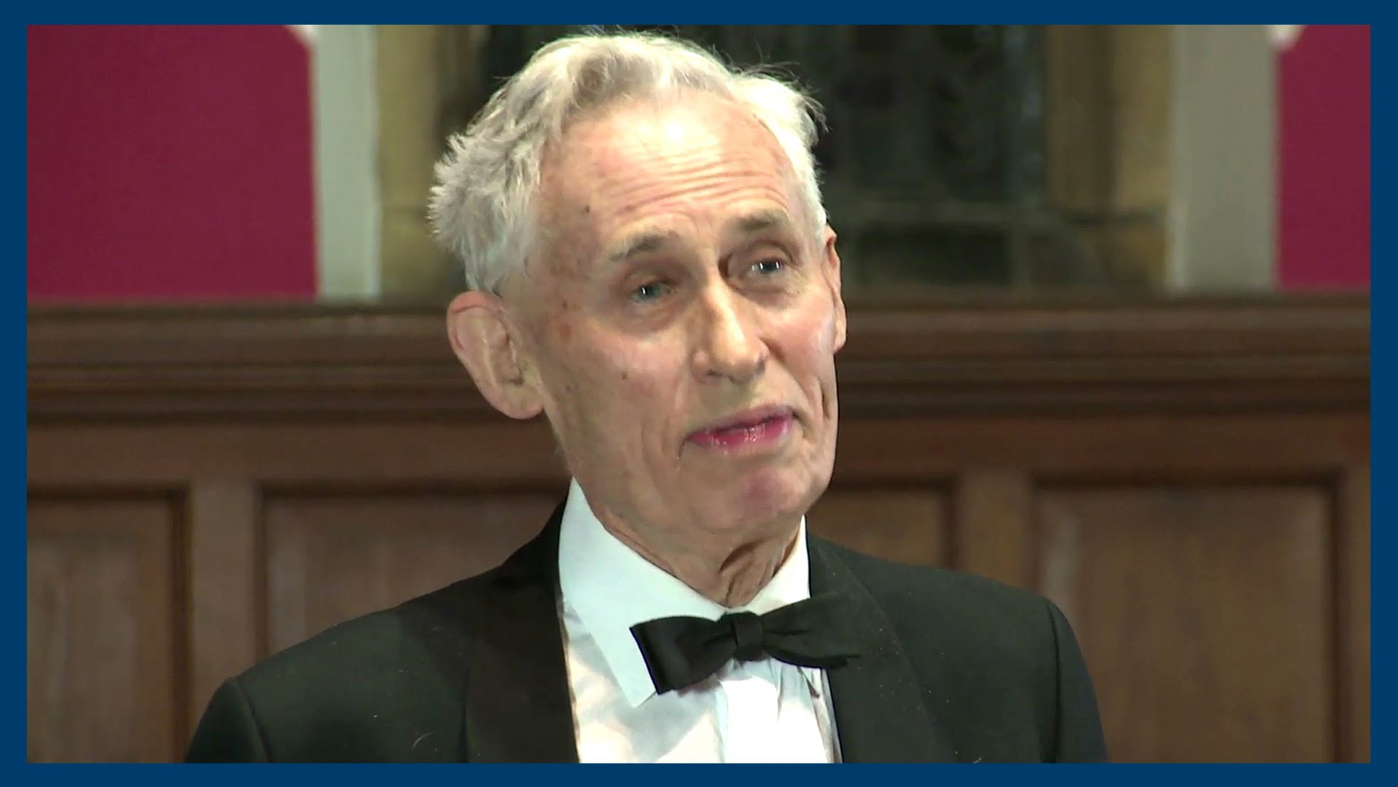
Richard Swinburne
Responsibility and Atonement has made an attempt to retrieve transactional conception. His understanding of atonement is as follows:
Guilt is the great barrier between man and God and so eternal life is not available
For humans, reconciliation needs four things (i) Repentance (ii) apology (iii) reparation (iv) penance
God is a personal being
All wrong doing to fellow humans is also wrong doing done to God
We can apologise and repent for sins to God but we cannot give adequate atonement
The “perfect human life” is given by Christ who lived without sin and voluntarily suffered a death which he gave as a sacrifice that if we accept from him can give us atonement for our sins both individually and collectively
To be sanctified and saved is only possible to those who take part in Christian worship of God and plead the atoning death of Christ thereby throwing off their guilt. To be saved we must be joined either in this life or the one after with the Christian Church which is the Body of Christ

Slide 24
Richard Swinburne
Hick suggests that all of this is possible BUT the real question is whether it is religiously plausible and to many it will seem implausible
Hick offers his own critique of Swinburne’s proposal:
Salvation being linked to guilt and atonement is a central theme of Latin theological tradition launched by St Augustine. The Greek tradition thinks of salvation as transforming. Swinburne prefers the Greek to the Latin and he does not seem to have considered the radical alternative which the Eastern church offers. If you see salvation as the transformation of human existence from self-centredness to a new view centred upon the Divine Reality, the transaction theories of salvation then appear as implausible answers to a mistaken question
Swinburne’s analysis of guilt and reconciliation between human beings is excellent
That God is another person with unique attributes but subject to the same moral requirements as us is anthropomorphic and unimaginative
Oure relationship with other humans involves our relationship with God so that in all we do we are also ultimately having to do with God is “another element of truth”

Slide 25
Richard Swinburne
When we do wrong, the action we do to make up for our wrong is in some way to reverse the consequences of our action. When we contribute to the common evil of the world, we can counter it and contribute to the common good of the world. Swinburne points out it is good to do something extra – penance. Can we do this for God? When we have offered reparation to a human there is nothing extra we can do for God. God cannot be benefitted by human acts in addition to those that benefit his creation. The penitent can only accept forgiveness as a free gift of grace, undeserved and unearned. Swinburne emphasises that “one man can help another to make the necessary atonement- can persuade him to repent, help him formulate the words of apology and give him the means by which o make reparation and penance.” To do something extra for God rests upon a mistake in which God is treated as another individual within the same moral community as ourselves. Swinburne suggests that God was free to choose what he wanted as an atonement for sin. This means that there was no necessity for the cross. God could have established the conditions for salvation. This means that God’s insistence on the sweat, pain and anguish involved in the crucifixion of God’s innocent Son now seems to cast doubt on the moral character of the deity

Slide 26
Richard Swinburne
(6) Swinburne suggests that Jesus openly intended his death “as an offering to God to make expiation in some way for the sins of men” There is no consensus among New Testament scholars as to how Jesus understood his own death. E. P. Sanders says it is possible that Jesus gave his own death a martyr significance. Joachim Jeremias suggests that Jesus saw his death as an eschatological Passover sacrifice bringing about the new covenant of God. Swinburne goes on to suggest that the payment to God was not a full payment and God let men off the rest. If this is the case, why could God not just forgive people anyway. Why was the sacrifice needed?

Slide 27
Richard Swinburne
(7) Swinburne modifies the traditional exclusivist view that salvation is confined to Christians. He suggests that non-Christians have an opportunity to be converted after this life.
Hick does not like or find convincing Swinburne’s idea of Jesus’ death as a n atonement to God for human sin.

Slide 28
Karl Barth – “Jesus Christ, the Lord as servant”
The Obedience of the Son of God
Jesus shows himself to be God in the way that he went into the Far Country and became a servant
The eternal son of the eternal father became obedient by offering and humbling himself to be the brother of man, taking his place, and dying
Christ takes the place of judge and judges himself
God the Father raised him from the dead and gave effect to his death giving humans redemption from death to life

Slide 29
Karl Barth – “Jesus Christ, the Lord as servant”
The Way of the Son of God into the Far Country
Atonement is history of God with man and man with God
Jesus Christ is himself both God and man and so through Christ God and man are brought together
The atonement is an act of grace, of God’s free will, humans do not deserve it but God still gives it
Jesus is both the Son of Man and the Son of God.
These are not Christian concepts of Christ but Christ himself in his revelation and being
It is as the man Jesus that he is the Messiah. By being man, he is concealing his being
The true God is obedient. Jesus is the suffering servant of God necessarily
The history of redemption is essentially the history of the Passion
In Jesus, God himself made himself the object of accusation and willed to confess himself a sinner. The man who rejects God is also rejected by God

Slide 30
Karl Barth – “Jesus Christ, the Lord as servant”
The Son of God was a man. He stands under the wrath and judgement of God. In him, God did not merely affirm the divine sentence on man but allowed it to be fulfilled on himself
Jesus Christ the Lord and servant is a slave
The “word being made flesh” is a free divine activity. God remains God in his humiliation. He went into a strange land but never became a stranger to himself. How is this not blasphemous?
Is it a paradox? God against God? (Barth rejects this)
No paradox in God. Through Jesus God put into effect the freedom of his divine love
The humility of Christ is proper and this confronts us with the mystery of Christ as God
Subordinationism
Economic modalism

Slide 31
Karl Barth – “Jesus Christ, the Lord as servant”
Three presuppositions about this (a) Reconciliation is Jesus Christ, the one who takes upon himself the judgement of the world (b) Atonement is an event in the world. God enters the world (c) The one God is himself the subject of the act of atonement. His action and presence coincide and are identical with existence of the humiliated Jesus
The cross shows the true humiliation of God. He obeys and is obeyed. The Spirit holds the other two together
Jesus who becomes man is one with God the Father, he is equal to him

Slide 32
Karl Barth – “Jesus Christ, the Lord as servant”
The Judge Judged in our place
Why did Jesus become a servant?
God willed to bear the need of man. He took it upon himself and he cries with man
God exposed himself and withstood temptation. Jesus became man to judge the world and to show his grace
God became man that he might bring about our reconciliation and conversion
Jesus Christ took the place of all men and gave us salvation. This was done with no co-operation from humans. Jesus is both our representative and substitute
Jesus was and is “for us” in that he took our place as our judge.
Jesus took the place of us sinners. He does not come to sin but accepts responsibility for what we do. As he does this, it ceases to be our sin. Jesus is the one who is judged, condemned and rejected
A) We do not know we are sinful
B) Christ bears our sin
C) Jesus closes the door for the return to evil

Slide 33
Karl Barth – “Jesus Christ, the Lord as servant”
Jesus Christ was an is for us in that He suffered and crucified and died
In the passion of Jesus, we have a free self-offering
This act took place on earth
This act was coincidental with the free act of a man and so it was the passion of God himself
Jesus was and is for us in that He has done this before God and has done right
Jesus was amongst us and lived and acted for us as the just or righteous man
Jesus was obedient in that He willed to take our place as sinners and did take our place

Slide 34
Karl Barth – “Jesus Christ, the Lord as servant”
The Verdict of the Father
How do we believe that we are those for whom Jesus has acted?
There is a large gulf between us and Christ caused by time
There is also a problem with the atonement itself. There is a distance between God and man
God for man – Order
Man against God – Disorder
That Christ has died for us does not mean that we do not have to die but that we have died with him and in him.
Anything beyond judgement must meet the following:
It must be an act of the same God
It must be actual and revealed in a distinct and new act of God
It must stand in a meaningful relation to the first act
It must take place in history
It must be in unity with the first event – it must be an event in the life of the same historical subject, Jesus

Slide 35
Karl Barth – “Jesus Christ, the Lord as servant”
The resurrection decided that what Jesus was then, he is for all time. He is the mediator between God and man
The New Testament differentiates its time from the time of Christ not only by looking back and by looking forward to it expecting the coming of the Lord. Our time is time of expectation and hope. So our time is a time between times; as with Christ in the tomb between death and resurrection. Jesus is the absolute and final future of humanity. The death of Jesus is not an end but a beginning.

Slide 36
Karl Barth – “Jesus Christ, the Lord as servant”
The resurrection happened in the human sphere and time. Jesus appeared to his disciples but there is no proof this happened. The problem is that it is a unique event but it is still an event.
The awakening of the faith of the disciples in the living presence of Jesus and the formation of the community
The two acts of crucifixion and resurrection are one act of one God, one Jesus and one goal of reconciliation. Jesus is the One Word of God that we must hear, trust and obey, both in life and death.
How can we arrive at the perception that Jesus belongs to us and we to him? If in Christ’s death we were delivered up to death, what more is there?

Slide 37
Karl Barth – “Jesus Christ, the Lord as servant”
5. The crucified and risen Christ is God’s YES to man. Death is swallowed up in victory
4. Easter depends on Christ’s concrete otherness. If he is not rise then our preaching and faith are futile
3. The Christian community shows the fact that even after Ester God still has time for humanity
2. This divine verdict has been passed, Jesus loves and acts and speaks for all ages and in eternity
1. The resurrection was a free act of the grace of God. It is of this act that when we say “Jesus lives” and can continue “and I with him”

Slide 38

Review of information and test your knowledge
You will be given a sheet with some general questions.
Have a go at answering them.

Slide 39
Review of information and test your knowledge
Now have a look at some exam style questions
Make notes on how you would answer them.

