Slide 1

CHRISTIANITY REVISION (6)
Religious beliefs, Values and teachings Nature of God as personal / Creator The Trinity Nature of the Church Key Moral Principles | (2)Sources of Wisdom and Authority The Bible The nature and role of Jesus (Arius vs Athanasius) The Reformation (Luther and Calvin) Does God suffer? (Moltmann / Weinandy) | (3) Practices that shape and express religious identity Diversity of practice in the Eucharist Diversity of creative expressions
(4) Social and historical developments Science (2) Secularisation New movements in theology | (5) Works of Scholars Comparison of Barth and Hick (3 & 4) Atonement (Anselm and Aulen) | (6) Religion and Society Pluralism and Diversity Equality and discrimination (gender)

Slide 2
CHRISTIANITY REVISION (6)
Religious beliefs, Values and teachings Nature of God as personal / Creator The Trinity Nature of the Church Key Moral Principles | (2)Sources of Wisdom and Authority The Bible The nature and role of Jesus (Arius vs Athanasius) The Reformation (Luther and Calvin) Does God suffer? (Moltmann / Weinandy) | (3) Practices that shape and express religious identity Diversity of practice in the Eucharist Diversity of creative expressions
(4) Social and historical developments Science (2) Secularisation New movements in theology | (5) Works of Scholars Comparison of Barth and Hick (3 & 4) Atonement (Anselm and Aulen) | (6) Religion and Society Pluralism and Diversity Equality and discrimination (gender)

Slide 3

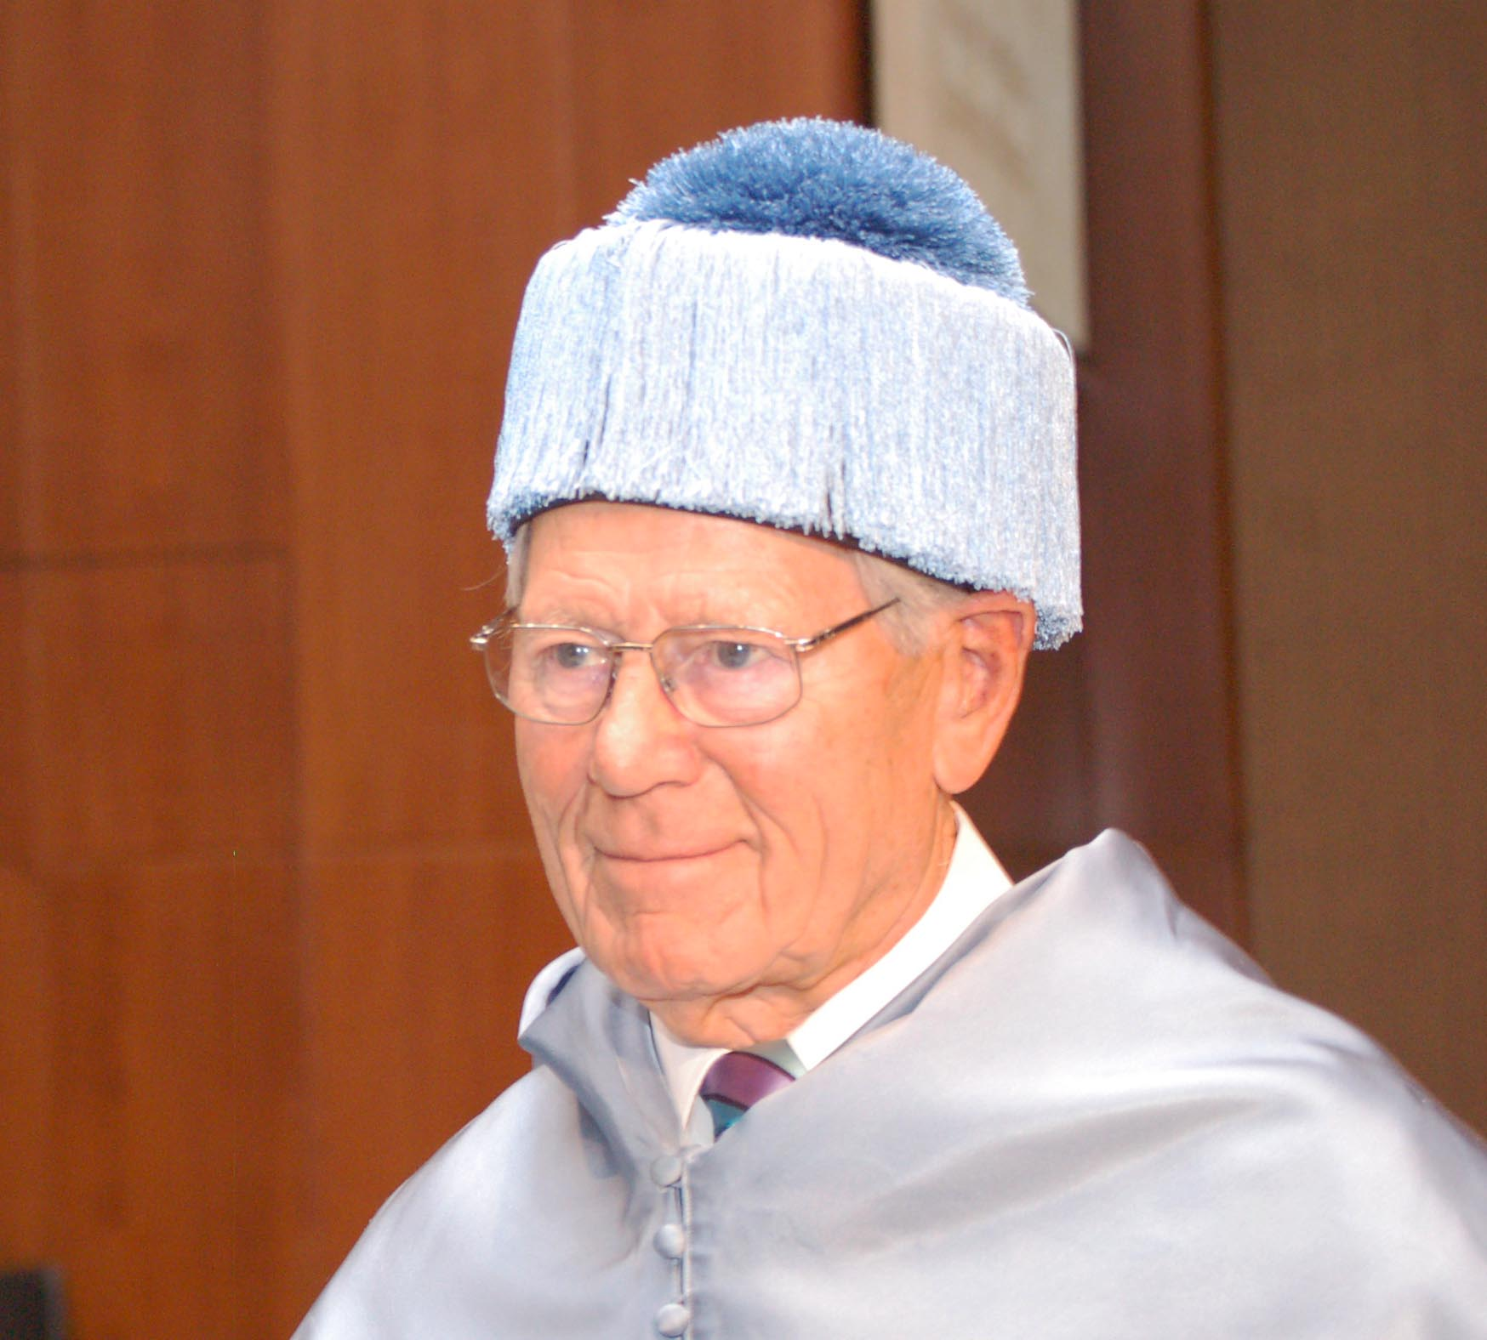
Attitudes to other religions
"... it is impossible today for any one religion to exist in splendid isolation and ignore the others. Today more than ever, Christianity too is brought into contact, discussion and confrontation with other religions. To the extension of the geographical horizon of religion at the beginning of modern times there has been added in our own time an enormous extension of the historical horizon.“
Hans Küng, On Being a Christian

Slide 4
Attitudes to other religions
It has become a commonplace to say that we live in a pluralist society -- not merely a society which is in fact plural in a variety of cultures, religions and lifestyles which it embraces, but pluralist in the sense that this plurality is celebrated as a thing to be approved and cherished.
Lesslie Newbigin

Slide 5
Attitudes to other religions - PARTICULARISM
Particularism
God has revealed the Way and the Truth and the Life in Jesus Christ, and wills this to be known throughout the world. Hendrik Kraemer (1888 – 1965) Christian message in a Non-Christian World
Particularism says that:
The revelation of Christianity is in a category of its own.
It is a unique, and distinctive faith. The “revelations” found in other religions are inauthentic, purely human inventions.
This approach can also be called “Exclusivism”

Slide 6
Attitudes to other religions - PARTICULARISM
There are two camps of Particularists:
Those who say there is no knowledge of God to be found outside of Christ (Karl Barth)
Those who say that God’s self-revelation may occur outside of Christianity, but can only be interpreted correctly in the light of the revelation of God in Jesus Christ (Hendrik Kraemer)

Slide 7
Attitudes to other religions - PARTICULARISM
Criticisms
The main criticism is that it is inconsistent with the God’s desire to save all human beings. What of those who have not heard the Gospel or choose to reject it? For centuries, within the Church, a standard answer to this question is that they would be condemned.
While a Particularists may believe that all non-Christians will be condemned, they do not have to believe this. In particular in Karl Barth’s theology, particularism is still comparative with universal salvation.

Slide 8
Attitudes to other religions - PARTICULARISM
Barth says:
Knowledge of God and salvation are possible only through Christ
At the end of history, grace will triumph over unbelief and all will come to faith in Christ.
The particularity of God’s revelation through Christ is thus compatible with belief in universal salvation

Slide 9
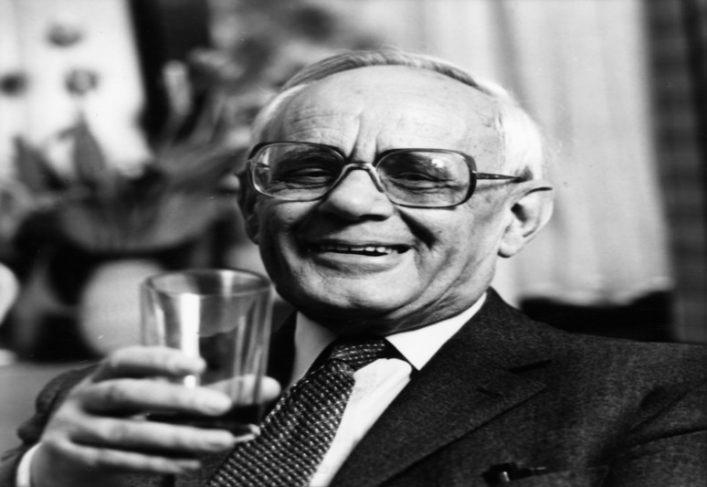
Attitudes to other religions - INCLUSIVISM
Inclusivism
Karl Rahner is the most significant advocate of inclusivism.
In Volume 5 of his Theological Investigations he argues that:
“Christianity understands itself as the absolute religion, intended for all people, which cannot recognise any other religion beside itself as of equal right.”
Revelation of God in Christ too place at a specific time in history. Those who lived before, or who have not yet heard of it, would seem excluded from salvation. This is incompatible with God’s will to save all.
Knowledge of God and God’s saving grace must therefore be available outside Christianity, including other religions, despite their errors and shortcomings.
Faithful adherents of non-Christian religions should be regarded as “anonymous Christians.” “Somehow all people must be able to be members of the Church.”
Religious pluralism will always be part of human existence.

Slide 10

Attitudes to other religions - INCLUSIVISM
In other words, Rahner says:
Christianity and Christ have a unique and exclusive status that other religions do not share
Nevertheless, knowledge of God may be present in other religions (God’s self-revelation)
The grace of God and even salvation may be present in other religions
Grace might be mediated by the lifestyle they evoke e.g. selfless love
Rahner justifies his position as follows:
Consider the Old Testament, the outlook of a non-Christian religion, Judaism
We discard some practices we regard as unacceptable (e.g. dietary laws)
We retain others as valid (e.g. moral laws)
We can do the same with other religions.

Slide 11
Attitudes to other religions - INCLUSIVISM
In other words, Rahner says:
Christianity and Christ have a unique and exclusive status that other religions do not share
Nevertheless, knowledge of God may be present in other religions (God’s self-revelation)
The grace of God and even salvation may be present in other religions
Grace might be mediated by the lifestyle they evoke e.g. selfless love
Rahner justifies his position as follows:
Consider the Old Testament, the outlook of a non-Christian religion, Judaism
We discard some practices we regard as unacceptable (e.g. dietary laws)
We retain others as valid (e.g. moral laws)
We can do the same with other religions.
The term “Anonymous Christian” has been widely criticised:

Slide 12
Attitudes to other religions - INCLUSIVISM
John Hick “honorary status granted unilaterally to people who have not expressed any desire for it.
Hans Jung: “It would be impossible to find anywhere in the world a sincere Jew, Muslim or atheist who would not regard the assertion that he is an “anonymous Christian” as presumptuous.
In Rahner’s defence, the term “anonymous Christian” was perhaps intended to suggest that Christians should give the faithful adherents of non-Christian religions the same “status” in their reflections on the People of God as they give to their fellow Christians.

Slide 13
Attitudes to other religions - PLURALISM
Pluralism
Pluralism suggests that each religion is a distinctive yet equally valid understanding of God / ultimate reality.
The most significant advocate of pluralism has been John Hick. Pluralism is presented in his books:
God and the Universe of Faiths (1973)

Slide 14
Attitudes to other religions - PLURALISM
The Second Christianity (1983)
“…we need a Copernican revolution in our understanding of religion. The traditional dogma has been that Christianity is the centre of the universe of faiths, with all other religions seen as revolving at various removes around the revelation in Christ and being graded according to the nearness to or distance from it. But during the last hundred years or so we…have realised that there is deep devotion to God, true sainthood and deep spiritual life within these other religions; and so we have created our epicycles of theory, such as notions of anonymous Christianity and of implicit faith. But would it not be more realistic now to make the shift from Christianity at the centre to God at the centre, and to see both our own and the other great world religions as revolving around the same divine reality?”

Slide 15
Attitudes to other religions - PLURALISM
Hick says we must distinguish between:
The ultimate spiritual, transcendent reality underlying the various religious systems
The perceptions of this reality within the various religions
He draws on Kant’s distinction between
The “thing in itself” (never directly knowable)
Our indirect knowledge of things, always coloured by our subjective experience and our limited ability to conceptualise
Following Kant, Hick would argue:
We have no direct knowledge of “The Real”
Religions are human responses to “The Real” and are coloured by the historical and social contexts in which the religions evolved.
“The distinction enables us to acknowledge both the one unlimited transcendent divine Reality and also a plurality of varying human concepts, images and experiences of response to that Reality” (Hick)

Slide 16
Attitudes to other religions - PLURALISM
Challenges
Some differences between the various religions cannot be reconciled with any intellectual honesty in a “both-and” manner. They are clearly contradictory.
Sets aside a major Christian conviction: that Jesus Christ is a unique revelation of God. This point of view therefore cannot be considered a “Christian” perspective.

Slide 17

Ecumenical Movement
The Ecumenical Movement (from the Greek oikumene, meaning “the whole inhabited earth”) was established in 1910, following the World Missionary Conference held in Edinburgh
At this conference, three Christian movements came together:
The missionary societies who preached the gospel in remote areas of the world. They were trying to establish areas of influence for the different Christian groups and to establish common truths that were agreed by all Churches.
Evangelical and inter-denomination groups, such as the Evangelical Alliance who sought to help people from different denominations to work together in harmony.
Young people’s societies, such as the Young Men’s Christian Association (YMCA), the student volunteer Missionary Union and the World Student Christian Federation, which sought to urge the established churches into unity and ecumenical action.

Slide 18
Faith and Order Movement
On the one hand, in 1919 the leaders of the Eastern Orthodox churches were very positive and the Patriarch of Constantinople issues his own appeal for greater dialogue and understanding between the different churches. On the other hand, the Roman Catholic Church refused to take part, because Pope Benedict XV claimed that the Catholic Church possessed all truth. He gave the conference organises his best wishes and prayed that, “…those who take part may, by the Grace of God, see the light and become reunited to the visible Head of the Church, by whom they will be received with open arms.”

Slide 19
Ecumenism in the UK
For their own part, the bishops of the Church of England at the 1888 Lambeth Conference had issues a statement giving four requirements which they saw as necessary before there could be union with the other denominations.
These were an acceptance by all sides of:
The Bible as the rule and ultimate standard of faith and “containing all things necessary to salvation”
The Apostles Creed as the baptismal symbol and the Nicene Creed as the statement of the Christian faith.
The Sacraments of Baptism and the Lord’s Supper
The adoption of the historic episcopate (the way the church is run and administered)

Slide 20
Equality of Men and Women
²⁵ Now that this faith has come, we are no longer under a guardian. So in Christ Jesus you are all children of God through faith, ²⁷ for all of you who were baptized into Christ have clothed yourselves with Christ.²⁸ There is neither Jew nor Gentile, neither slave nor free, nor is there male and female, for you are all one in Christ Jesus. ²⁹ If you belong to Christ, then you are Abraham’s seed, and heirs according to the promise.” (Galatians 3.25-29).
“For God does not show favouritism.” (Romans 2:11).
“Very truly I tell you, no servant is greater than his master, nor is a messenger greater than the one who sent him” (John 13:16).
“Then Peter began to speak: “I now realize how true it is that God does not show favouritism ³⁵ but accepts from every nation the one who fears him and does what is right.” (Acts 10:34-35).

Slide 21
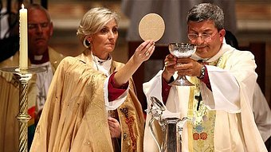
Attitudes towards Women Priests
Catholic attitudes:
The Catholic Church teaches that men and women should have equal roles in life and equal rights in society.
As far as ministry is concerned, women are able to study and teach in theological colleges.
Women can also be extraordinary ministers of Holy Communion (people who give out the bread and wine which been consecrated by a Priest), visit the sick, take funerals in certain circumstances and so on.
However, the Catholic Church teaches that only men can be ordained priests. It teaches that this does not affect the equal status of women. It is because of the special function of the priest representing Jesus at the Mass.

Slide 22
Attitudes towards Women Priests
This teaching is based on:
Genesis 1:27 which teaches that God created men and women at the same time and both in the image of God. So the Church teaches that men and women have equal status in the sight of God.
The teaching of the Catholic Catechism that men and women are equal, and should have equal rights in life and society and Catholics should follow the Catechism.
The 1971 report, “Justice in the World”, in which the Third World Synod of Bishops called for women to “participate in and share responsibility for the life of society and of the Church.
The teaching of the Catechism that only men can be priests because the apostles were all men, and priests and bishops are successors of the apostles.
The teaching of the Catechism that only men can be priests because Jesus was a man and the priest represents Jesus in the Mass.

Slide 23
Attitudes towards Women Priests
The Traditional attitude of Protestant Christianity:
Many Evangelical Protestants teach that men and women have separate and different roles and so cannot have equal rights in religion. It is the role of women to bring up children and run a Christian home. Women should not speak in church and must submit to their husbands. It is the role of men to provide for the family and to lead the family in religion. Men must love their wives as themselves, but only men can be church leaders and teachers.

Slide 24
Attitudes towards Women Priests
They have this attitude because:
It is the teaching of the New Testament, which they believe is the final word of God. St Paul teaches that women should not teach or speak in Church.
St Paul also uses the story of Adam and Eve in Genesis to show that men have been given more rights by God because Adam was created first and it was the woman who was led astray by Satan and then led man astray.
Although Jesus had women followers, he chose only men as his twelve apostles.
It has been the tradition of the Church from the beginning that only men should have leadership rights in the Church.

Slide 25
Attitudes towards Women Priests
The modern attitude of Protestant Christianity:
Many Protestant Churches now accept that men and women should have equal rights, and they have women ministers and priests (for example Church of England, Methodist, United Reformed Church and Baptist).
This teaching is based on:
The creation story in Genesis 1, which says that God created male and female at the same time and of equal status because both were created in the image of God.
Some letters of Paul where he teaches that in Christ there is neither male nor female therefore men and women should have equal rights.
The evidence from the Gospels that Jesus treated women as his equals. He treated a Samaritan woman as his equal. He had women disciples who stayed with him at the cross unlike the male disciples who ran away. It was to women that Jesus first appeared after the resurrection.
Some evidence that there were women priests in the early Church. The Council of Laodicea banned women priests in the fourth century and it would have not banned something that did not exist.

Slide 26
Arguments against Women Priests
Jesus’ disciples were all men so we should not have women priests
The ordained ministry of the Church has not changed in 2000 years and so it should not start now
The tradition of the Church should be relied upon and they did not have women priests
To change now would be too much and so much caution needs to be given to such a move
Such a change needs to be done by the whole Church and they need to be called to a Council to do this
It is not fair to those who have given their life to the Church to now find it changed
The aim should be bringing churches closer together but women priests will only divide churches
The bible uses male imagery of God as Father, Jesus as Son and so this gives a distinctive male role

Slide 27
Arguments against Women Priests
Priests represent Jesus at the altar, Jesus was male and so the Priest should also be male
The Bible talks about headship: The Bishop is the head of the Diocese; the priest is head of the congregation and the father the head of the family as Jesus is head of the church and God is the father of us all
The Bible says that headship should be exercised by men
St Paul says that women should not address large numbers of people or speak in public
Changes to bringing women Priests in happened a while ago and it has not improved the church
Male and female are complimentary – insisting on male priests and Bishops is not to suggest that men are better or more important; having female priests and Bishops dilutes those complimentary gifts. We should allow the distinction to stand

Slide 28
Arguments against Women Priests
Jesus had lots of women disciples
Mary Magdalene was the first witness to the resurrection
“Apostle” means sent and so Mary was the first apostle
In the early Church women had status and there were many other ministries so why can we not return to these variations?
Waiting for all churches to agree with take a long time. Some churches have “gone it alone” and so the divisions will always exist
God has given the church work to do and if they are to fulfil the work then changes are needed
The Bible often talks about God as “we” and sometimes uses female imagery e.g. God’s wisdom is usually a “she”

Slide 29
Arguments against Women Priests
Jesus sacrifices himself for all humanity and so all humanity is represented at the altar. Therefore, the Priest and Bishop can be male or female
St Paul’s cautious nature about women was relevant to his time
St Paul also says that “there is neither female nor male”
Women clergy are often better than the male clergy
It is simply justice!

Slide 30

Review of information and test your knowledge
You will be given a sheet with some general questions.
Have a go at answering them.

Slide 31
Review of information and test your knowledge
Now have a look at some exam style questions
Make notes on how you would answer them.

