Slide 1

CHRISTIANITY REVISION (3)
Religious beliefs, Values and teachings Nature of God as personal / Creator The Trinity Nature of the Church Key Moral Principles | (2)Sources of Wisdom and Authority The Bible The nature and role of Jesus (Arius vs Athanasius) The Reformation (Luther and Calvin) Does God suffer? (Moltmann / Weinandy) | (3) Practices that shape and express religious identity Diversity of practice in the Eucharist Diversity of creative expressions
(4) Social and historical developments Science (2) Secularisation New movements in theology | (5) Works of Scholars Comparison of Barth and Hick (3 & 4) Atonement (Anselm and Aulen) | (6) Religion and Society Pluralism and Diversity Equality and discrimination (gender)

Slide 2
CHRISTIANITY REVISION (3)
Religious beliefs, Values and teachings Nature of God as personal / Creator The Trinity Nature of the Church Key Moral Principles | (2)Sources of Wisdom and Authority The Bible The nature and role of Jesus (Arius vs Athanasius) The Reformation (Luther and Calvin) Does God suffer? (Moltmann / Weinandy) | (3) Practices that shape and express religious identity Diversity of practice in the Eucharist Diversity of creative expressions
(4) Social and historical developments Science (2) Secularisation New movements in theology | (5) Works of Scholars Comparison of Barth and Hick (3 & 4) Atonement (Anselm and Aulen) | (6) Religion and Society Pluralism and Diversity Equality and discrimination (gender)

Slide 3
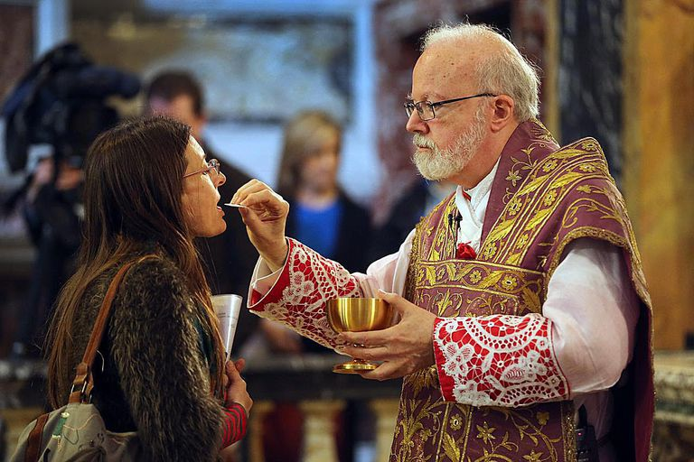
Bread and Wine at Mass
“Take this all of you and eat it. This is my body…This is the blood of the new and everlasting covenant which will be poured out for you and all people so that sins may be forgiven. Do this in memory of me.”
Jesus was anticipating his death
Jesus was showing that his whole being was present, by saying the bread was his body and the wine was his blood.
The actions of breaking the bread and pouring the wine symbolise the death of Jesus, which he accepted for the sake of humanity. Both actions reflect the idea of the body and life force being destroyed.
Jesus’ command to eat and drink makes his followers sharers in the offering that he made to the Father on the cross.

Slide 4
Bread and Wine
The Our Father and Communion
Through Christ’s redemption, believers are allowed to call God “Father”. At this point in the Mass they say the prayer that Christ taught, the “Our Father”.
In Communion, believers believe the Body, Blood, Soul and Divinity of Christ – everything that he is – in the form of bread and wine. Through this action:
Believers are brought even closer to Christ
They are given power and grace to resist temptation and sin
Jesus’ words are remembered: “Those who eat my flesh and drink my blood have eternal life, and I will raise them up on the last day; for my flesh is true food and my blood is true drink. Those who eat my flesh and drink my blood live in me and I in them. (John 6:54-56)

Slide 5
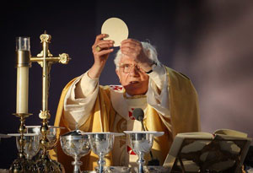
Different attitudes on the Eucharist
For Catholics, the Mass is the “source and summit” of Christian life. This means:
The offering of Christ on the cross is the highest form of prayer to God. All other acts of prayer and praise are simply joining in with Christ’s prayer.
The Mass re-enacts the sacrifice of Christ on the cross, so it is the highest form of prayer that a believer can make.
All prayers offered by Christians are inspired by the Spirit that flowed from the crucified Christ
All acts of love are reflections of the total love for the Father that was shown in the death of Christ, which is repeated in every Mass.
Without receiving the Eucharist, Christians cannot live the full life that Christ wants. Christ’s Body and Blood give life to the soul just as normal food gives life to the human body.
Offering Mass on Sunday is the perfect way to “keep holy the Sabbath day”, fulfilling this commandment from God in a Christian way by celebrating the day of resurrection every Sunday.

Slide 6
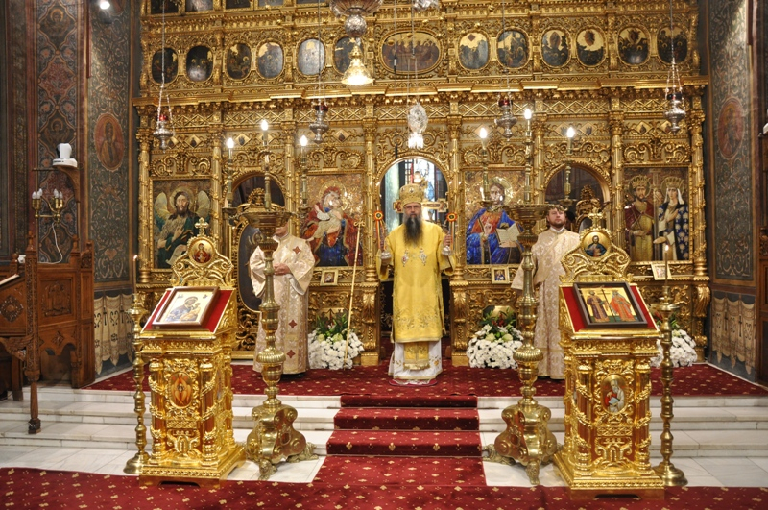
Different attitudes to the bread and wine
Orthodox Christians have an understanding of the Eucharist that is very similar to what Catholics believe, although there are a few differences in the practice:
The Orthodox Eucharist is called the Liturgy and is full of intense symbolism and ritual, more so than in the Catholic Mass.
In Orthodox Churches the consecration takes place behind the Holy Doors of the iconostasis, as what happens is considered to be too holy to be seen directly by the congregation. The Holy Doors represent a gateway between heaven and earth and the Eucharist is on the side of heaven but is given to humans in communion.
The Orthodox and Catholic Churches both believe that Christ is fully present in the Eucharist.
The Liturgy is a communal activity that the whole group of believers are called to share in, whereas a Catholic Priest is allowed to say the Mass in private.

Slide 7
Different attitudes to the bread and wine
ANGLICAN
There is a range of acceptable beliefs within the Anglican Church about the Eucharist:
Some share the Catholic understanding that in the Eucharist the bread and wine become the Body and Blood of Christ.
A larger group believe that the Spirit of Christ is received when Communion is given. Christ is spiritually present, but the bread and wine do not literally become the Body and Blood of Christ.
Christ is present in the community that shares the Eucharist.

Slide 8
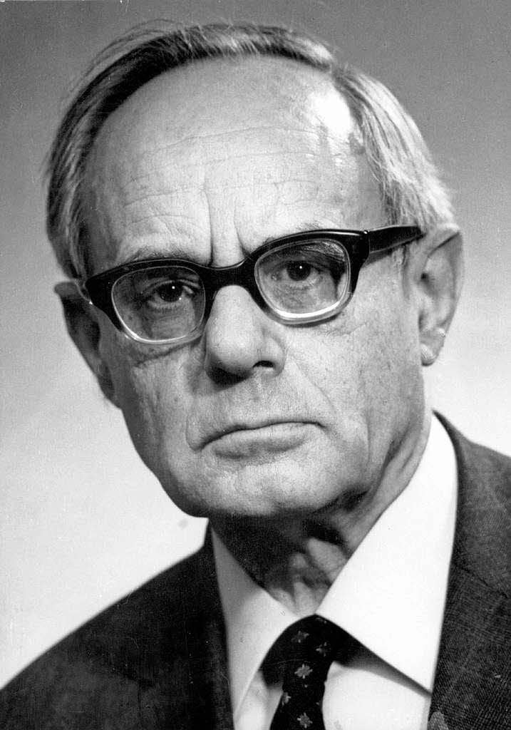
Karl Rahner
The mental event as such is the individually occurring real and actual event. The fact that besides this there is physical being with activities, but not present to itself in its own awareness, does not make such a being a paradigm case of what being "real" means. The physical must be regarded as a deficient mode of that being and reality which is immanently present to itself and precisely thereby brings its own ontological nature as an objective datum before itself.¹⁹
While it is true that "physical being" is not the only "real" being, Rahner is saying here that to be "physical" does not mean to be "real" at all, i.e., "physical being" is not "real" being.
So, transubstantiation must now be understood as "transfinalization or transignification."²⁸ The bread is only a "symbol" of Christ. For Rahner, the bread is not Christ, himself, but rather Christ is "in the bread" spiritually and symbolically.

Slide 9

Different attitudes to the bread and wine
Set (formulaic) prayer. Formal prayers are said at Mass and other liturgical celebrations and the Rosary. Set prayers may be said in a formal service by everyone or led by a Priest.
Informal (extempore) prayer. Among informal prayer are meditation, contemplation, personal reflection, centring oneself in the presence of God, and silence. Informal prayers can be used by a Christian whenever they want to contact God.
Adoration: Adoration is praising God for his greatness and admitting dependence on him. Adoration is important because Christians sometimes find it hard to keep on the straight and narrow, so need to rely on God for the continuation of moral behaviour. Also when their faith wanes, they need God to guide them. Finally, recognising God as omnipotent and omniscient is extremely important.
Confession: Confession is owning up to sin and asking for God's mercy and forgiveness.
Thanksgiving: Thanksgiving is thanking God for his many blessings, eg health or children.

Slide 10
Private and Public worship
Private worship gives Christians a chance to spend time alone with God. Prayer, meditation, Bible study and singing hymns may all be done at home. Christians can unite themselves with the Church of God as they pray while not actually going to a physical church. Some Christians belong to the 'house church' movement and meet for worship in each other's homes.
Different Christian denominations worship in different ways:
Anglicans, Roman Catholics and Orthodox Christians have a set form of worship. It is a formal ritual based around the sacraments, particularly Holy Communion. This type of worship is called liturgical worship.
Other Christian churches practise non-liturgical worship, eg Baptists and Quakers. This kind of worship has no set form and often does not involve Holy Communion. It is usually centred on Bible readings, a sermon, music and prayers. It can be structured or unstructured and spontaneous.

Slide 11
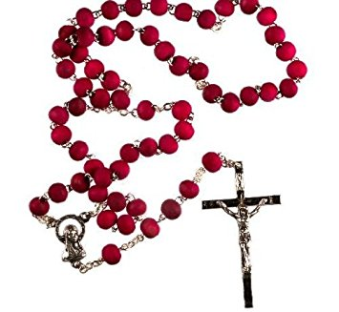
Private and Public worship
Catholics try to place themselves "into" the scene of the particular mystery as you pray, imagining the sights, smells, sounds, and emotions that Jesus, Mary, Joseph, and other participants experienced during the actual events.

Slide 12
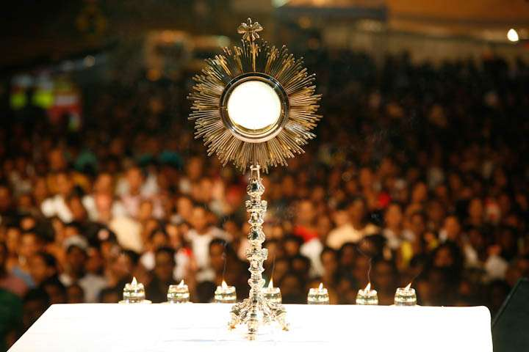
Private and Public worship
Understood simply, Eucharistic Adoration is adoring or honouring the Eucharistic Presence of Christ. The Eucharist is: Jesus truly present - Body, Blood, Soul, and Divinity! At the moment of Consecration, during the Mass, the "gifts" of bread and wine are transformed (transubstantiated) into the actual Body and Blood of Christ, at the Altar. This means that they are not only spiritually transformed, but rather are actually transformed into the Body and Blood of Christ. The elements look like bread and wine, but are actually Body and Blood of Christ according to Catholics. This is what is meant by Real Presence: the actual, physical presence of Jesus in the Eucharist. A priest or deacon removes the sacred host (consecrated bread and wine) from the tabernacle and places it in the Monstrance on the Altar for adoration by the faithful. "Monstrance" is the vessel used in the Church to display the consecrated Eucharistic Host. When a consecrated host is placed in the monstrance, It is said to be a solemn exposition. Catholics can experience Jesus’ presence through Eucharistic adoration.

Slide 13
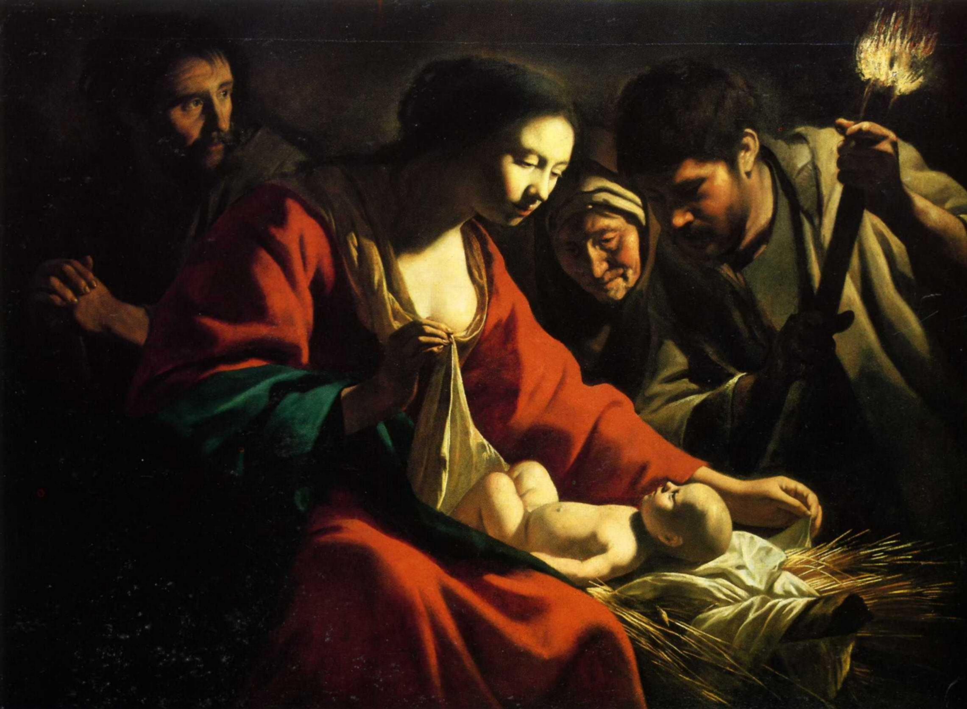
ART
In spite of the nativity's popularity, there are a few theological errors in many of them.
First, most nativity scenes are set in a stable or cave. While this may have been where Jesus was born, it's just as likely that Jesus was born in the lower level of a home, amongst animals who were brought inside for the night (the Greek word for "inn" (kataluma), found in Luke 2:7, can also mean "house").
The angels that are often shown hovering over the stable in a nativity were likely not there, at least not visibly. The angels' part in the Christmas story took place in a field, where they announced Jesus' birth to a group of shepherds (Luke 2:8–14).
Although the wise men often appear in a nativity, they did not visit Jesus the night of His birth. The magi visited Jesus some time later, when He was a toddler (Matthew 2:1–11).

Slide 14
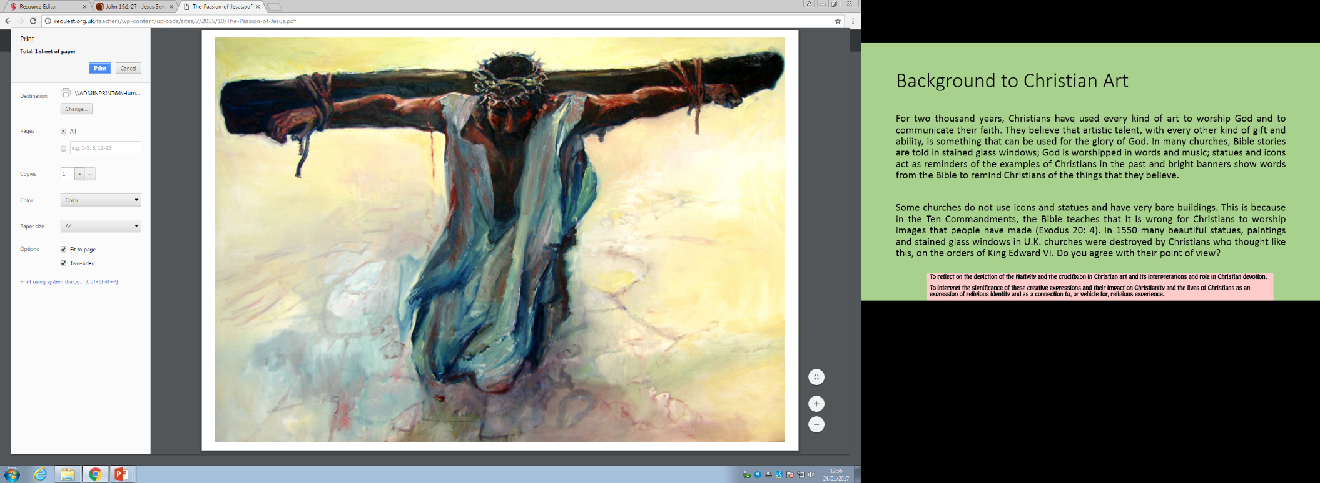
ART
Images of the crucifixion depict number of things:
The suffering of Jesus
The pain that Jesus went through for us
How Jesus humbled himself and carried his own cross
Art is an emotive way of getting across a message. It is a visual representation of what happened and can show important aspects.
The painting above shows that Jesus was broken as he is on his knees. Is he coming to revelation that there is no backing out now and that death is coming? The weight of the beam is evident in the posture of Jesus. His clothes are white but stained. Does the white represent his purity and the staining our sins? The crown of thorns shows that he was a King but he was not recognised as a King. Jesus himself said that his Kingdom was not of this world. The colours in the background show a calm sense of reflection. Chaos is not present.

Slide 15
ART
Problems with some depictions of the crucifixion
Sometimes the portrayal is wrong. Jesus would not have carried the whole cross but only the beam as shown in the painting above.
Jesus would not have had nails through his hands, as the flesh would have torn. The nails would have gone through the wrist to prevent this happening.
The lack of chaos at the crucifixion gives it a serene feel, which would not have been the case. Jesus would have been one of many people crucified.

Slide 16
ART
Strengths
It provides people with a visual look of the crucifixion
Art is subjective and so people can have their own view of something but the variations with always show something new and make a person reflect more on the events.
It provides comfort for someone knowing that Jesus (God incarnate) died for us. He did this without even knowing me and before we were born!

Slide 17
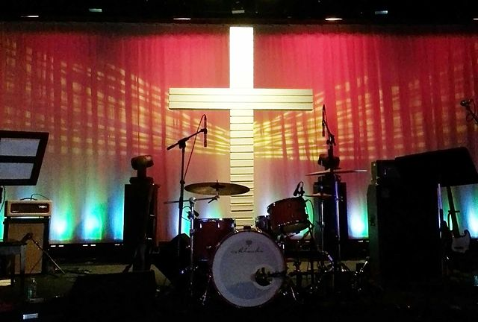
MUSIC
Hymns – these can be traditional or modern. Using well known hymns can unit people of all ages and they can join in their worship of God together. Being able to join in with a hymn and sing is an uplifting experience as the whole person is being used. (Used by Catholics, Methodists, Anglican)

Slide 18
MUSIC
Modern hymns – these can engage the young but leave out the older people. There is a need for different styles of music to be played so that all ages are catered for but, what is more important – the praising of God or that we enjoy the music? Some would say that one can come from the other. (Used by all denominations)

Slide 19
MUSIC
Live music – some churches have bands who play live and so lead the worship. This can sometimes lead to a concert style of service which some people like but others may not. Where does it become focused on the band rather than God? Is it more important that we are there worshipping God rather than jumping to modern music? (Mainly used by evangelical)

Slide 20
MUSIC
Plainchant – this is a type of music that is used in monasteries or in certain services during the day. It is a very spiritual type of music. It is very reflective and provides the opportunity for individual, private prayer. The music follows the same pattern in how it is sung and so has a mesmorising way of being listened to. The problems with this is that it can be difficult to understand what is being sung as sometimes it is in Latin. Also, for the younger generation it is very old fashioned. (Mainly used by Catholic and Anglican in certain services)

Slide 21
MUSIC
The role of music is to do the following:
Bring heart and mind together when thinking about God
Praise God through the whole person – “He who sings prays twice”
Lift the spirits of the person
Provide some time for reflection of the work of God for us
Unite people in their faith through their singing
People are lifting their voices and so are lifting themselves to God

Slide 22
MUSIC
Problems
Some people may not like the style of music being played and so cannot engage with the worship of God
The music may overtake the focus of the service
Some people do not like singing as they believe that they do not have a good voice
To sing is embarrassing for some people

Slide 23
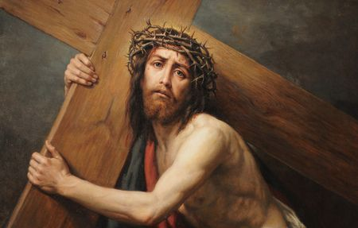
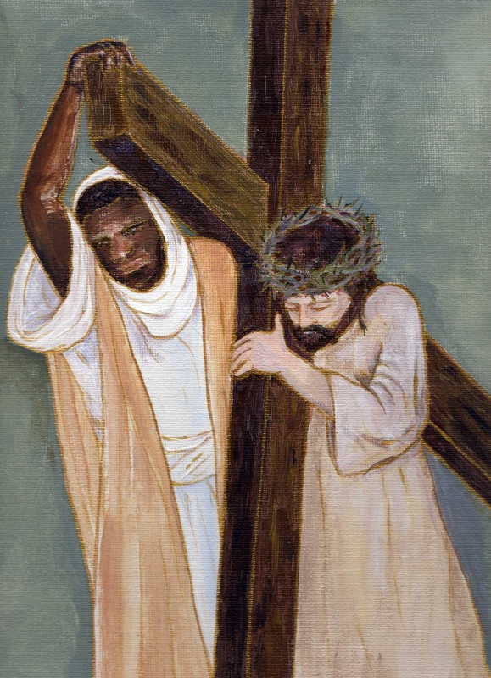
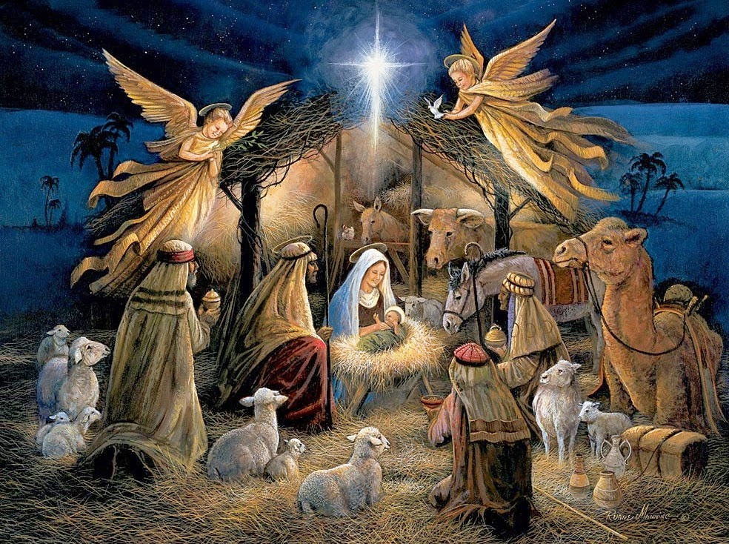

Slide 24

Review of information and test your knowledge
You will be given a sheet with some general questions.
Have a go at answering them.

Slide 25
Review of information and test your knowledge
Now have a look at some exam style questions
Make notes on how you would answer them.

