Slide 1

CHRISTIANITY REVISION (1)
Religious beliefs, Values and teachings Nature of God as personal / Creator The Trinity Nature of the Church Key Moral Principles | (2)Sources of Wisdom and Authority The Bible The nature and role of Jesus (Arius vs Athanasius) The Reformation (Luther and Calvin) Does God suffer? (Moltmann / Weinandy) | (3) Practices that shape and express religious identity Diversity of practice in the Eucharist Diversity of creative expressions
(4) Social and historical developments Science (2) Secularisation New movements in theology | (5) Works of Scholars Comparison of Barth and Hick (3 & 4) Atonement (Anselm and Aulen) | (6) Religion and Society Pluralism and Diversity Equality and discrimination (gender)

Slide 2
CHRISTIANITY REVISION (1)
Religious beliefs, Values and teachings Nature of God as personal / Creator The Trinity Nature of the Church Key Moral Principles | (2)Sources of Wisdom and Authority The Bible The nature and role of Jesus (Arius vs Athanasius) The Reformation (Luther and Calvin) Does God suffer? (Moltmann / Weinandy) | (3) Practices that shape and express religious identity Diversity of practice in the Eucharist Diversity of creative expressions
(4) Social and historical developments Science (2) Secularisation New movements in theology | (5) Works of Scholars Comparison of Barth and Hick (3 & 4) Atonement (Anselm and Aulen) | (6) Religion and Society Pluralism and Diversity Equality and discrimination (gender)

Slide 3
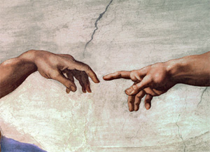
God as Personal and a Creator
God is a skilled builder
Job 38 he is the designer of the world
In Genesis 2 God is the potter shaping clay as he makes Adam from dust
God knows humans very well and interacts with them.
Humans are made in the image of God – nothing else is
God creates ex nihilo – he creates out of nothing
Omnipotence – God has limitless power. God brings order out of chaos. God has complete control over creation. He watches from above and sees his creation like “grasshoppers”. God is present in all of creation. He is both immanent and transcendent
Omnipresence – God sustains his creation. God is shown to be with his creation when he is in the Garden of Eden, his Spirit moves over the earth. There is no where we can go to where God is not there
Omniscience – God knows everything. He knew when Adam and Eve had sinned. God gives humans freewill even though he knows everything
Other qualities
Boethius said that God was eternal. God saw time all as one. He has no understanding of past, present or future
God is perfect and what he creates is perfect. God himself is unable to change

Slide 4

God as Personal and a Creator
Genesis 1
God’s power is shown
Humans are conscious beings, distinct from animals
The earth is created with harmony
Order is brought to chaos
God creates out of nothing- he commands it into existence
Genesis 2
Man is created and then woman
God makes man from clay
God interacts with his creation – speaks to Adam and Eve
Humans are given freewill and dominion
Genesis 3
Man loses immortality
Humans lose innocence as wanting to become like God in knowledge
God is the judge and banishes humans from the Garden
A gap appears between God and man as a result of sin

Slide 5
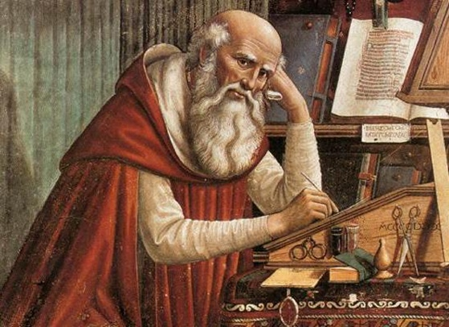
Saint Augustine and his view of God the Creator
God is uniquely simple. God is a perfect being
He is the sustainer of the universe
God is completely free and so did not have to create but he did so as an act of love
Evil was not created and so was a privation
God is not responsible for evil but it does have a purpose and that is show what is good with God
God loves his creatures so much that he becomes human to save them and bring them back to himself
The relationship God has with humans is the most important one he has
Strengths
Augustine has a literal interpretation of the Bible and some Christians would support this
Beliefs about the Trinity emphasise the relationship God has with humans
Aquinas also believed that God is the creator and sustains the universe. God is Cause in Esse
Weaknesses
Schleiermacher argues it is a contradiction to claim a perfectly created world could go wrong. Either the world was not perfect or God made it go wrong
If there was no knowledge of evil, how could Adam and Eve have gone against God?
Augustine’s view does not consider evolution. How can we all be affected by the sin of one man?

Slide 6
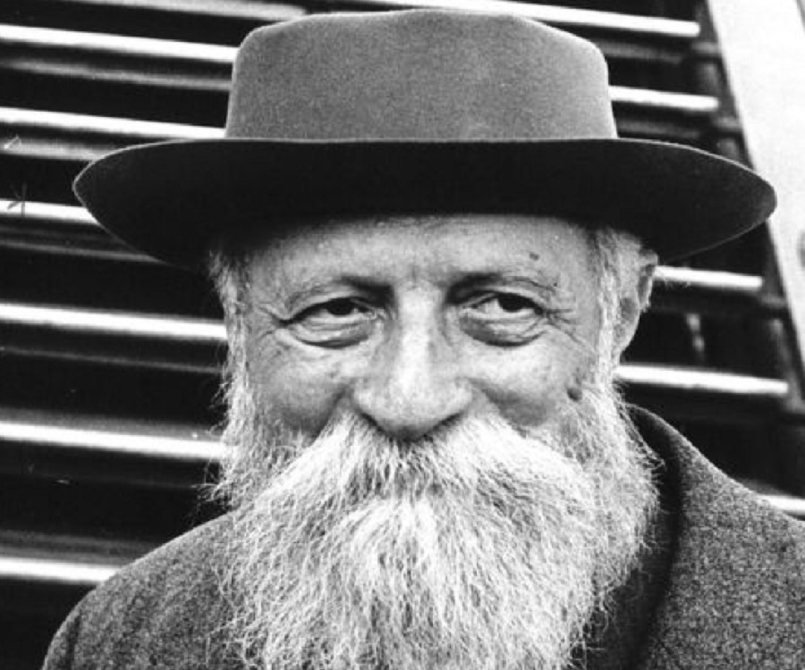
Buber and his view of God as personal
The Eternal Thou is God
God is only thou which never became and IT
God cannot be used as a means to an end
Our relationship with God serves as a foundation for our relationships with others
I-Thou relationship involves God and has meaning
I-It involves little as the object or thing is not important to us
“Meet the world with the fullness of your being and you shall meet God”

Slide 7
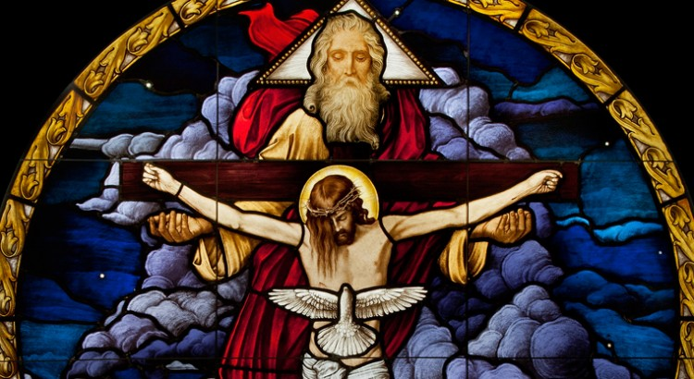
Beliefs on the Trinity
The Eternal Thou is God
God is only thou which never became and IT
God cannot be used as a means to an end
Our relationship with God serves as a foundation for our relationships with others
I-Thou relationship involves God and has meaning
I-It involves little as the object or thing is not important to us
Can also be called Triune God or Three in one
It is the belief that there is one God who is Father, Son and Spirit
The Father is God
The Son is God
The Spirit is God
The Father is not the Son
The Son is not the Spirit
The Father is not the Spirit
“Meet the world with the fullness of your being and you shall meet God”

Slide 8
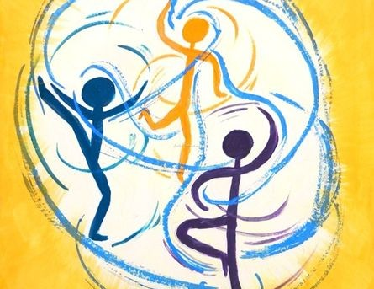
Models of the Trinity
Perichoresis
Mutual Interpenetration
About how the three persons of the Trinity relate to each other
Allows individuality to be maintained whilst each person shares in the life of the other two
“Community of being”
Appropriation
All three persons of the Trinity are involved in every action of God
It is appropriate to think of some actions as distinctive and belonging to one person of the Trinity
For example, creation is the work of the Father / salvation is the work of the Son

Slide 9
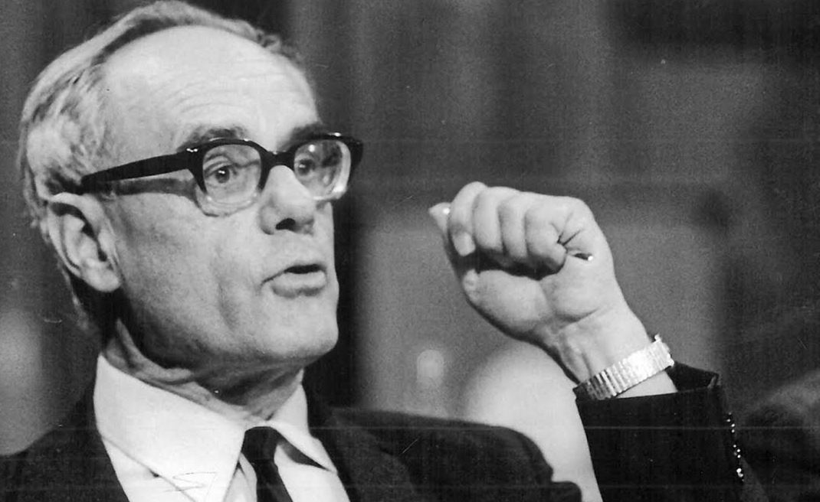
Modern views of the Trinity
Karl Rahner
Treatise of the Trinity 1970
“Economic” and “Essential” trinities
Essential Trinity
Also known as the “Immanent Trinity”
Formulate God outside of limiting conditions of time and space
This Trinity is beyond our experience and that is beyond the universe
Economic Trinity
Way in which the Trinity has been made known through salvation
This is also the Immanent Trinity and vice versa
This Trinity is when we speak of salvation. How God saved humans
This Trinity is seen in actual events e.g. the crucifixion, resurrection, creation

Slide 10
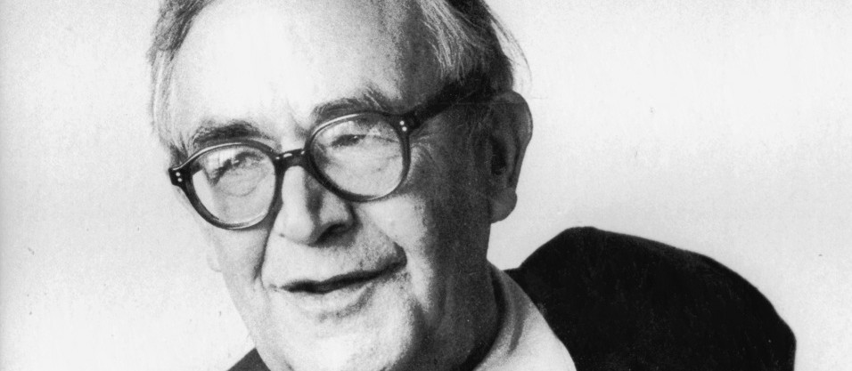
Modern views of the Trinity
Karl Barth
Church Dogmatics
God is only revealed as a result of the Trinity
It is through the Trinity that we can understand what God is
“God reveals himself, through himself. He reveals himself”
The Trinity was purposefully formed by God so he could reveal himself through each of the three persons
The task of theology is to enquire what the revelation of God through the Trinity implies
He believes that the Trinity reveals God to us through the word of God in the Bible
Jesus makes the message heard
Holy Spirit was sent to support the founders of the Church
We have a God who wants to reveal himself and also we have a God who is self-revealed
Humans cannot understand God fully and so he reveals himself as Jesus and the Spirit helps us to hear this revelation

Slide 11
Modern views of the Trinity
Karl Barth
Church Dogmatics
Strengths
Shows an awareness that humans are limited in their ability to understand God
A purpose and a logic is created to the separate forms of the Trinity
He is reinstating the importance of the Trinity when for a time it was not deemed to be important
Weaknesses
Does not support the belief that the Trinity are all equal in status
Goes against the belief that the Father, Son and Spirit were all present a the beginning of time
His theory may imply that before Jesus and the Holy Spirit arrived, humans were not able to understand God

Slide 12
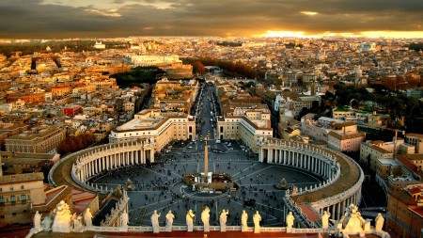
The Nature of the Church
The Nicene Creed professes,
“We believe in one, holy, Catholic and Apostolic Church”
These are the four marks of the Church
They are linked to each other. The belief is that Jesus himself, in founding the Church, marked it with these characteristics which reflect its features and mission.
The Holy Spirit guides the Church to fulfil these

Slide 13
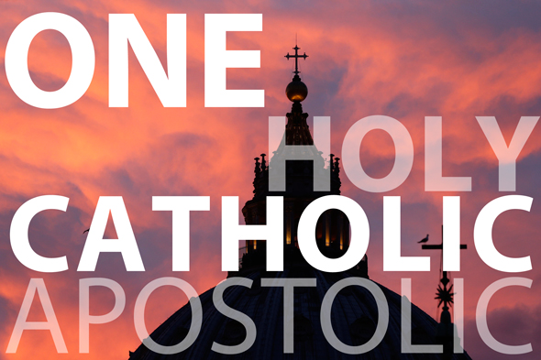
The Nature of the Church
The Church is ONE:
It is the source of the Trinity that is united
All humans are united and reconciled to God through the sacrifice of Jesus
The Church has a soul that unites all people of faith
Catholic must work for unity so everyone believes in the ONE true Church.
The Church is CATHOLIC:
Catholic means “universal”
Jesus is present throughout the world
“Go and make disciples of all nations”
The Church has a duty to evangelize to all
The Church is APOSTOLIC:
Jesus founded the Church
Authority was passed to the disciples / apostles
St Peter was the first Pope
This authority is handed down from the apostles to the Popes, Bishops and Priests
This is called APOSTOLIC SUCCESSION
They have the same responsibility and work the apostles did
The Church is HOLY:
Jesus is the source of all holiness and the Church continues the work of Jesus
Many aspects of the Church are holy – prayer and worship
The holiness of the Church can be experienced through the sacraments and prayer
Saints provide examples on how to live a holy life

Slide 14
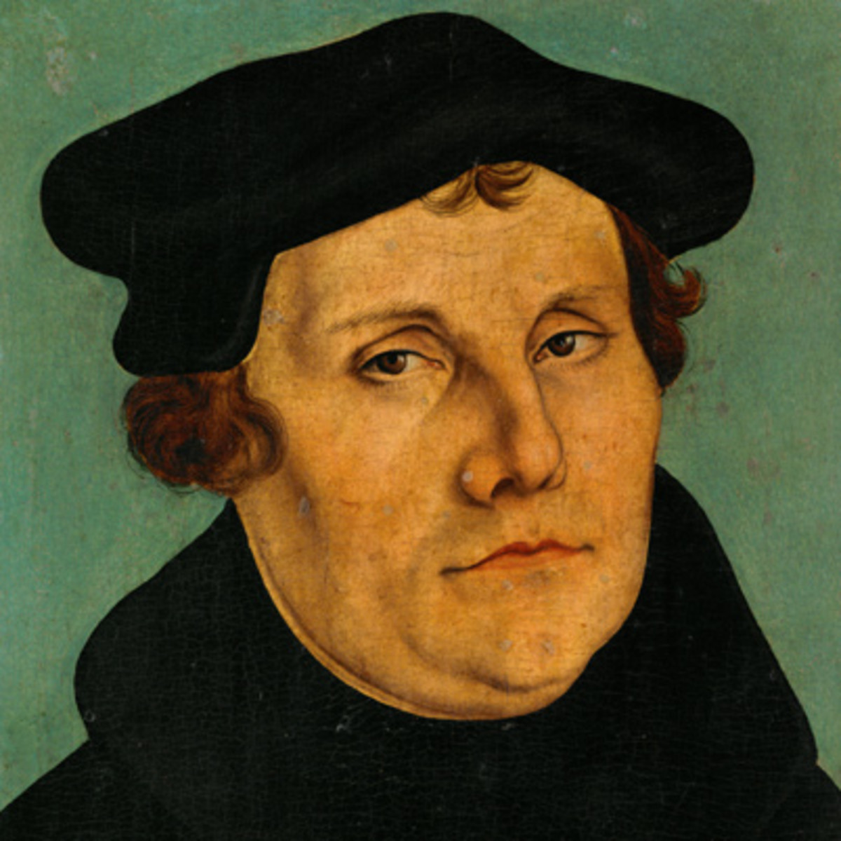
The Nature of the Church
MARTIN LUTHER
He was at the centre of the Reformation
The reformers were certain that the Catholic Church had lost sight of its teaching and grace
Martin Luther believed that the Church was no longer authentic
He felt it was emphasising the way it looked rather than the quality of worship
Luther wanted to simplify worship so that people could feel closer to God
Luther was focused on what a person had to do in life to be saved
He emphasised FAITH
The cross is the centre of faith and so too much decoration in church takes away from this
Luther sees the presence of Christ in the Eucharist but does NOT admit there is transubstantiation

Slide 15
The Nature of the Church
MARTIN LUTHER AND HIS SEVEN MARKS OF THE CHURCH
Christian people are to be known as HOLY
The Christian people are to be known by BAPTISM
The Christian people are to be known as the SACRAMENT OF THE ALTAR (Eucharist)
The people are to be known by KEYS
The people are to be known by the fact that it consecrates ministers
Public prayer and praise
Possession of the HOLY CROSS

Slide 16
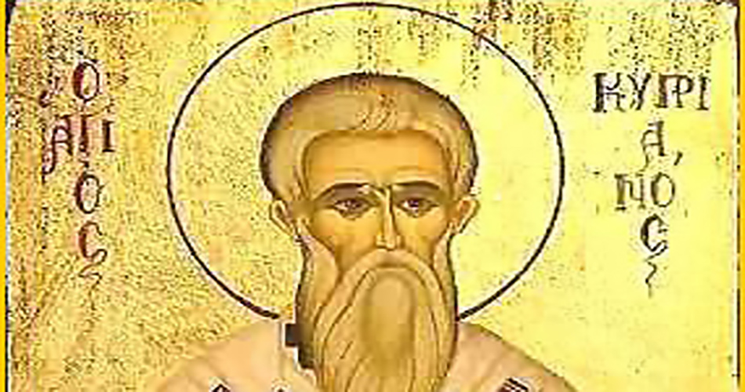
The Nature of the Church
CYPRIAN OF CARTHAGE
THE UNITY OF THE CHURCH (His book)
He was trying to prevent a split in the Church
He argued that there could only be ONE church and any other breakaway movement was a false church
He raised the profile of the Bishops and the idea that there should be ONE church united in practice
He was responding to Christians dying for their faith and those who had lost trust in the Church and had turned away from ONE god
What would happen to those who had turned away from the Church? Could they return to it? How would this work?
Cyprian was sympathetic and suggested that they should be allowed back to the ONE church

Slide 17
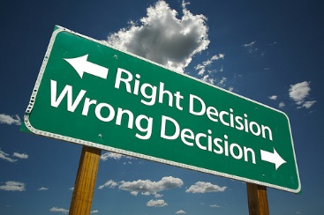
Key Moral Principles
LOVE
Love is a basis of all actions / principles
St Paul spoke of Agape (selfless love)
“Love your neighbour”
“Love your enemies”
FLETCHER
Situation Ethics
“Always do the most loving thing”
All actions should result in love
Agapeic Calculus
4 presuppositions – Pragmatism, Positivism , personalism and
TRINITY AND LOVE
God shows his love for humans through the sacrifice of Jesus
CHRISTIAN VALUES
Working and supporting charities
Patience for people
Christians should be faithful in their relationships
Christians should have self-control, moderation
Christians are challenged to stand up for what they believe to be right
Jesus said his work was with those who did not need a doctor
Pope Francis told his Bishops “to get the smell of their sheep”

Slide 18

Review of information and test your knowledge
You will be given a sheet with some general questions.
Have a go at answering them.

Slide 19
Review of information and test your knowledge
Now have a look at some exam style questions
Make notes on how you would answer them.

