Slide 1
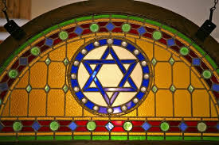
Topic 5:Comparing two religions:
Christianity and Judaism
Lesson 2: The nature of G-d in Judaism.

Slide 2
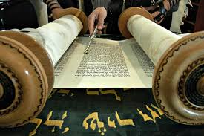
Lesson Objectives
To know and understand key beliefs about God in Judaism.
To compare beliefs with Christianity.

Slide 3
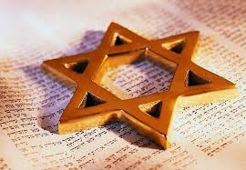
Starter Activity
In your exercise book record at least four things you know about Judaism and the Jewish G-d.
We will share this information as a class.
As your teachers adds information to the board, ensure you copy into your exercise books.

Slide 4
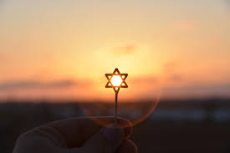
Jewish ideas about G-d
Jews have very strong beliefs about what G-d is like.
They believe that G-d is so important that they will not make any images of Him; this is to stop people worshipping false idols.
They will also not write His name as a sign of respect and to avoid His name being damaged.

Slide 5
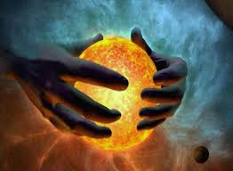

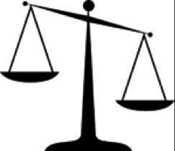

Main Activity 1: Characteristics of G-d.
In Judaism there is a belief in four key characteristics of God. These four characteristics will be handed out. You have 3 minutes for each piece of information then YOU must swap with the person next to you. You must summarise each characteristic in at least 30 words.
You have 12 minutes!
Lawgiver
Creator
God is ONE
Judge

Slide 6
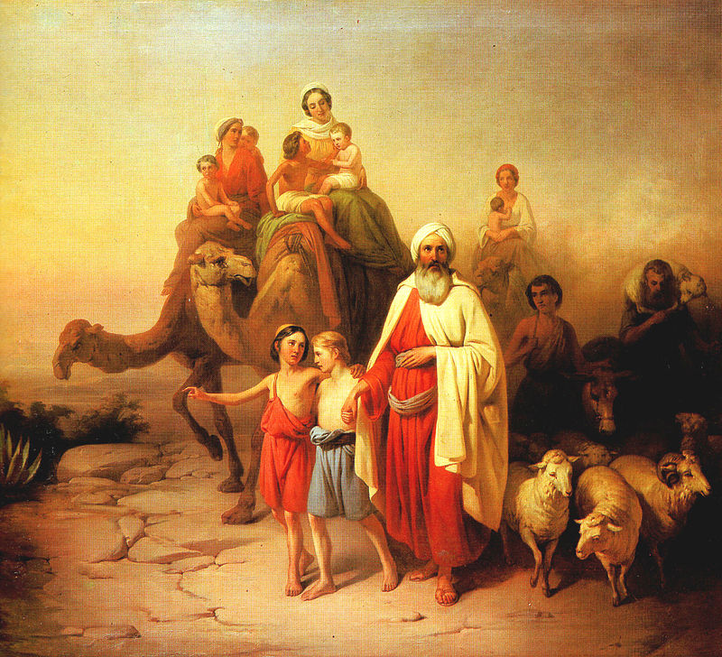
Main Activity 2: The relationship between G-d and the Jewish people
This is an image of Abraham.
From this picture and the clip record anything your thoughts on who Abraham is and why he is important.
You have five minutes.
https://www.youtube.com/watch?v=4yGyLdKF_-I

Slide 7
Main Activity 3: The relationship between G-d and the Jewish people
God and Abraham
The covenant between God and the Jewish people is a thread running throughout the early parts of the Torah, and one of the vital pillars of Judaism. A covenant is a promise.
God asks Abraham to do certain things, in return for which He will take special care of them.
The covenant between God and Jews is the basis for the idea of the Jews as the chosen people.
God promised to make Abraham the father of a great people and said that Abraham and his descendants must obey God.
In return God would guide them and protect them and give them the land of Israel.
But it wasn’t simply a matter of obeying rules - God didn't just want the Jews to follow a particular set of laws, but to live their lives in such a way as to show the world that God actually was the one and only all-powerful God, whom people should follow and worship.
Summarise the information above in at least 50 words.
Extension: Why do you think Abraham is know as the Father of Judaism? Explain in at least thirty words.

Slide 8
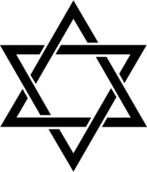
Main Activity 4: Comparing Christianity and Judaism
Return to the sheet that you created during the plenary last lesson. From this information create a table of at least three similarities and three differences.
Similarities | Differences

Slide 9
Homework
MUST
Create a quiz on Christian and Jewish teaching about God. Include at least 10 questions and answers.
SHOULD
Explain in at least forty words why Jews and Christians believe God is all-powerful.
COULD
Create an A4 overview outlining different and similar beliefs about God.

Slide 10
Plenary
List at list two things you have learnt.
Explain at least three qualities of God.
Create two differences between Judaism and Christianity.

