Slide 1
Year 5 Homework Menu
Summer Term
Throughout the term please choose one piece of homework to complete weekly. In year 5, we can share our homework electronically via email (r.shields@carcroftschool..co.uk) or as a paper copy.. We will share all homework submitted in our crew circles and all homework will be rewarded with raffle tickets which will be entered into our weekly draw.
Year 5 children are expected to read at least 3 times a week at home with their parents or carers. Please write each time you have read in your reading journal so that your books can be changed and your child can collect their reading reward. Reading books can be changed as and when they need to be. Please ensure children bring their book bags daily.
Educational websites: -
https://www.topmarks.co.uk/maths-games/7-11-years/ordering-and-sequencing
https://www.topmarks.co.uk/maths-games/daily10
https://www.mymaths.co.uk/
https://sites.google.com/carcroftschool.co.uk/readingrevision/home
https://sites.google.com/carcroftschool.co.uk/mathsrevision/home
https://sites.google.com/carcroftschool.co.uk/spagrevision/home

Slide 2
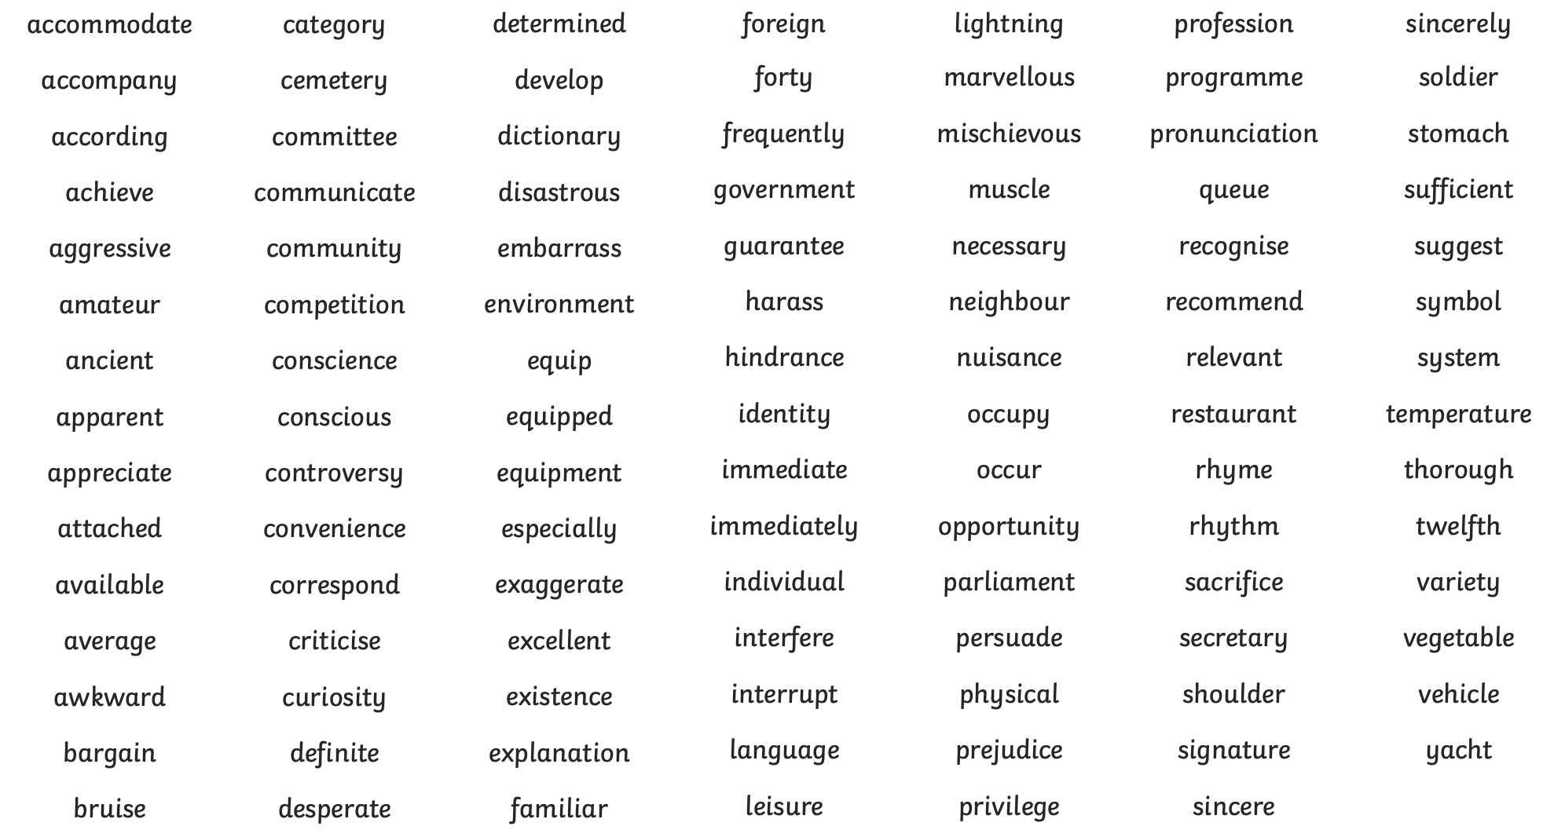
Year 5/6 statutory spelling list - to be able to spell the words from the list.

Slide 3
Expeditionary Learning | Maths https://sites.google.com/carcroftschool.co.uk/mathsrevision/home | English https://sites.google.com/carcroftschool.co.uk/readingrevision/home | Grammar https://sites.google.com/carcroftschool.co.uk/spagrevision/home
Have a walk around your local area and make a list of human and physical features? | Practise timetables daily either on TTRS or chanting. | Read some of your book and write a short summary of what you’ve read. | Write 3 sentences about your weekend that includes coordinating and subordinating conjunctions.
To interview a member of their family about what Carcroft was like when they were younger? Has it changed? Where is your favourite place to go? | Login to Mymaths and complete a lesson - these have been allocated. Access maths revision site and practise an area you don’t feel confident with. | Write a poem about the things you enjoy doing. | Access grammar revision on the school website.
Listen to different genres of music e.g country, pop, classical, folk, jazz etc. Which was your favourite and why? | To add and subtract 5 digit numbers that involve carrying and exchanging. | Write a description of your bedroom or favourite place - can you use a range of ambitious vocabulary? | Write a short passage about mining that includes fronted adverbials.
Can you find out 5 facts about mining in another country? What do they mine? Where do this do this? Do they have good working conditions? | Divide numbers that have remainders/no remainders. Multiply 4 digit numbers by digit/2 digit. | Write a postcard to your friend explaining the conditions of working in the mine. | Write a poem that contains prepositions.

