Slide 1
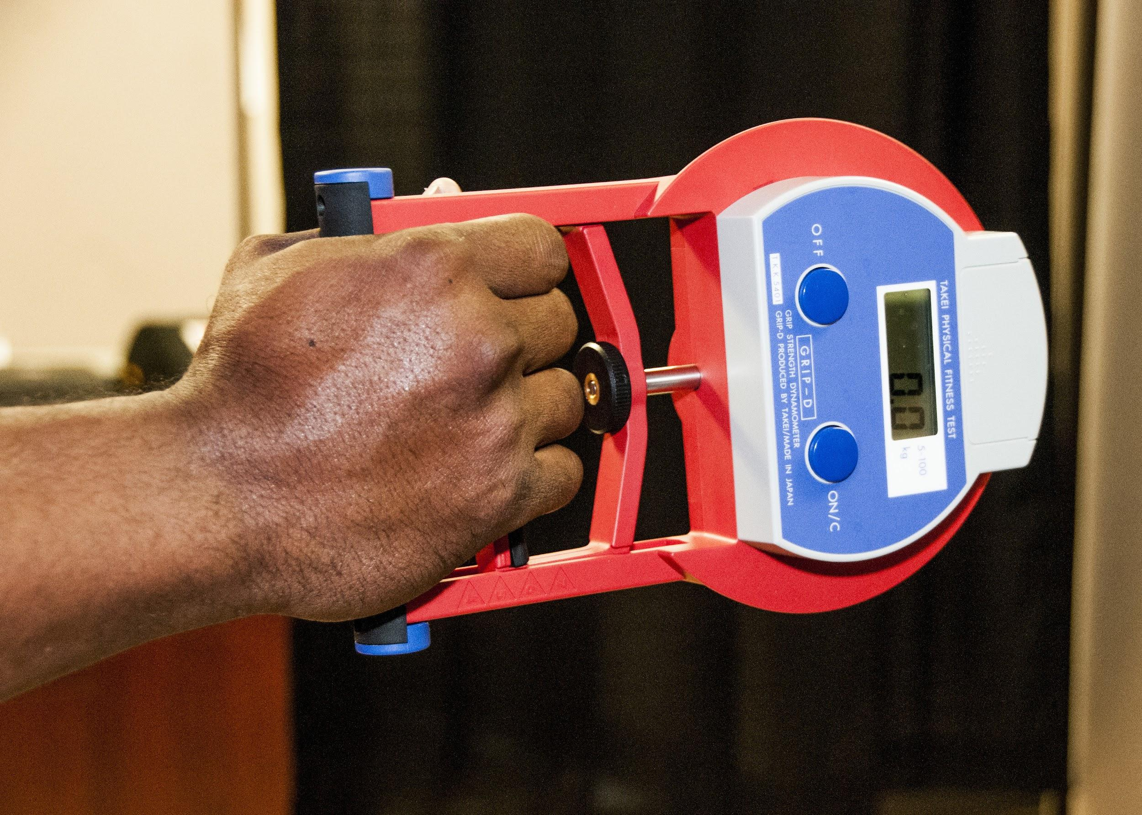
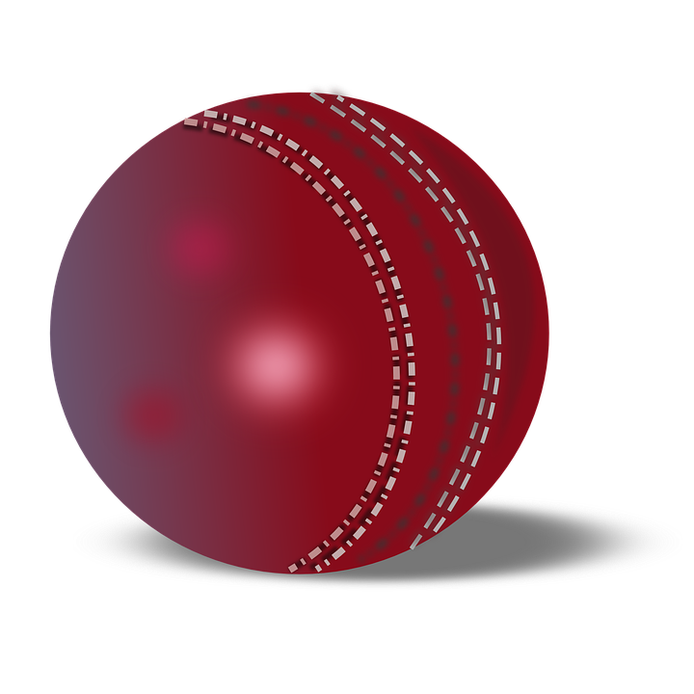
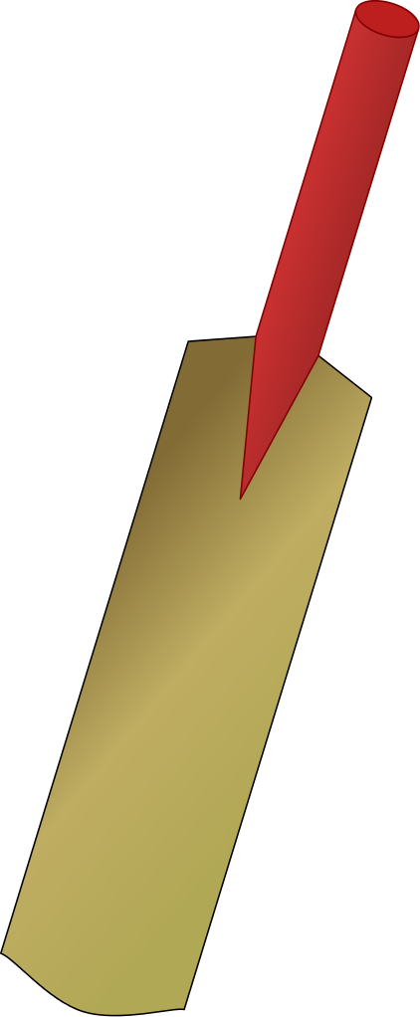
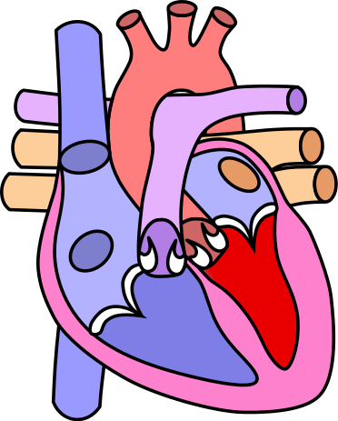
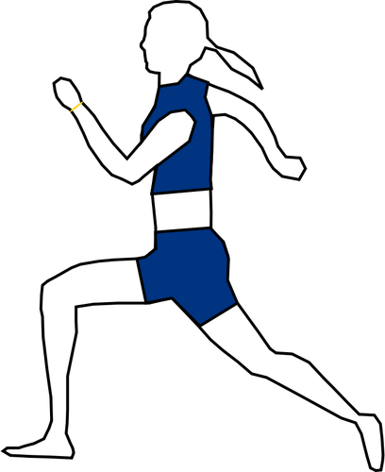
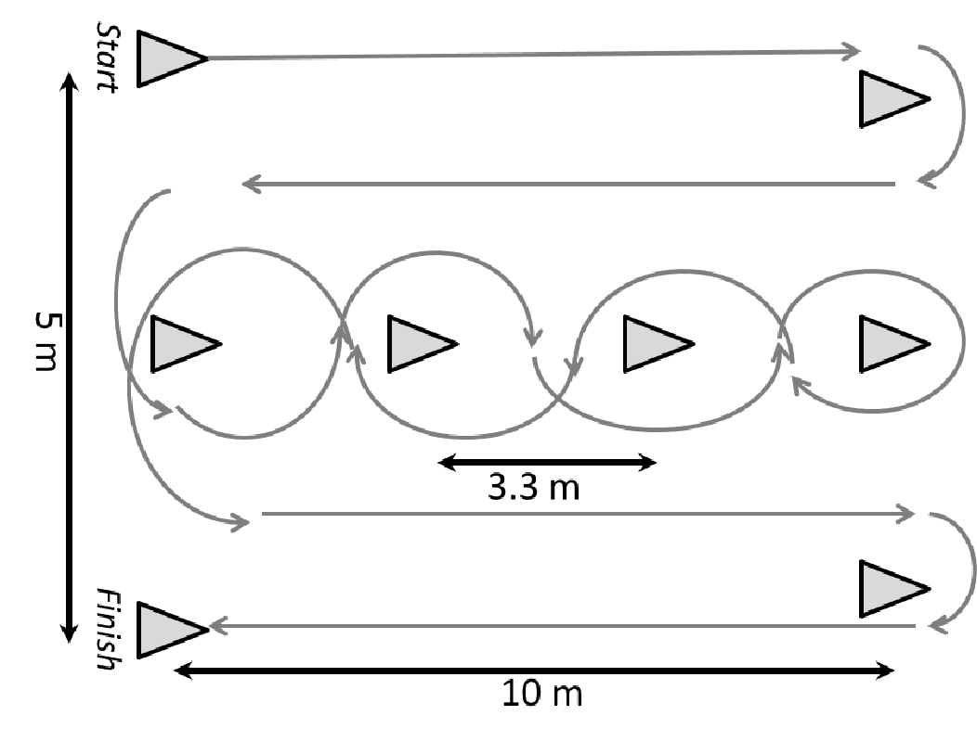
REDMOOR ACADEMY: P.E. Core CURRICULUM JOURNEY
A Redmoor PE student will be inspired to lead a lifelong healthy active lifestyle and have the opportunity to engage in competitive sport.
We allow students to participate in a challenging and enjoyable environment that focuses on the physical and holistic development of our students.
Our curriculum develops skills to build the whole character and embeds values such as teamwork, resilience and respect.
Football
Netball
Badminton
Assist with school events
(sports day)
11
Rounders / Cricket
Tennis
Core PE for enjoyment
Basketball
Rounders/
Cricket
Core PE for enjoyment
Netball
Badminton
Football
10
Striking & Fielding
Unit 1
Developing Leadership Skills
Unit 2
Plan, assist and review
sport and activity sessions
Volunteer for festivals
Athletics
Gymnastics
Performing Skills with Technique, Tactics & Leadership
Rugby
Cross Country
Fitness PEP
9
Basketball
Handball
Football
Theory Health Fitness & Wellbeing
Netball
Striking & Fielding
Basketball
Handball
Developing Skills, Techniques & Rules
Fitness Methods
Cross Country
Gymnastics
OAA
Rounders
8
Football
Theory A&P
Netball
Rugby
Athletics
Cricket
Tennis
OAA
Rugby
Basketball
Football
Learning Fundamental Skills and Rules
7
Athletics (T&F)
Handball
Gymnastics
Netball
Fitness Testing
Our students learn to love sport for life.

Slide 2
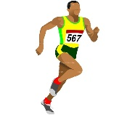
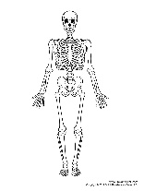
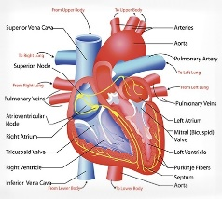
REDMOOR ACADEMY: P.E. GCSE CURRICULUM JOURNEY
A Redmoor PE student is inspired to lead a lifelong healthy and active lifestyle and to engage in competitive sport.
Students participate in a challenging and enjoyable environment that focuses on physical and holistic development.
Our curriculum develops skills to build the whole character and embeds values such as teamwork, resilience and respect.
Health Fitness & Wellbeing
HEFP, Lifestyle Choices, Nutrition, Optimum Weight
Socio-Cultural Issues
Sportsmanship, Gamesmanship, Deviance
Sport Psychology Feedback, Guidance, Practice
Start of PEP
11
Revision for Paper 1 & 2
Write Up of PEP
Performing PEP Sessions
Athletics
Athletics
Netball
Handball
Football
10
Striking & Fielding
Anatomy & Physiology Skeletal System, Muscular Cardiovascular System, Respiratory System
System
Aerobic/Anaerobic respiration, Long and Short term effects of exercise
Movement Analysis Planes, Levers and Axis
Physical Training Components of fitness, Fitness Testing, Methods of Training, Principles of Training, Drugs in Sport
Athletics
Rugby
Cross-Country
Fitness PEP
Gymnastics
Performing Skills with Technique, Tactics & Leadership
9
Basketball
Handball
Football
Theory Health Fitness & Wellbeing
Netball
Striking & Fielding
Handball
Developing Skills, Techniques & Rules
Fitness Methods
Basketball
Cross Country
Gymnastics
OAA
Rounders
8
Football
Theory A&P
Netball
Rugby
Athletics
Cricket
Tennis
OAA
Rugby
Basketball
Football
Learning Fundamental Skills & Rules
7
Athletics (T&F)
Handball
Gymnastics
Netball
Fitness Testing
Our students learn to love sport for life.

