Slide 1


Slide 2
Welcome Message
from Hemishram, Year 8

Slide 3
Welcome from
Mr Phil Snelling
Acting Headteacher

Slide 4
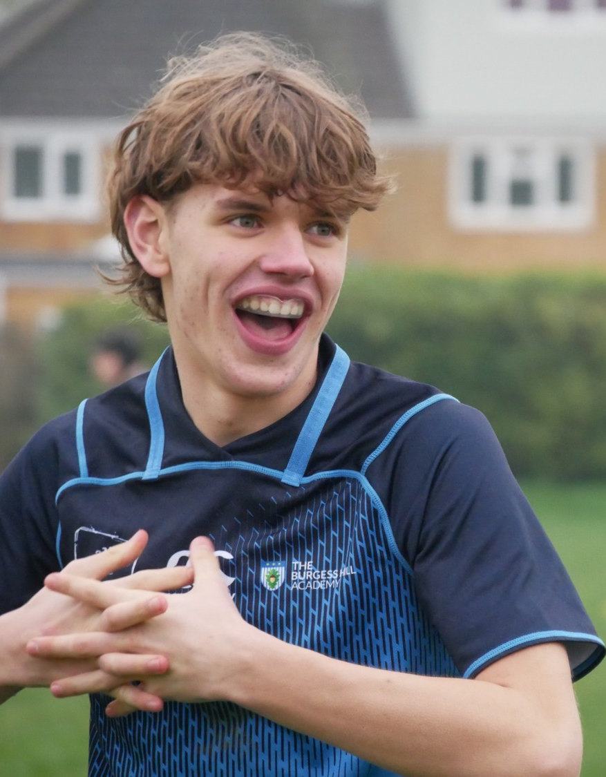
A Community
where Students Thrive
Knowledge
Experiences
Opportunities

Slide 5
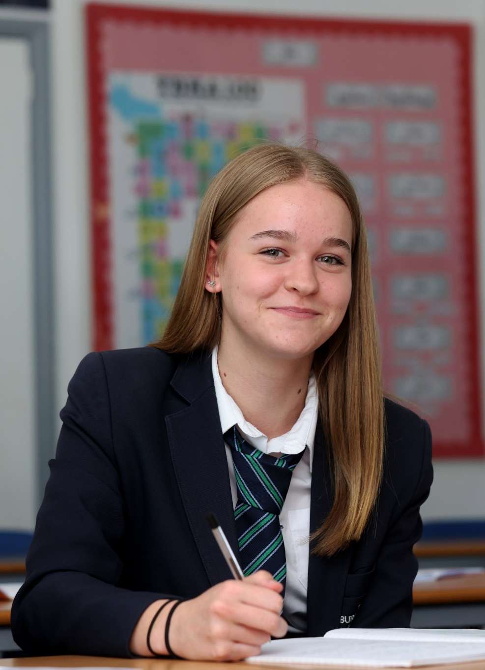
A School That
Knows Your Child
“
Staff know their pupils well and relationships are strong
Pupils are happy and welcoming at this school
Staff are committed to providing an ambitious and inclusive school experience for all.
”
Ofsted, December 2024

Slide 6
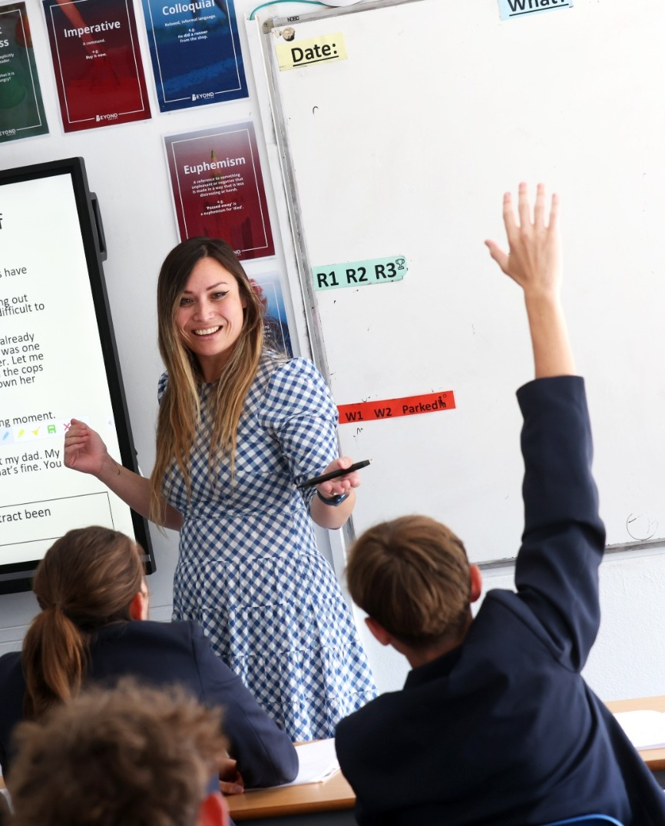
Exceptional Teaching, Every Day
“
Lessons are calm and purposeful.
Teachers introduce new content effectively and provide pupils with regular opportunities to practise and apply their learning.
”
Ofsted, December 2024

Slide 7
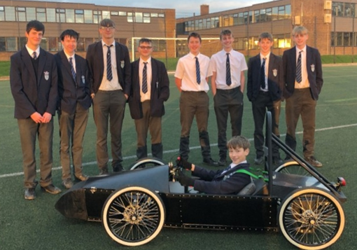
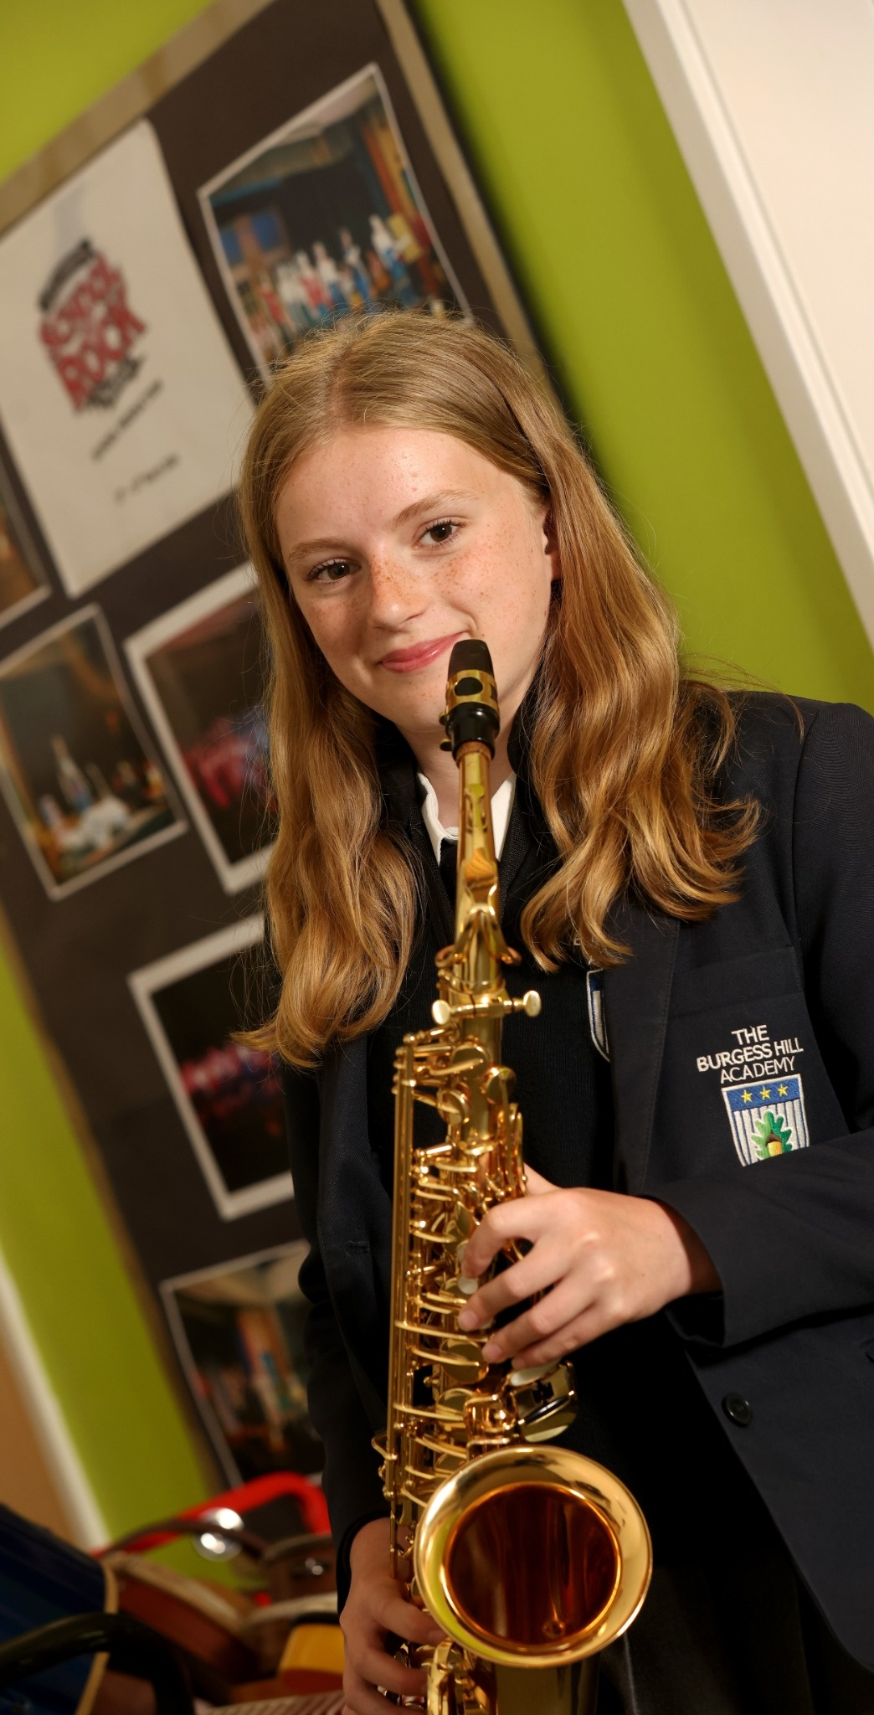
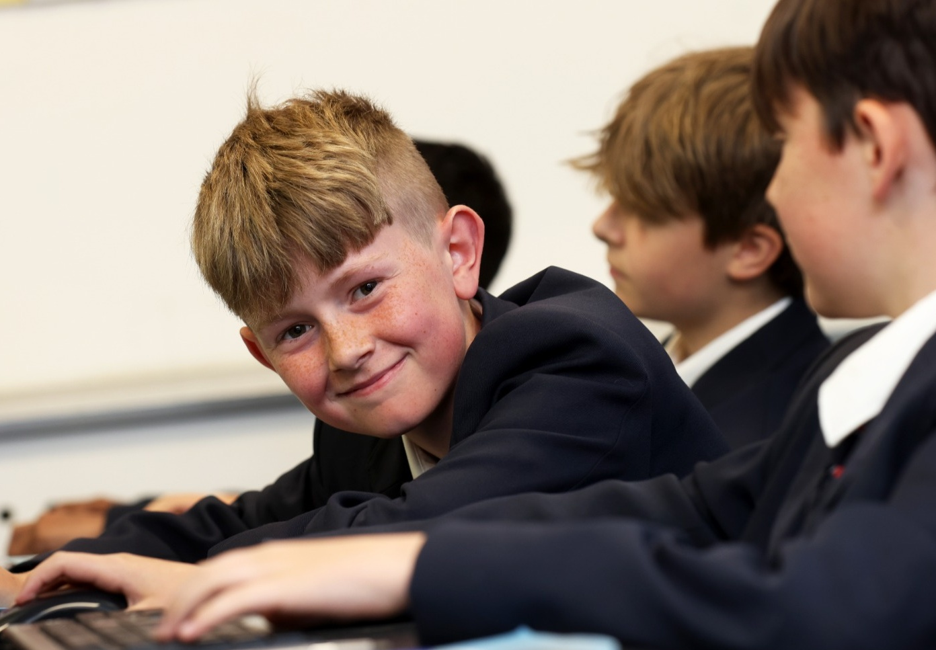
A Powerful Curriculum
“
Pupils follow a broad and balanced curriculum.
Pupils can choose from a range of Key Stage 4 options.
”
Careers education is strong.
Ofsted
Ofsted, December 2024

Slide 8
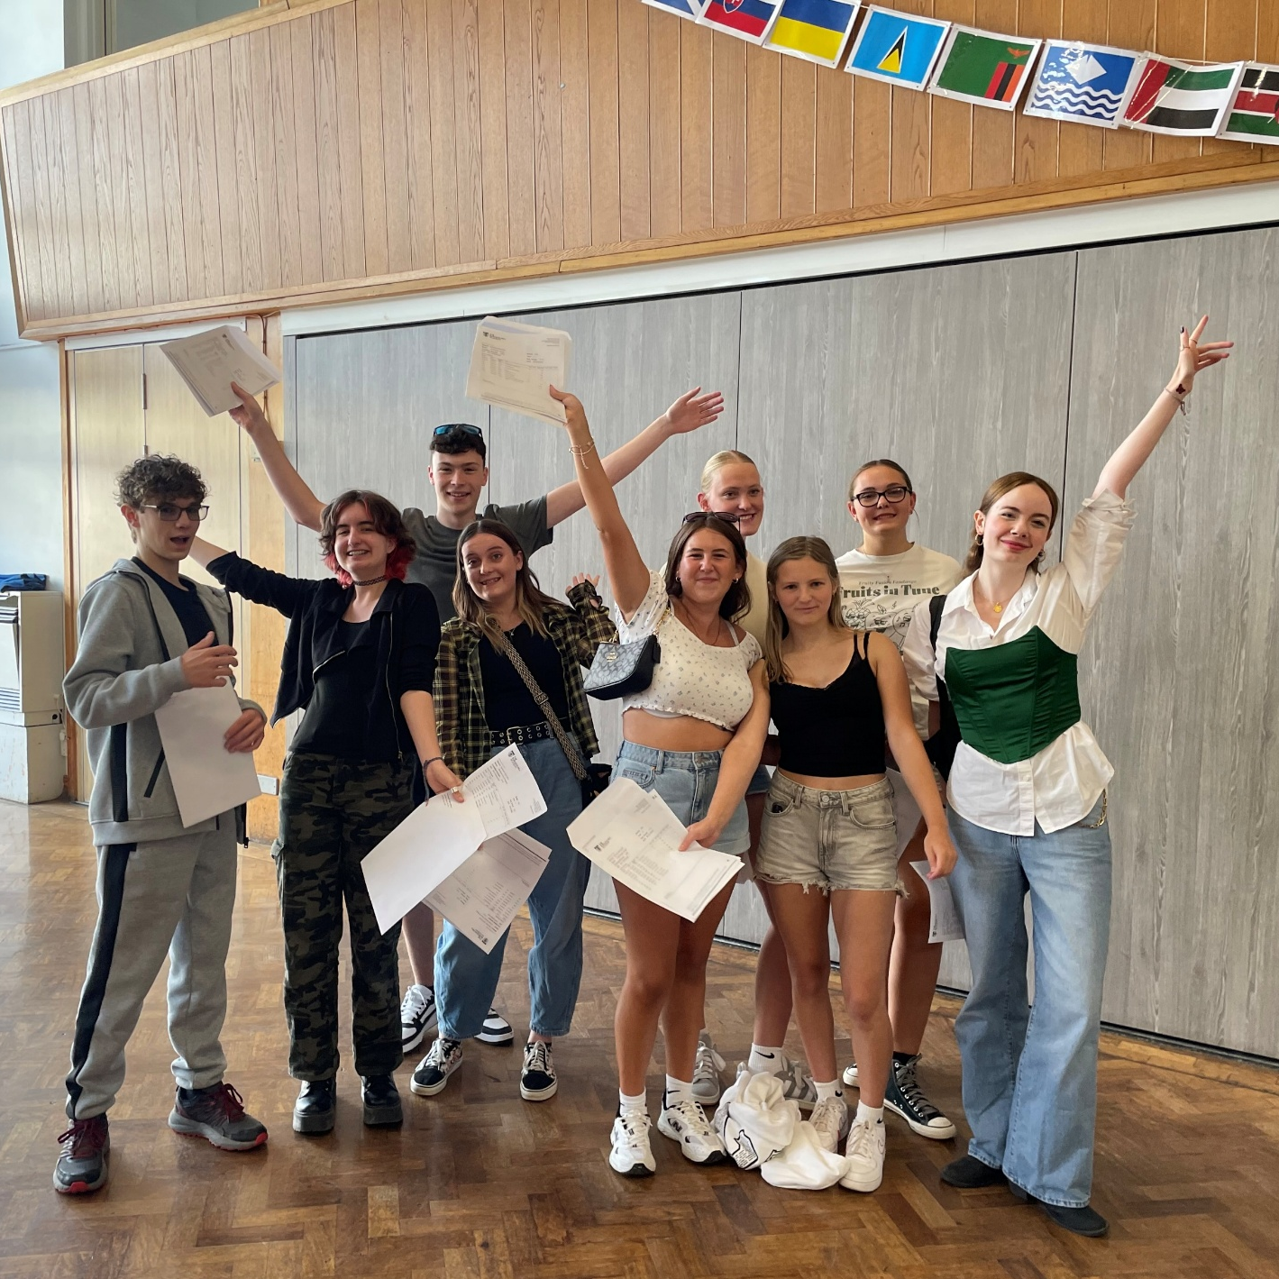

Strong Academic Outcomes
Progress 8
English & Maths
Attainment 8

Slide 9
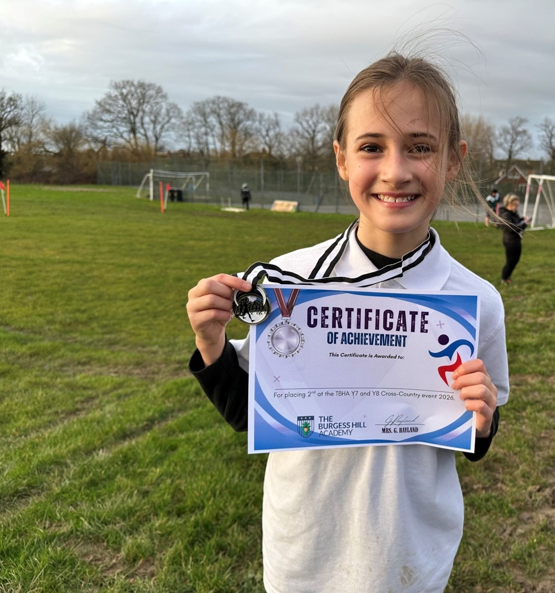
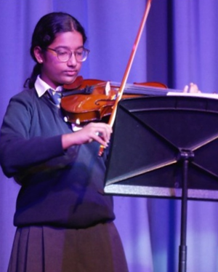
Opportunities That
Broaden Horizons
“
Pupils are well-prepared for the future.
Pupils appreciate the extra-curricular and leadership opportunities at the school.
Staff ensure that these activities are accessible to all pupils.
”
Ofsted, December 2024

Slide 10
A Year 11’s Perspective:
Jenia

Slide 11
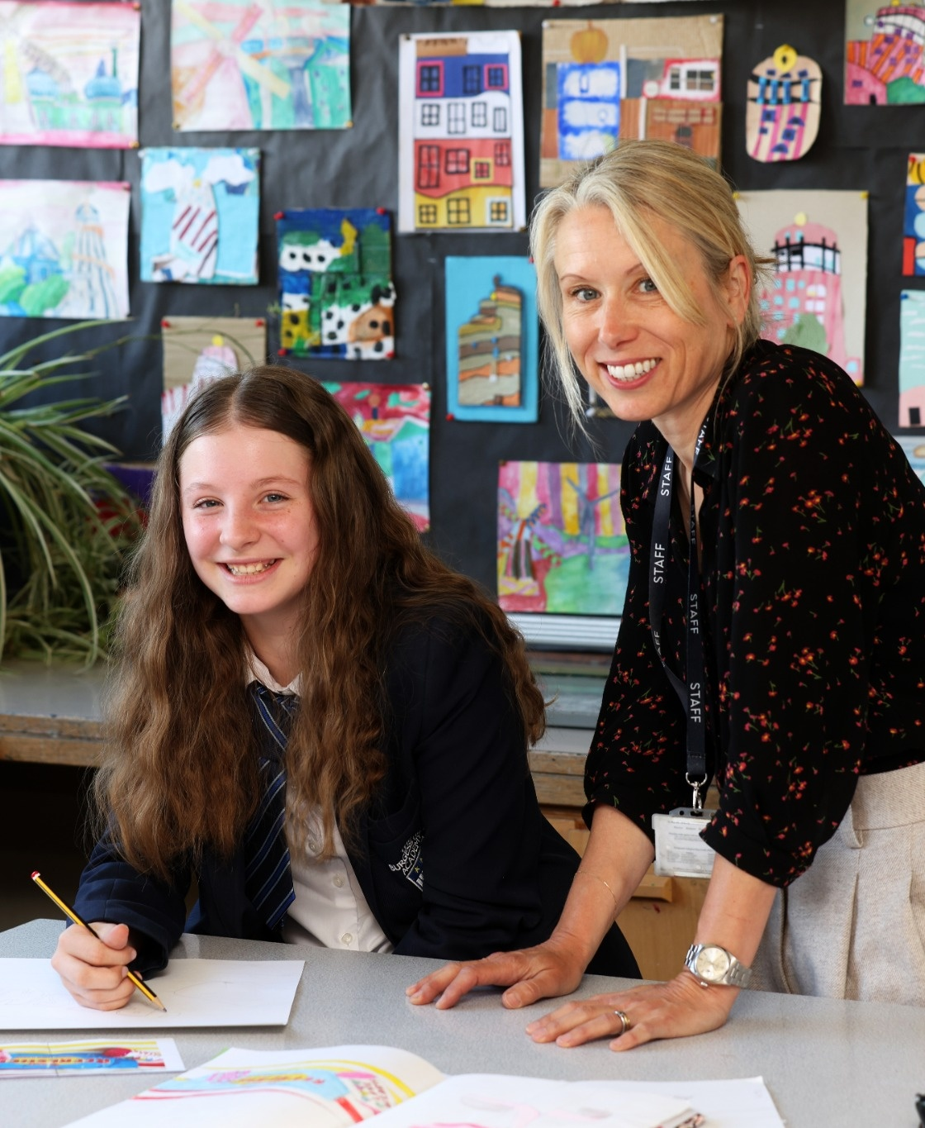
A School We’re All
Proud Of
High quality provision
A new library and IT suite
Refurbished changing rooms and student toilets
A new dance studio and graphics suite that will be completed this year.

Slide 12

A Stronger Future with
Sussex Learning Trust
A strong local Trust, embedded in our community
Additional expertise and support for our academy
Shared specialist knowledge that strengthens teaching
Support and professional development
Opportunities for collaboration across schools

Slide 13
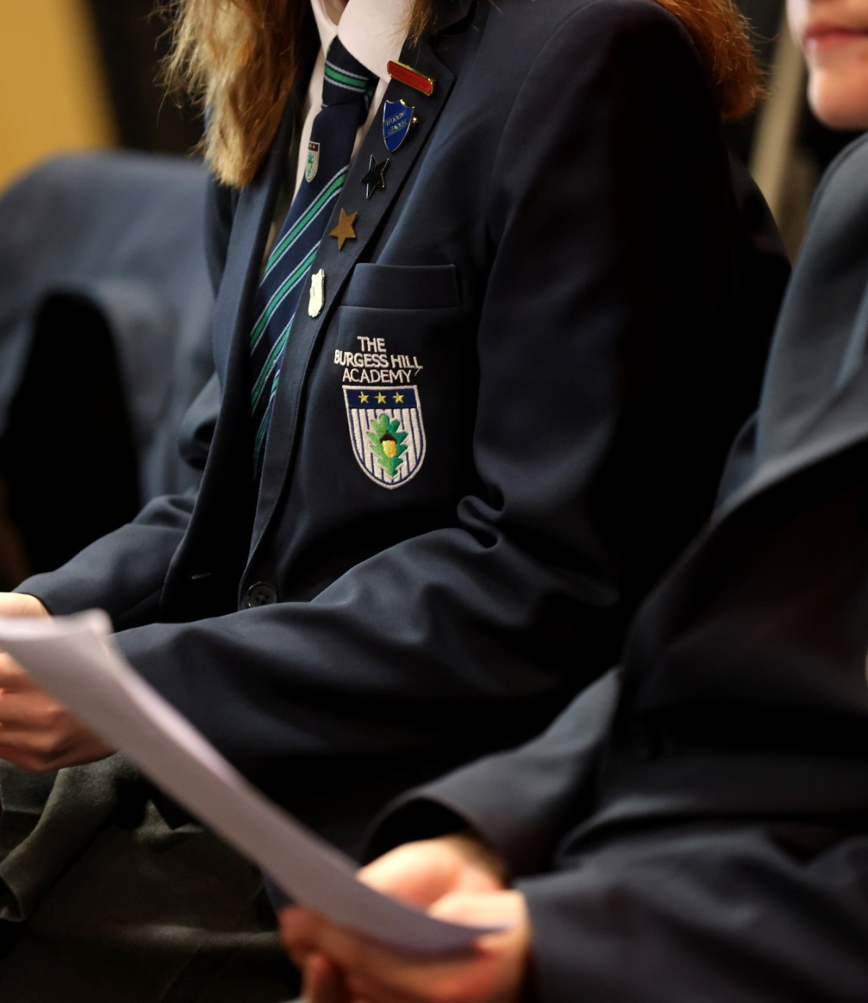
A Shared Commitment
to High Expectations
We hold traditional values and we expect our students to live up to these values.

Slide 14
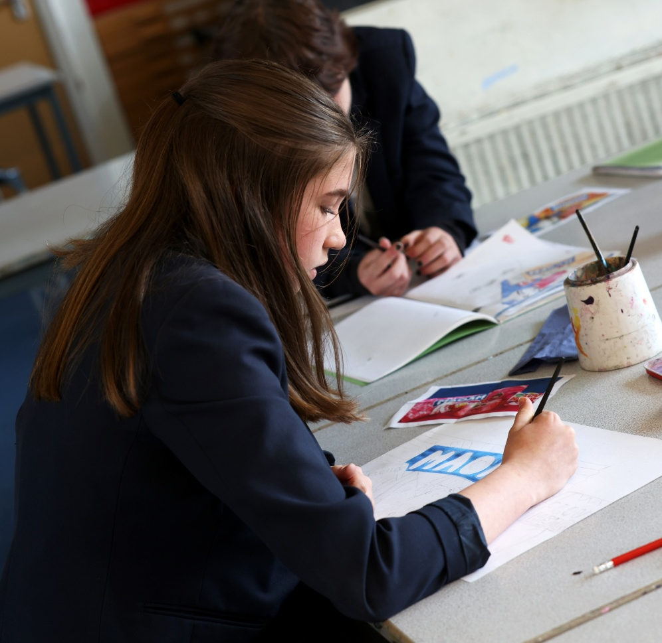
Open Mornings
Beginning
Monday 21 September 2026
Each day at 10.00am
Booking opens tomorrow

