Slide 1
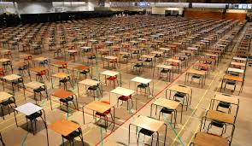
Summer Exams 2026

Slide 2

Information you will receive:
You should have received your updated personal timetable which will have information about exam rooms/timing/ seating. Please check this carefully and let me know of any concerns immediately. Take a photo of this at home.
This powerpoint will be uploaded to google classroom along with instructions for candidates and social media warning.
The policies and other information are all on the school website

Slide 3
Where do I sit?
If you know where you are going to sit it removes one worry!
The room and seat number will be on your updated timetable.
Seating plans will be displayed on the Exam Notice Board for each exam to be held that day

Slide 4
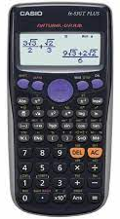

Equipment (the minimum)
Clear pencil case
BLACK Biros (at least 2)
Pencil
Eraser - No Tipp-ex
Pencil sharpener
Protractor/compass
Ruler
Calculator (if allowed) without the case
Optional:
Highlighters
Coloured pencils

Slide 5

Our main objective is the advancement of public education by enabling our members to act together in:
providing, wherever possible, common administrative arrangements for examinations thereby reducing bureaucracy for schools and colleges;
responding to proposals from the regulators, Government and other stakeholders;
communicating with a single voice to the media and other interested parties.

Slide 6
Exam Timings
For morning exams, you must go to your form room to hand in your phone promptly so that you can be at your exam room by 9am sharp. If you are late you must sign in at reception and hand in your phone.
Afternoon exams start at 1.15pm or 1.30 pm, you must be at your exam room at least 5 minutes before the start.
Some exams are shorter than others, you must leave the exam room in silence when you are dismissed. Please remember there are other rooms being used for exams.
Once you have been dismissed you need to go straight to your lessons.
Other Information

Slide 7
What to expect at the start of your exam?
Arrive on time and wait outside your exam room – you are not to enter the room until invited in by invigilator/staff.
Your desk will have a card with your name, invigilators will help you to locate your desk if you are not sure
DO NOT WRITE ANYTHING ON YOUR EXAM PAPER UNTIL INSTRUCTED TO DO SO. It is considered as malpractice if you do.

Slide 8
What to expect at the start of your exam?
A member of SLT or invigilator will give you instructions to follow, please listen carefully
Check your exam paper is correct – this is your responsibility
If you sit the wrong paper, you must say something to the invigilators BEFORE you leave the room
Write your name clearly on all exam papers, and sign. You must write your full legal name.
If you are using a laptop you need to fill in all the information on the ExamWritePad screen and save it to documents.

Slide 9
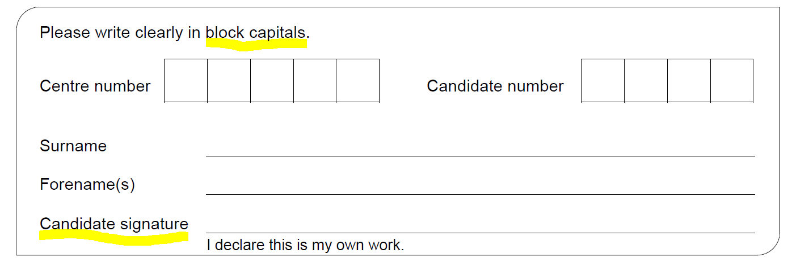
Write your name clearly on all exam papers, and sign if required. You must write your full legal name as it appears on your birth certificate (or as you are registered with school)

Slide 10
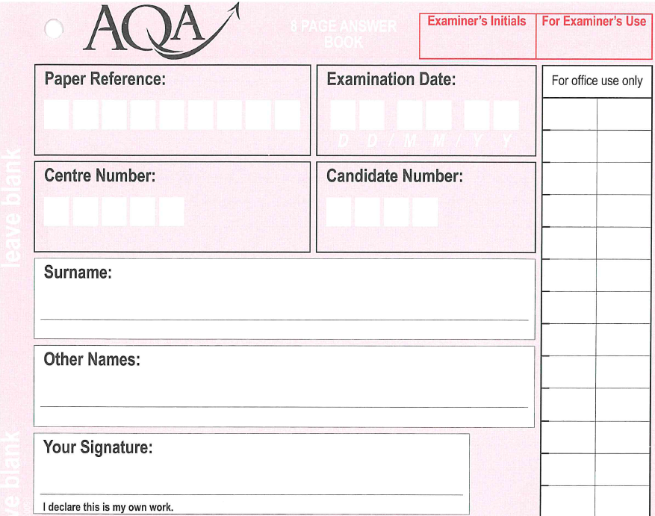
In some exams (English Literature) you will be given a booklet of lined paper to work in.

Slide 11
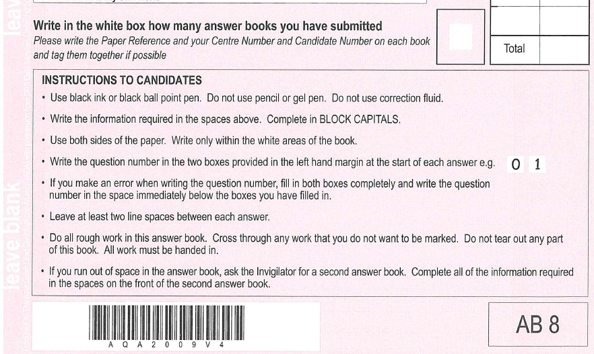

Slide 12

THE FOLLOWING ITEMS ARE NOT ALLOWED AND ANY CANDIDATE IN POSSESSION OF ANY OF THESE ITEMS WILL BE REPORTED FOR MALPRACTICE
No watches of any type
No mobile phones
No earpods, earbuds etc.
Also.. No bits of paper, sweet wrappers….

Slide 13

Yes these really are the official rules!
You are not allowed to have anything hanging on your chair
You can only use a clear plastic water bottle (label removed no writing)
You cannot have your calculator cover
You cannot have any writing on your hand/skin (you can’t draw on your hand/skin during the exam)
Pencil case must be clear
You must not write on the desks – we may charge you for a new one
You cannot “doodle” on your exam papers – an examiner can refuse to mark your paper
You cannot chew gum
Any additional paper that you write on will be sent to the Examiner
Year 11 – if you are wearing your leavers hoody, you must keep the hood down.

Slide 14

More rules:
Use black ink - papers are scanned and other colours are not clear. Erasable pens disappear under the heat of the scanners.
No erasable pens/gel pens/correcting fluid are allowed
Highlighters can be used to highlight parts of a question/phrase only! You cannot highlight/underline any part of your answer
Only write in the space provided – do not write in the margins.
The exam is treated as in progress from the time you enter the room until the moment you leave it.
You can’t have a new paper if you make a mess of the first one!

Slide 15
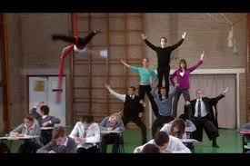
Invigilators
Can only read the instructions on the front of the question paper to a candidate. They cannot read any part of a question to a candidate. They cannot explain what something means either.
They cannot comment if a candidate believes there is an error on the question paper. If this occurs they will inform the Exams Officer immediately… but you just need to keep going!

Slide 16
Invigilators
They cannot give you any advice or comment on a candidate’s work
If they believe there is any sign of communication/cheating they will warn the candidates involved and this will be recorded and sent to the Exam Boards.

Slide 17
Invigilators
They will have their mobile phones as they will use these to contact school if any issues arise. They will all be told that these must be on silent and only to be used in an emergency.
They will move around the room – it is part of the requirements of their role
They cannot leave the hall until they are replaced by someone else – a specific number of invigilators has to be maintained during an exam.

Slide 18
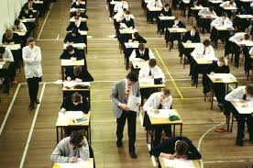
General Advice
GO TO THE TOILET BEFORE EACH EXAM. You are only allowed to leave the room for emergencies or if you have a medical condition.
Read the exam paper thoroughly – right to the back page
If you need any assistance, please raise your hand
If you require more paper for an answer, please raise your hand. Do not squash in your answers, the scanned copy may not pick it up.
Use all the available time
If you have finished early, please have consideration for others and ensure you are not causing any disturbance. You are not allowed to leave early.

Slide 19
What to do if you are unwell on the day of an exam
If you feel unwell on the day of an exam please let school know as soon as possible so we can make necessary arrangements for you.
We strongly recommend you come in to take your exam still as in the majority of cases it is far better to take the exam.
Being upset or nervous is normal but you must attempt the exam. Exam boards are not generous if you don’t.
PLEASE BE AWARE THAT CONTRARY TO POPULAR BELIEF
EXAM BOARDS DO NOT JUST GIVE YOU A GRADE IF YOU ARE ABSENT

Slide 20
If I’m late, can I still sit the exam?
If your bus is late or doesn’t pick you up please make sure you let school reception know. They will inform us and we can make arrangements for you.
Once you arrive at school please go straight to the school reception and wait there. A member of exam staff will come to collect you and escort you to the exam room.
YOU CANNOT ENTER AN EXAM ROOM WITHOUT BEING WITH A MEMBER OF STAFF
Please remember that depending on how late you are the exam board may not accept your paper.

Slide 21
Personal Difficulties
There is a possibility of some consideration being granted by Exam Boards. For example a recent bereavement within your family, severe illness of immediate family member or illness of candidate at the time of the exams.
By not attending your exam you are limiting your chances of success. Exam Boards are not known to be generous.
If you believe you may be entitled to this consideration please speak to me (or your pastoral manager) as soon as possible.
There is a deadline for applications – telling school on results day is too late!

Slide 22
Myths
It is not true that if you are unwell on the day of your exam you will receive your estimated grade (these don’t exist anymore)!
It is not true that you can leave an exam after 20 minutes or an hour. You are expected to stay for the duration of the exam unless alternative provision has been made for you.
If a fire alarm disturbs your exam this does not mean you will be awarded your estimated/predicted grade. Where possible the exam board will expect candidates to continue with your exam. They expect schools to move candidates to another part of the school that is not affected by the fire. An application for special consideration will be made for all candidates affected.

Slide 23
Fire Alarm
You must follow the instructions given by the invigilators
You will be asked to close your paper then you will be asked to leave the room
You must stay in exam conditions (SILENCE) as you leave the room. You will line up in the Tennis courts and must not talk to anyone else.
You will be expected to continue your paper when you are allowed back in school.
Any communication between candidates will be treated as malpractice by the exam boards.

Slide 24
Lockdown Procedure
You must follow the instructions given by the invigilators
You will be asked to close your paper then you may be asked to move away from any doors.
You must stay in exam conditions (SILENCE).
Any communication between candidates will be treated as malpractice by the exam boards.

Slide 25
Malpractice – The Don’ts!
Examples of malpractice are:
Possession of watch/mobile/earpods etc – even if switched off. They are not allowed in the room.
Writing/drawing inappropriate or offensive material
Talking/disruption/ communication
Trying to catch someone’s attention
Possession of notes (even for another subject)
Writing on hand/skin
Leaving the exam room during the exam unless accompanied by a member of staff

Slide 26
Malpractice
Consequences of malpractice range from
Loss of marks for that paper
Loss of marks for full subject
Loss of marks across all subjects with that exam board
All exams cancelled across all exam boards
Banned from exams for 1 to 5 years.
In 2025 there were 5,025 cases of malpractice.
3,080 students had their papers zeroed or lost marks due to malpractice. This was the most common penalty.
42% were due to mobile phones.
15% were due to unauthorised items.
6% were for disruptive behaviour.

Slide 27
Enquiries about Results
It is possible that on receiving your results, an appeal can be made.
If you received marks that were very close to the next grade it is possible that you may be able request a review of marking. Before making this application it will be necessary for you to sign a form giving your consent. This will have a cost to you.
Please always be aware that a review of marking can result in your mark being reduced.
It is possible for you to request a copy of your exam paper, so that you can see where you have lost marks.
On results days there will be information available and your teachers will be able to advise you about the suitability of a review of marking. A full remark of your paper is no longer possible.

Slide 28
Results Day
Your results will be available on THURSDAY 20th AUGUST 2026.
Year 11 - You will receive your results in a sealed envelope addressed to you.
If you are unable to collect your results in person, it can be arranged to either send them via first class post or you can nominate someone to collect them on your behalf. To do this I will need a signed letter of confirmation from you stating who will be collecting them for you before the summer holidays.
Year 10 – You will receive an email on Thursday 20th August by 2pm

Slide 29
Exam Clashes
Occasionally two exams that you are entered for may be timetabled at the same time. The rules are that if the exams total 3 hours or less you must remain in the exam room under exam conditions and there is no more than a 20 minute break between the papers
If it is more than 3 hours, one paper will be moved earlier. You will be able to revise between the two papers in this case.
In these circumstances it will be necessary for you to remain with an invigilator (no contact with other students) until you have completed both exams. You will not be allowed access during this time to your mobile phone.
I will speak to candidates involved personally to make arrangements for these clashes.

