Slide 1

Wellbeing and supporting students with exams

Slide 2

Exam stress
It is normal to feel a bit worried about exams, especially if your child feels under pressure from school or family.
Exam stress can cause young people to feel anxious or low in mood, and this might impact their sleep or appetite.
If you recognise any of these feelings in your child, or are worried that exam pressure is taking over their life, we have some tips to help!
Notes:
If you have further concerns other than expected worry - then please do not hesitate to contact us as we will do what we can to support within school but also direct for further support if required. (Wimt/school counsellor)

Slide 3
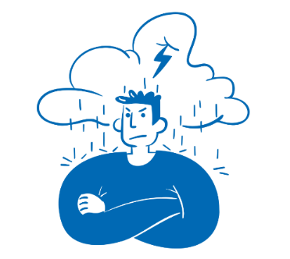
Signs that your child may be struggling with exam stress:
Every young person is different, but typical signs that your child is struggling with exam stress may include:
Worrying a lot
Feeling tense
Having headaches and stomach pains
Struggling to sleep
Being irritable
Losing interest in food or eating more than normal
Not enjoying activities they previously enjoyed
Being negative and having a low mood
Feeling hopeless about the future
Always thinking about exams or worrying about them
Notes:
Their worry maybe displayed in avoidance - as they get lost and don’t know where to start or prioritise.

Slide 4
Top tips for before exams:
Get organised – help your child to make a plan of when and where the exams will be to avoid any last-minute panic or confusion. Timetables/Routines are really beneficial both to assist study but to also manage stress/worry.
Encourage your child to take frequent breaks when revising; using the pomodoro technique can be helpful for them to keep track of revision and break times.
Break revision down into smaller chunks to make it less overwhelming. Keeping a list of revision that has been covered can help your child to see how much they have achieved.
Notes:
The Pomodoro Technique is a time management method based on 25-minute stretches of focused work broken by five-minute breaks. Longer breaks, typically 15 to 30 minutes, are taken after four consecutive work intervals. Routines/revision timetables that include everything - rest/social times/revisions/lessons - are really beneficial to support students ensure that they manage their time and stress - it also reassures them that they are completing equal sections of revision. Supporting students to identify their strengths and their areas to improve can also assist them to target their revision effectively.

Slide 5
Top tips for before exams:
Encourage effective studying – practice mock exams, past papers and learn memory enhancing techniques like chunking or mnemonics. (identify the techniques that work for them)
Help your child get 8-10 hours of sleep each night to help improve thinking and concentration. Encourage your child to have a wind down hour between studying, watching tv, or going on their phone and going to bed to help them sleep better.
Help your child to find ways to relax – make sure your child still makes time for hobbies, going out with friends and self-care.
Notes:
The Pomodoro Technique is a time management method based on 25-minute stretches of focused work broken by five-minute breaks. Longer breaks, typically 15 to 30 minutes, are taken after four consecutive work intervals.

Slide 6
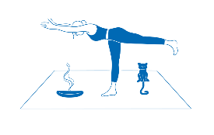
Top tips for during exams:
Try to encourage your child to practice positive self-talk e.g., “I have revised, I can do this, and it will all be over soon.”
Prepare items the night before like pens and a water bottle.
Drinking water regularly can help concentration.
Practice breathing, grounding or mindfulness techniques on the morning of the exam, just before the exam starts or if panic starts to set in – see Calm zone | Childline for more examples. Mind and NHS UK websites also have advice for parents in supporting young people.

Slide 7
Top tips for during exams:
Read all questions carefully and remind your child to think about their answers before writing them down. (take a breath - re-read the question)
Encourage exercise during exam season – this can help to boost energy levels, relieve stress and clear the mind.
Do not add to the pressure on your child – try to support your child by being positive, reassuring and by avoiding any criticism.

Slide 8
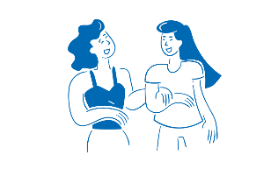
Top tips for after exams:
Remind your child that whatever their results, try to help them to keep things in perspective – exam success does not define them as a person.
Encourage your child to relax before their next exam – getting through an exam can be exhausting so it is important to have a break before trying to revise again.
Once exams are finished, try to remind your child to forget about them. Or if your child wants to talk things through with you, encourage them to focus on the positive parts of the exams instead of the parts they found difficult.

Slide 9
Top tips for after exams:
Remind your child to not compare themselves with their friends as this can make them feel like they aren’t good enough.
Make time for treats and celebrations – plan some rewards for your child doing their revision and for getting through each exam so they have things to look forward to

Slide 10
Preparing for Exams:
You can support your child by
Finding a quiet place for them to work at home - if this poses difficulties as homes are busy places we can support by providing a quiet space in school for an hour each day after school
Monitoring that they are working and not distracting themselves (on phones etc)
Encourage your child to complete past papers in full, they can use revision guides, revision websites and asking for help from teachers if they are stuck
Testing them on facts/ quotes - using their flash cards
Encouraging them to use the revision techniques in the revision booklet shared before the November Progress Exams
Notes:
Ask your child about how they feel that they best revise (what does it look like) - this can help you support them in their preferred techniques - it also gives you the opportunity to be involved in helping them to complete revision.

Slide 11
The Exams

Slide 12
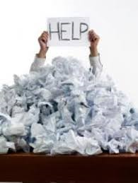
Information students will receive:
Students have been issued with an individual exam timetable with dates/approximate times; this has also been published on MCAS. They will then receive an updated timetable which will have information about exam rooms/seating after Easter.
They need to check this carefully and let Mrs Bauwens know of any concerns immediately. They might want to take a photo of it or (if possible) parents could print it out.
All policies related to exams and other information are on the school website
External exams run from Thursday 7th May (11th) to Wednesday 19th June. However students must be available up to and including Wednesday 24th June for the exam contingency day.

Slide 13


Equipment (the minimum)
Clear pencil case
BLACK Biros (at least 2)
Pencils
Eraser - No Tipp-ex
Pencil sharpener
Protractor/compass
Ruler
Calculator (if allowed)
Highlighters
Coloured pencils
Clear plastic water bottle (no labels) with water only

Slide 14


Our main objective is the advancement of public education by enabling our members to act together in:
providing, wherever possible, common administrative arrangements for examinations thereby reducing bureaucracy for schools and colleges;
responding to proposals from the regulators, Government and other stakeholders;
communicating with a single voice to the media and other interested parties.

Slide 15

Exam Timings
Morning exams start at 9am, students must be at the exam room at 8.50 am
Afternoon exams start at 1pm, 1.15pm or 1.30pm, students must be at their exam room 5 minutes before the start.
If the bus doesn’t turn up/ breaks down – ring school immediately!

Slide 16
What to expect at the start of the exam
Go to the bathroom before the exam - rules changed last year about who can leave the exam room!
Arrive on time and wait outside the exam room – students are not to enter the room until invited in by invigilator/staff.
Do not bring bags, phones etc to the exam room.
The desk will have a card with their name, invigilators will help them to locate their desk if you are not sure
DO NOT WRITE ANYTHING ON THE EXAM PAPER UNTIL INSTRUCTED TO DO SO. It is considered as malpractice if they do.

Slide 17
What to expect at the start of the exam
A member of SLT or invigilator will give instructions to follow, they must listen carefully
Check the exam paper is correct – this is the student’s responsibility
If they sit the wrong paper, they must say something to the invigilators BEFORE they leave the room
Write their name clearly on all exam papers, and sign if required. They must write their full legal name as it appears on their birth certificate/change of name documentation

Slide 18
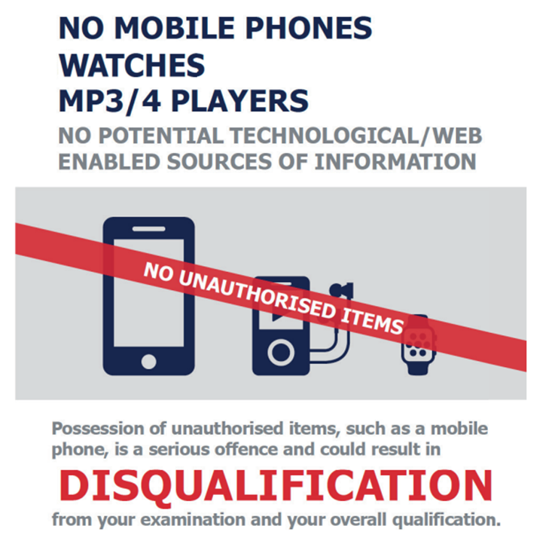
THE FOLLOWING ITEMS ARE NOT ALLOWED AND ANY CANDIDATE IN POSSESSION OF ANY OF THESE ITEMS WILL BE REPORTED FOR MALPRACTICE
No watches of any type
No mobile phones
No MP3/4 players
No earpods

Slide 19

Yes these really are the official rules!
You are not allowed to have anything hanging on your chair
You can only use a clear plastic water bottle (label removed)
You cannot have your calculator cover
You cannot have any writing on your hand/skin (you can’t draw on your hand/skin during the exam)
Pencil case must be clear
You must not write on the desks – we may charge you for a new one
You cannot “doodle” on your exam papers – an examiner can refuse to mark your paper
You cannot chew gum
Any additional paper that you write on will be sent to the Examiner
Year 11 – if you are wearing your leavers hoody, you must keep the hood down.

Slide 20

More rules:
Use black ink - papers are scanned and other colours are not clear. Erasable pens disappear under the heat of the scanners.
No erasable pens/gel pens/correcting fluid are allowed
Highlighters can be used to highlight parts of a question/phrase only! You cannot highlight/underline any part of your answer
The exam is treated as in progress from the time you enter the room until the moment you leave it.
You can’t have a new paper if you make a mess of the first one!

Slide 21
Invigilators
Can only read the instructions on the front of the question paper to a candidate. They cannot read any part of a question to a candidate. They cannot explain what something means.
They cannot comment if a candidate believes there is an error on the question paper. If this occurs they will inform the Exams Officer immediately. They will not communicate with the candidates unless directed by the exam board.
They cannot give any advice or comment on a candidate’s work
If they believe there is ANY sign of communication/cheating they will warn the candidates involved and this will be recorded and sent to the Exam Boards.

Slide 22
Invigilators
They will have their mobile phones as they will use these to contact school if any issues arise. These will be on silent and only to be used in an emergency.
They will move around the room – it is part of the requirements of their role.
They cannot leave the hall until they are replaced by someone else – a specific number of invigilators has to be maintained during an exam.

Slide 23
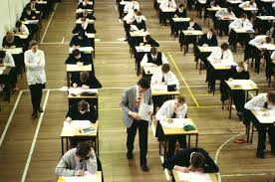
General Advice
Go to the toilet before the exam.
Read the exam paper thoroughly – right to the back page.
If you need any assistance, raise a hand and wait.
If you require more paper for an answer, please raise your hand. Do not squash in your answers, the scanned copy may not pick it up.
Use all the available time.
If you have finished early, please have consideration for others and ensure you are not causing any disturbance.

Slide 24
What to do if a student is unwell on the day of an exam
If they feel unwell on the day of an exam please let school know as soon as possible so we can make necessary arrangements for them.
We strongly recommend they come in to take the exam still as in the majority of cases it is far better to take the exam.
PLEASE BE AWARE THAT CONTRARY TO POPULAR BELIEF
EXAM BOARDS DO NOT JUST GIVE STUDENTS A GRADE IF THEY ARE ABSENT

Slide 25
If they are late to school, can they still sit the exam?
If the bus is late or doesn’t pick them up please make sure they let school reception know as soon as possible. They will inform us and we can make arrangements for them.
Once they arrive at school please go straight to school reception and wait there. A member of exam staff will come to collect them and escort them to the exam room.
THEY CANNOT ENTER AN EXAM ROOM WITHOUT BEING WITH A MEMBER OF STAFF
Please remember that depending on how late they are the exam board may not accept the paper.

Slide 26
Personal Difficulties
There is a possibility of some consideration being granted by Exam Boards. For example a recent bereavement within your family, severe illness of immediate family member or illness of candidate at the time of the exams.
By not attending the exam they are limiting their chances of success. Exam Boards are not known to be generous.
If you believe your child may be entitled to this consideration please speak to Mrs Bauwens (or your pastoral manager).
There is a deadline for applications – telling us on results day is too late!

Slide 27
Myths
It is not true that if you are unwell on the day of your exam you will receive an estimated grade (these don’t exist anymore)!
It is not true that you can leave an exam after 20 minutes or an hour. You are expected to stay for the duration of the exam unless alternative provision has been made for you.
If a fire alarm disturbs an exam this does not mean you will be awarded your estimated/predicted grade. Where possible the exam board will expect candidates to continue with the exam. An application for special consideration will be made for all candidates affected.

Slide 28
Malpractice
Examples of malpractice are:
Possession of watch/mobile/earpods etc – even if switched off in a pocket. They are not allowed in the exam room
Writing/drawing inappropriate or offensive material
Talking/disruption
Trying to catch someone’s attention
Possession of notes (even for another subject)
Writing on hand/skin

Slide 29
Malpractice
Consequences of malpractice range from
Loss of marks for that paper
Loss of marks for full subject
Loss of marks across all subjects with that exam board
All exams cancelled across all exam boards
Banned from exams for 1 to 5 years.

Slide 30
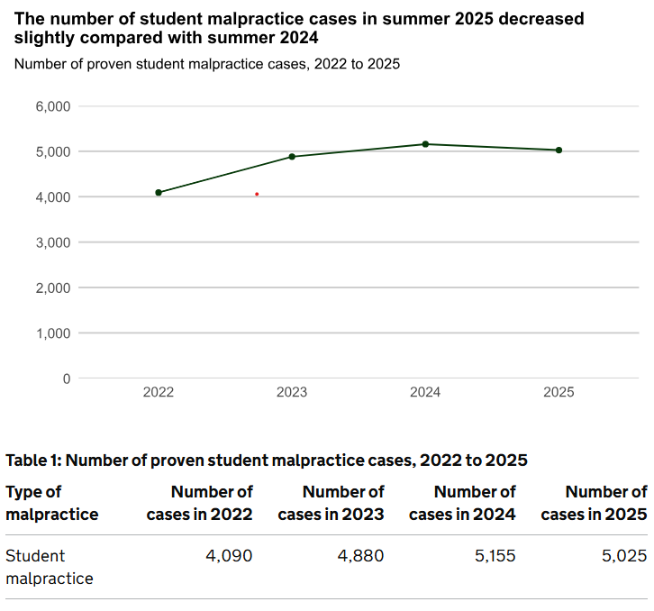
Malpractice
In 2025 there were 5,025 cases of malpractice.
3,080 students had their papers zeroed or lost marks due to malpractice. This was the most common penalty.
42% were due to mobile phones.
15% were due to unauthorised items.
6% were for disruptive behaviour.

Slide 31
Enquiries about Results
If they received marks that were very close to the next grade it is possible that they may be able request a review of marking. Before making this application it will be necessary for them to sign a form giving their consent. This will have a cost to you.
Please always be aware that a review of marking can result in their mark going down as well as up.
It is possible for to request a copy of the exam paper, so that they can see where they have lost marks.
On results days there will be information available and we will be able to advise you about the suitability of a review of marking. A full remark of your paper is no longer possible.

Slide 32
Results Day
Year 11 results will be available on THURSDAY 20th AUGUST 2026.
Year 11 – They will receive their results in a sealed envelope that must be picked up by the candidate.
If they are unable to collect their results in person, they can nominate someone to collect them on their behalf. To do this we will need a signed letter or email of confirmation from the student stating who will be collecting them for them. Results can also be emailed out.
Year 10 – They will receive an email with their results on Thursday 20th August by 2pm

Slide 33

Any questions?

