Slide 1
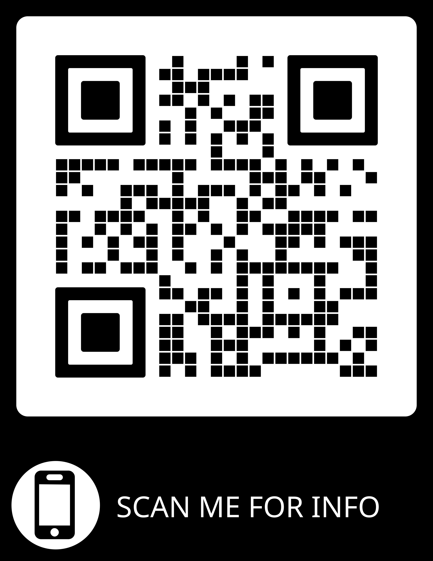
Is your child up to date with their MMR?
If you think your child is outstanding the MMR Vaccine
Please complete a consent form by visiting;
MMR Vaccination Consent Form (buckschildimmunisations.co.uk)
Please use school code :EE136846
Why vaccinate?
As part of their childhood immunisation programme
Protection against Measles, Mumps and Rubella.
2 Combined doses of MMR after 1st Birthday
Measles highly contagious
Mumps is a viral illness can be spread through coughs and sneezes.
Rubella also known as German Measles.
Vaccinate to protect them against these diseases.
For queries, please contact the Immunisation team on 01494 323000
Alternatively, email the Immunisation Team at buc-tr.BucksChildImms@nhs.net
For further information on the vaccinations please visit
MMR (measles, mumps and rubella) vaccine - NHS (www.nhs.uk)
MMR for all: general leaflet - GOV.UK (www.gov.uk)
http://www.buckshealthcare.nhs.uk/School-nursing/immunisations.htm
Vaccine Knowledge Project — Oxford Vaccine Group
Vaccinations - NHS (www.nhs.uk)
The vaccine we use in Bucks does not contain porcine gelatine

