Slide 1
Year 7
Information
Evening
Welcome to Aylesbury High School

Slide 2
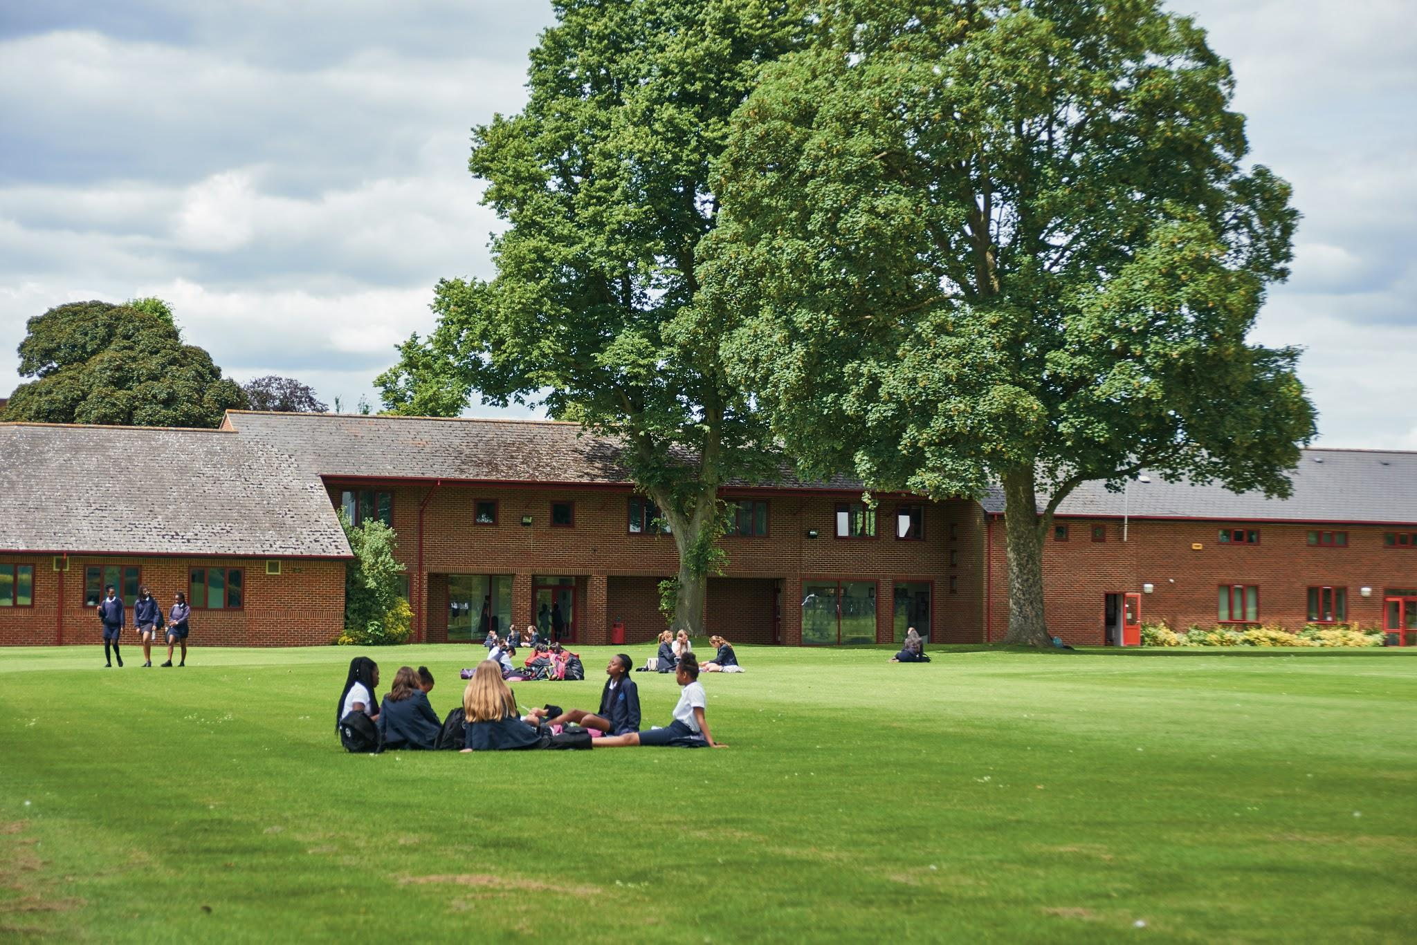
Welcome to AHS!

Slide 3
Fire Evacuation Procedure
The fire signal is a continuous ring of the bell. If this is heard everyone must evacuate the building immediately
Our meeting point is in front of the school by the front entrance
Should we need to evacuate, please do not re-enter the building until a school representative has said it is safe to do so

Slide 4
Welcome
Mrs Forster Headmistress
Mrs Helen Bush Co-Chair of Governors
Dr Kate Weir Co-Chair of Governors
Miss Quesne Head of Year 7
Mrs Queralt Deputy Head
Mrs Crafts SENDCo
Mrs Westcott Wellbeing

Slide 5
Mrs Forster- Headteacher
The what, the how, but most importantly, the why.

Slide 6
Our Vision:
‘Developing independent young women of strength and confidence’

Slide 7
Our Mission
To create a welcoming environment which draws the very best from all in our community. Achieved by providing an ambitious education that stimulates critical thinking, values diversity and facilitates dynamic personal development.

Slide 8
‘Developing independent young women of strength and confidence’
To create a welcoming environment which draws the very best from all in our community. Achieved by providing an ambitious education that stimulates critical thinking, values diversity and facilitates dynamic personal development.

Slide 9
Co-Chairs of the Board of Trustees (Governing Body)
Mrs Helen Bush
Dr Kate Weir

Slide 10
Our core functions as trustees:
Ensure clarity of vision, ethos and strategic direction
Hold the headteacher to account for the educational performance of the school and its pupils
Oversee the financial performance of the school, making sure its money is well spent

Slide 11
Jo Quesne
Head of Year 7
The transition programme at AHS

Slide 12
Transition is a process not an event!

Slide 13
Will I make friends?
How will I manage the journey?
How will I fit in all the homework?
How do I take advantage of all the clubs and activities at AHS?
Will I keep up with all the work?
Notes:
Please have a good look at all the information on our Year 6 webpage as lots of these worries are answered there: https://www.ahs.bucks.sch.uk/year-6-entrance-to-year-7-september-2023/

Slide 14
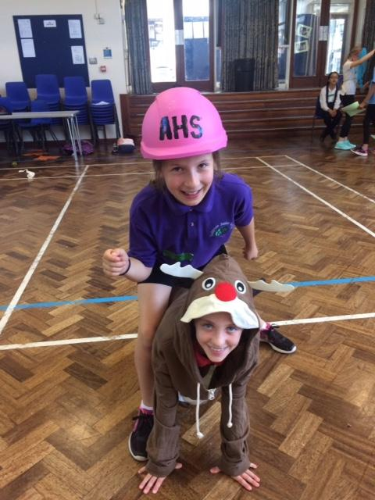
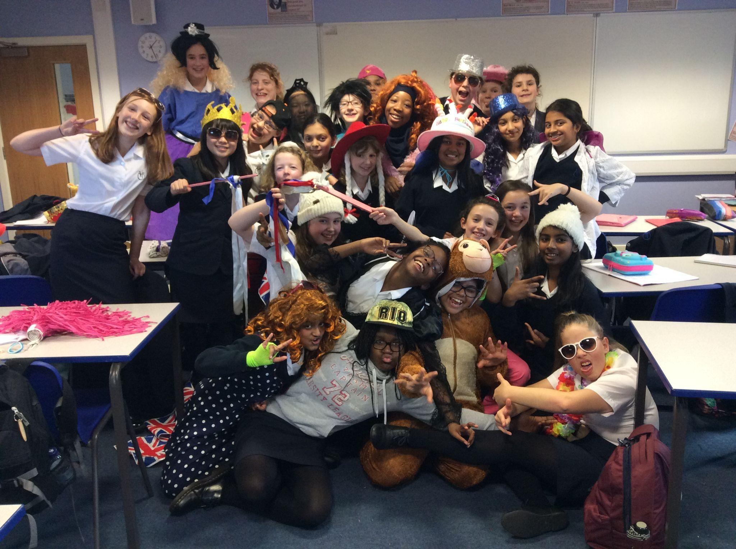
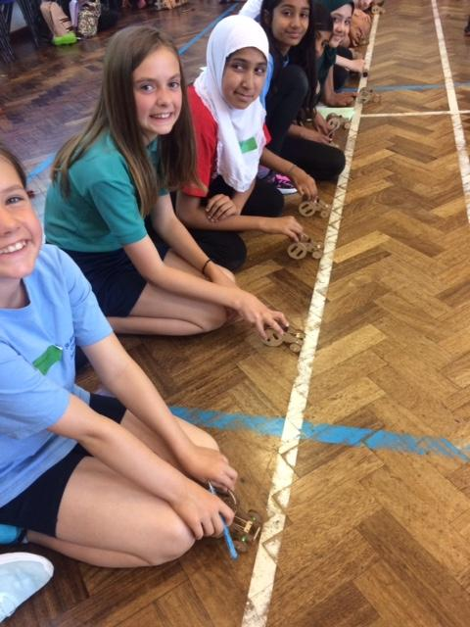
Transition Days July 4 and 5

Slide 15
For the transition days:
Tuesday 4th - please come in your primary school uniform
Wed 5th - please wear leggings/T-shirt in your house colour
Our canteen will be providing lunch on Tuesday 4th, but please bring a packed lunch for Wednesday 5th
Please discuss with your parent/guardian a method of contact that you would be comfortable sharing with other students
Please bring a pen!

Slide 16
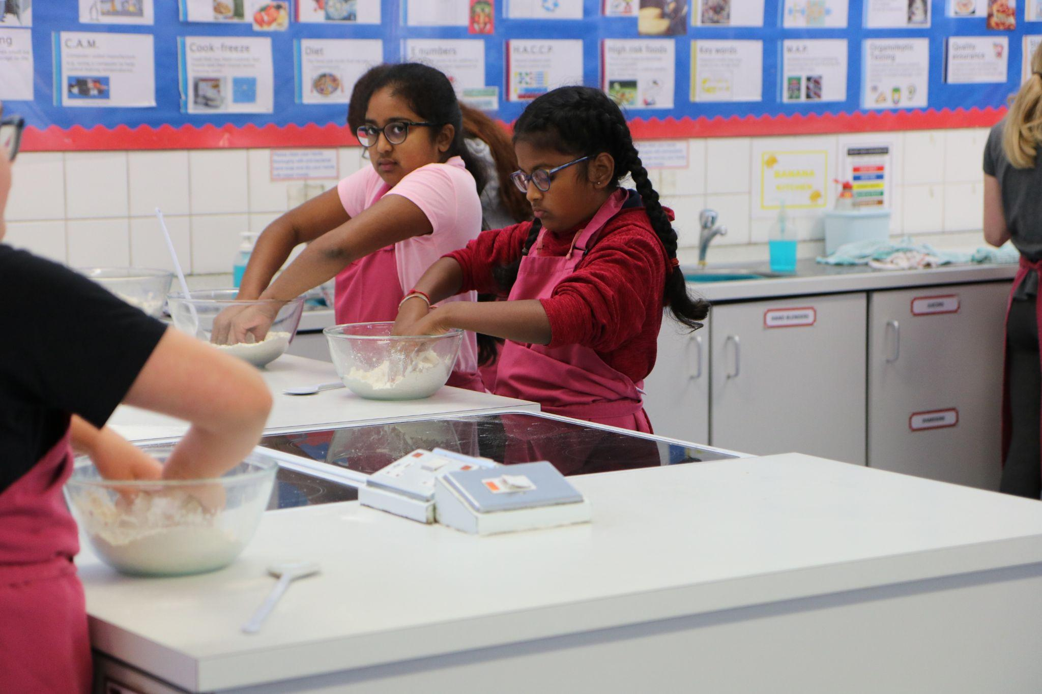
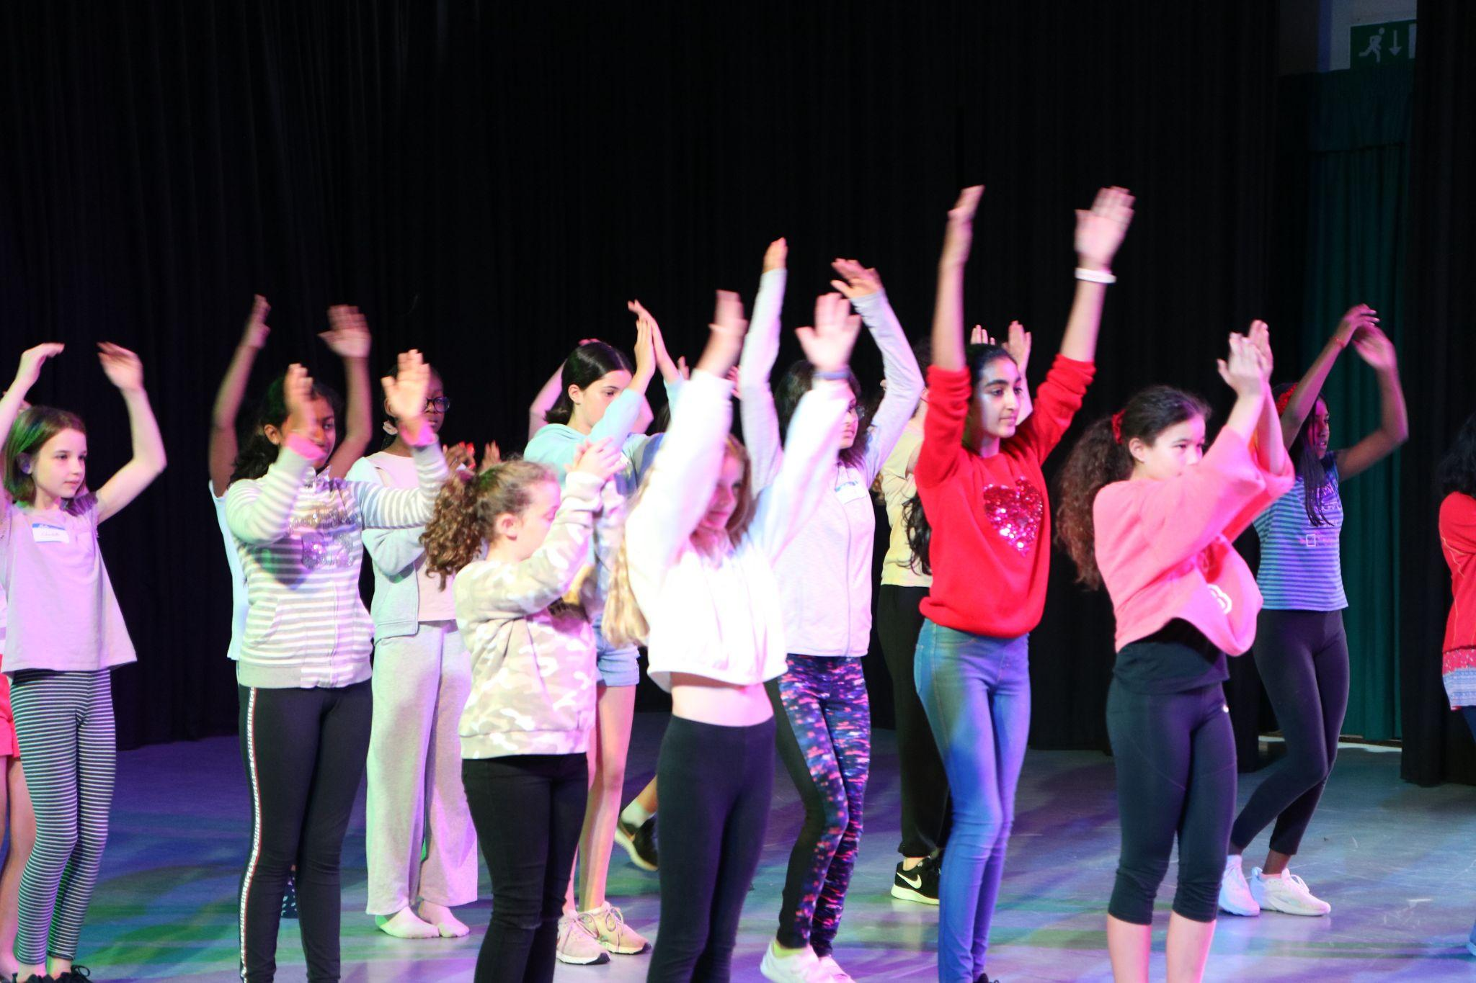
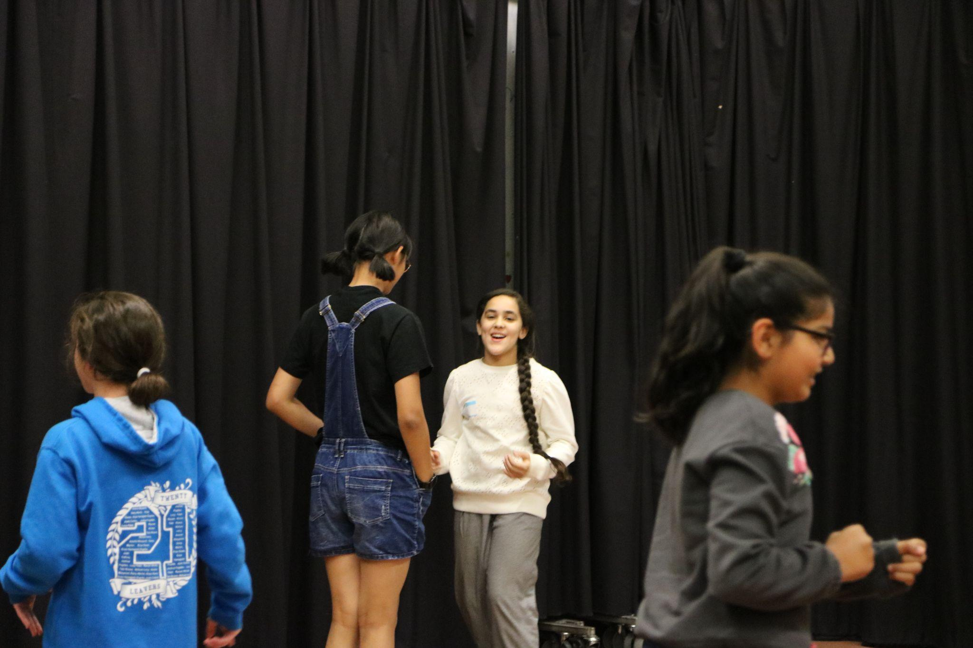
Summer Camp
31 Aug and 1 Sept
9.00 - 2.00 pm

Slide 17
Staggered Start - 6 September
Just Y7 and Y12
Bring pencil case, packed lunch (or money on canteen account) and PE Kit

Slide 18
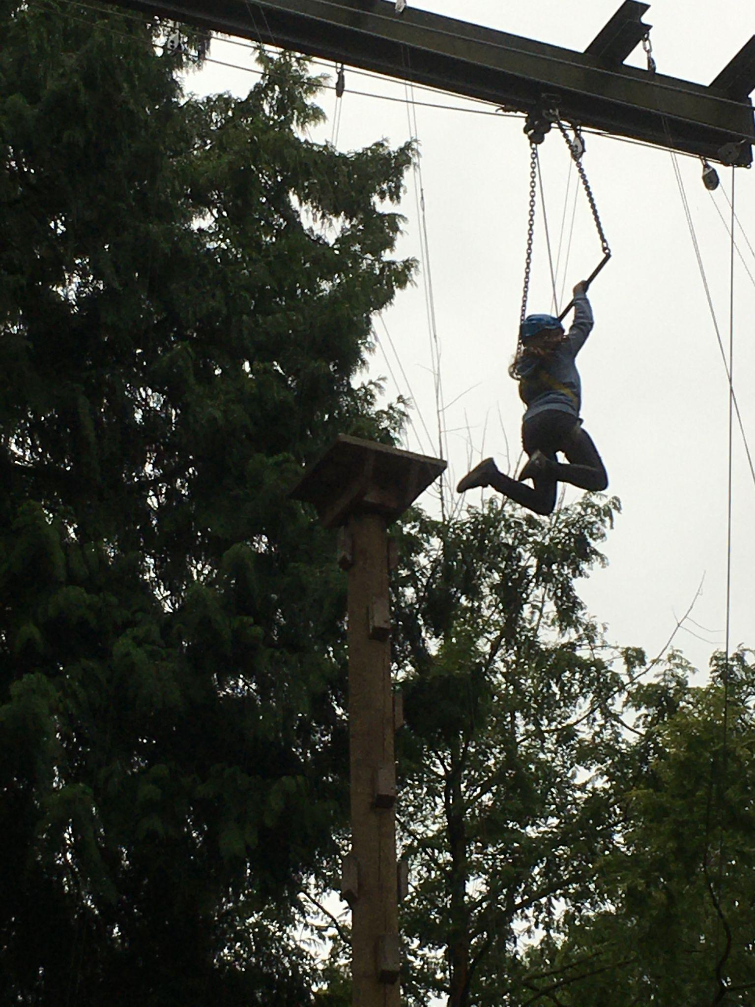
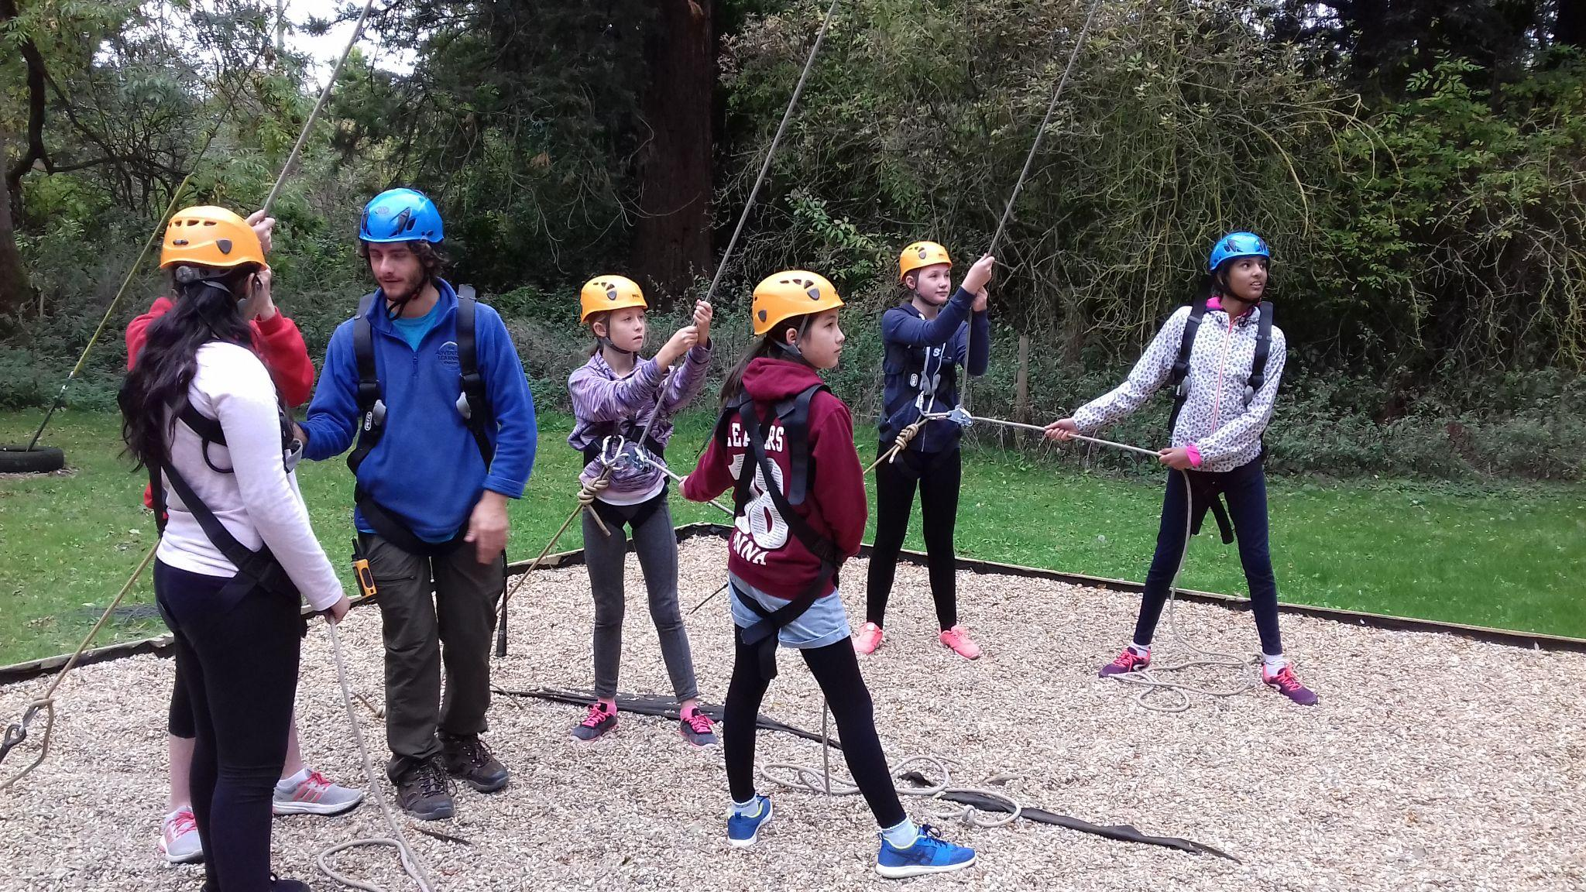
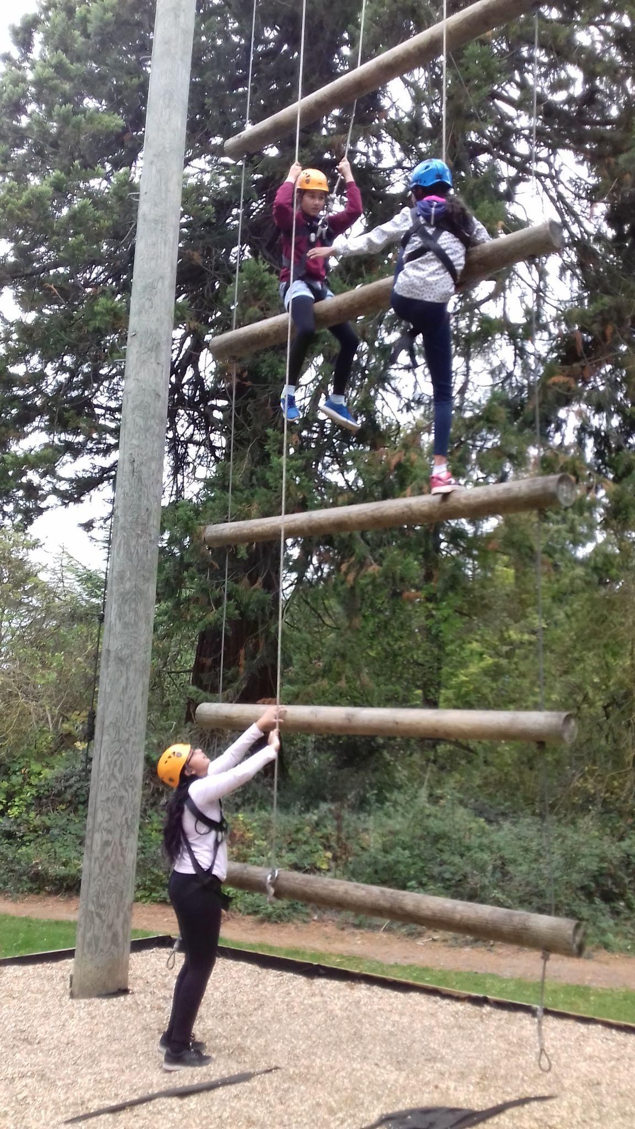
Y7 Activity Day- October 2023

Slide 19
Harriet Queralt
Deputy Headteacher (Pastoral)
Designated Safeguarding Lead (DSL)

Slide 20
Chromebooks
@ AHS

Slide 21
Why 1:1 ?
Teach and learn in ways that aren’t possible with pen and paper
Encourage collaboration and creativity
Makes IT access much easier
Notes:
APR

Slide 22
Why Chromebooks?
Looked at ipads and Windows too
Already using Google-based systems successfully
Affordability
Battery life and boot up time
Notes:
APR

Slide 23
99% have purchased own device
All students now using them daily
Used in a range of ways in lessons
Notes:
HEQ

Slide 24
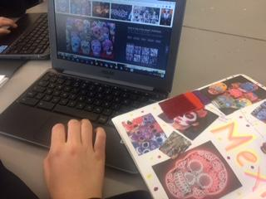
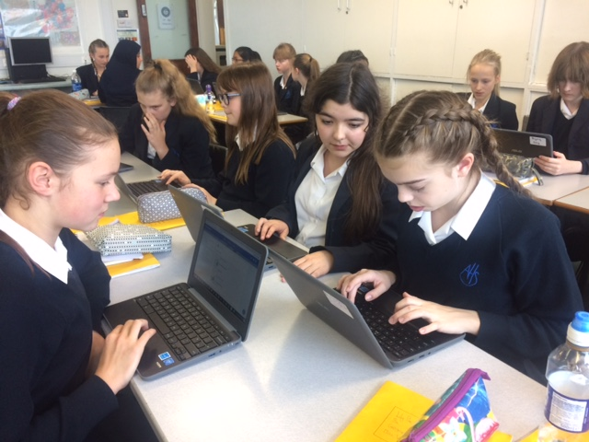
We can use our Chromebooks to research a topic without having to go to a computer room.
They are great for collaboration. Here we are all working on one presentation.
Notes:
HEQ

Slide 25
Groups can collaborate using G Suite
Notes:
HEQ

Slide 26
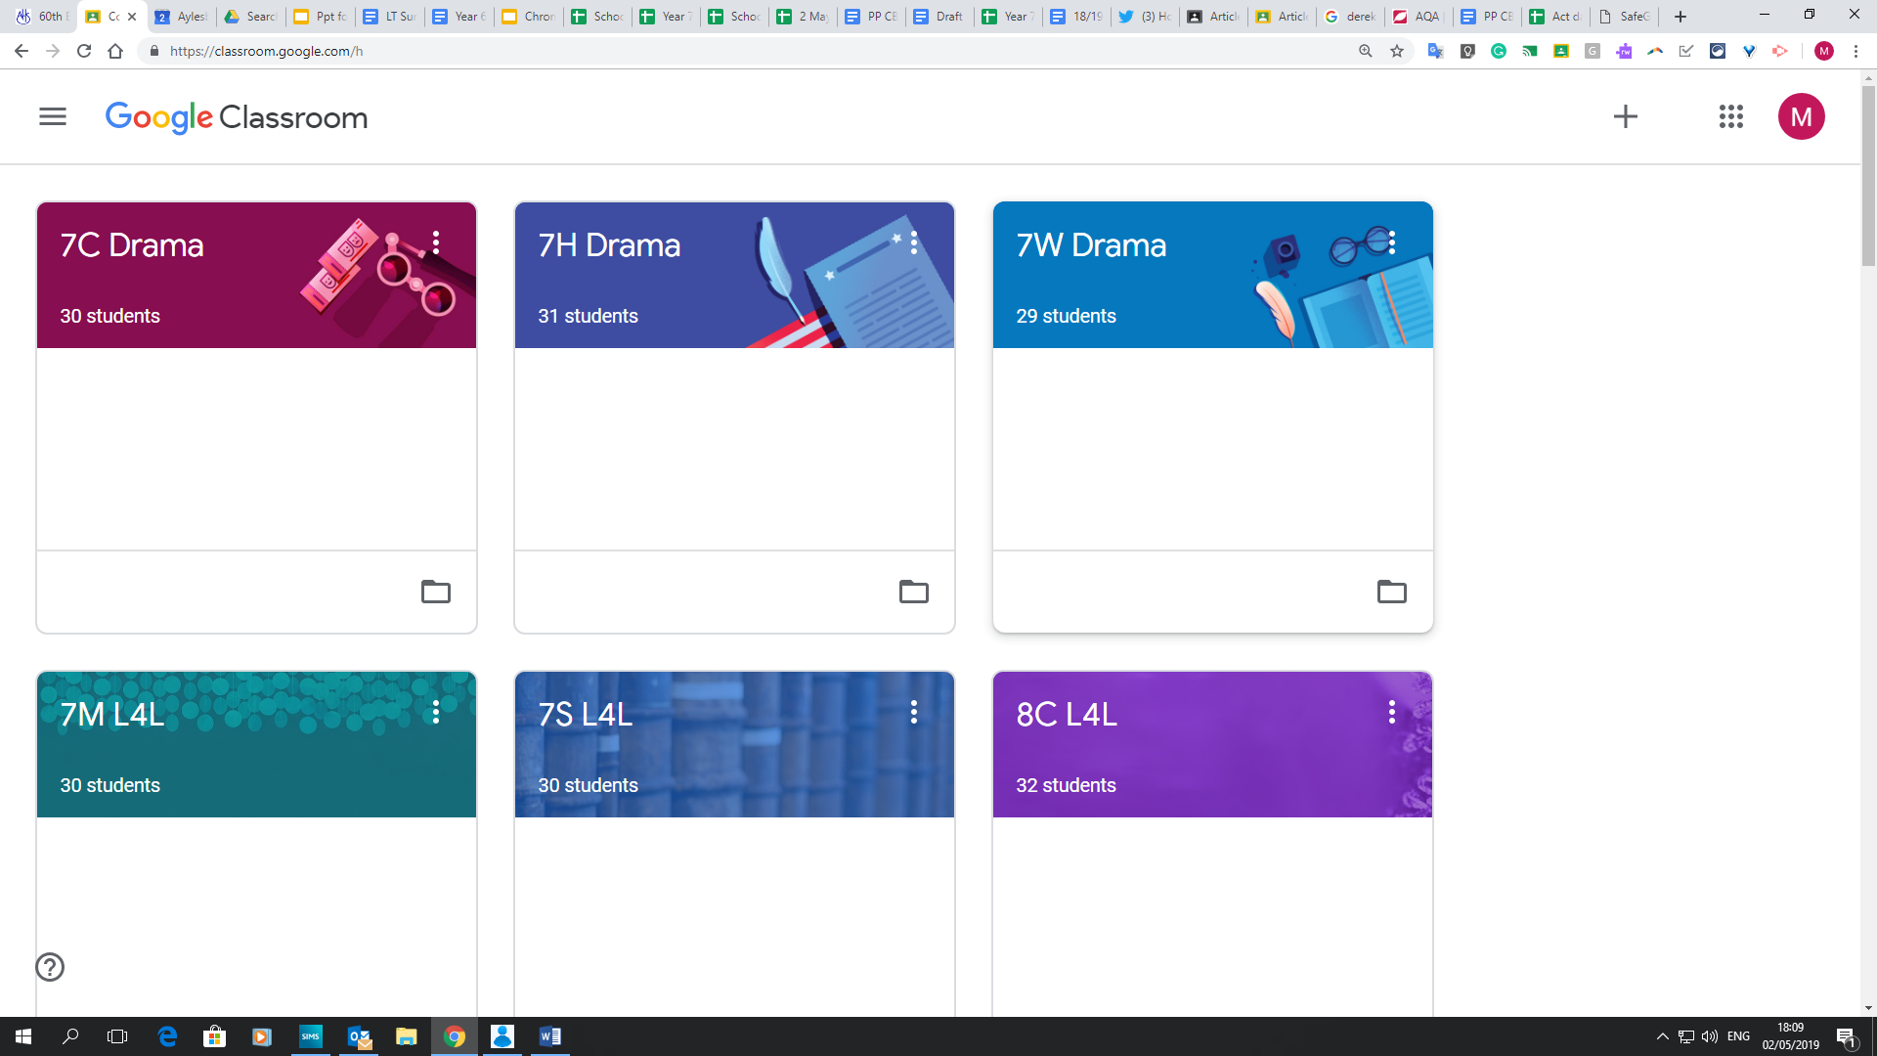
Google Classroom
Notes:
HEQ

Slide 27
Google Classroom
Notes:
HEQ

Slide 28
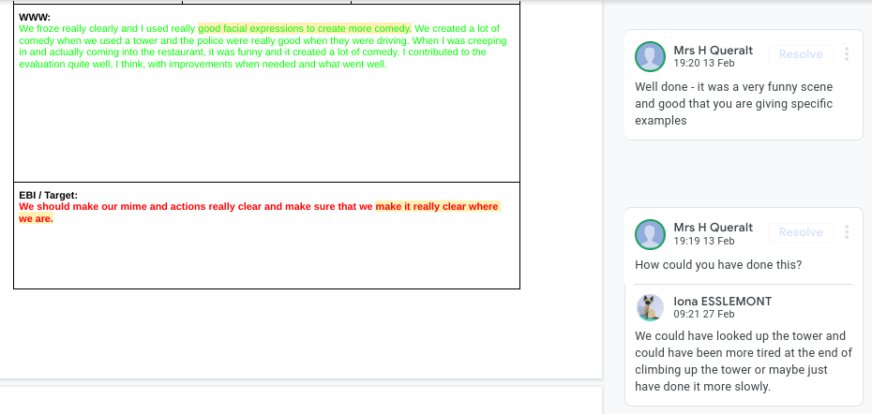
Students and teachers can add comments to work
Notes:
HEQ

Slide 29
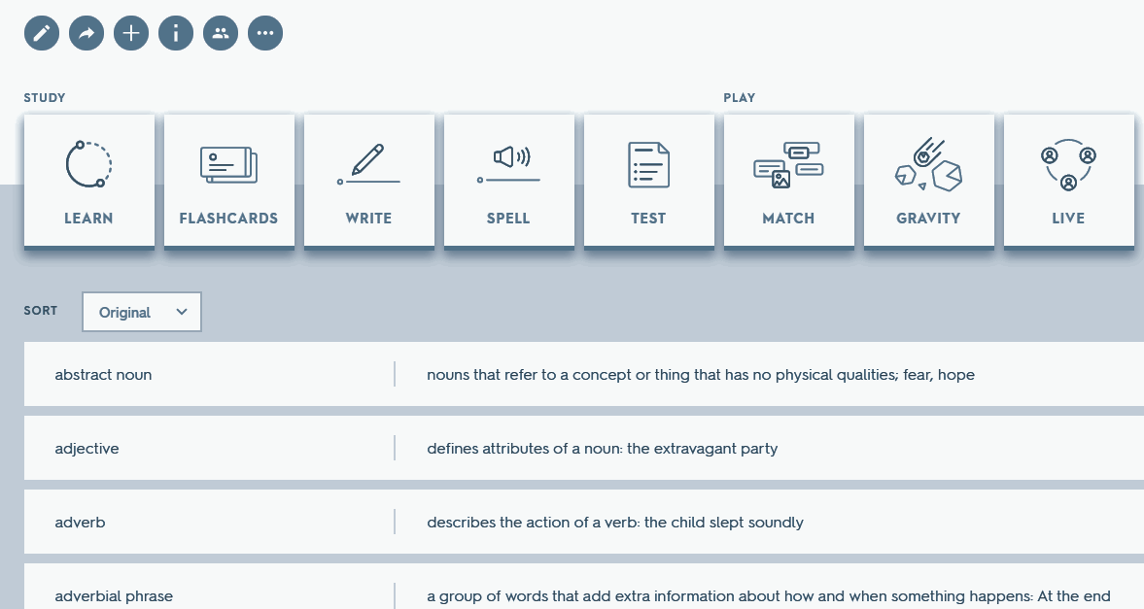
Quizlet provides learning and revision tools
Kaizena gives online feedback
Draw graphs with Geogebra
Useful for research
Notes:
HEQ

Slide 30
Practicalities
Charging
Security
Personalise
Cases
Notes:
CEW

Slide 31
Monitoring use
Students only log on with AHS accounts
Web filtering
Class management software
Notes:
CEW

Slide 32
Which Chromebook to purchase?
Up to you - but:
Must be a UK Chromebook
Must be at least 4GB RAM
You will need to purchase an AHS license (from Parentmail) and your own insurance

Slide 33
Do I have to buy one?
Strongly encouraged
99% of our students do
Long term loan option for FSM and PP students
Daily loan option from library
It must be a Chromebook (not laptop or Macbook)
Notes:
Spec must be at least 4GB RAM (they'd struggle to find less these days), UK model, CBook not laptop or MacBook.

Slide 34
Uniform
In order to try to save parents money on uniform we have an Affordable Uniform Policy here which explains which items are necessary and which are optional.
You can buy some items from local suppliers rather than the AHS branded items as long as the items are the correct style.
Our online Uniform supplier is SWI Schoolwear – please see their guide to Online Ordering. Once you have set up an account, you will be taken to the AHS uniform page.

Slide 35
Uniform
Please do look closely at our guide to what is and what isn’t acceptable
We want to save you money and keep students out of uniform detentions!

Slide 36
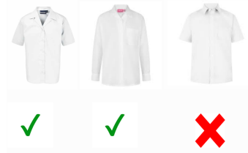

Slide 37
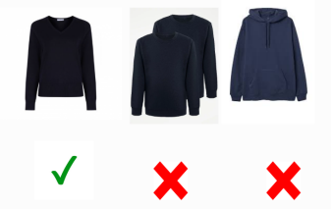

Slide 38
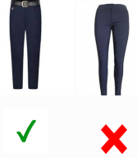
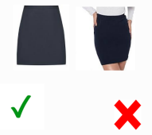

Slide 39
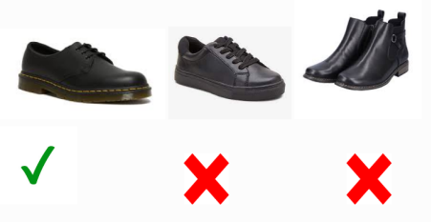

Slide 40
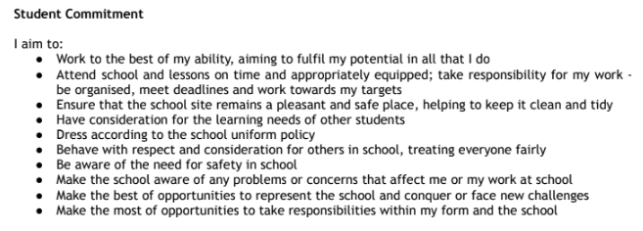
Home School Expectations - student

Slide 41
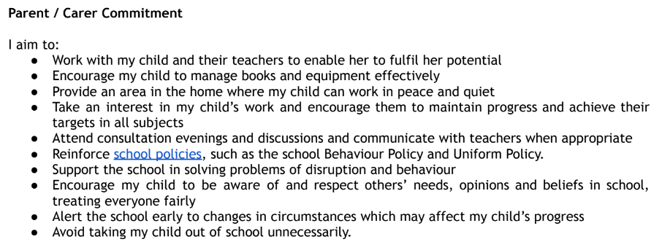
Home School Expectations - parent/carer

Slide 42
Resilience Evening 10 July 6-8.30 pm

Slide 44
Mrs Crafts - SENDCo
- SEND team
Donna Fox-Learning practitioner and dyslexia specialist
Galia Khalid- teaching assistant- manages our SEND classroom
Yudy Ali/Katrina Blakeman- PP lead and KS3 teaching assistant
- We encourage students and parents to communicate with us to avoid difficulties getting bigger than they need to be.
-It is a strength to ask for help.

Slide 45
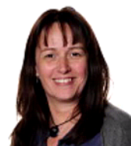
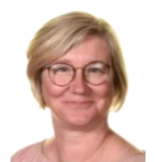
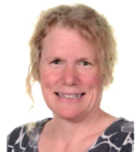
Health and Wellbeing
Mrs Westcott Mrs Kiteley Mrs Nix
Wellbeing & Safeguarding Wellbeing Assistant Matron
Manager
Notes:
Support, advise and signpost.

Slide 46
Key Dates
Transition Days: 4 and 5 July
Summer Camp: 31 Aug and 1 Sept
First day of term: 6 Sept (Just Yr 7 and 12)
Year 7 New Parent Evening:
Meet the AHSA, Tutors and other parents Wed 13 Sept

Slide 47
Our Vision:
‘Developing independent young women of strength and confidence’

Slide 48
Our results and student destinations
All groups of students learn deeply including those who have SEND and those who are disadvantaged.
The destination of Year 13:
2022 - 168 students went into higher education
The School supported the remaining 29 students with Year 14 UCAS applications and/or autumn series exams.
We secured 12 Oxbridge places in 2021 and have 10 students with offers in 2022/23

Slide 49
Trip Participation
90% of students went on a trip between Sep 21 and Oct 22 - this includes data for students who were in exam year groups last year
Strong numbers of PP and SEND students participating
We expect these numbers to increase this year as we move to our full trip offering

Slide 50
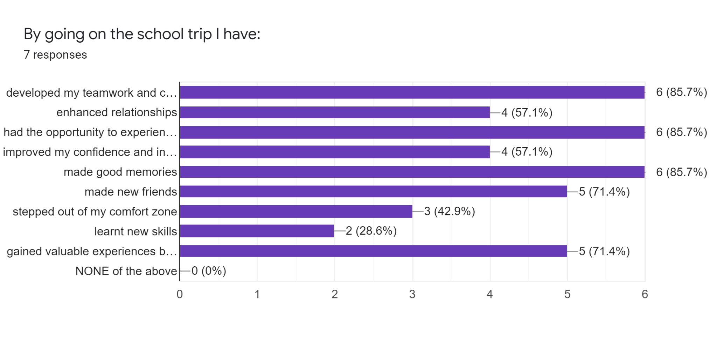

Slide 51
DofE
AHS had the highest number of completed awards not just in Bucks and also in the whole of the South East region with 276 awards achieved in the last academic year.
As 284 of our students started the Award that academic year this also gives us the best completion rates in the region as well.

Slide 52
Our Vision:
‘Developing independent young women of strength and confidence’

Slide 53
