Slide 1
3rIVERS Curriculum and
assessment Development
Group
‘The Changing Landscape’
Notes:
Begin with intros and schools. Job description –curriculum one of our areas. SR curriculum lead for science JE ICT. Daunting prospect upon returning from maternity leave even as a SLT. Aware of the demands for TLR post holders. Action research based from Dfe and key etc to keep updated work with RT @ kevi.
Presentation running order
Chris to present slides 1-3
Sumeena to present slides 4-7
Julie to present slides 8-19
Sumeena to present slides 20-35
Rebecca to present slides 36-37
Chris to present slide 38

Slide 2
3Rivers Curriculum Vision
‘To inspire all students across the 3rivers learning trust to become successful learners, through learning a coherent, stimulating and personalised curriculum which celebrates success and encourages all students to maximise their potential’
Notes:
Begin with intros and schools. Job description –curriculum one of our areas. SR curriculum lead for science JE ICT. Daunting prospect upon returning from maternity leave even as a SLT. Aware of the demands for TLR post holders. Action research based from Dfe and key etc to keep updated work with RT @ kevi.

Slide 3
Key stage 1- 5 Curriculum and Assessment Timeline
September 2014
Introduction of the new national curriculum (Years 1,3,4,5, 7).
Final year of the ‘old’ NC for Year 2 and 6 and final old style KS2 tests in May 2015
September 2015
Introduction of the new national curriculum (Year 2, 6, 8)
First teaching of new GCSE English Language, English Literature & Maths.
First teaching of 14 new AS/A level specifications
Reception baseline testing available
September 2016
First teaching of new AS/A level and GCSE specifications
First reporting of the new GCSE accountability measures ‘progress 8’
New KS1 tests administered reported as scaled scores
New KS2 accountability measures introduced reported as scaled scores
Notes:
Never meant to be a label – Levels were never meant to be a label, they were meant to support progress.
Undue pace – There has become an unnecessary focus on getting through levels quickly, rather than embedding deep understanding of key concepts.
Levels mean different things – In some instances they are marks on a test, or APP work best matched a descriptor or ‘just in….’
Successful nations don’t use them – Nations with successful educational systems believe that children are capable of anything because of the effort they put in…not because they are level 4, 5 etc. This very much supports growth mindset theory.
Levels were designed to be used at the end of a key stage
Students cannot articulate progress – subjects vary depending on time allocation
1988 - levels

Slide 4
Our Philosophy
Changes to our assessment format and framework are not about reinventing the wheel…
…they are about making the wheel turn more smoothly and effectively.

Slide 5
Why Assessment Without Levels?
Original purpose
Never meant to be a label
Undue pace
Levels mean different things
Successful nations don’t use them
Articulation of progress
Notes:
Never meant to be a label – Levels were never meant to be a label, they were meant to support progress.
Undue pace – There has become an unnecessary focus on getting through levels quickly, rather than embedding deep understanding of key concepts.
Levels mean different things – In some instances they are marks on a test, or APP work best matched a descriptor or ‘just in….’
Successful nations don’t use them – Nations with successful educational systems believe that children are capable of anything because of the effort they put in…not because they are level 4, 5 etc. This very much supports growth mindset theory.
Levels were designed to be used at the end of a key stage
Students cannot articulate progress – subjects vary depending on time allocation
1988 - levels

Slide 6
The future of assessment
Consistently delivered
Common format and framework
whole-school and subject-specific criteria
Tracking system
Sensitive and constructive

Slide 7
Assessment for Progress
We are establishing a framework for 2014-15 and beyond to ensure that assessment genuinely supports progressive learning in all subjects
PROGRESS

Slide 8
Newminster and Chantry
Strategic curriculum meetings
Assessment & data meetings
Subject leader meetings
Department meetings
Notes:
When – Spring 2013
Assessment & Innovation Fund Action Research

Slide 9
Summer 2014
Curriculum jigsaws for Y5 and 7 published to website
Training day and other time allocations to facilitate planning
Opportunity for HSL/FSL to map Y4-5 and Y8-9
SoW templates agreed and used as a collaborative planning tool
Assessment & curriculum group meetings.
Principled assessment design training – Dylan William.
Autumn 2014
Subject development plans identify key curriculum priorities
Ongoing work on short term and medium term plans
SOW on FROG for first term
Establish curriculum working parties with a ‘License to innovate’ –small scale projects to trial new cross curricular, enrichment, outdoor learning projects
Assessment working parties to trial new assessment systems to consider how progress and attainment will be measured.

Slide 10
Spring 2015
Curriculum Leaders’ monitor and evaluate plans.
Start to consider how pupil progress and attainment will be tracked against the new PoS.
Summer 2015
Curriculum Leaders’ review the provision and quality of learning in their subject and identify next steps according to the annual monitoring and evaluation cycle.
Moderation of assessments to build up a portfolio
Propose and agree reporting methods from September 2015.

Slide 11
Autumn 2015
New curriculum taught to Year 6 and 8
Planning ongoing.
Final assessment criteria, recording, tracking and reporting procedures.
Spring 2015
Curriculum Leaders’ to ensure plans highlight how key skills are developed in areas such as -reading, writing, mathematics, digital literacy, SMSC and citizenship.
The first Y6 national assessment of the new National Curriculum.

Slide 12
360 Assessment
Based on good points about APP
Uses idea of ‘Threshold Concepts’
Embedded in planning and marking
Starts with an assessment framework…

Slide 13
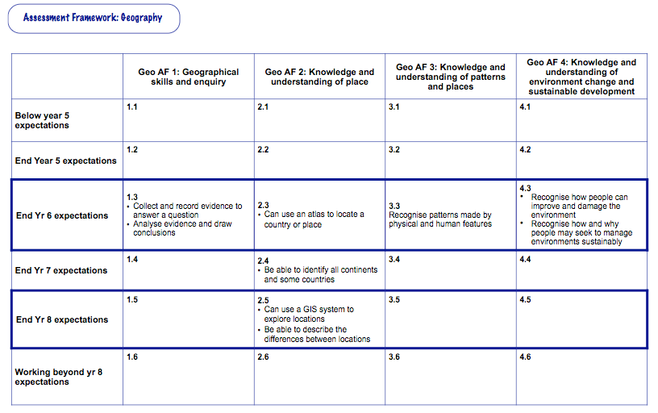

Slide 14
Learning goals
Use results
Learning opportunities
Assess learning

Slide 15
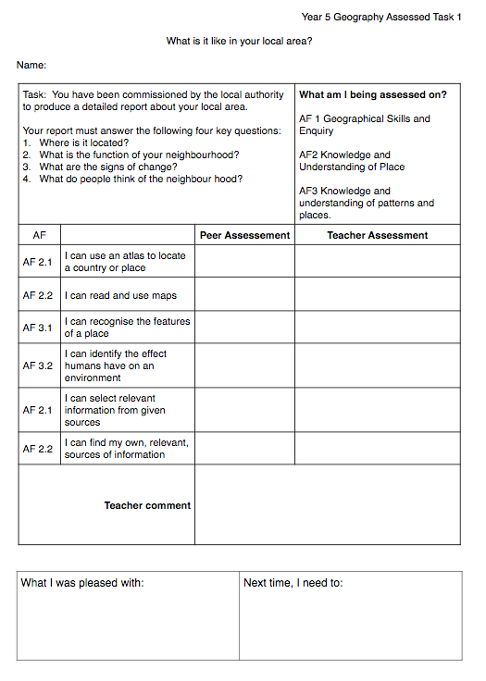
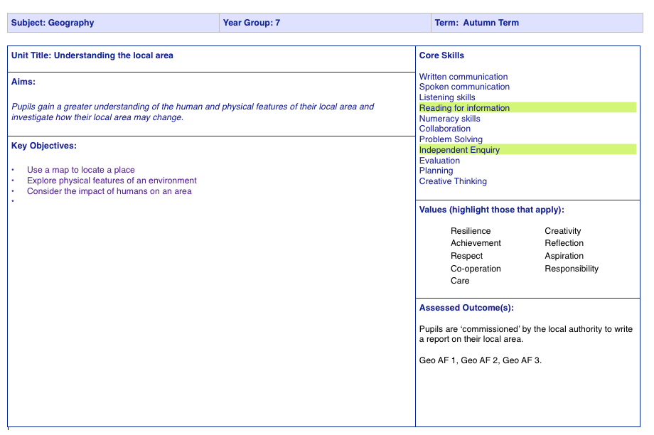
Planning for assessment

Slide 16
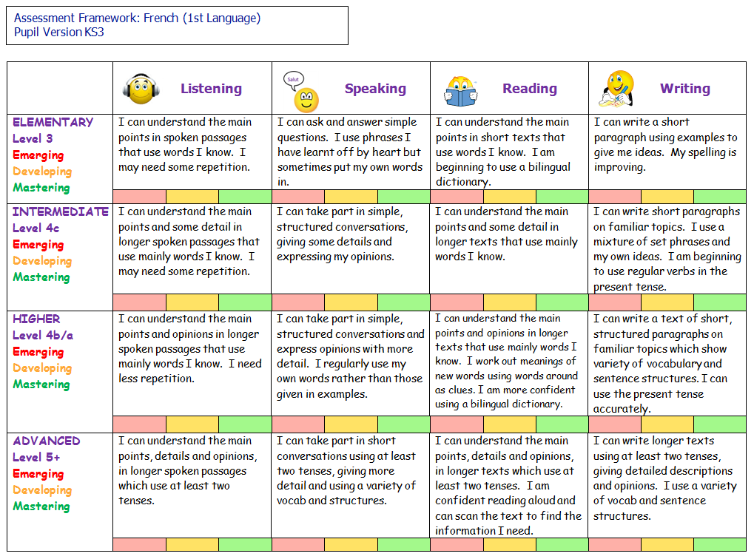
French model

Slide 17
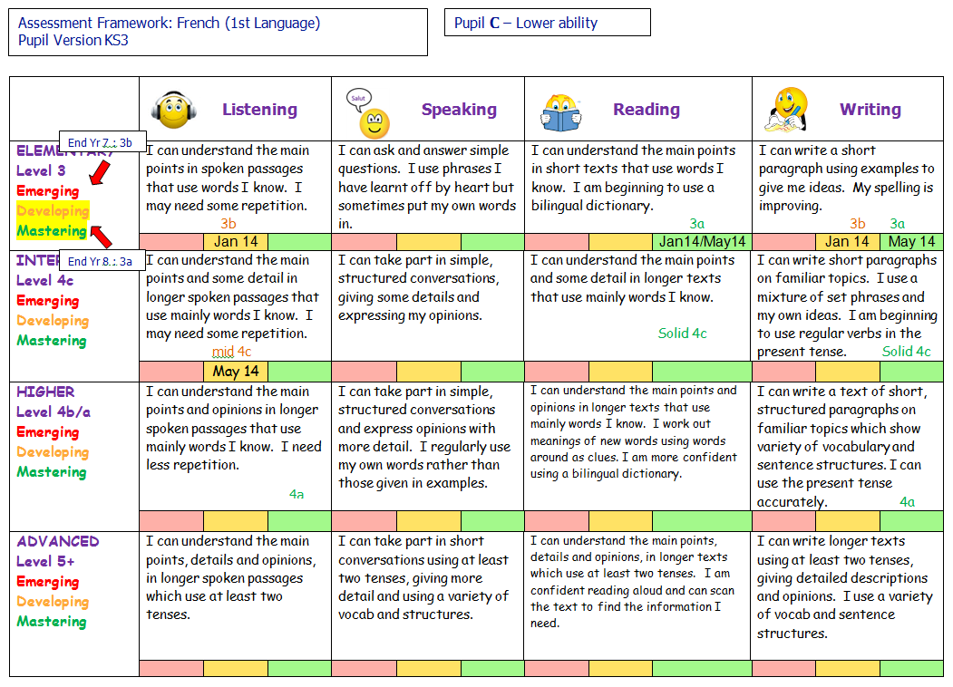

Slide 18
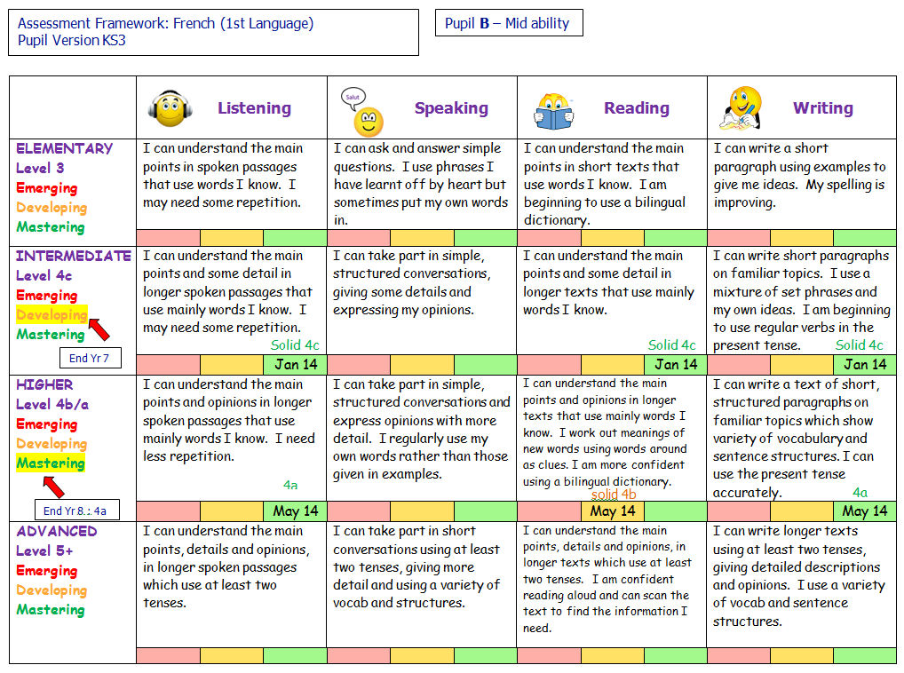

Slide 19
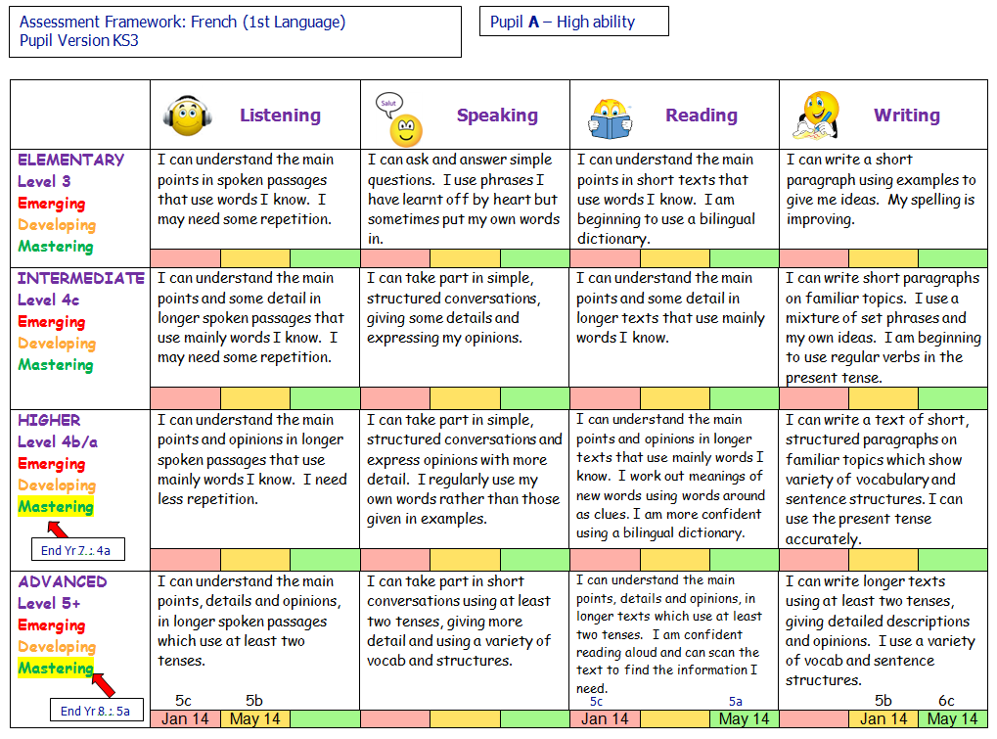

Slide 20
Solo taxonomy
Notes:
Classifying learning outcomes in terms of complexity
The SOLO taxonomy stands for: Structure of Observed Learning Outcomes
First proposed by Biggs and Collis in 1982, however has really taken off recently thanks to Twitter, blogging and the work of various individuals such as Pam Hook in New Zealand.
SOLO taxonomy is a way to build up your learning from shallow learning to deep learning. It is a good way to self assess learning and progress so that your work is personalised according to your ability and prior knowledge. The use of this linear structure allows teachers to focus a class and add layers to learning. James Atherton describes SOLO taxonomy as: ‘levels of increasing complexity in a student’s understanding of a subject, through five stages, and it is claimed to be applicable to any subject area. Not all students get through all five stages, of course, and indeed not all teaching (and even less “training” is designed to take them all the way)’ (James Atherton 2005).

Slide 26
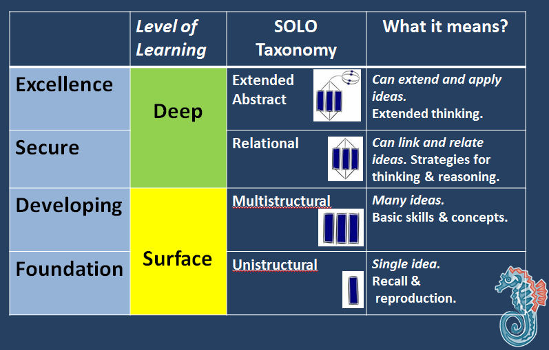
The science model: Solo taxonomy
Notes:
Identifies the core knowledge and skills that students will need to master in each topic area.
Trials carried out with the working scientifically strand.

Slide 27
Visible learning approaches
The Science Model
When teaching and learning are visible – that is, when it is clear what teachers are teaching and what students are learning, student achievement increases.
As featured in ‘Visible Learning for Teachers’ (Hattie, J. 2012) ways to make learning and teaching more explicit were explored by several schools.

Slide 28
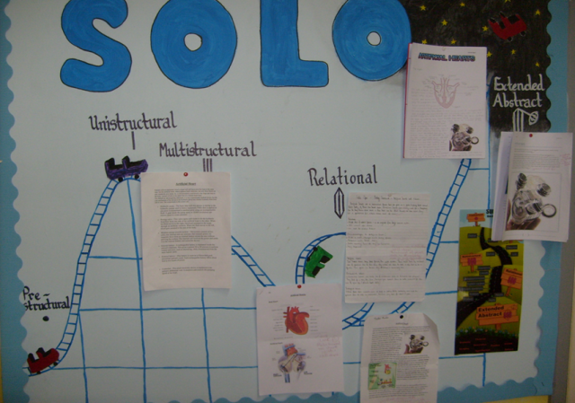
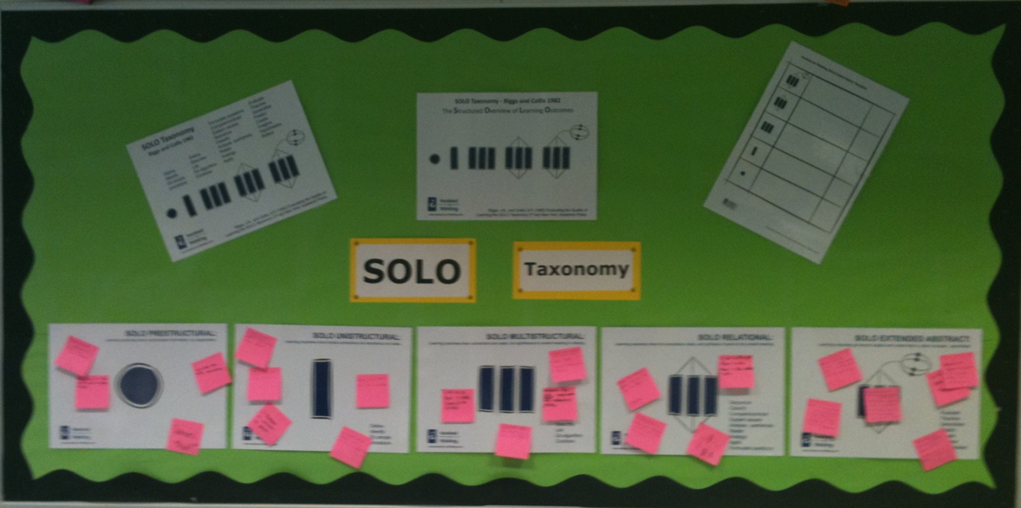
Notes:
Declarative Verbs
Wall display in the classroom helps remind pupils of the key wordsVisible learning approaches
Visible learning approaches
When teaching and learning are visible – that is, when it is clear what teachers are teaching and what students are learning, student achievement increases. As featured in ‘Visible Learning for Teachers’ (Hattie, J. 2012) ways to make learning and teaching more explicit were explored by several schools. These included self and peer assessment initiatives, which sought to offer students increasing agency over their learning. In particular the SOLO Taxonomy as supported by the materials created by Pam Hook (2011, 2012, 2013) and widely used in New Zealand, was applied to a variety of primary, secondary and special school settings.

Slide 29
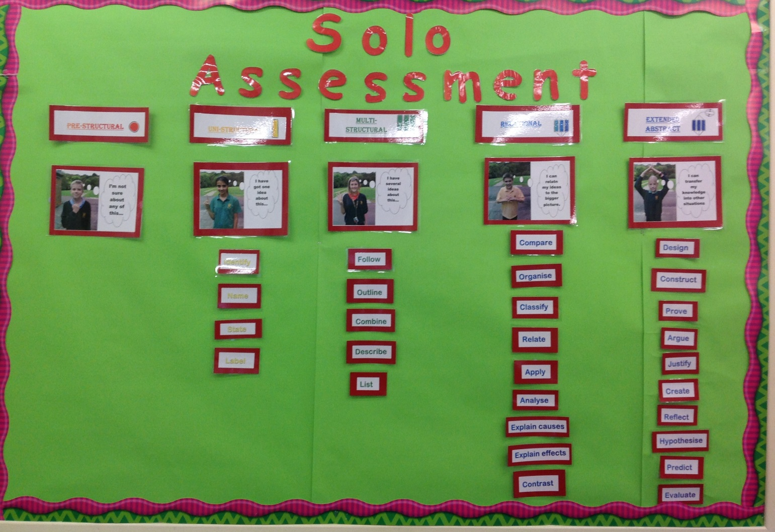
Notes:
Facilitates diferentiation

Slide 30
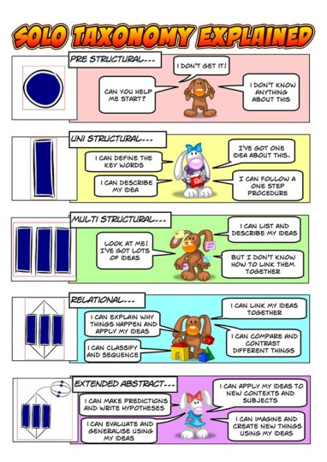
Notes:
Student friendly explanation of solo –Marden Middle school

Slide 31
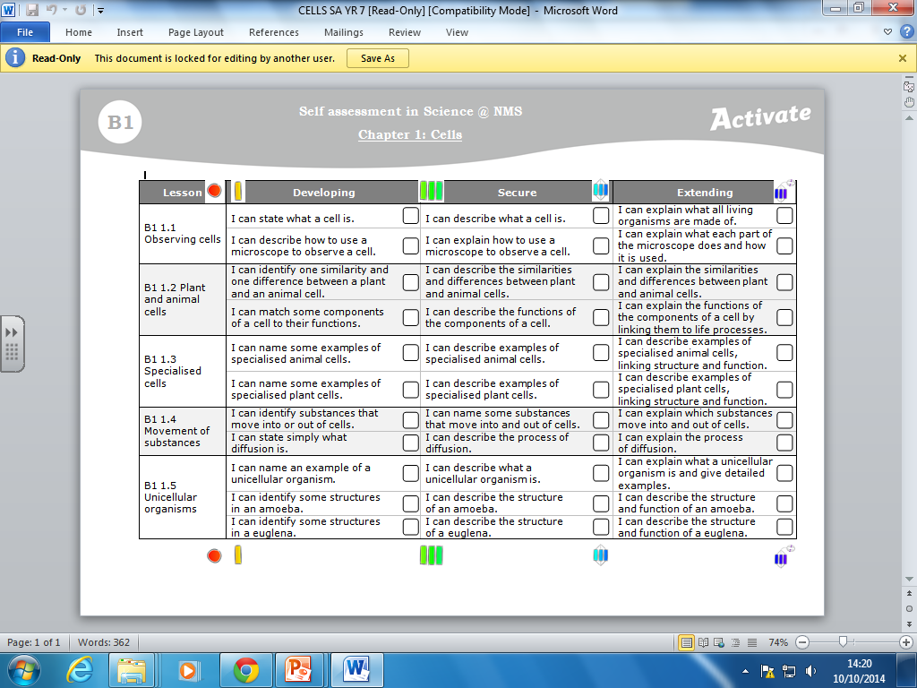

Slide 32
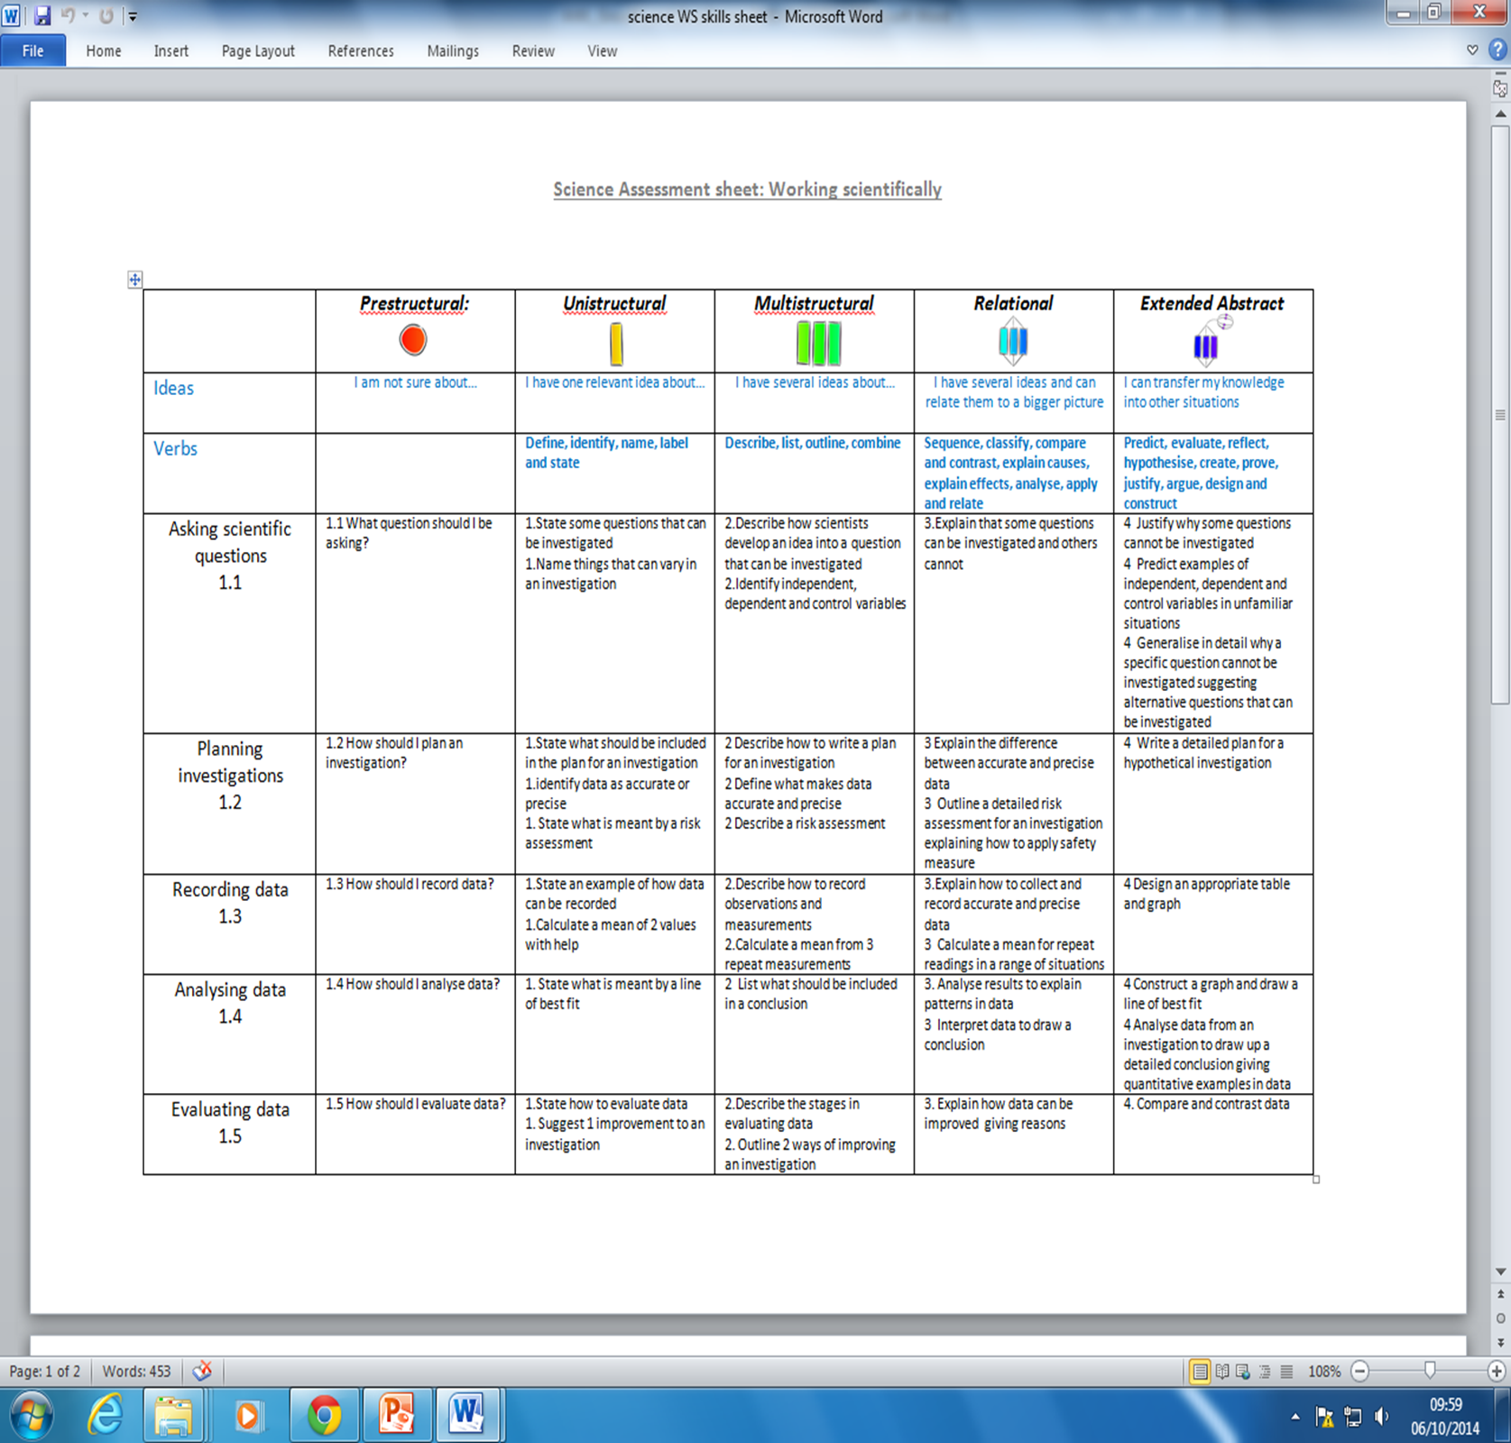
Notes:
WS strand linked to the new science curriculum. Big picture

Slide 33
Notes:
Example assessment of 1 strand with 7.4 group
Students identify next stages with support

Slide 34
Notes:
Another example ..

Slide 35
Summative assessment
Test score % | Threshold
75-100 | Extended Abstract
50-75 | Relational
25-50 | Multi-structural
0-25 | Uni-structural
Notes:
Final thought –Links to summative assessment.
Challenges-language? Reporting. Challenges →Showing progress. Mastery pathway?

Slide 36
King Edward VI School & Curriculum Change
GCSE 2015
Begin teaching new English and Maths specifications
Embed new, larger content into KS3 curriculum
All other subjects to focus on
KS3
Y9 -2016

Slide 37
King Edward VI School & Curriculum Change
KS3
2014
Trial and review of ‘skills-based’ models
Assessment without levels training courses attended
Collaborative work across 3RLT
Research completed into various trials across England
Key if we are going to ensure a consistent approach to our children

Slide 38
The next steps FOR THE 3rIVERS
To broaden the work of the 3Rivers curriculum group to extend more widely across the partnership. This could include:
A fully integrated curriculum from key stage 1-5
A common agreed approach to ‘assessing without levels’ key stage 1-3
A common agreed approach to recording and reporting student progress key stage 1-3 in SIMS

Slide 39
Workshops

