Slide 1
Week 5
Year 6 – English - Explanation texts
This week in Year 6, we are focusing on explanation texts. An explanation text is a non-fiction piece of writing which is meant to describe a process such as how a car is made for example. As part of this, we will look at the use of parenthesis in our writing.
Parenthesis is just a fancy name for adding extra information to our sentence. You already do this when you use brackets, however, extra information can also be marked using dashes or commas.
In this week’s activities, you will read some Explanation texts, complete some reading practice and look at the features of an explanation text. You will then learn all about how to use parenthesis so by the end of the week, you can write your very own explanation text.

Slide 3
What Is Parenthesis?
Parenthesis is the addition of extra information or an afterthought in our writing.
It can be a word, phrase or clause marked with brackets, dashes or commas.
When a parenthesis is removed, the sentence still makes grammatical sense.
e.g. I moved to Sheffield in 2011 (when I was six years old).
This sentence still makes sense if the extra information is taken out, as can be seen below.
I moved to Sheffield in 2011.

Slide 5
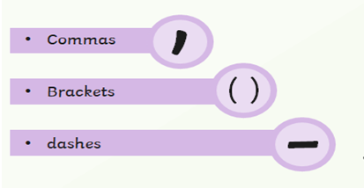
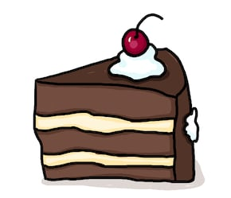
Parenthesis can be marked with brackets, dashes or commas and when it is removed, the sentence still makes sense.
This cake (which was made by my gran) is delicious.
This cake - which was made by my gran - is delicious.
This cake, which was made by my gran, is delicious.

Slide 6
Week 5
Year 6 – Explanation texts
On the following page you will find a link to follow each day.
On each link, you will find a 15 minute teaching video - make sure that you have a pen and paper ready in case you are asked to write anything down.
After watching the video, click Next to turn to the following page and bring up an activity which you can complete online or print off.
Before finishing the work, test your knowledge by completing the quiz.
At the end of the week, come back to this PowerPoint and try the challenge sheets, ‘Speedy SPAG’ at the end of this PowerPoint to see how much
you have remembered.
Spellings: Don’t forget to practise your spellings each day at the end of each activity.
To do this, you could choose a spelling task from the spelling slides!

Slide 7
Week 5
Year 6 – English - Explanation texts
Monday - Reading Focus: Summary
https://classroom.thenational.academy/lessons/reading-focus-summary
Tuesday - Reading Focus: Summary
https://classroom.thenational.academy/lessons/reading-focus-summary-ea06ec
Wednesday – Writing focus: Identify the key features
https://classroom.thenational.academy/lessons/writing-focus-identify-the-key-features-594152
Thursday - Writing focus: Punctuation for parenthesis
https://classroom.thenational.academy/lessons/writing-focus-punctuation-for-parenthesis
Friday – Writing focus: Write an explanation
https://classroom.thenational.academy/lessons/writing-focus-write-an-explanation
Challenge sheet
To test what you have learnt, complete the ‘Speedy SPAG’ sheet on the next page and then mark your own work.

Slide 8
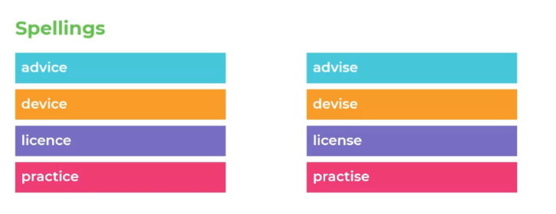
Spellings
Why not try one of the spelling tasks on the next pages to help you learn your spellings?
These words are homophones – these are words which sound the same but have a different meaning. Research each one to find out what each word means.

Slide 9
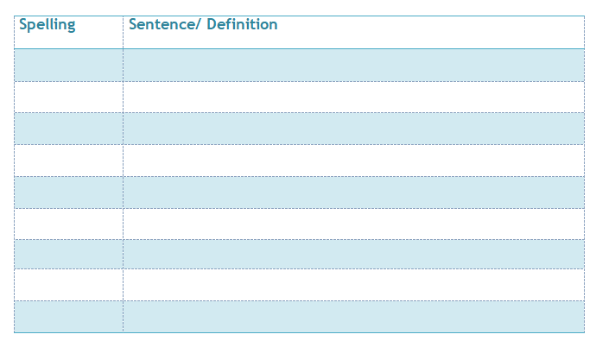
Spelling activities
Definitions
Use a paper or online dictionary to find out the meaning of each of your spelling words – can you write your own definition in your own words to explain what it means ?
Sentences
Write a sentence for each of your spellings.
Challenge: Can you include this week’s
SPAG focus in one of your sentences?

Slide 10
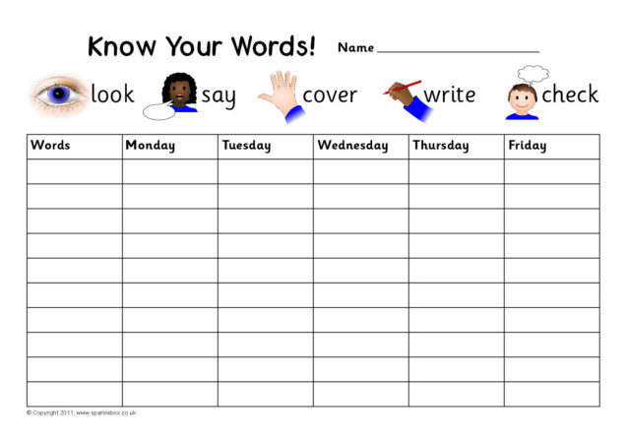
Spelling activities
Look, say, cover, write, check
Can you practise learning your spellings using look, say, cover, write, check?
Look at the word.
Say it aloud a few times.
Cover it up with a piece of paper or your hand.
Write the spelling next to the original word.
Check your version to see if you got it right.

Slide 11
Spelling activities
Mnemonics
Can you make up your own mnemonic to help you remember your most difficult spelling? A mnemonic is a tool that helps you to remember something – they are great for tricky spellings! Here’s a great video which explains how they work….
https://www.youtube.com/watch?v=AcUoW1ek5zU

Slide 12
Spelling activities
Spelling Pyramid
Use this template (or create your own on paper) and order your spellings from easiest to hardest. Write the easiest spelling at the top and the hardest at the bottom, you will need to write each word several times to fill the entire line.

Slide 13
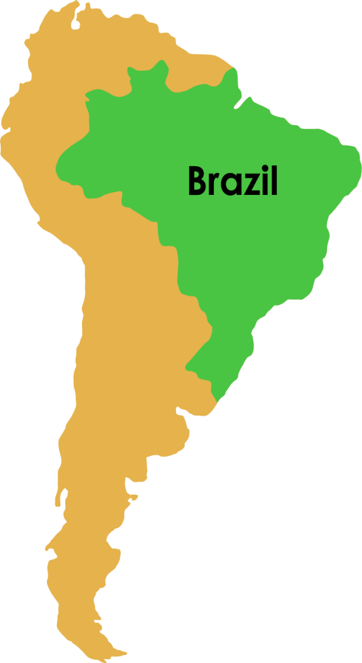
Week 5
Year 6 – Speedy SPAG
Brazil, South Americas largest country, is the worlds fifth largest country which covers three time zones.
Find the parenthesis in the sentence.
How else could the parenthesis have been punctuated?
Add two missing apostrophes.
4. Write a question you could ask about Brazil.

Slide 14
Week 5
Year 6 – Speedy SPAG
Click onto the next page to see the answers

Slide 15
Answers
Week 5
Year 6 – Speedy SPAG answers
Brazil, South Americas largest country, is the worlds fifth largest country, which covers three time zones.
1. is the fifth largest country
2. commas, dashes or brackets
3. South America’s, world’s
4. Various possibilities: Where is Brazil? Etc…

Slide 16
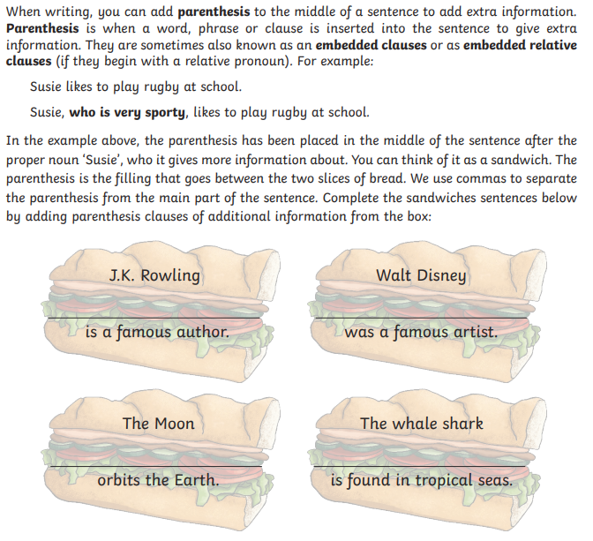

Slide 17
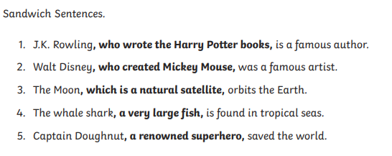
Answers
There are various different answers – here are some you could have used.

Slide 18
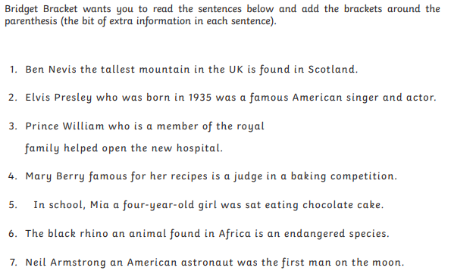

Slide 19
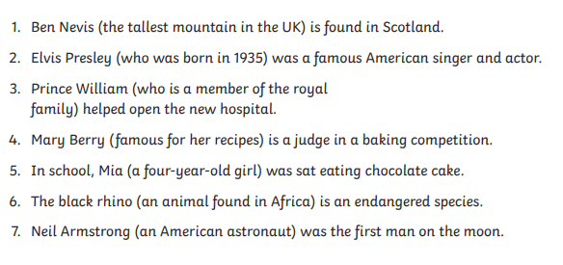
Answers

Slide 21
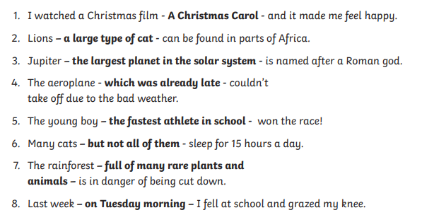
Answers
There are various different answers – here are some you could have used.

