Slide 1
Week 5
Year 5 – Maths
This week in Year 5, we are focusing on decimals. We will be representing and solving problems that include decimals. We will look at 2 digit by 3 digit multiplication and use long multiplication to solve problems.
Remember to use TT Rockstars to practise your times tables! https://play.ttrockstars.com/auth/school/student

Slide 2
Week 5
Year 5 – Maths
On the following page you will find links to home learning work set for Monday - Friday…
On each link, you will find a 15 minute teaching video - make sure that you have a pencil and paper ready in case you're asked to write anything down.
Click next to turn to the following page and bring up the activity that you can complete online or print off.
Before finishing the work, test your knowledge with the quiz.
At the end of the Week 5, come back and try the challenge sheet -
‘Magical Maths’ to see how much you have remembered.
Want some extra challenges? Try the worksheets towards the end of the PowerPoint.

Slide 3
Week 5
Year 5 – Maths
Monday - To use mental multiplication strategies
https://classroom.thenational.academy/lessons/decimals-to-use-mental-multiplication-strategies
Tuesday - To solve and represent decimal problems.
https://classroom.thenational.academy/lessons/decimals-to-solve-and-represent-decimal-problems
Wednesday – To represent two digit multiplication
https://classroom.thenational.academy/lessons/decimals-to-represent-two-digit-multiplication
Thursday – To solve three by two digit multiplication
https://classroom.thenational.academy/lessons/decimals-to-solve-three-by-two-digit-multiplication
Friday – To solve long multiplication problems
https://classroom.thenational.academy/lessons/decimals-to-solve-long-multiplication-problems
Challenge sheet
To test what you have learnt, complete the ‘Magical Maths’ sheet on the next page and then mark your own work.

Slide 4
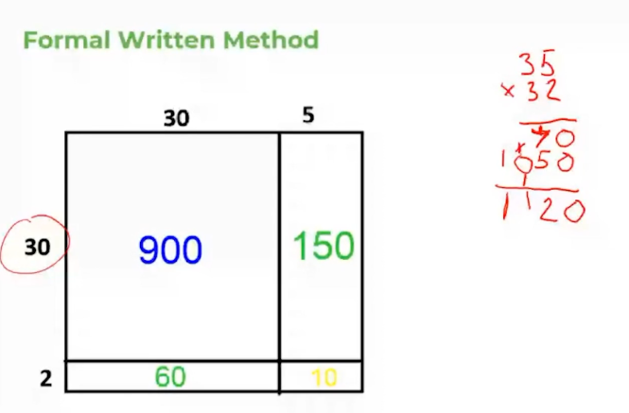

Slide 5
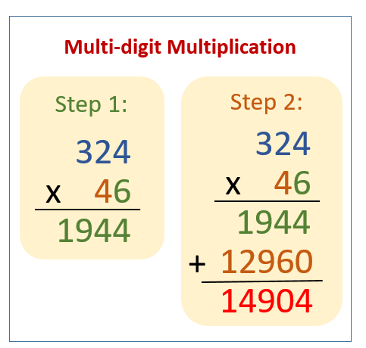
How do we multiply a 3-digit number by a 2-digit number?
1. Multiply by the number in the ones place.
2. Put a zero (place holder) below in the ones place.
3. Multiply by the number in the tens place.
4. Add them up.

Slide 7
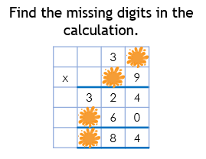
Week 5
Year 5 – Magical Maths
3)
5)
1)
2)
4)

Slide 8
Click onto the next page to see the answers

Slide 9
Week 5
Year 5 – Magical Maths ANSWERS
3) True
5)
1) 58 × 17 = 986
 |  | 3 | 6
x |  | 1 | 9
 | 3 | 2 | 4
 | 3 | 6 | 0
 | 6 | 8 | 4
2) 1368
4) 53 x 16 = 848

Slide 10
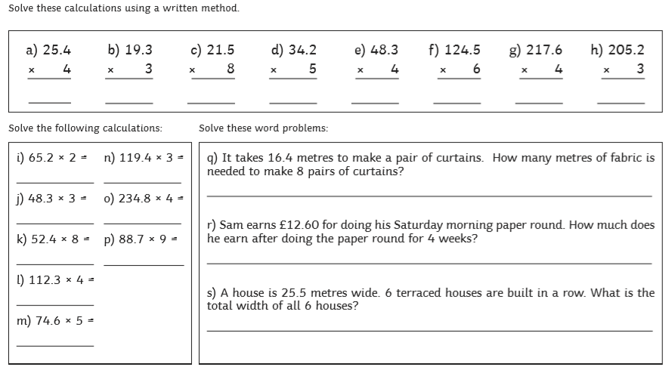
Try this worksheet

Slide 11
Answers

Slide 12
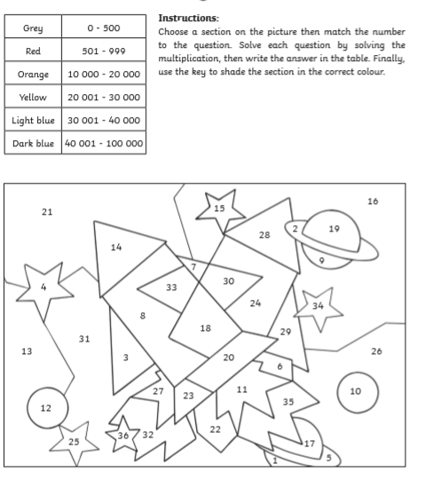
Try this worksheet

Slide 13
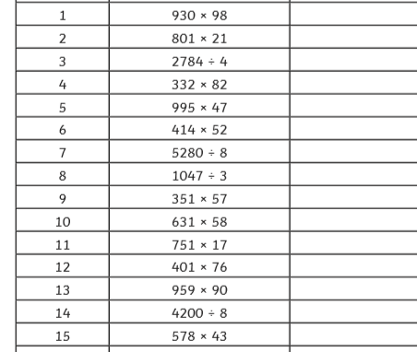
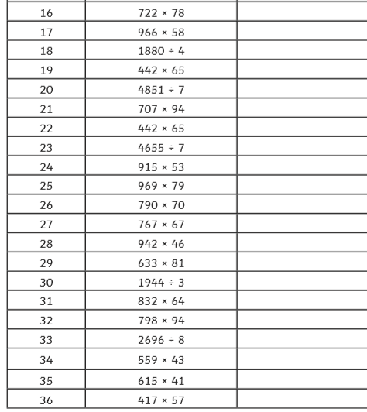
Try this worksheet

Slide 14
Try this worksheet

Slide 15
Answers

Slide 16
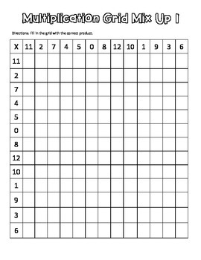
Remember to practise your times tables.

