Slide 1
Week 4
Year 5 – English - Setting Descriptions
This week in Year 5, we are learning how to write setting descriptions. When we write a setting description we try to paint an image in the readers mind. To do this, we use our senses to describe what we can see, hear, smell and feel. As part of our setting descriptions, we will be practising using parenthesis.
Parenthesis is just a fancy name for adding extra information to our sentence. You already do this when you use brackets, however, extra information can also be marked using dashes or commas.
In this week’s activities, you will read some setting descriptions, complete some reading practice and look at the features of setting descriptions. You will also learn about parenthesis and by the end of the week, you will write your own setting descriptions.

Slide 2
What Is Parenthesis?
Parenthesis is the addition of extra information or an afterthought in our writing.
It can be a word, phrase or clause marked with brackets, dashes or commas.
When a parenthesis is removed, the sentence still makes grammatical sense.
e.g. I moved to Sheffield in 2011 (when I was six years old).
This sentence still makes sense if the extra information is taken out, as can be seen below.
I moved to Sheffield in 2011.

Slide 4
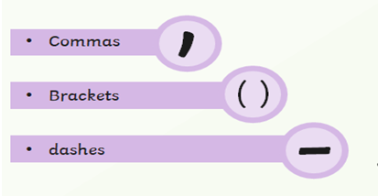
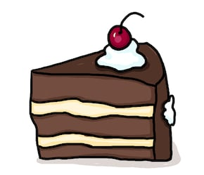
Parenthesis can be marked with brackets, dashes or commas and when it is removed, the sentence still makes sense.
This cake (which was made by my gran) is delicious.
This cake - which was made by my gran - is delicious.
This cake, which was made by my gran, is delicious.

Slide 5
Week 4
Year 5 – Setting Descriptions
On the following page you will find a link to follow each day.
On each link, you will find a 15 minute teaching video - make sure that you have a pen and paper ready in case you are asked to write anything down.
After watching the video, click Next to turn to the following page and bring up an activity which you can complete online or print off.
Before finishing the work, test your knowledge by completing the quiz.
At the end of the week, come back to this PowerPoint and try the challenge sheets, ‘Speedy SPAG’ at the end of this PowerPoint to see how much
you have remembered.
Spellings: Don’t forget to practise your spellings each day at the
end of each activity.
To do this, you could choose a spelling task from the spelling slides!

Slide 6
Week 4
Year 5 – Setting Descriptions
Monday - Setting Description: Reading Comprehension - Fact Retrieval
https://classroom.thenational.academy/lessons/setting-description-reading-comprehension-fact-retrieval
Tuesday – Setting Description: Reading Comprehension - Fact Retrieval
https://classroom.thenational.academy/lessons/setting-description-reading-comprehension-fact-retrieval-5a6612
Wednesday – Setting Description: Identifying the features of a text
https://classroom.thenational.academy/lessons/setting-description-identifying-the-features-of-a-text
Thursday – Setting Description: SPaG focus - Parenthesis
https://classroom.thenational.academy/lessons/setting-description-spag-focus-parenthesis
Friday – Setting Description: Write a Setting Description
https://classroom.thenational.academy/lessons/setting-description-write-a-setting-description
SPAG Challenge sheets
To test what you have learnt, complete the ‘Speedy SPAG’ sheet and then mark your own work. Also, try some of the other SPAG challenges which you can find at the end of this PowerPoint.

Slide 7
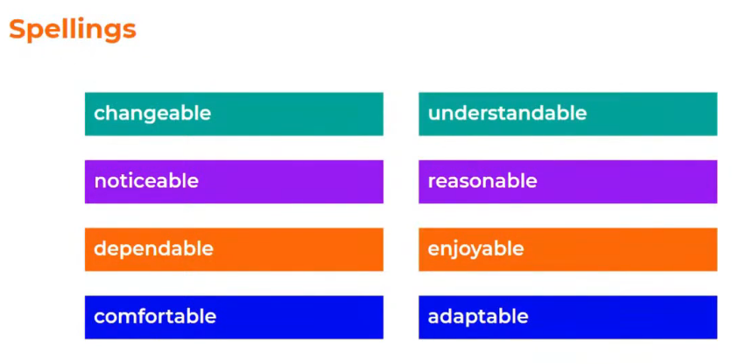
Spellings
Why not try one of the spelling tasks on the next pages to help you learn your spellings?

Slide 8
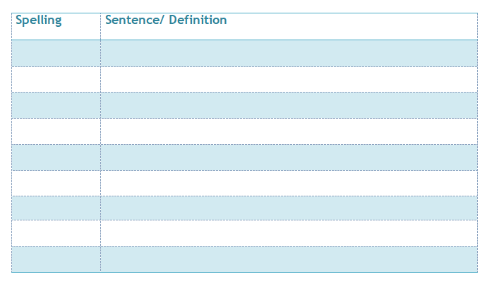
Spelling activities
Definitions
Use a paper or online dictionary to find out the meaning of each of your spelling words – can you write your own definition in your own words to explain what it means ?
Sentences
Write a sentence for each of your spellings.
Challenge: Can you include this week’s
SPAG focus in one of your sentences?

Slide 9
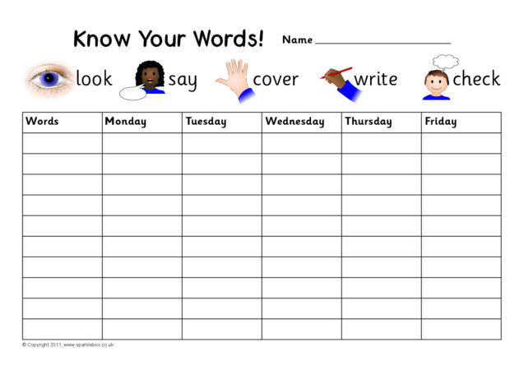
Spelling activities
Look, say, cover, write, check
Can you practise learning your spellings using look, say, cover, write, check?
Look at the word.
Say it aloud a few times.
Cover it up with a piece of paper or your hand.
Write the spelling next to the original word.
Check your version to see if you got it right.

Slide 10
Spelling activities
Mnemonics
Can you make up your own mnemonic to help you remember your most difficult spelling? A mnemonic is a tool that helps you to remember something – they are great for tricky spellings! Here’s a great video which explains how they work….
https://www.youtube.com/watch?v=AcUoW1ek5zU

Slide 11
Spelling activities
Spelling Pyramid
Use this template (or create your own on paper) and order your spellings from easiest to hardest. Write the easiest spelling at the top and the hardest at the bottom, you will need to write each word several times to fill the entire line.

Slide 12
Week 4
Year 5 – Speedy SPAG
An adjective is a word we use to describe a noun.
The eiffel tower (a famous landmark) was built in the 19th century and is still popular today.
Can you add any missing punctuation?
Can you explain why this is needed?
Why have they used brackets in this sentence?
4. Change the brackets for different punctuation.
5. Identify the adjectives in the sentence.

Slide 13
Week 4
Year 5 – Speedy SPAG
Click onto the next page to see the answers

Slide 14
Week 4
Year 5 – Speedy SPAG answers
Answers
The eiffel tower (a famous landmark) was built in the 19th century and is still popular today.
1. The Eiffel Tower (a famous landmark) was built in the 19th century and is still popular today.
2. It is the name of the landmark.
3. to mark parenthesis (or extra information) in the sentence
4. Dashes or commas could be used instead of brackets to mark the extra information.
5. famous, popular

Slide 15
What is the name of each piece of punctuation you can see?

Slide 16
Answers
Parenthesis is just a fancy name for extra information in a sentence. Your sentence should still make sense if you remove the extra information.

Slide 17
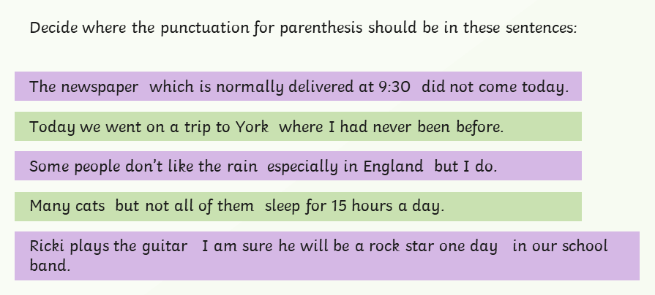
Where should the parenthesis go? Can you use a mix of commas, brackets and dashes?

Slide 18
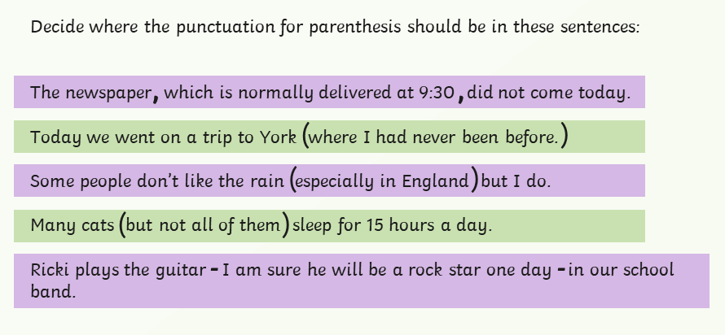
Answers
Where should the parenthesis go? Can you use a mix of commas, brackets and dashes?

Slide 19
Remember, parenthesis is just a fancy name for extra information in a sentence.

Slide 20
Answers

