Slide 1
Week 1
Year 6 – English - Information Leaflets
This week in Year 6, we are focusing on information leaflets. As part of this, we will look at using third person and different levels of formality.
Depending on the situation, we adjust our formality. If we were speaking to the queen, we would talk in a much more formal way than we would if we were speaking to a friend on the playground. When we write using third person, we use words like her, he, she and they.
In this week’s activities, you will read some information leaflets and complete some reading practice and look at the features of an information leaflet. You will then learn all about how to use formality in your writing so by the end of the week, you will write your very own information leaflet.

Slide 2
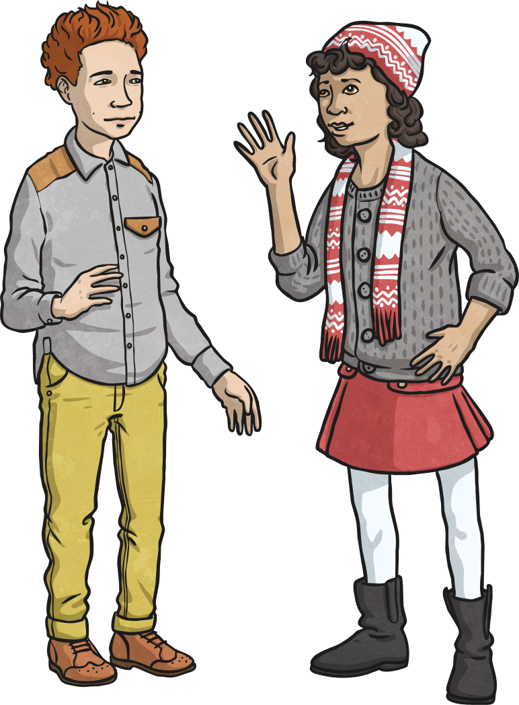
Informal Speech and Writing
So, what is informal speech or writing?
When or where would you use it?
An informal style is more commonly used where we are more familiar with our audience and have a less important purpose for writing or talking.
Informal writing tends to have a chatty, conversational style that may refer directly to the reader. It often includes slang/dialect, contracted words and question tags.

Slide 3
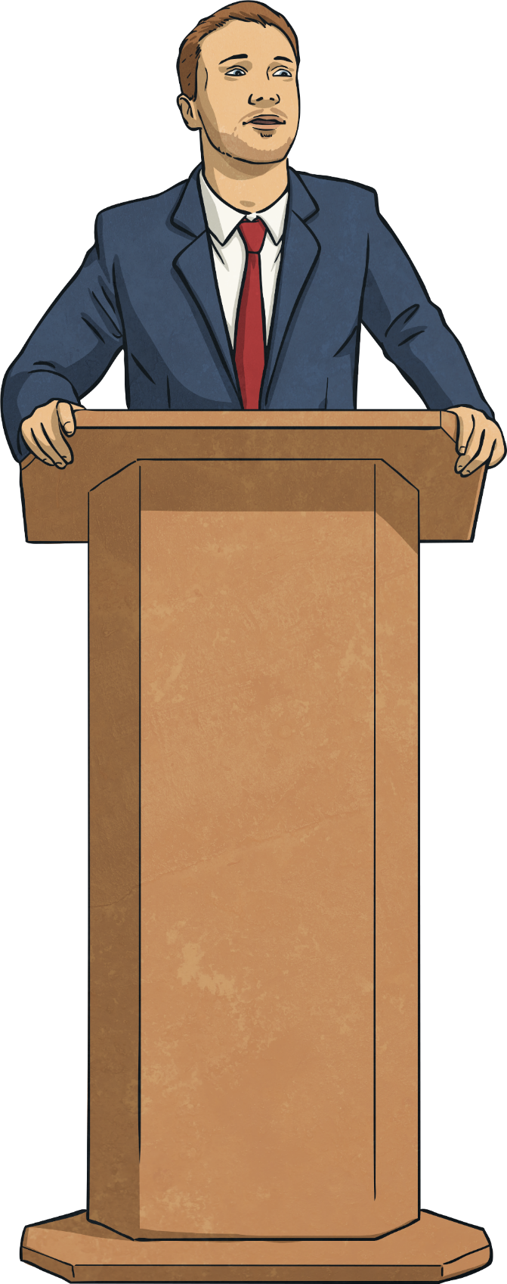
Formal Speech and Writing
What is formal speech or formal writing?
When or where would you use it?
A formal writing or speaking style is not necessarily ‘better’ than an informal style; we just use a more formal style for different purposes and audiences.
Formal writing tends to include more complex sentence structures, more precise/technical language and higher-level punctuation.

Slide 4
Week 1
Year 6 – Information Leaflet
On the following page you will find a link to follow each day.
On each link, you will find a 15 minute teaching video - make sure that you have a pen and paper ready in case you are asked to write anything down.
After watching the video, click Next to turn to the following page and bring up an activity which you can complete online or print off.
Before finishing the work, test your knowledge by completing the quiz.
At the end of the week, come back to this PowerPoint and try the challenge sheets, ‘Speedy SPAG’ at the end of this PowerPoint to see how much
you have remembered.
Spellings: Don’t forget to practise your spellings each day at the end of each activity.
To do this, you could choose a spelling task from the spelling slides!
You could even write your own information leaflet about the last place you visited!

Slide 5
Week 1
Year 6 – English Information Leaflet
Monday - Information Leaflet : reading focus – Words in context
https://classroom.thenational.academy/lessons/information-leaflet-lesson-1-reading-focus/
Tuesday - Information Leaflet : reading focus – Words in context
https://classroom.thenational.academy/lessons/information-leaflet-lesson-2-reading-focus/
Wednesday – Information Leaflet : Identifying features
https://classroom.thenational.academy/lessons/information-leaflet-lesson-3-identifying-features/
Thursday – Information Leaflet : Formality
https://classroom.thenational.academy/lessons/information-leaflet-lesson-4-formality/
Friday – Information Leaflet : Writing an information leaflet
https://classroom.thenational.academy/lessons/information-leaflet-lesson-5-writing-an-information-leaflet/
Challenge sheets
To test what you have learnt, complete the ‘Speedy SPAG’ sheets on the final pages and then mark your own work.

Slide 6
Spellings
This week we will look at words which contain the letter ‘y’ pronounced as an /i/ sound. Can you think of any other words with a ‘y’ that sounds like /i/?
Spellings
rhythm
system
physical
symbol
mystery
lyrics
oxygen
symptom
typical
crystal
Why not try one of the spelling tasks on the next pages to help you learn your spellings?

Slide 7
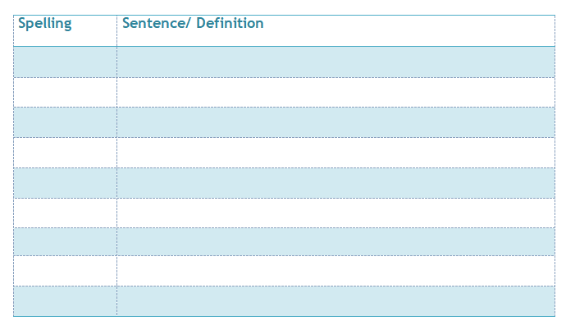
Spelling activities
Definitions
Use a paper or online dictionary to find out the meaning of each of your spelling words – can you write your own definition in your own words to explain what it means ?
Sentences
Write a sentence for each of your spellings.
Challenge: Can you include this week’s
SPAG focus in one of your sentences?

Slide 8
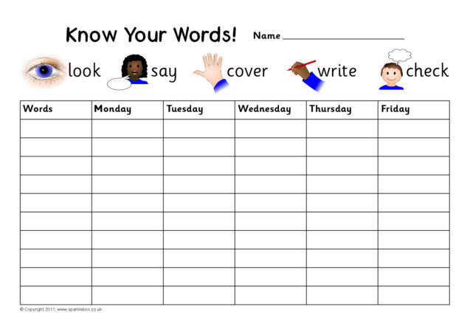
Spelling activities
Look, say, cover, write, check
Can you practise learning your spellings using look, say, cover, write, check?
Look at the word.
Say it aloud a few times.
Cover it up with a piece of paper or your hand.
Write the spelling next to the original word.
Check your version to see if you got it right.

Slide 9
Spelling activities
Mnemonics
Can you make up your own mnemonic to help you remember your most difficult spelling? A mnemonic is a tool that helps you to remember something – they are great for tricky spellings! Here’s a great video which explains how they work….
https://www.youtube.com/watch?v=AcUoW1ek5zU

Slide 10
Spelling activities
Spelling Pyramid
Use this template (or create your own on paper) and order your spellings from easiest to hardest. Write the easiest spelling at the top and the hardest at the bottom, you will need to write each word several times to fill the entire line.

Slide 11
Week 1
Year 6 – Speedy SPAG
“It is imperative you brush your teeth before you go to bed, Dad informed us as we devoured chocolate on the sofa.”
1. Correct the use of the inverted commas.
2. Is the sentence written in formal or informal language?
3. Write two synonyms of ‘imperative’.
4. Which words in the sentence make it sound formal?
5. Form a command using three words in the sentence.
A command tells someone what to do and often starts with a bossy imperative verb.
A synonym is a word that means the same as another word.

Slide 12
Week 1
Year 6 – Speedy SPAG
Click onto the next page to see the answers

Slide 13
Week 1
Year 6 – Speedy SPAG answers
“It is imperative you brush your teeth before you go to bed, Dad informed us as we devoured chocolate on the sofa.”
1. “It is imperative you brush your teeth before going to bed,” Dad informed us as we devoured chocolate on the sofa.
2. formal language
3. Various possibilities: important, crucial, vital etc…
4. imperative, informed, devoured
5. Brush your teeth.

Slide 17
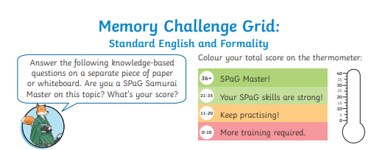
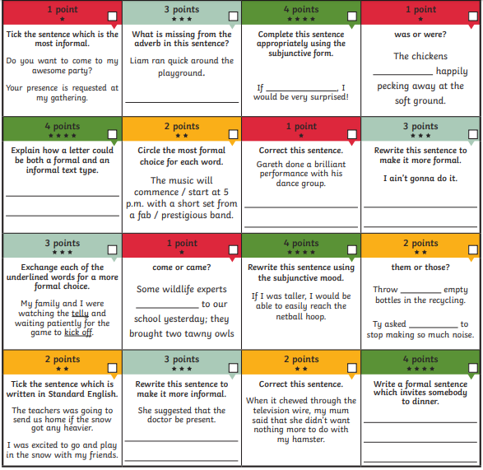

Slide 18
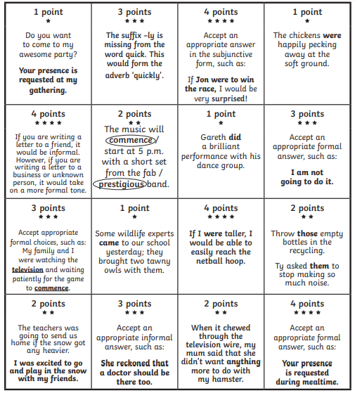
Answers

