Slide 1
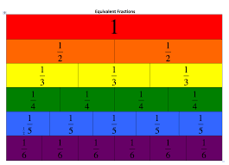
Week 1
Year 6 – Maths
This week in Year 6, we are focusing on being able to understand, identify and simplify equivalent fractions
Remember to use TT Rockstars to practise your times tables! https://play.ttrockstars.com/auth/school/student

Slide 2
Week 1
Year 6 – Maths
On the following page you will find links to home learning work set for Monday - Friday…
On each link, you will find a 15 minute teaching video - make sure that you have a pencil and paper ready in case you're asked to write anything down.
Click next to turn to the following page and bring up the activity that you can complete online or print off.
Before finishing the work, test your knowledge with the quiz.
At the end of the week, come back and try the challenge sheet -
‘Magical Maths’ to see how much you have remembered.
Want some extra challenges? Try the challenge cards at the end of the PowerPoint.

Slide 3
Week 1
Year 6 – Maths
Monday - Representing Fractions
https://classroom.thenational.academy/lessons/representing-fractions/
Tuesday - Fractions: Understanding Equivalence https://classroom.thenational.academy/lessons/understanding-equivalence/
Wednesday – Fractions: Finding Equivalent Fractions.
https://classroom.thenational.academy/lessons/finding-equivalent-fractions/
Thursday – Fractions: Compare Fractions Less Than One.
https://classroom.thenational.academy/lessons/compare-fractions-less-than-one/
Friday – Fractions: Compare Fractions Greater Than One. https://classroom.thenational.academy/lessons/compare-fractions-greater-than-one/
Challenge sheet
To test what you have learnt, complete the ‘Magical Maths’ sheet on the next page and then mark your own work.

Slide 4
Week 1
Year 6 – Magical Maths
2) Use < or > to compare the fractions. Remember, the crocodile eats the bigger number.
3) Order the fractions in descending order (large to small).
Simplify all of the fractions and then write down the 2 fractions which simplify to the same fraction.
7
21
2
7
9
14
18
21
9
15
6
20
18
21
5) Which one is the odd one out?
Megan says, “
is the same as ”.
Do you agree?
6
7
0.1
0.1
0.01
0.01
0.01
0.01
0.01
Extra Help
https://www.bbc.co.uk/bitesize/articles/zb8wqp3
one quarter
twenty-five percent

Slide 5
Click onto the next page to see the answers

Slide 6
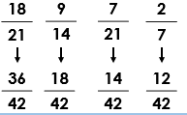
Week 1
Year 6 – Magical Maths ANSWERS
2) Use < or > to complete the sentences.
3) Order the fractions in descending order.
1a) Simplify all of the fractions.
1b) Write down the 2 fractions that are equivalent.
>
8 | = | 1
16 |  | 2
15 | = | 3
20 |  | 4
1a)
, in its simplest form is
Yes, I agree. We can divide both the numerator (18) and the denominator (21) by 3…so this gives you which is the same.
5) Which one is the odd one out?
is the odd one out.
= 0.4 = 40%
The rest are equivalent to one quarter = 0.25 = 25%
18
21
6
7
30 | = | 1
60 |  | 2
7 | = | 7
12 |  | 12
6
7
8 | = | 30
16 |  | 60
are equivalent because they both simplify to ½ .
1b)

Slide 7
Try the challenge cards.

Slide 8
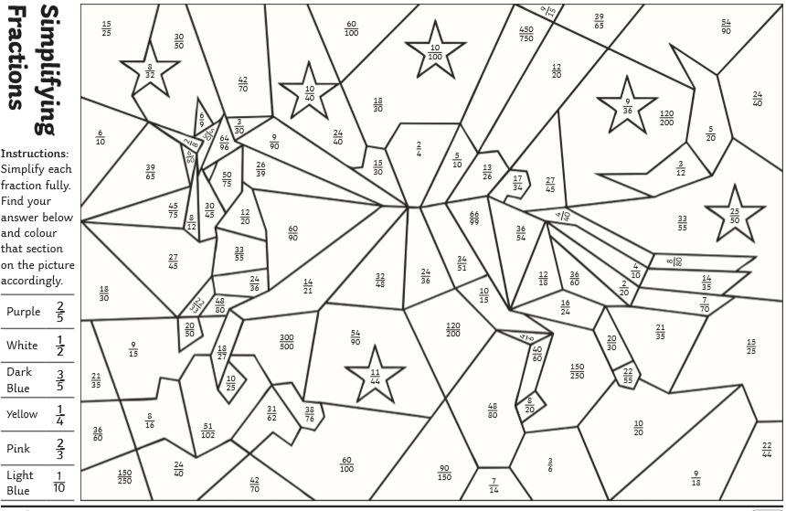
Print the worksheet out, simplify fractions then colour in to reveal a picture.

Slide 9
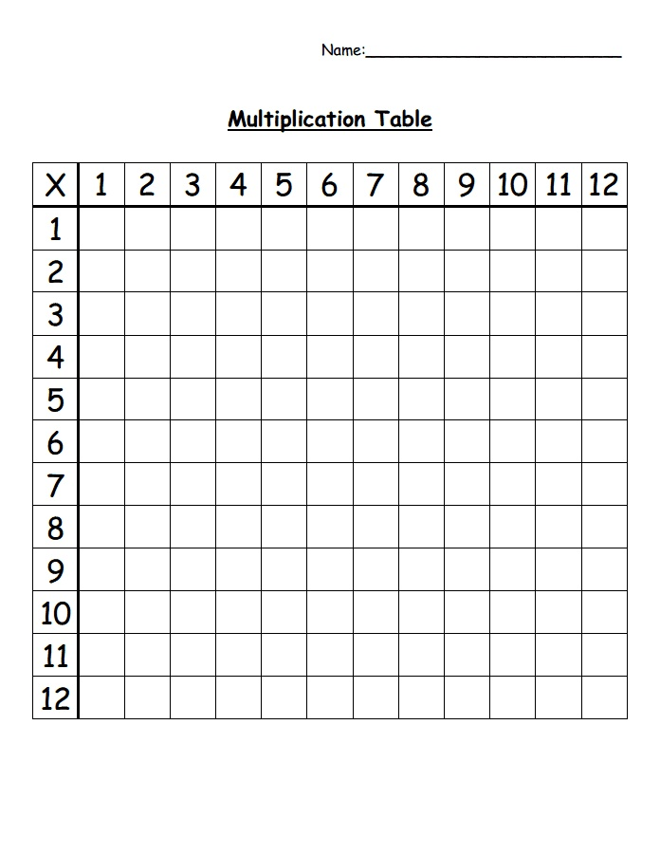
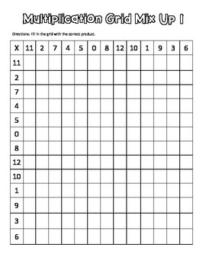
Remember to practise your times tables.

