Slide 1


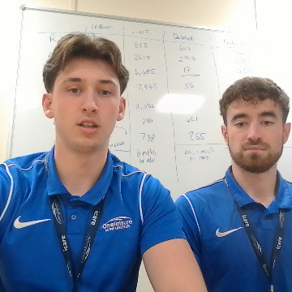
Teens multi sports
By ACTIVE LIFESTYLES

