Slide 1
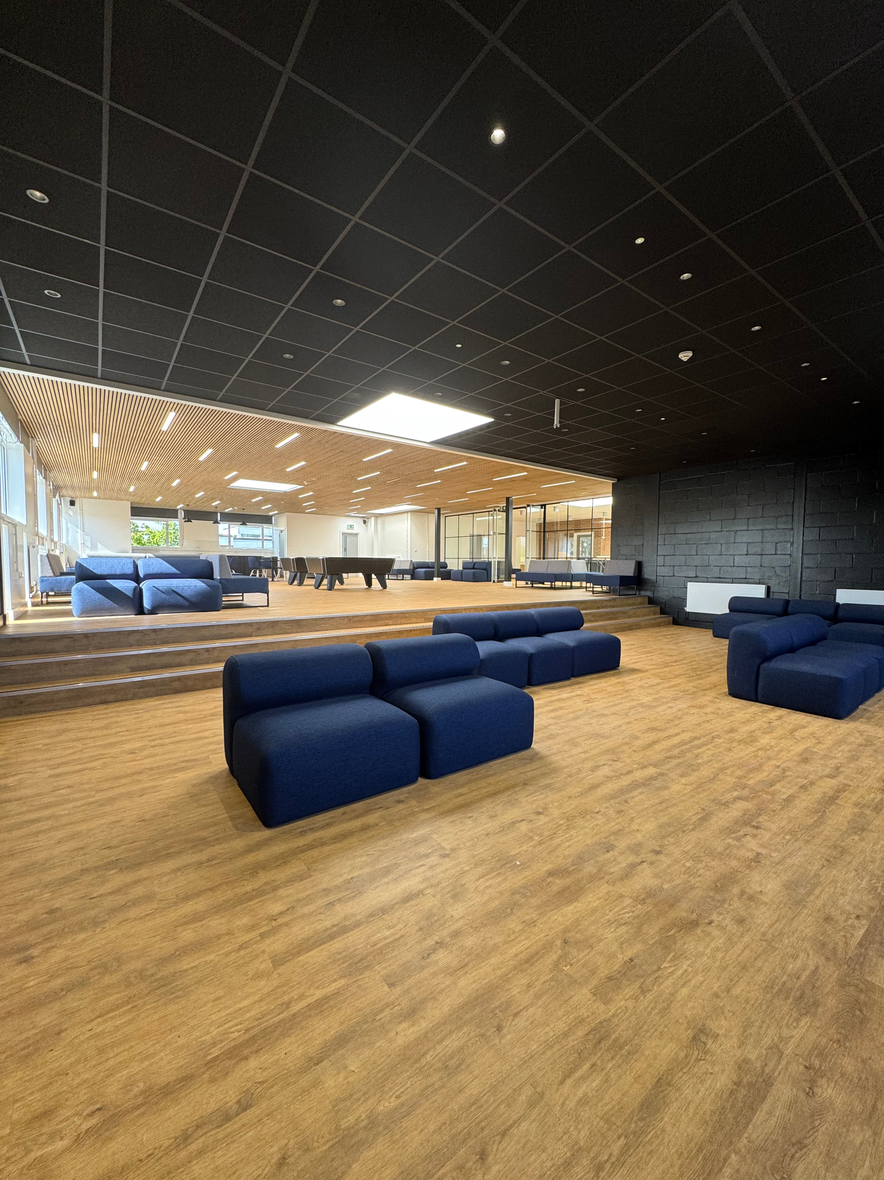

WELCOME TO
YEAR 11 OPEN EVENING

Slide 2

Achieving excellence ​in everything we do, ​for everyone​.
WORK HARD, BE KIND​

Slide 3
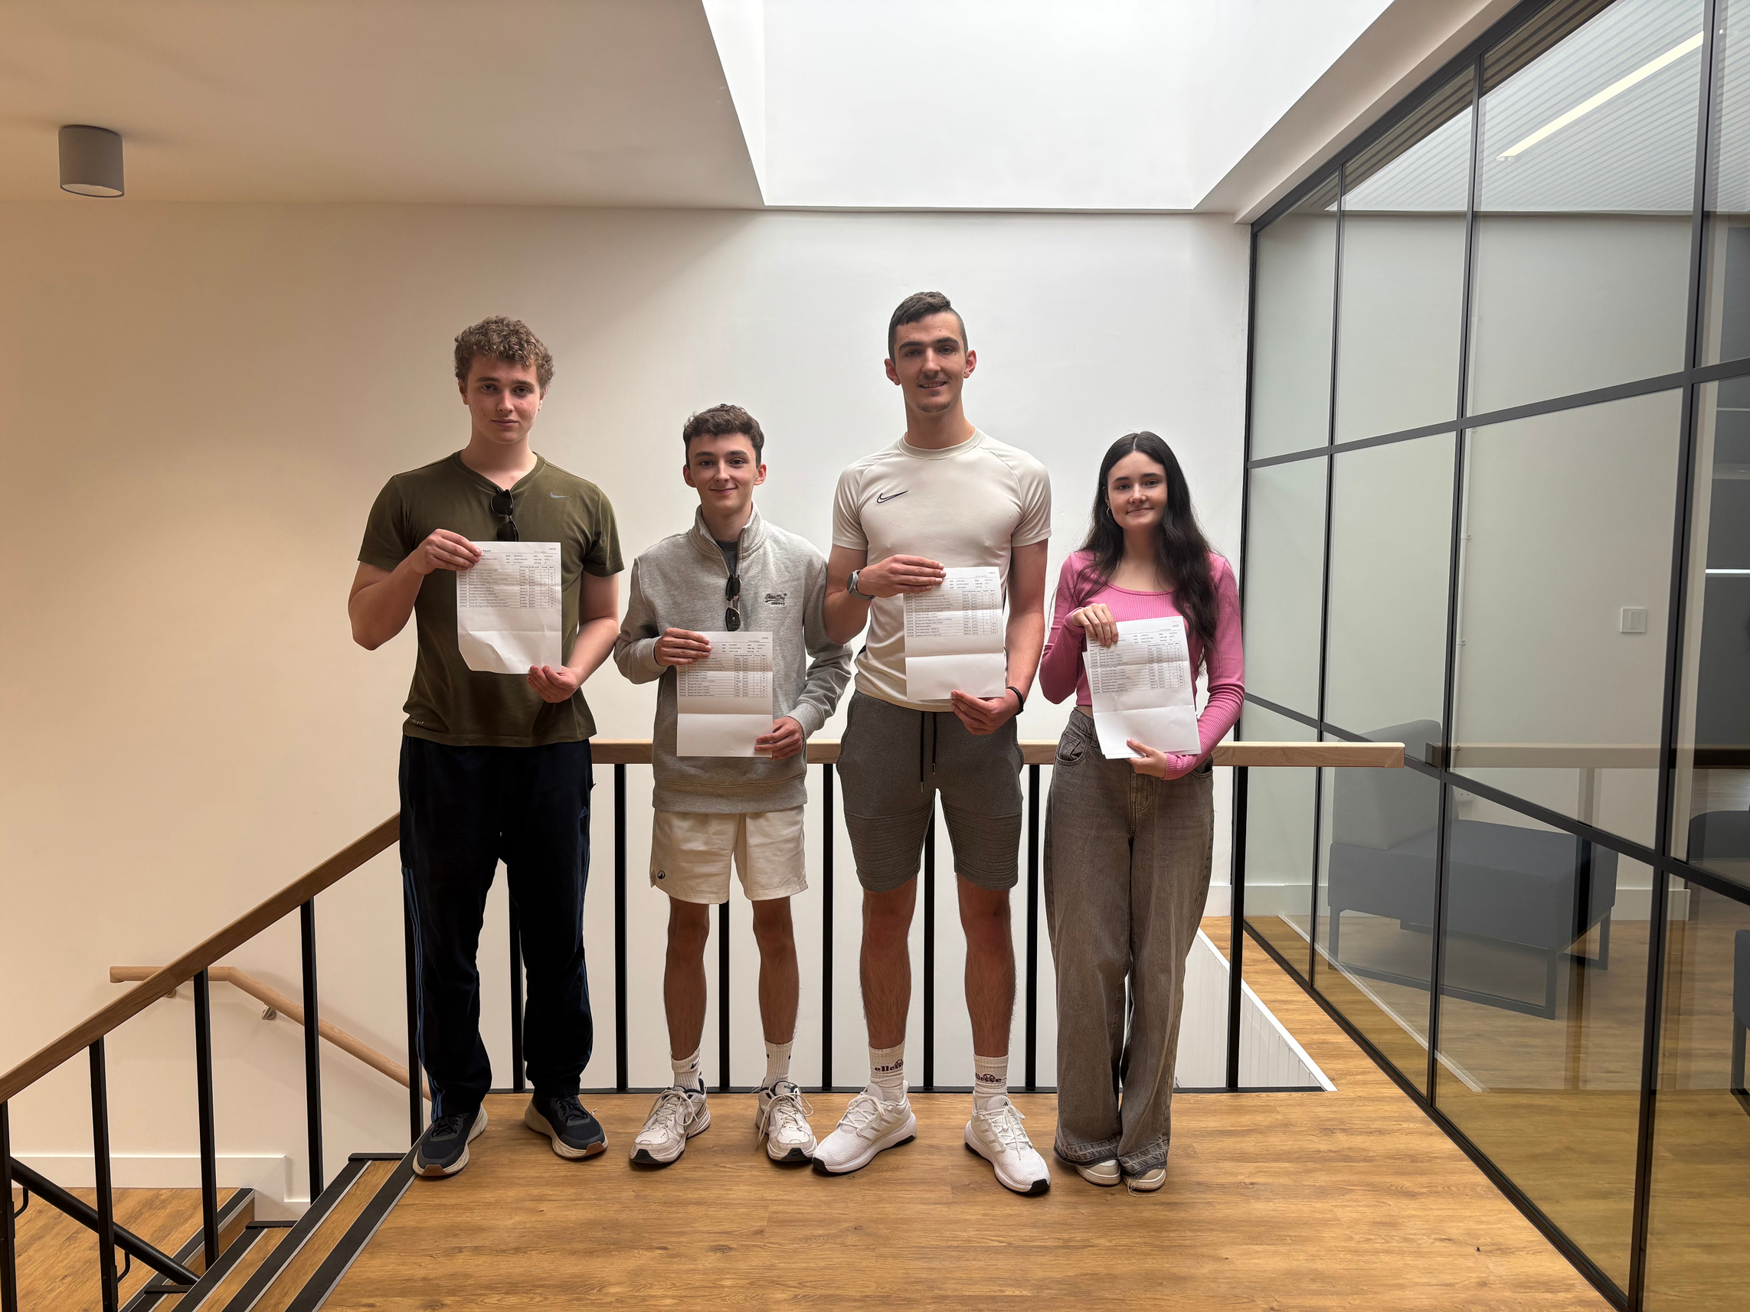

Top Performers:
Josie Burgess is going to read Mathematics at Emmanuel College, Cambridge - (Computing A*, Mathematics A*, Further Mathematics A*, Economics A)
Amy Johnstone is going to study Medicine at Anglia Ruskin University - (Biology A*, Chemistry A*, Mathematics A*, Extended Project Qualification A)
Other high performers include:
Finlay Doyle is going to study Aerospace Engineering at Sheffield University (Geography A*, Mathematics A*, Physics A*, Extended Project Qualification B)
Alex Mortimer is going to study Civil Engineering at Bristol University (Computing A*, Mathematics A*, Physics A*, Extended Project Qualification B)
Jake Mansfield is going to study Law at University of York (Biology A, Geography A, Law A, Extended Project Qualification A)
Kaziu Sharp is going to study Physics at Birmingham University (Computing A, Mathematics A*, Physics A, Extended Project Qualification A)

Slide 4


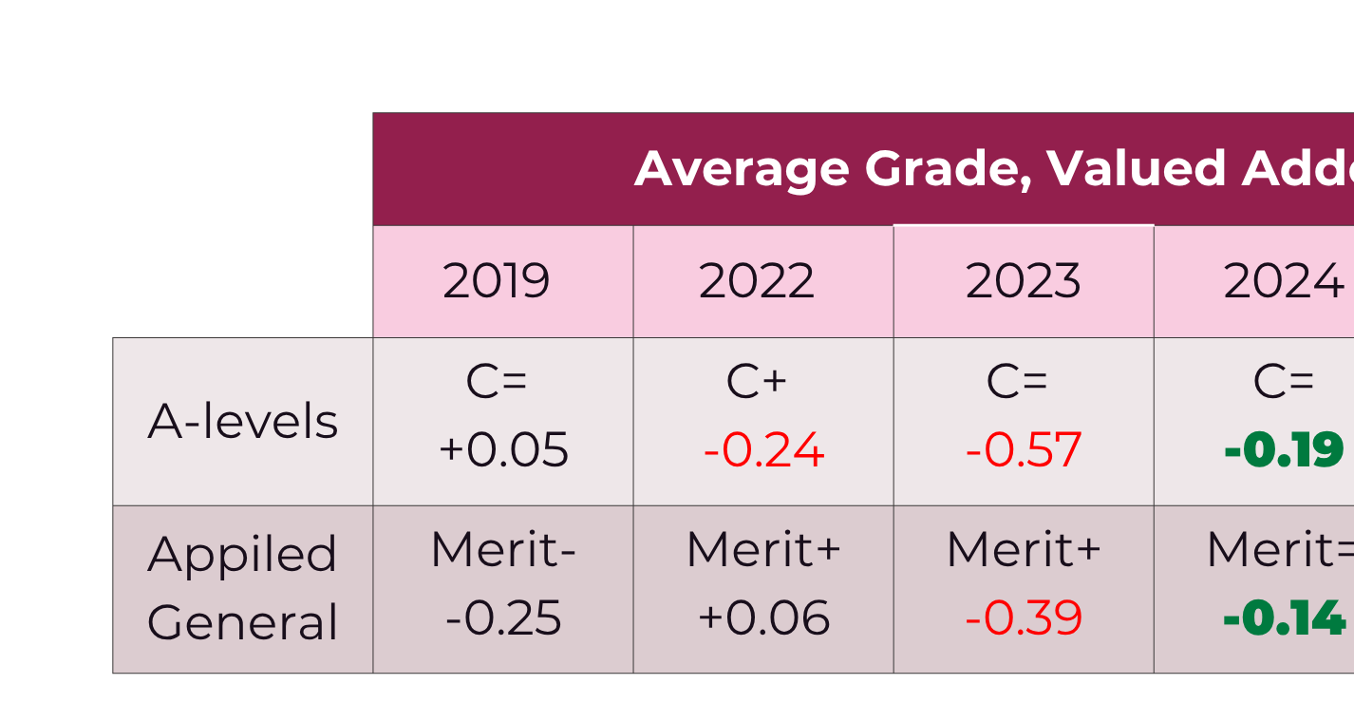
OUR
YEAR 13 RESULTS
Improving trend over the last two years in student progress​
* Early indications of results; not finalised​

Slide 5
WE WANT YOUR
YOUNG PERSON TO:
01
02
03
A sixth form provision that is tailored to the needs of our young people, and on their doorstep​
To have a wide range of opportunities beyond the classroom to widen their horizons​
To feel safe and happy in school
04
05
To achieve the best possible outcomes at the end of their education so they are able to choose their future​
To have the best teachers who know you, who inspire you, who engage and develop a joy of learning in you​

Slide 6
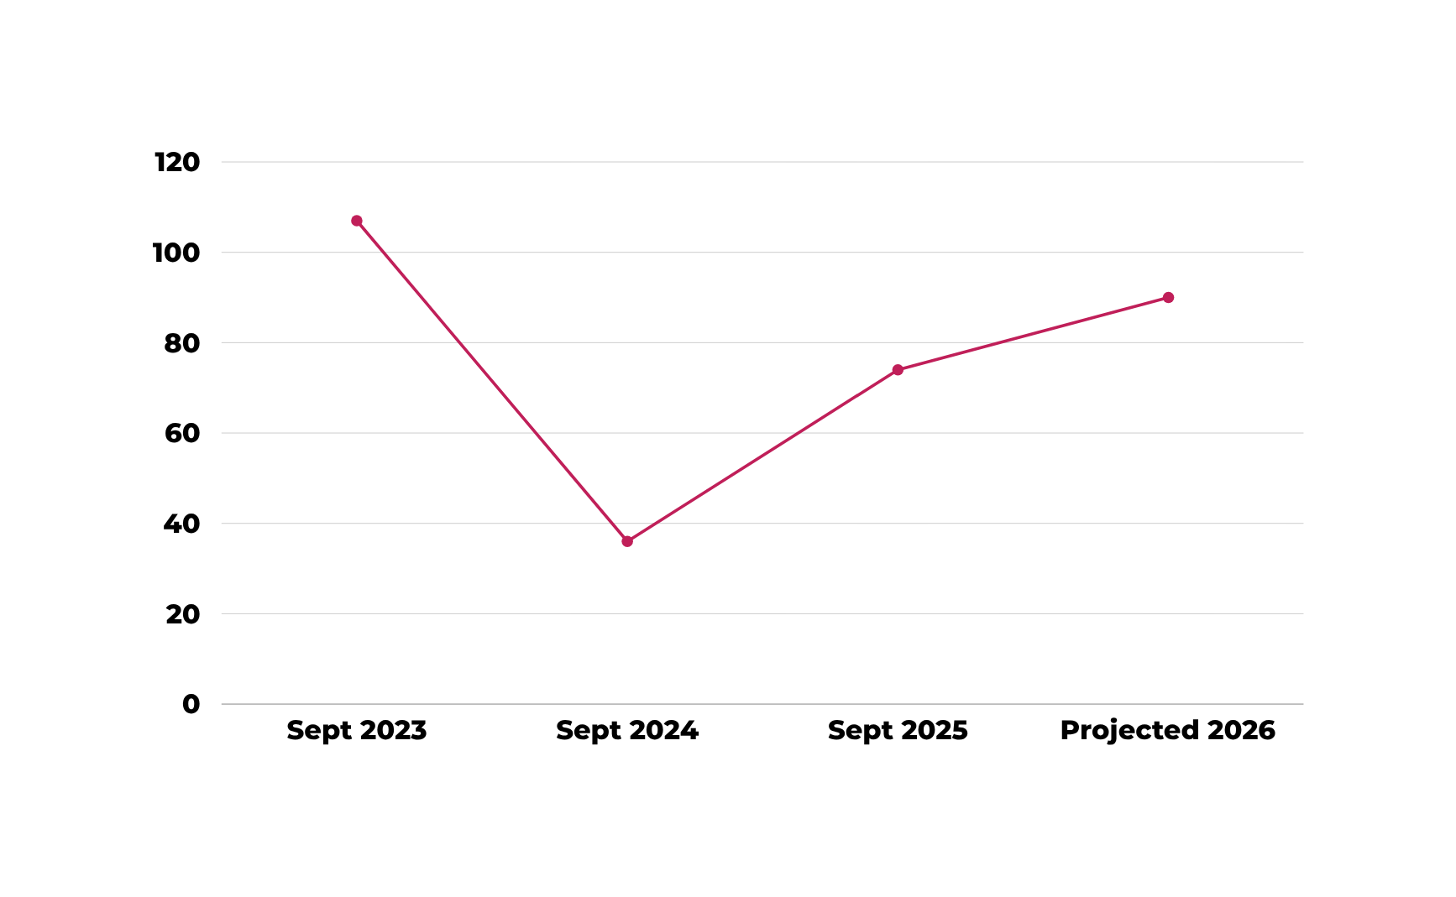
OUR
SIXTH FORM NUMBERS

Slide 7
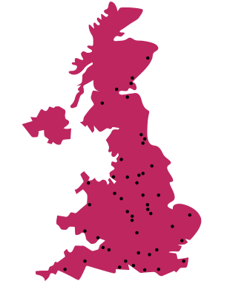
OUR
84%
DESTINATIONS
*bold = Russell Group University
Overall 1st choice destination
  Cardiff Metropolitan University
  Durham University
  Edinburgh Napier University
  Northumbria University, Newcastle
  Norwich University of the Arts
  Nottingham Trent University
  Oxford Brookes University
  Queen Margaret University, Edinburgh
  Queen Mary University of London
  Ravensbourne University, London
  Royal Holloway University
  Sheffield Hallam University
  University - Central Film School, London
  University of Bath
  University of Birmingham
  University of Brighton
  University of Bristol
  University of Cambridge
  University of Cardiff
  University of Central Lancashire
  University of Chester
  University of East Anglia
  University of Essex
  University of Greenwich
  University of Hertfordshire
  University of Kent
  University of Lancaster
  University of Leicester
  University of Lincoln
  University of Liverpool
  University of Loughborough
  University of New Hampshire, USA
  University of Newcastle
  University of Northampton
  University of Nottingham
  University of Plymouth
  University of Portsmouth
  University of Sheffield
  University of Southampton
  University of St Andrews
  University of Surrey
  University of Warwick
  University of West of England, Bristol
  University of Westminster, London
  University of York

Slide 8
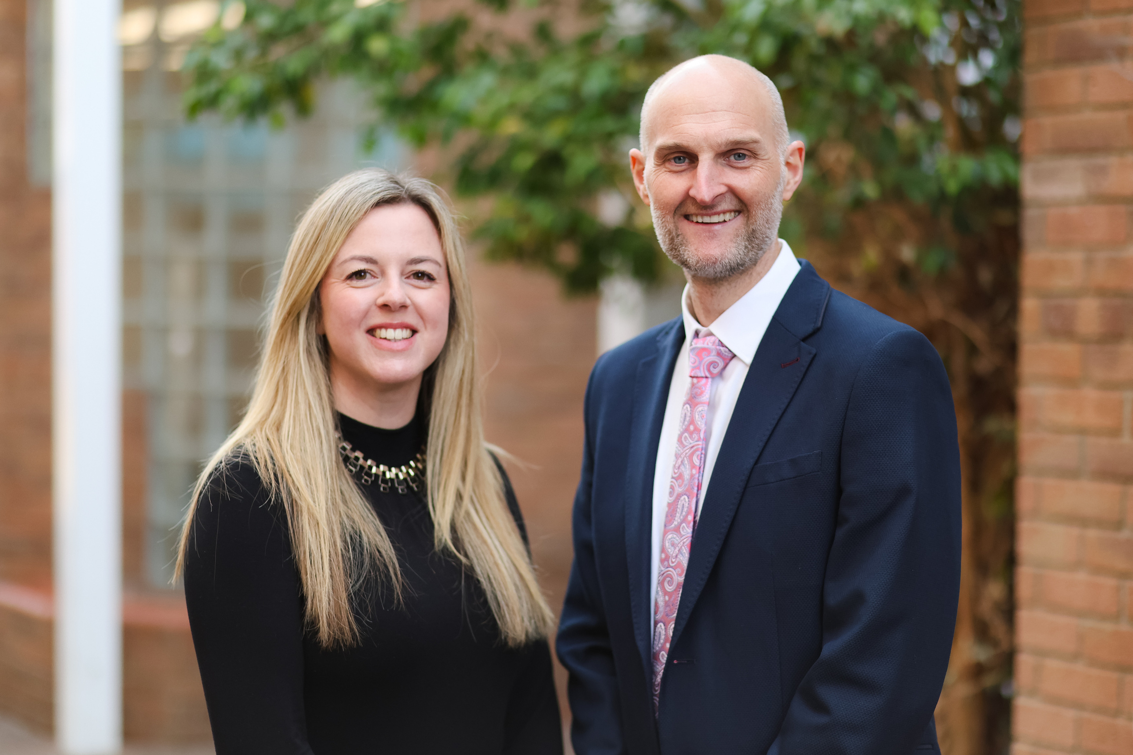

We are invested 100% in delivering a vibrant sixth form, tailored for our community.​
WHY
CHOOSE US?
  We know you!​
  Pastoral support and care​
  1:1 HE application, career support and guidance​
  Our student destination outcomes are excellent ​
  Regular mentoring opportunities​
  Supportive and nurturing environment​
Pat Braybrook - Assistant Principal, Head of Sixth Form
Clare Webster - Deputy Head of Sixth Form

Slide 9
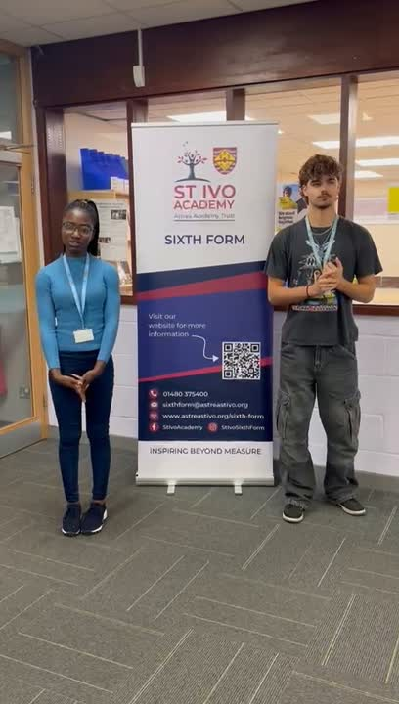
OUR
STUDENT VOICES
I joined your school this year and honestly, I was a bit nervous and excited at first. But I quickly got used to everything and started to feel like I truly belong here. The school’s environment is really nice; the classrooms are well-organised, the technological facilities are very helpful, and especially the library and the sixth form center give us great opportunities both academically and socially.
One of the things I liked the most is how friendly and welcoming both the teachers and students are. When a student has difficulty understanding something, I was really impressed to see how teachers take time to help them one-on-one. The friendships here are also very strong; everyone is respectful and supportive toward each other. Thanks to that, I didn’t feel like an outsider and quickly made new friends. I’m really happy to be here and I feel lucky to be part of this school.
Mehmet - External Student

Slide 10
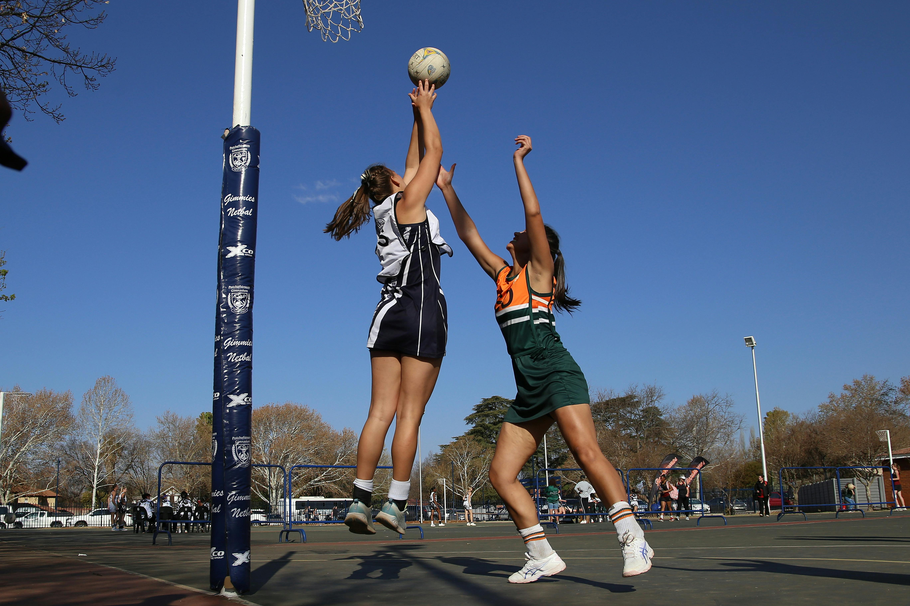
CLUBS, SOCIETIES AND
ENRICHMENT OPPORTUNITIES
Sixth form life offers more than just lessons, with a wide range of clubs, societies and enrichment activities to explore interests and develop new skills. From sports and music to debating and student-led societies, these opportunities are a fun way to connect with like-minded people and make lasting friendships.
  STEM and competitive
  applications
  The faculty cup football
  tournament
  Arts and crafts
  Book club
  Senior choir
  Competitive and recreational sports
  Theatre club and school productions
  Chess club
  Tennis club
  Debating
  Foreign film club
  Italian language
  and culture
  Japanese
  Yoga
  Life skills
  Writing group

Slide 11
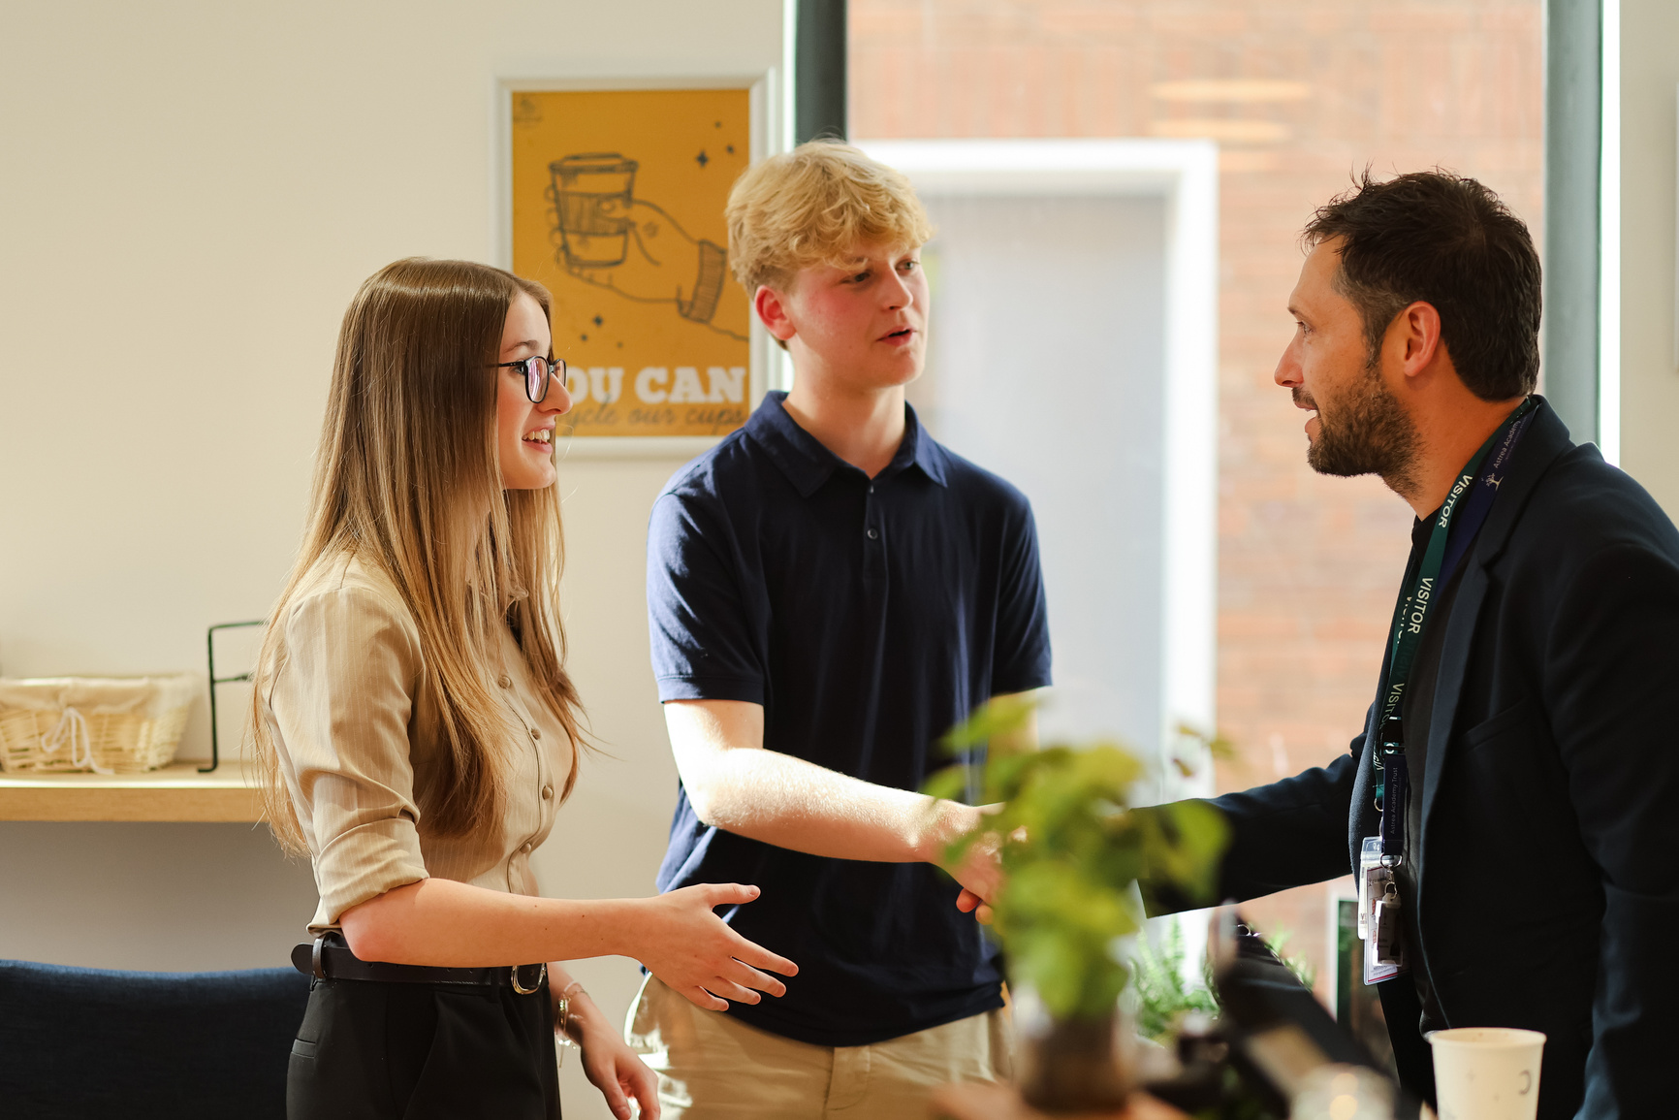
STUDENT
LEADERSHIP COUNCIL
St Ivo’s Sixth Form Leadership Council is a peer-elected group of student representatives who work with staff, house councils, and the whole-school student council to enhance student life, address issues, and plan events. Two Head Students, appointed annually through a competitive process, lead the Council and support committees run by other representatives, ensuring student ideas are acted upon.
Members help shape the school environment, develop leadership skills, and contribute to charitable and whole-school events like Pink Day and the annual charity day. House Captains also sit on the Council, strengthening ties with the House system and providing role models for younger students.

Slide 12









13 JANUARY
JUNE
St Ivo Academy application deadline (in line with most other providers) (*​Non CAP schools differ in some cases)
Year 11 into 12 Sixth Form summer induction days.
02 OCTOBER
Publication of prospectus and Sixth Form Open Evening.
20 AUGUST
GCSE Results day
WB 20 OCTOBER
Publication of option blocks for 2026 entry. Meet with students informally if chosen subject combinations appear problematic.
14 JAN - 13 FEB
03 - 13 OCTOBER
Sixth form offer letters sent out.
School commitment to courses that will run (except if there are significant changes), published.
Year 11 assembly, explaining the “Initial thoughts form” and My Choice 16 tutorial and slideshow presentation by Year 11 team/tutors
14 JAN - 13 FEB
10 OCTOBER
Applicant consultation
Deadline for completing the “Initial thoughts form”

Slide 13
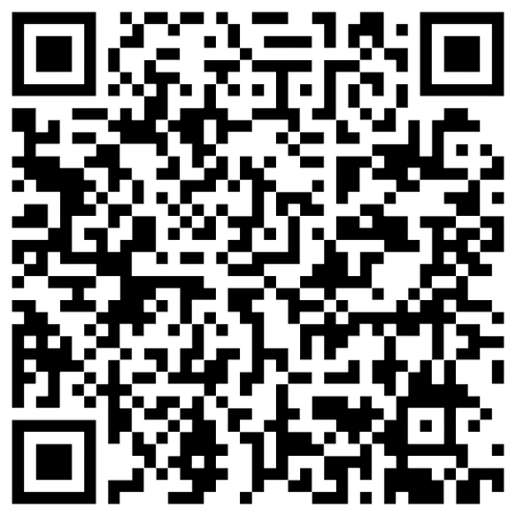
FIND OUT MORE
Ask the experts​
Please ask our students and staff as many questions as possible – they are the experts on our school.​
Tours​​
Come into school during the day and see what it's like for yourself for sixth form students.​
Keep in touch​
If you are an external student, please give us your contact details on the way out so we can keep you updated.
LEAVE YOUR FEEDBACK
Tel: 01480 375400
www.astreastivo.org
Facebook and Twitter @stivoacademy
Instagram @stivosixthform
office@astreastivo.org
sixthform@astreastivo.org
HAVE A GREAT EVENING!

