Slide 1

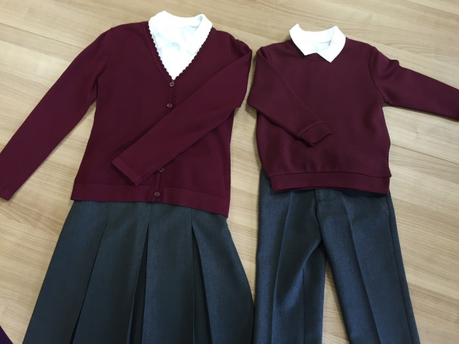
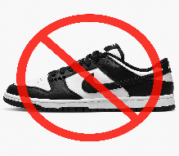
Hartley Brook Academy Uniform
Girls Uniform
Burgundy Jumper or Cardigan (with or without the school logo) - required
Grey skirt, trousers or pinafore dresses - required
White polo shirts (with or without the school logo) required
! Burgundy Gingham checked dresses (Summer only)
Plain White/Grey/Black socks or tights
Plain black shoes/boots/trainers with black laces only
! Small Stud earrings (to be removed for PE)
! A watch if desired (not a smart watch)
! Burgundy, White or Grey hair bands
! Plain headscarves for religious purposes
Boys Uniform
Burgundy Jumper (with or without the school logo)
Grey trousers or tailored shorts
White polo shirts (with or without the school logo)
Plain Grey/Black/White socks
Plain black shoes/trainers with black laces only
! Small Stud earrings (to be removed for PE)
! A watch if desired
PE KIT
Burgundy ‘Hartley Brook PE’ T-shirt or a plain white t-shirt
Plain black shorts, jogging bottoms or leggings
Trainers (any colour) or PE Pumps
! Burgundy Sweatshirt (if desired) with or without logo
Please note all uniform will be available from ASDA/other supermarkets or you can order direct from our uniform supplier Logo Leisurewear using the following website:
https//logoleisurewear.com
Hartley Brook hold regular “pre-loved” uniform sales – please keep a look out for further updates or, ask the school office for further details
Symbol Meanings:-
√ - Required
! - Optional
Not Allowed:
Make–up
Nike Dunks →
Jewellery
Nail varnish or false nails
Baseball caps, PE kit with branded logos on
Sandals, heels, flip flops or Crocs

