Slide 1

Ernulf Academy Wellbeing Team

Slide 2
Meet the Team
Sue Larkins – Educational Services Manager and Wellbeing Team Lead
MHST Co-ordinator
Kimberley Stamford – Designated Safeguarding Lead
Designated Senior Lead for Mental Health
Albus – Wellbeing Dog

Slide 3
The Wellbeing Team’s Role within Ernulf Academy
The Wellbeing Team are qualified mental health first aiders, we are not qualified Counsellors.
The Wellbeing Team is comprised of a group of staff volunteers. This means that the team are not always available to see students on a regular basis.
We are here to:
Promote the safety and wellbeing of both students and staff
Ensure safeguarding for the health and safety of all within the Academy
Advise, and signpost staff and students to the correct agency for their individual needs.
We do work alongside teachers, pastoral and support staff when dealing with students who require support.

Slide 4
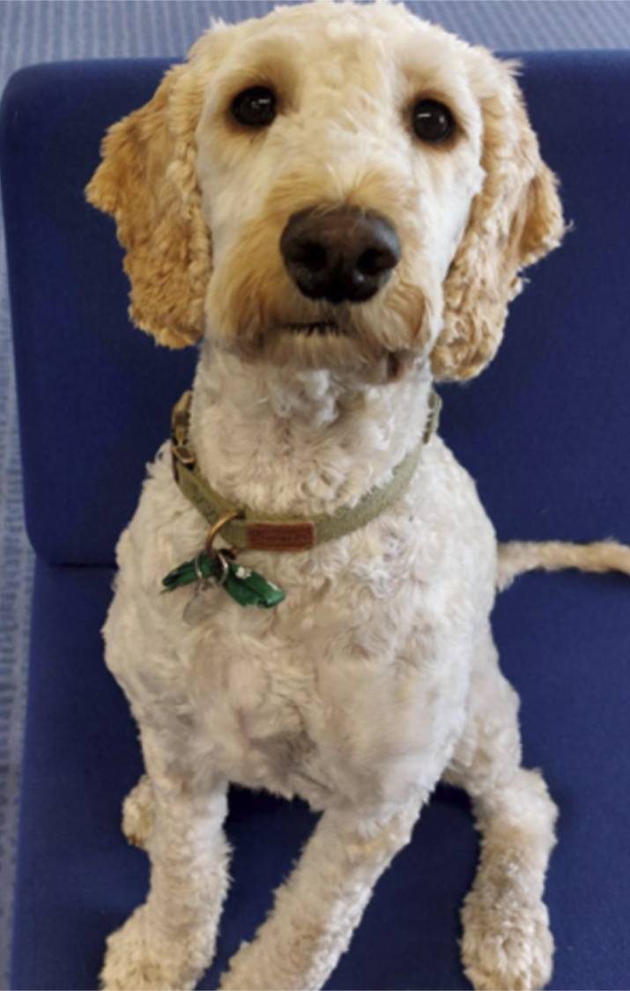
Albus – A brief history of how he became part of our wellbeing team
“First the sad bit. During lockdown I lost both of my elderly Labs, Alice and Molly. Knowing this and having done some research The Academy had already been thinking about the positive affects of getting a wellbeing dog . I was asked as Wellbeing Lead if I would consider getting a puppy that would become part of our wellbeing team and part of the Ernulf community.
Puppies as we all know are hard work, so this was a big decision to make, however I was persuaded. Myself and our HR manager started to look for the right breed of dog for school. Cockapoos are hypoallergenic and have a great temperament. They are intelligent, good-tempered, friendly and love to please.
Albus came from a local breeder and we went to visit him at his home with his mum. It was love at first sight and so here he is!
His role within school is a pastoral one and although he has his “fun moments”, he is also sensitive to situations and will become calm when needed.
Albus has been coming into school since he was 10 weeks old. He is loved by students and staff alike. The young people like to come and visit him and he always enjoys being fussed and played with.
He is based in the Wellbeing Hub but he spends a lot of time in the “Cabin”, which is a safe space for SEN students or students with EHCPs.”
Sue Larkins

Slide 5
The School Counsellors
We have an Astrea Counsellor, Angie Baker, who is assigned to Ernulf. Angie does a total of 4 counselling sessions per week.
Sessions offered within school are face to face, and 50 minutes in total. These sessions are currently on a Thursday.
Each student is offered 6 sessions, with a view to extend to 9 if it is felt the counsellor believes the individual student would benefit from the extra sessions.
Students are asked if they would like to see the counsellor and if they do not wish to, regardless as to whether or not Staff and parents think they should, we respect their wishes.
We will still add them to the waiting list for future sessions should they wish to see a counsellor at a later date.
If a student is already receiving support from another counselling service, due to a conflict of interest that student will not be seen by our Astrea Counsellors. However, this will not exclude them from seeing a member of the Wellbeing Team.

Slide 6
Identifying Students in need
Here are some examples of signs that show students may benefit from speaking with a counsellor
Disengaged from learning
Changes in behaviour - disruptive/making bad choices
Difficulty managing emotions – anger/sadness
Expressing feelings of anxiety/sadness/not knowing how they feel
Issues around food
Isolating themselves
Issues with relationships – friend/family
Constant or increased physical complaints – headache/stomach ache
Frequently talks about morbid subjects - death/suicide
Non attendance

Slide 7
Student in need identified
Discuss with Form Tutor – Tutor to inform Pastoral Co-ordinator
Referral of students to the Wellbeing Team
Pastoral Support
Monitor and perform regular check ins with the student
Pastoral Support
Discuss/refer to HOY
HOY
Complete referral form to Wellbeing Team
Wellbeing Team
Triage according to need

Slide 8

Positively supporting Parents of Children with Self-Harming Behaviours and Other Emotional and Mental Health Needs for Parents and Carers in Cambridgeshire & Peterborough
What they offer:
Free online and face-to-face workshops
Parent Support line for parents/carers of young people with self-harming behaviours: 07932 651319 (open Wednesdays 9 am – 12 pm or by appointment)
Private moderated Facebook support groups:
  Cambridge support group for parents of children/young people that self-harm
  Nessie parent/carer support group for other emotional and mental health needs
1-1 targeted support sessions for complex parental or family needs
Peer support groups
‘Drop In And Chat Coffee Mornings’ – an opportunity to talk about everything and anything

Slide 9

WHAT’S IT ALL ABOUT?
This website is a central point for information on children and young people’s mental health and wellbeing in Cambridgeshire and Peterborough.
This site signposts you to important online information and local services on mental health and wellbeing for young people. It’s for children, young people, parents, carers, teachers and other professionals.
It has some dedicated pages for young people, parents, teachers and professionals under 'How can I help myself', 'Need help now' and 'Resources'. If you are a young person, parent/carer or professional looking for tailored advice and support, also have a look at www.youngminds.org.uk.
https://www.keep-your-head.com/cyp/CP-MHS

