Slide 2
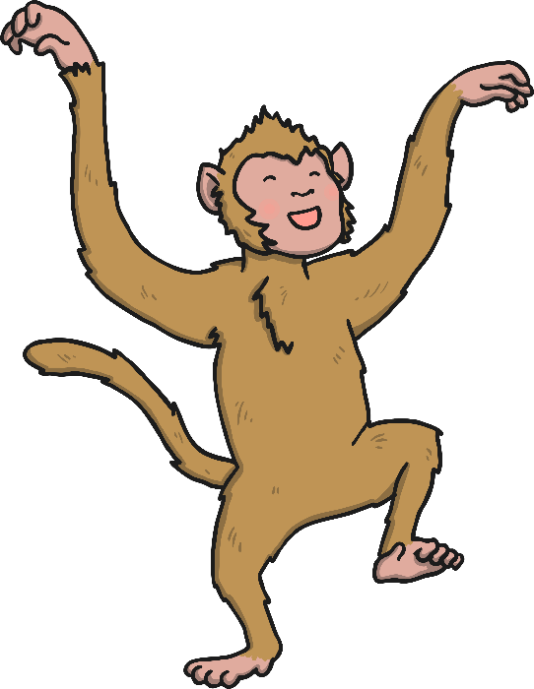
Every time the zookeeper arrives at an animal enclosure and counts the animals, the ‘more than’ monkey adds one more. Can you help the zookeeper work out what one more will be?
Today, the zookeeper is trying to count the animals in each enclosure but the cheeky ‘more than’ monkey is there.

Slide 3
How many lions are there?
Oh no! The ‘more than’ monkey is going to add one more. What is one more than 3?
Reveal Answer
0
1
2
3
4
5
6
7
8
9
10
One more than 3 is 4.

Slide 4
How many elephants are there?
Oh no! The ‘more than’ monkey is going to add one more. What is one more than 5?
Reveal Answer
0
1
2
3
4
5
6
7
8
9
10
One more than 5 is 6.

Slide 5
How many frogs are there?
Oh no! The ‘more than’ monkey is going to add one more. What is one more than 8?
Reveal Answer
0
1
2
3
4
5
6
7
8
9
10
One more than 8 is 9.

Slide 6
How many snakes are there?
Oh no! The ‘more than’ monkey is going to add one more. What is one more than 6?
Reveal Answer
0
1
2
3
4
5
6
7
8
9
10
One more than 6 is 7.

Slide 7
How many seals are there?
Oh no! The ‘more than’ monkey is going to add one more. What is one more than 4?
Reveal Answer
0
1
2
3
4
5
6
7
8
9
10
One more than 4 is 5.

Slide 8
How many parrots are there?
Oh no! The ‘more than’ monkey is going to add one more. What is one more than 9?
Reveal Answer
0
1
2
3
4
5
6
7
8
9
10
One more than 9 is 10.

Slide 9
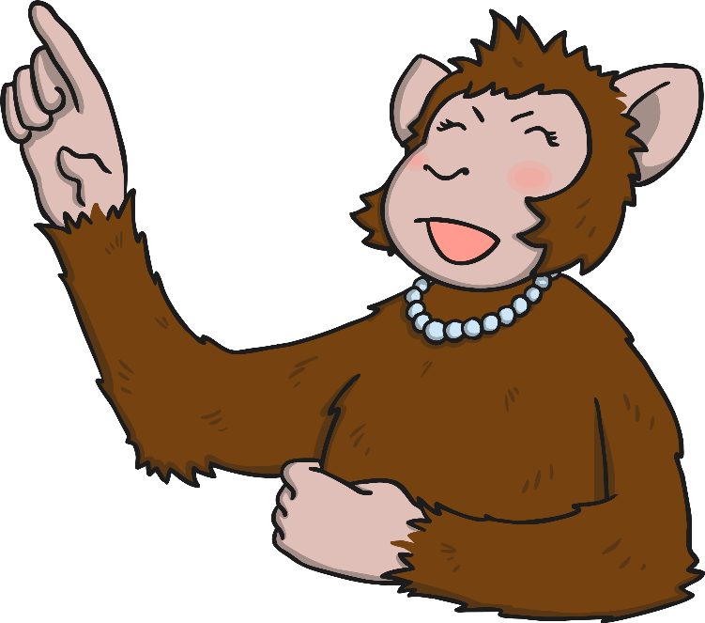
The cheeky ‘more than’ monkey has added one more himself. What’s one more than 1?
Reveal Answer
One more than 1 is 2.
The cheeky ‘more than’ monkey is in trouble with Mummy monkey for confusing the
zookeeper… Oh dear ‘more than’ monkey!

