Slide 1
www.youngwriters.co.uk

Slide 2
Today you are going to write a poem for Young Writers’ Imagine competition!
Grab a pen or open Word etc to make any notes...
Let’s get started!
Quick Activity
You have 2 minutes to write down a short
paragraph of what you think makes a good poem...

Slide 3
Learning Outcomes & Success Criteria for today’s lesson:

Slide 4
Watch the video that introduces you to the activity:
https://youtu.be/_-NnWGKNNOA
Then we’ll learn more about a poem and what you could write about

Slide 5
A brief history of poetry...
Poetry has been around for centuries, from epic Greek poems and 13th century sonnets to news being told in rhyme in the Middle Ages to modern-day poets advertising high street banks on TV!
Poems express emotions, feelings, thoughts, ideas and much, much more!
Quick Activity
You have 2 minutes to write down the names of any poets or poems you know...

Slide 6
Now we’re going to explore ideas to write poems about...
Revenge or justice?
A crime has been committed against you, do you choose justice or revenge?
Quick Activity
Write down why you made that choice and any emotions you felt.
Now think about these additional questions:
Imagine if the criminal was actually innocent?
Imagine if you regretted taking revenge?
Imagine if you enjoyed revenge so much it changed you?
Imagine if you chose justice and the criminal walked free?
Do you feel differently now?

Slide 7
Death or immortality?
You have been offered this exclusive opportunity, only you have this choice, no other humans, do you choose death or immortality?
Quick Activity
Write down why you made that choice and any emotions you felt.
Now think about these additional questions:
Imagine if you never aged from the day you agreed to be immortal?
Imagine if your choice meant instant death?
Imagine if you knew you’d suffer in life if you stayed mortal?
Imagine if external life drove you insane?
Do you feel differently now?

Slide 8
Now it’s time to think of ways to create questions or poetry prompts to inspire your poem...
Quick Activity
What do you find interesting and would like to write about?
Note your ideas down.
And write down one ‘Imagine’ question for each of your ideas.

Slide 9
Here are some Imagine question ideas:
Sports: Imagine if I won scored the winning goal at The World Cup?
Reality TV: Imagine if they knew the real me?
Nature: Imagine if the whole world flooded?
Politics: Imagine if kids ran the world?
You can you use this as an opportunity to tackle bigger subjects like mental health, prejudice or bullying, or keep it light-hearted... Imagine if had a super power?

Slide 10
Now let’s explore poetry types and techniques...
Quick Activity
You have 1 minute to write down as many poetry types as you know...

Slide 11
Acrostic
Where the first letter of the word is written vertically and the initial letter forms a word. You could use the word imagine, use a theme or name, it’s a fun and versatile poetic form!
I f aliens exist, I expect to see them
F lying down to Earth in spaceships
A lighting from their craft
L ike nothing we’ve ever imagined
I n countless Hollywood movies
E xtraterrestrial life will take us by surprise
N othing will ever be the same again
S uppose they attack us?
E xtraordinary powers never seen before
X -ray vision seeing to the heart of us
I wonder what they’ll think of us… Perhaps they’ll
ee what we’ve done to our world, and
urn around, never to come back.

Slide 12
Narrative Poem
Tells a story by using verses and poetic techniques.
If I Lived Underwater
As I live underwater I wake each morning Through the waves I see the sun dawning. Cereal goes soggy, so my breakfast feast
Is made from barnacles and crunchy seaweed. I drift through currents to see my friends Diving through the twists and bends.
But in-between the coral reef
I see some shiny, glinting teeth. The shark is here! Swim away! He’s out searching for some prey. A close escape, a narrow miss, That explains the lack of tropical fish.
I grab a driftwood spear from the ocean floor And threaten the shark to return no more. He swims away without looking back This is not the place for his fishy snack!
My friends return and we dance on the sand While listening to the Coral Reef Band This is my life under the sea
The water’s lovely, come and join me.

Slide 13
Anthem
Uses repeated lines or a chorus, could be sung!
If Superpowers Were Real
If superpowers were real, I’d fly high into the sky, Free like a bird on the wing.
My heart would sing!
If superpowers were real. I’d turn invisible as air,
Sneaking around, what fun it’d bring!
My heart would sing!
If superpowers were real,
I’d teleport instead of using transport, Travelling faster than you can blink.
My heart would sing!
If superpowers were real,
My super-strength would be the envy of all, I’d beat any bad guys in the ring.
My heart would sing
If superpowers were real,
My powers would know no bounds, More powerful than a king.
My heart would sing!
If superpowers were real.

Slide 14
Repetition
Repeating a line or a phrase, such as ‘Imagine if...’ helps convey the message to the reader and also creates a natural rhythm to the poem
Imagine if they knew the real me Imagine if they saw my hidden scars
Imagine if they knew how their words cut deep Imagine if this mask slipped
Imagine if, just imagine.

Slide 15
Imagery
Using senses and descriptive language to help readers empathise, connect and relate to the poem.
Cereal goes soggy, so my breakfast feast
Is made from barnacles and crunchy seaweed.
Can you imagine eating that?!

Slide 16
Metaphors
Make a comparison between two things that aren't alike but do have something in common to help the writer make their point.
He is a shining star He is a book of facts He is a cunning fox He is a raging bull He is a ball of fire He is me.

Slide 17
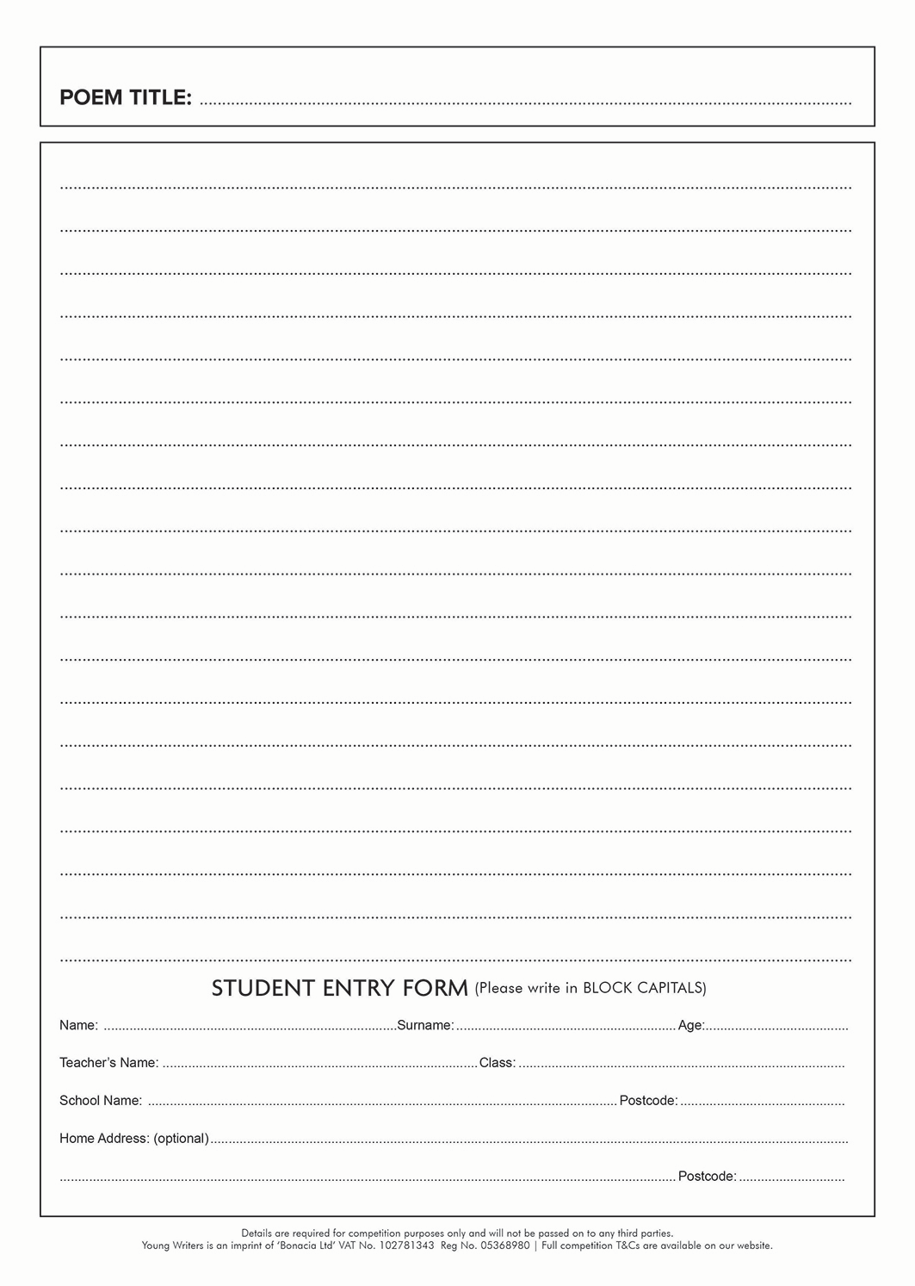
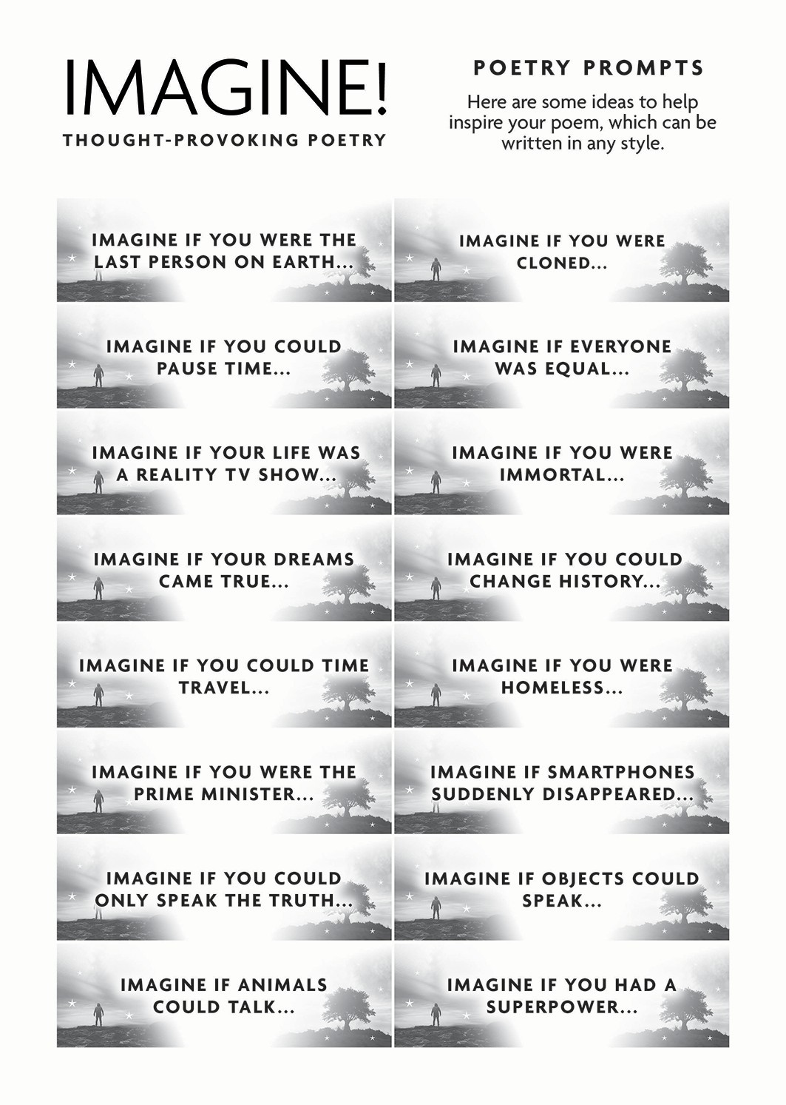
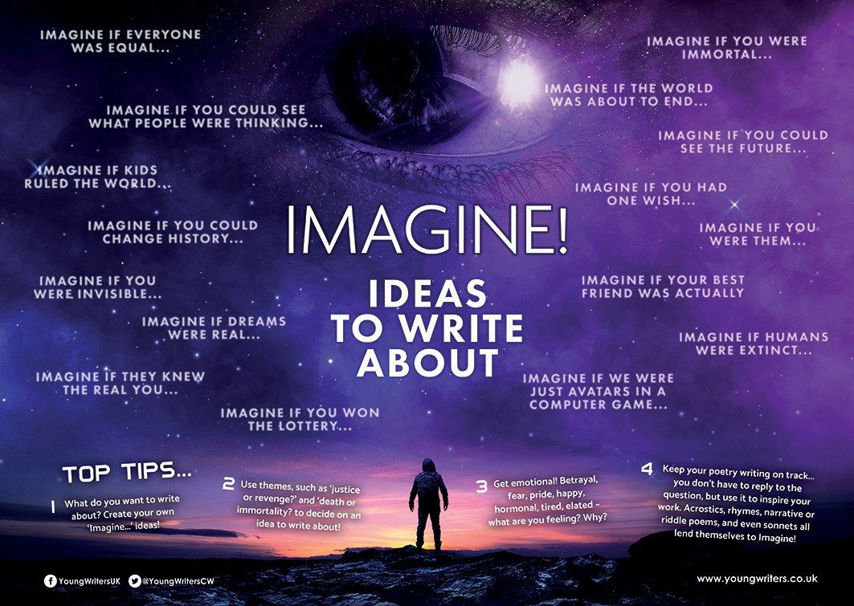
To help you write your poem there are some resources. These will help you generate ideas, plan and write your piece:
You also have different ways to enter, your teacher will let you know which way:
Student entry form (printed and completed in pen)
Word doc entry form (typed entry into and save file as your name)
Online writing portal (you will be given a login link by your teacher and then follow the instructions on screen)

Slide 18
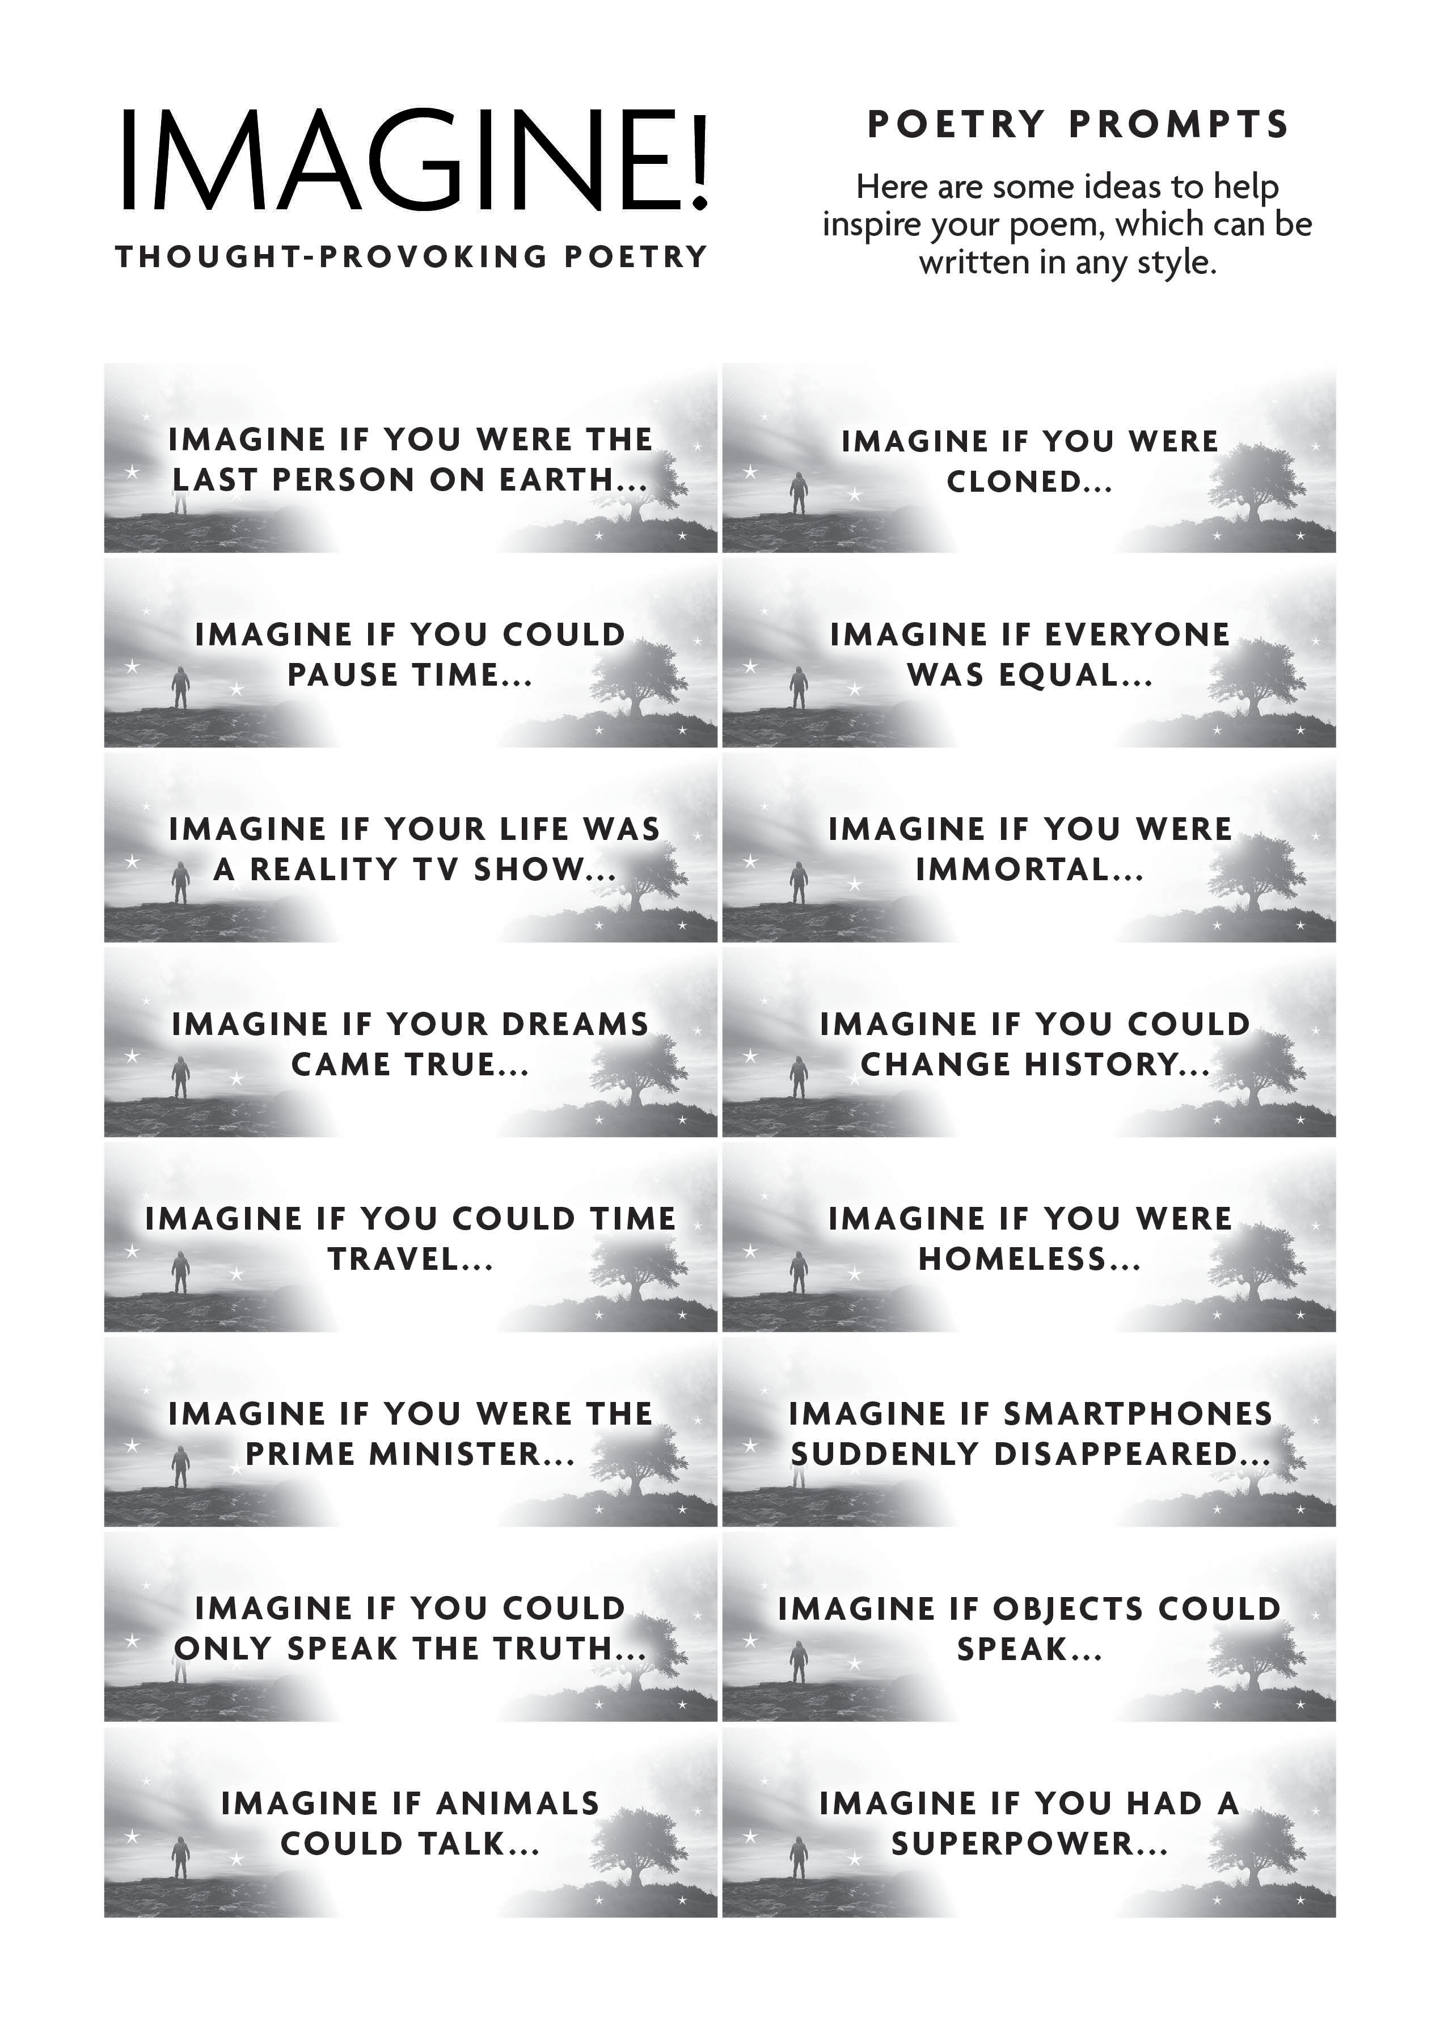
Feel free to use any of these poetry prompts or use your own idea:

Slide 19
Differentiation ideas
Bronze Activity
Your teacher will give you a poetry prompt and a poetry type, such as an acrostic to use.
Silver Activity
Choose a poetry prompt from slide 19. Your teacher will provide you with two narrative technique options and allow you to decide which narrative type to use. If possible, work with a partner to help generate ideas and vocabulary that you could use in their work..
Gold Activity
You work independently to create your own poem inspired by your own ‘Imagine!’ question. Choose the poetry type you’d like to use allowing you to showcase your vocabulary, writing and editing skills.
Platinum Activity
Your teacher will challenge you to write in a certain poetry style that will push your creativity! Create your own ‘Imagine!’ question to inspire your poem. Use a dictionary & thesaurus so you can use higher level vocabulary as well as edit your own work.

Slide 20
It’s time to get writing!
You can choose an optional poetry prompt or use your own idea
Your poem can be in any poetic style
Your poem must be your own original work – not a copy of someone else’s!
If you have any questions, please ask your teacher now!

Slide 21
Review your poem:
Does it make sense?
If you have used a poetic form with rules, does it follow them (e.g. a sonnet)
If you have used speech, is it clear who is speaking and when?
Does your poem flow – read it aloud & make any changes, if needed.
If you are able to share your poem with a classmate to provide feedback to you please do! Ask them to tell you why they like it and one thing you could do to improve it.

Slide 22
It’s time to submit your work to your teacher.
So hand in the form if you’ve written it in lesson.
Email or upload your work to your teacher if homework or remote learning
Click “finished” on your work if using the online writing portal
Make sure your name and age are on your work!

Slide 23
www.youngwriters.co.uk
YoungWritersUK
YoungWritersCW
youngwriterscw

Slide 24
Hello!
Thank you for downloading this PowerPoint, here are a couple of quick notes for you...
Slide 5 is left blank for you to add your own learning outcomes / success criteria
The PowerPoint is editable, so you can add images and info, or examples etc, should you wish to
We hope you and your students enjoy this lesson!

