Slide 2
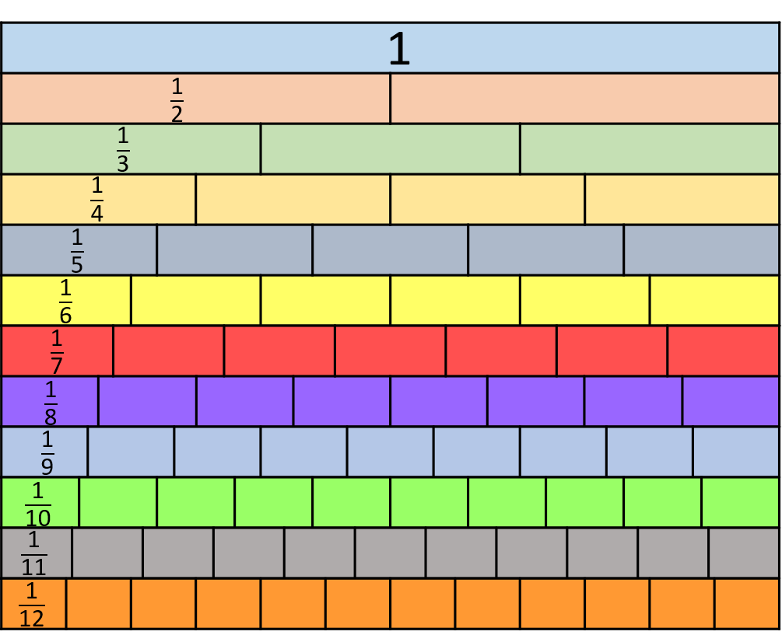

$\frac{\text{5}}{\text{6}}$ = $\frac{\text{10}}{\text{1}\text{2}}$
$\frac{\text{9}}{\text{12}}$ = $\frac{\text{3}}{\text{4}}$
3) $\frac{\text{6}}{\text{9}}$ = $\frac{\text{2}}{\text{3}}$
0
1

Slide 3
10
$\frac{\text{5}}{\text{6}}$ = $\frac{\text{10}}{\text{1}\text{2}}$
$\frac{\text{9}}{\text{12}}$ = $\frac{\text{3}}{\text{4}}$
3) $\frac{\text{6}}{\text{9}}$ = $\frac{\text{2}}{\text{3}}$
0
$\frac{\text{9}}{\text{12}}$
1
3
$\frac{\text{3}}{\text{4}}$
6

Slide 5
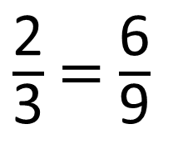
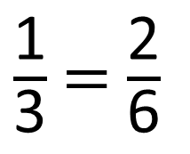
2
$\frac{\text{1}}{\text{3}}$ = $\frac{\text{2}}{\text{6}}$
6
$\frac{\text{2}}{\text{3}}$ = $\frac{\text{6}}{\text{9}}$
Have a think

Slide 6
Have a go at questions 1 – 2 on the worksheet

Slide 7
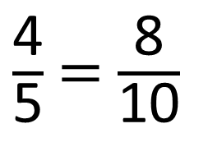
8
Use the different representations
to find the equivalent fraction.
$\frac{\text{4}}{\text{5}}$ = $\frac{\text{8}}{\text{10}}$
Have a think
$\frac{\text{4}}{\text{5}}$
$\frac{\text{8}}{\text{10}}$

Slide 8
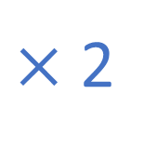
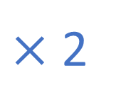
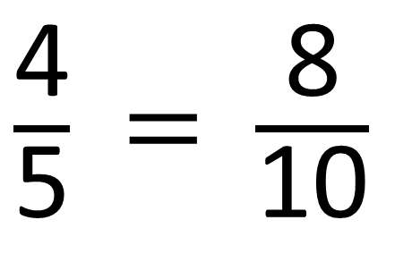
Have a think
$×$ 2
$\frac{\text{4}}{\text{5}}$ = $\frac{\text{8}}{\text{10}}$
$×$ 2
What do you notice?

Slide 9
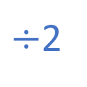
$×$2
$÷$2
$×$2
$÷$2
$×$3
$×$3

Slide 10
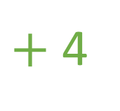
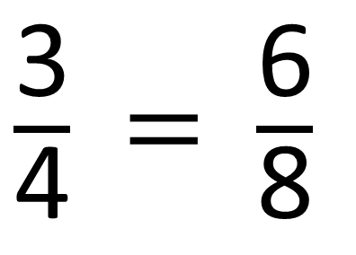
Have a think
$+$ 4
7
$\frac{\text{3}}{\text{4}}$ = $\frac{\text{6}}{\text{8}}$
$+$ 4
Do you agree with Tiny?

Slide 11
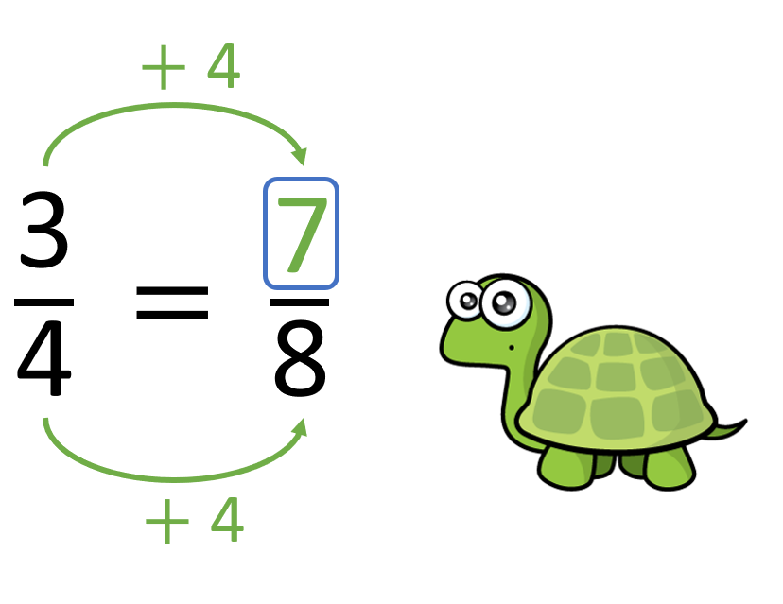
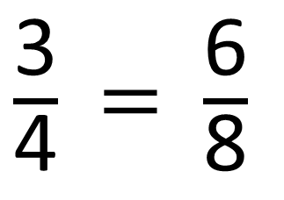
$×$ 2
$\frac{\text{3}}{\text{4}}$ = $\frac{\text{6}}{\text{8}}$
$×$ 2

Slide 12
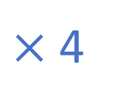
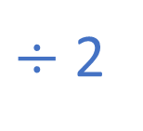

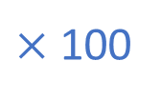
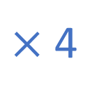
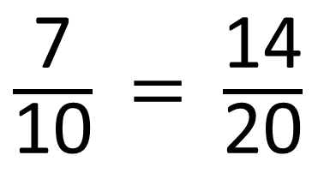
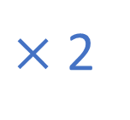
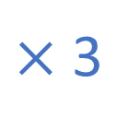


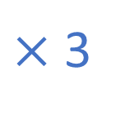

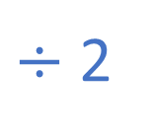
Have a think
$×$ 4
$×$ 3
12
$\frac{\text{3}}{\text{4}}$ = $\frac{\text{12}}{\text{16}}$
$\frac{\text{2}}{\text{9}}$ = $\frac{\text{6}}{\text{27}}$
27
$×$ 4
$×$ 3
$÷$ 2
$×$ 12
$×$ 2
$×$ 100
6
36
$\frac{\text{7}}{\text{10}}$ = $\frac{\text{14}}{\text{20}}$
$\frac{\text{3}}{\text{7}}$ = $\frac{\text{12}}{\text{16}}$
300
10
14
84
700
$×$ 12
$÷$ 2
$×$ 2
$×$ 100

Slide 13
Have a go at questions 3 – 4 on the worksheet

Slide 14
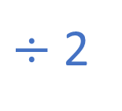
Have a think
$×$ 3
$÷$ 2
$×$ ?
15
$\frac{\text{3}}{\text{4}}$ = $\frac{\text{15}}{\text{20}}$ $=$ $\frac{\text{9}}{\text{12}}$ $=$ $\frac{\text{6}}{\text{8}}$
4
12
$×$ 5
$×$ ?

Slide 15
Have a go at the rest of the questions on the worksheet

