Slide 1
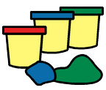
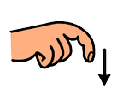
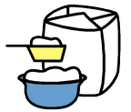
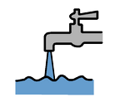
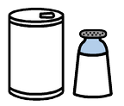
How to make playdough!
You will need:
Flour
Water
Oil
Colouring
Salt
1 |  | Mix together the flour and the salt
2 |  | Add the water, oil and food colouring.
3 |  | Mix it altogether
4 |  | Knead well

