Slide 2
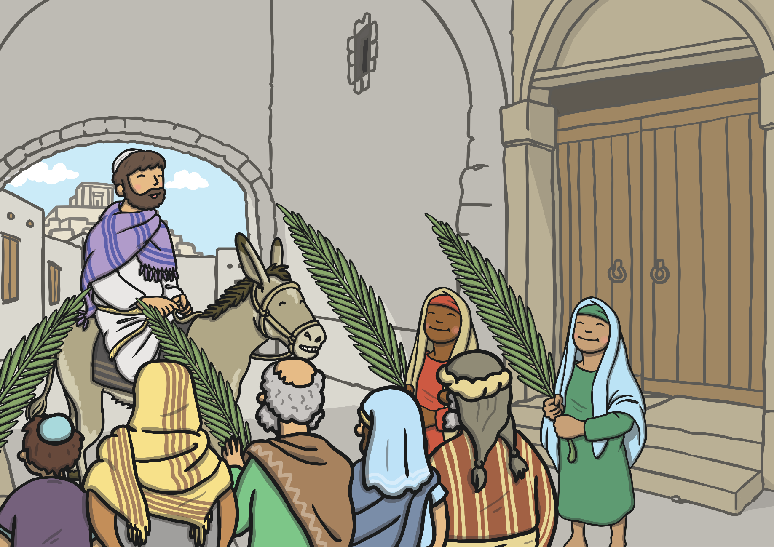
Jesus arrived in Jerusalem on Palm Sunday. The people were happy to see Jesus and waved palm branches.

Slide 3
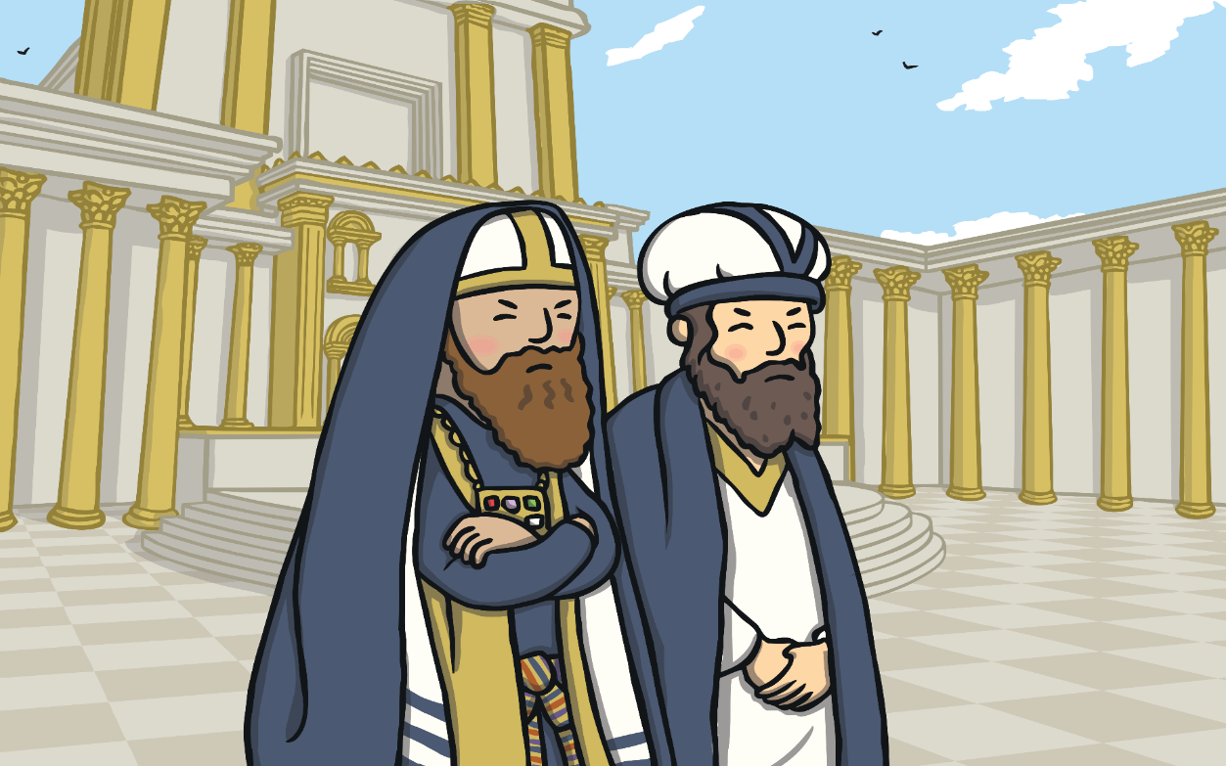
Some important people were jealous of how much the people loved Jesus.

Slide 4
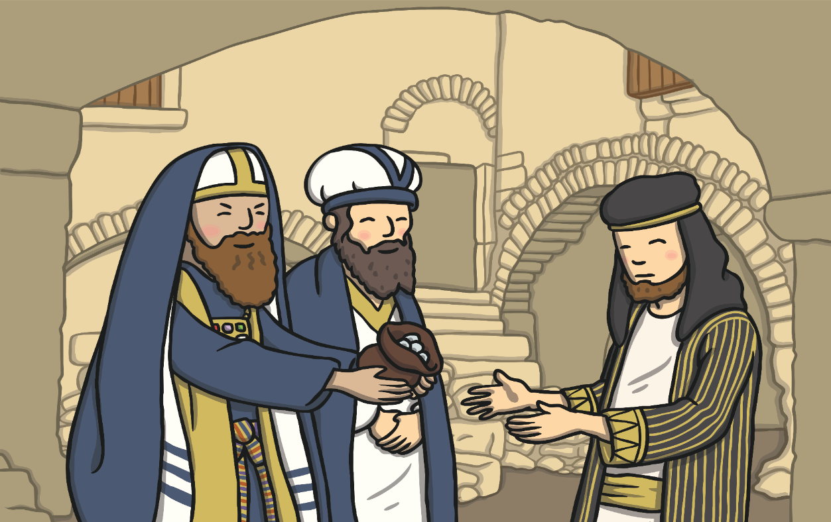
Judas was one of Jesus’ special friends. The important people gave Judas money to tell them where Jesus was so they could arrest him.

Slide 5
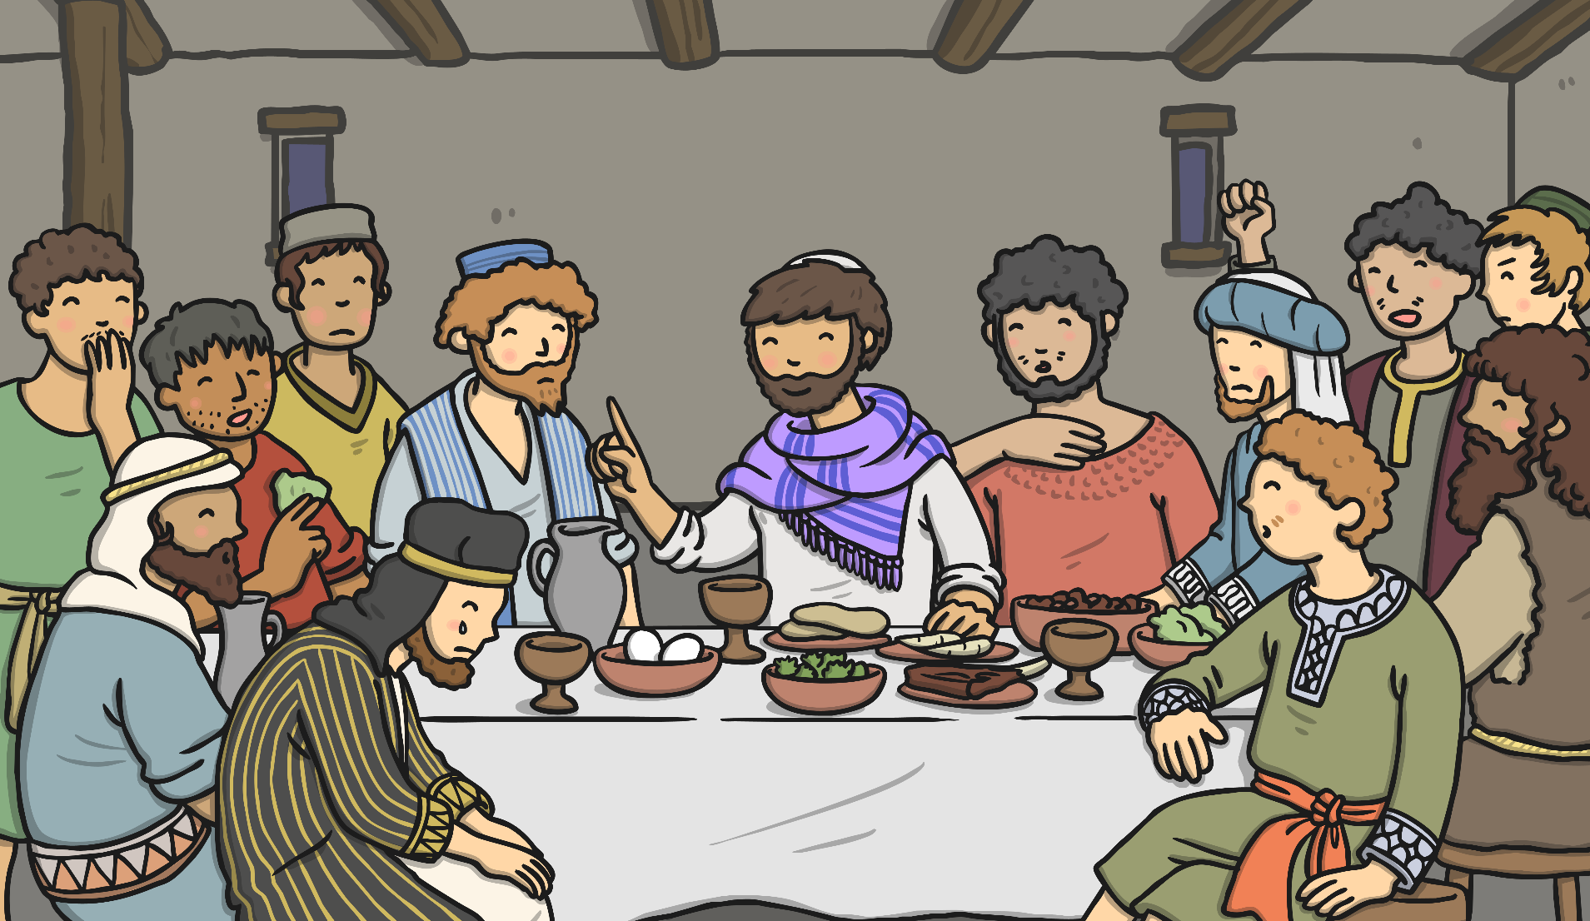
Jesus had a special dinner called a Passover meal with his friends. This meal is now known as the Last Supper.

Slide 6
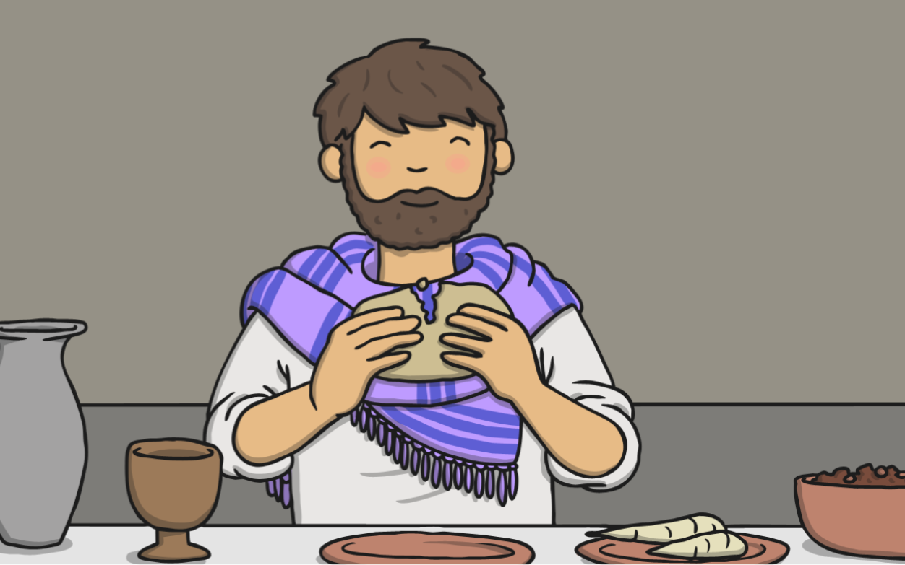
Jesus gave his friends bread and wine. He then told them that one of them had turned against him.

Slide 7
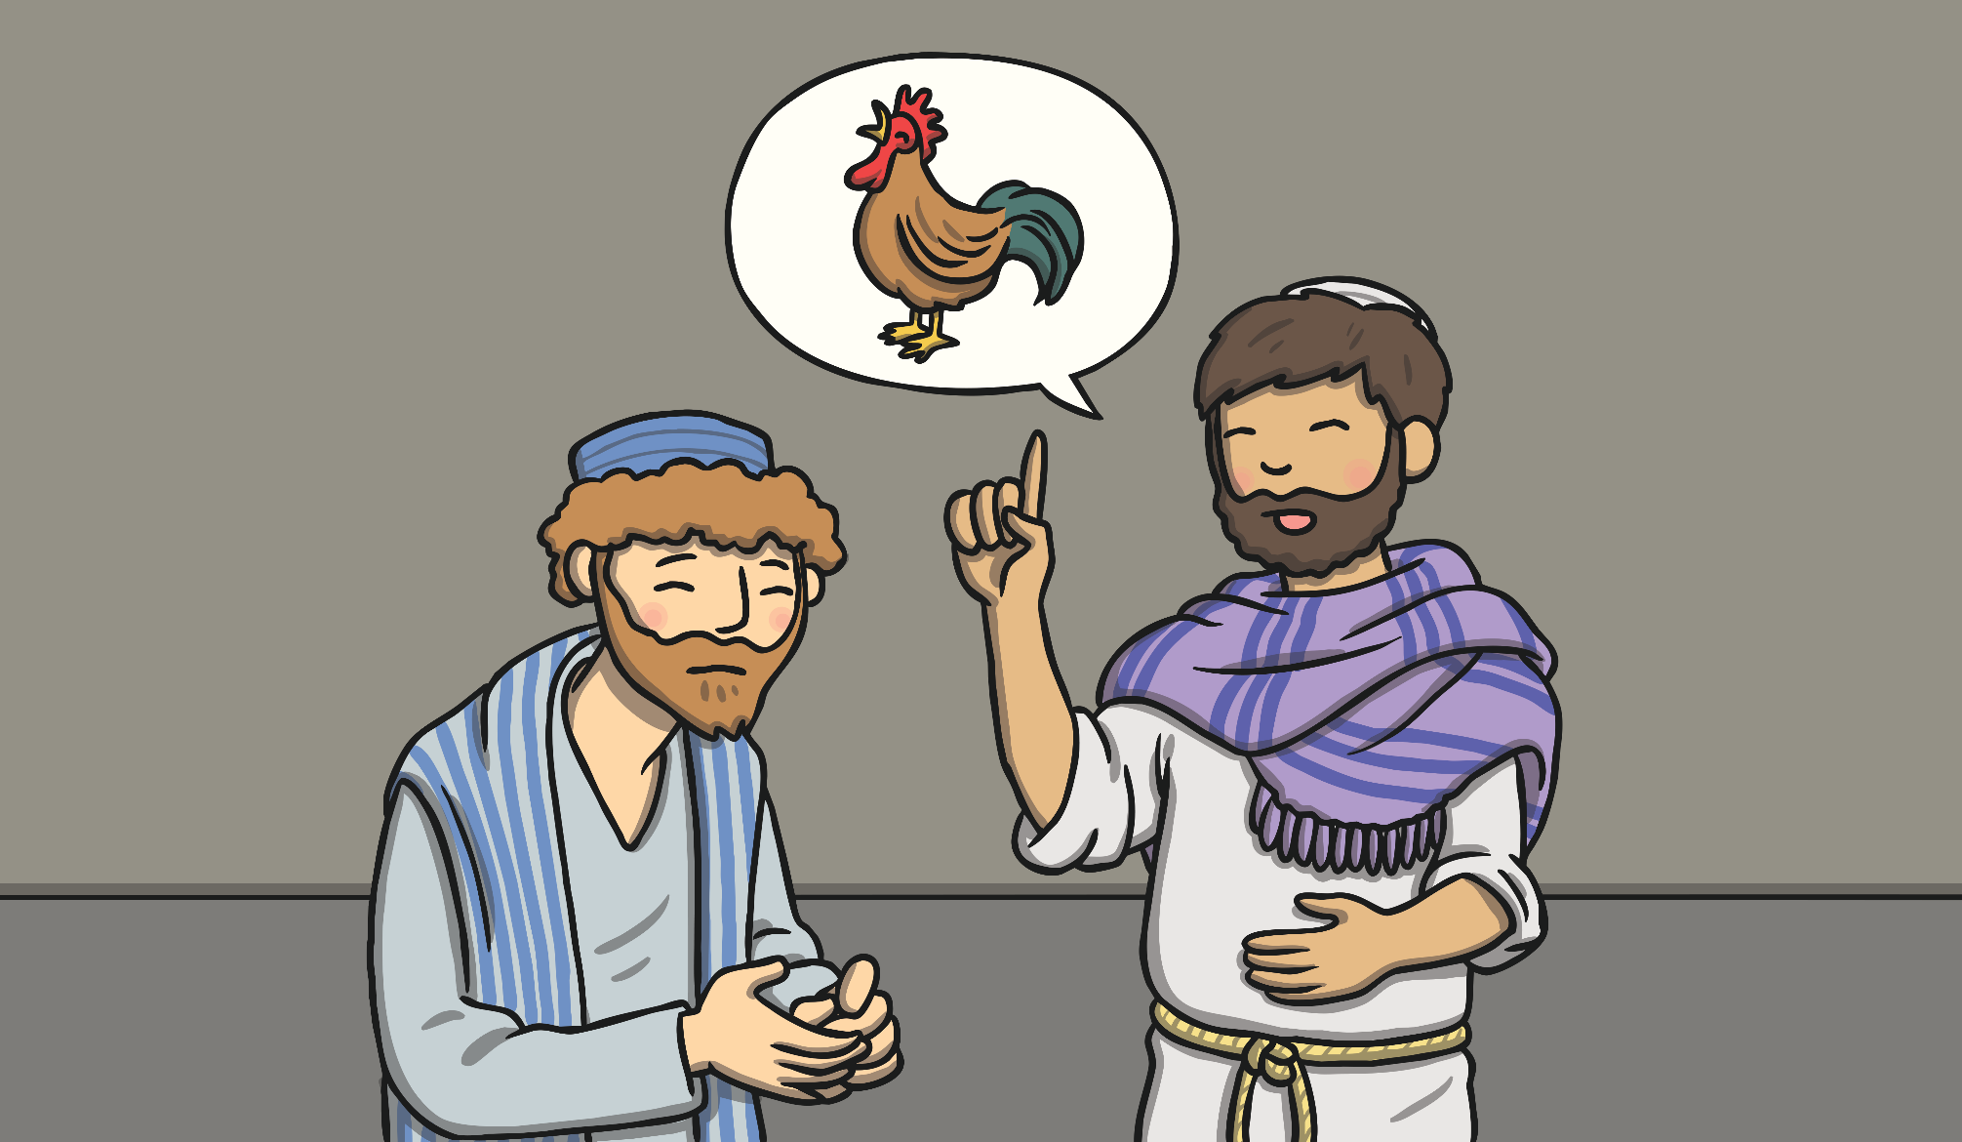
Jesus said that Peter would pretend he didn’t know Jesus before the morning arrived and the cock crowed.

Slide 8
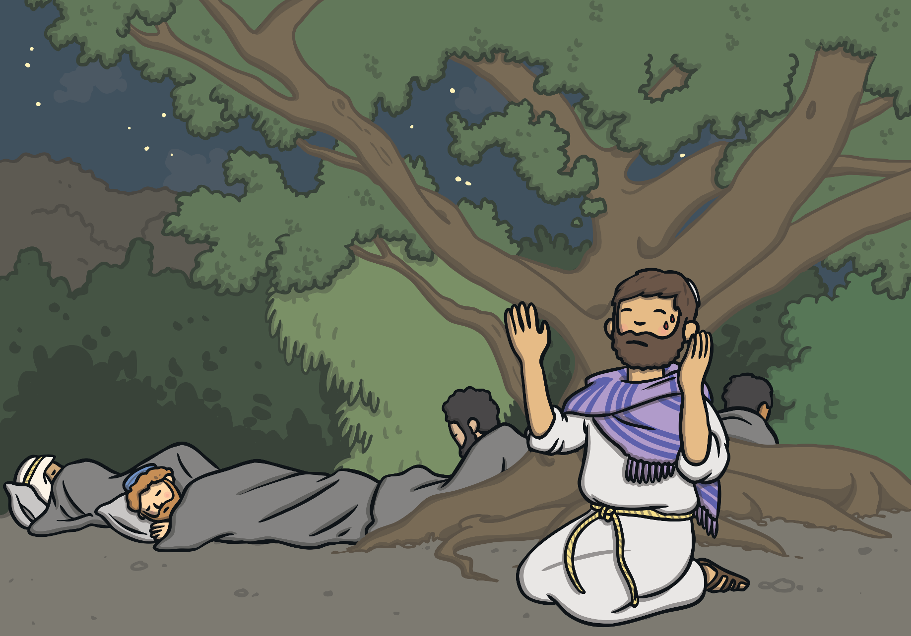
Then Jesus went to pray in the garden of Gethsemane.

Slide 9
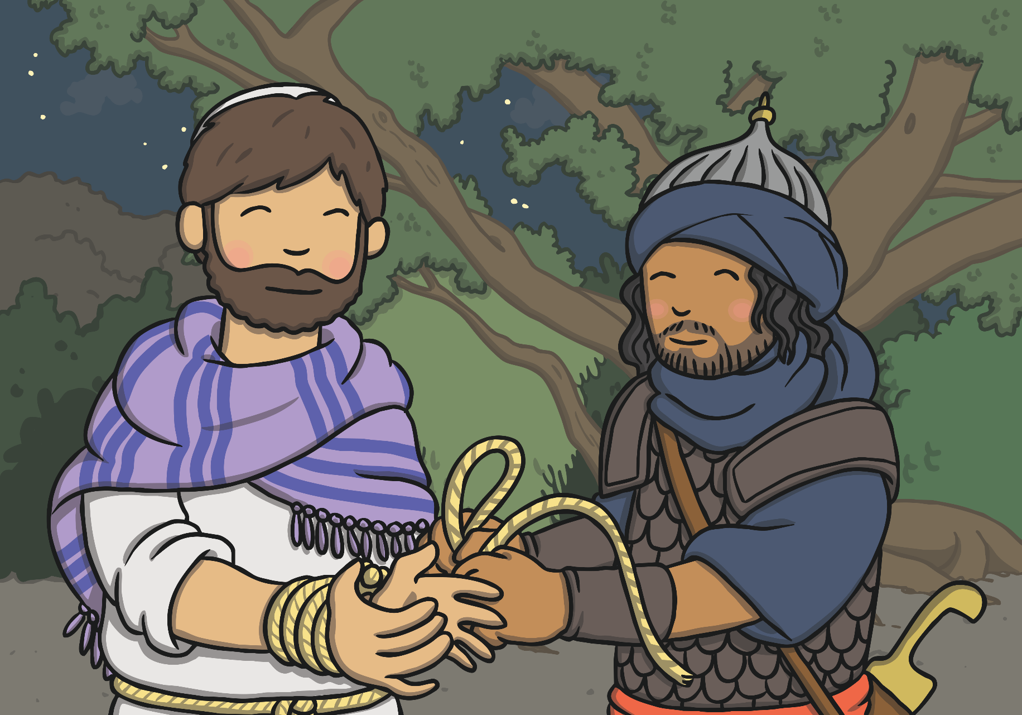
Judas told the important people where Jesus was. Jesus was arrested.

