Slide 1
The Cautious Caterpillar
Adapted story based on the book by Twinkl

Slide 2
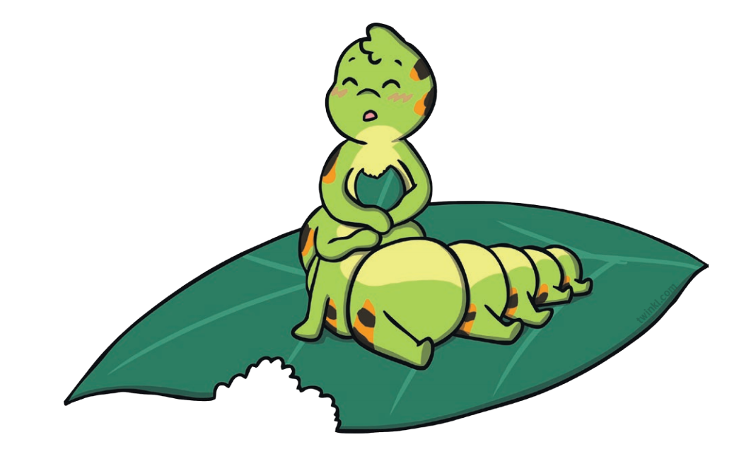
Once upon a time there was a caterpillar who hatched from an egg. “I love being a caterpillar!” she said, as she ate a big, juice leaf.
Week 1: Caterpillars, eggs, food

Slide 3
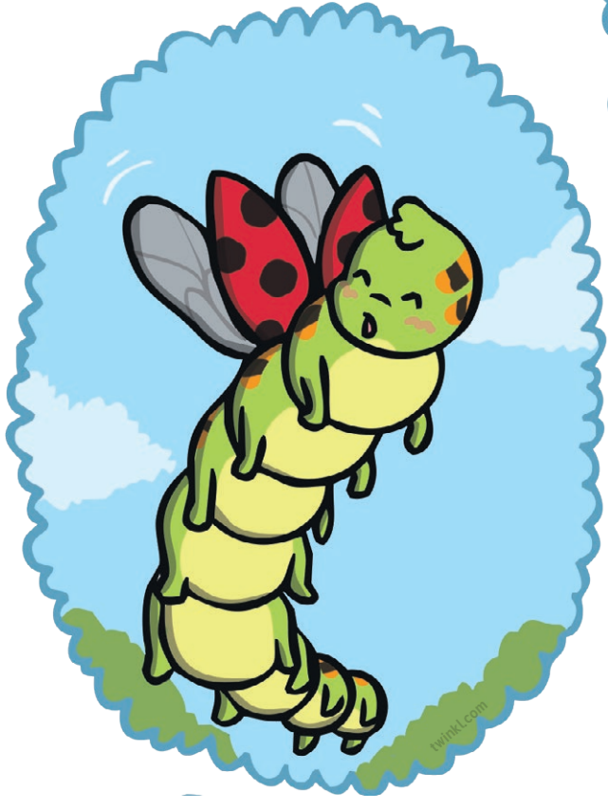
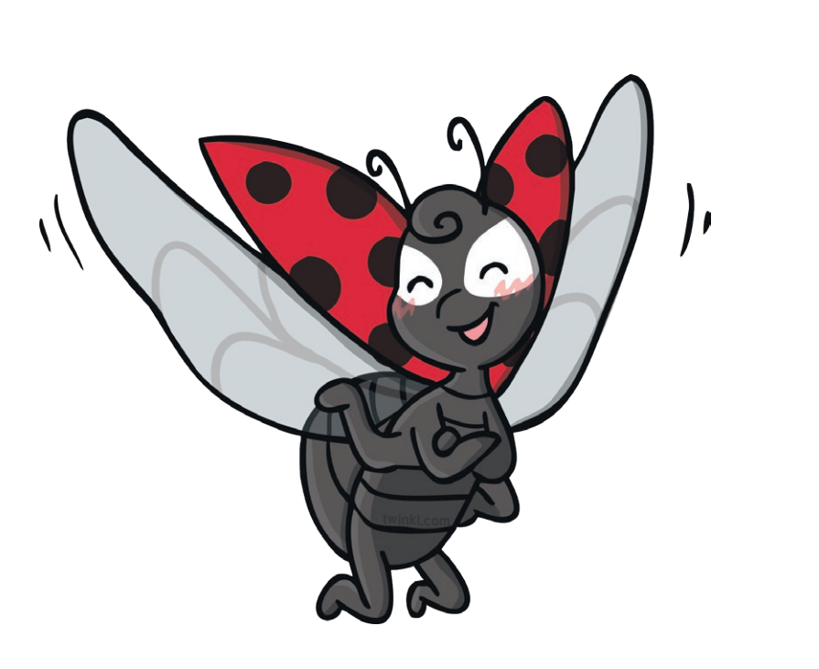
One day she met a flying ladybird. “One day you’ll be a butterfly and have wings like me,” said the ladybird. But the caterpillar didn’t listen and carried on eating.
Week 2: Ladybirds, things that fly

Slide 4
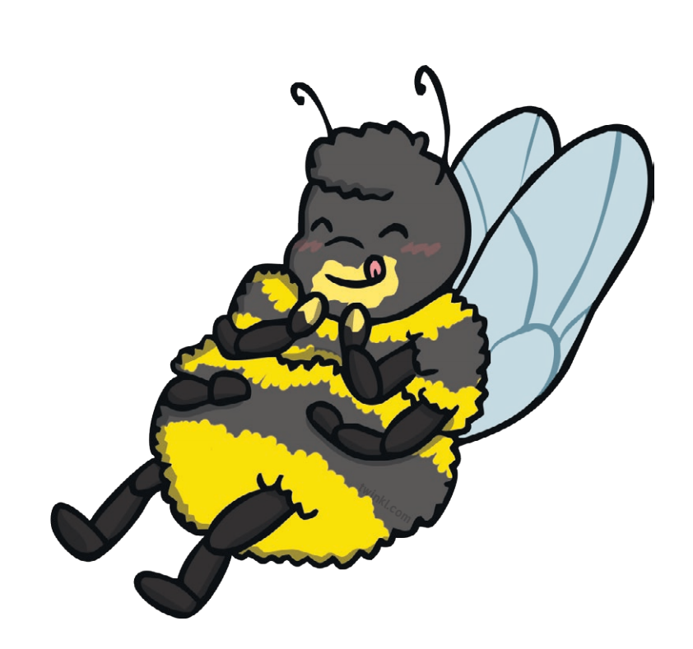
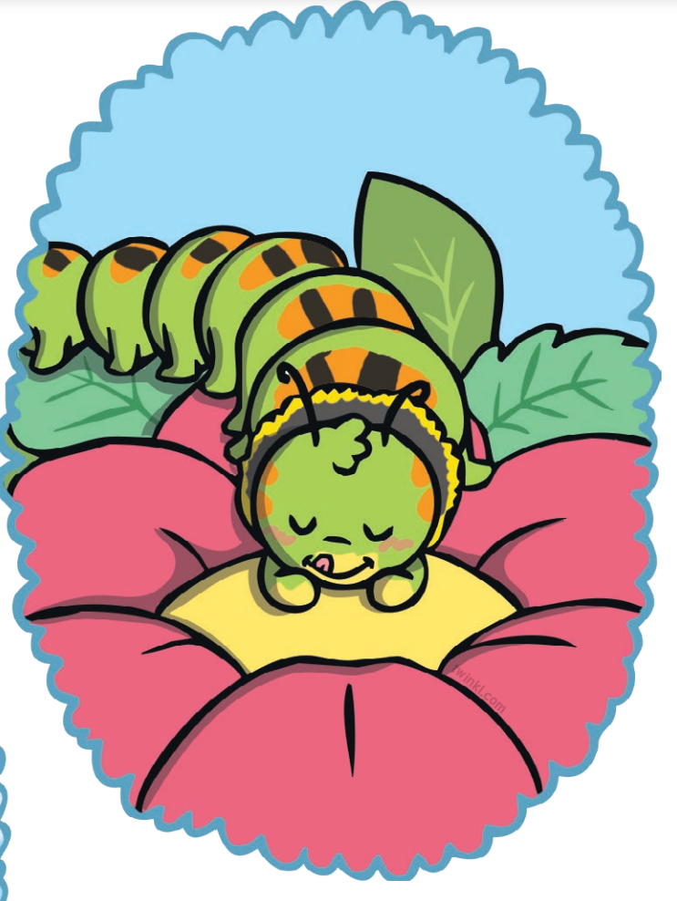
Next she met a buzzy bee. “One day you’ll be a butterfly and drink nectar like me,” said the bee. But the caterpillar didn’t listen and carried on eating.
Week 3: Bees, healthy food and drinks

Slide 5
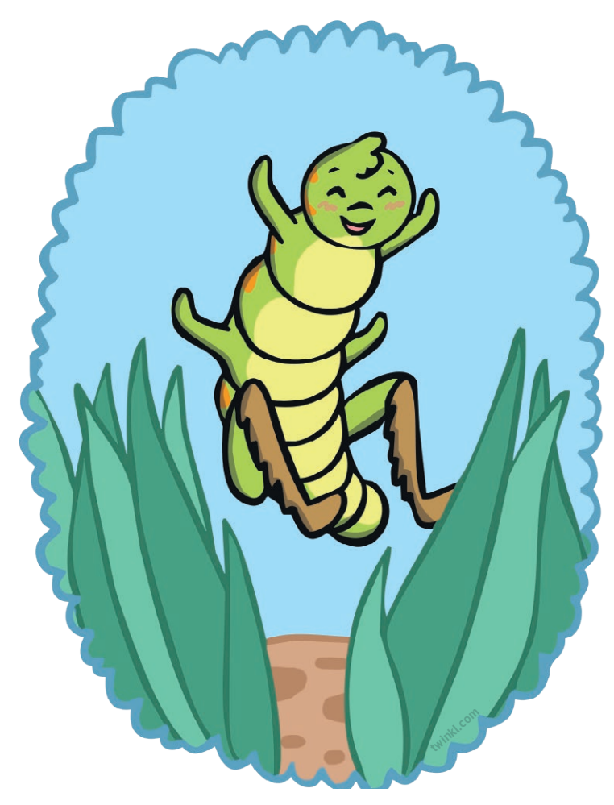
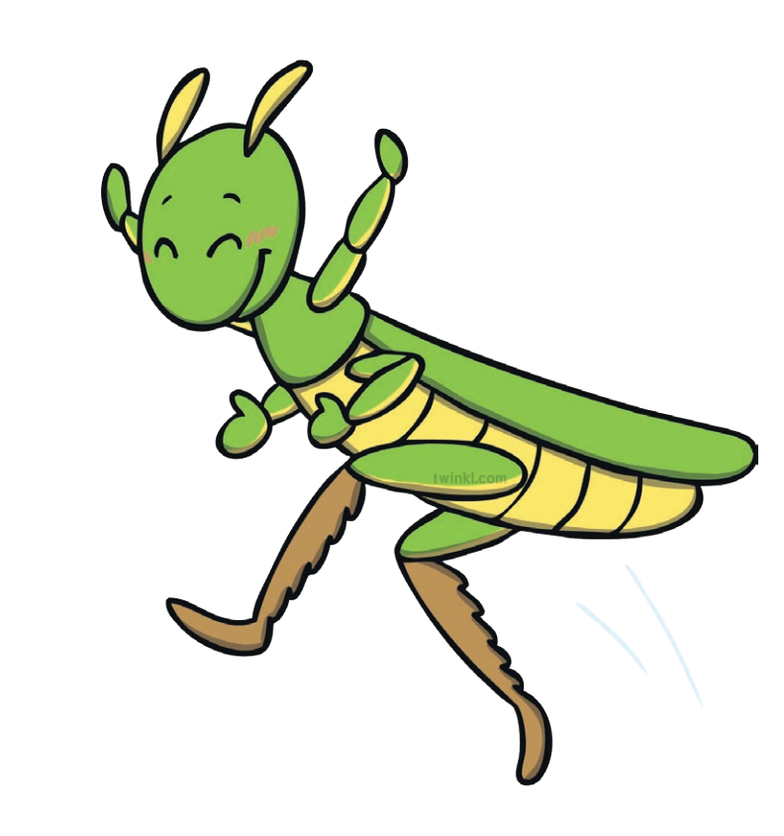
Next she met a jumping grasshopper. “One day you’ll be a butterfly and have 6 legs like me,” said the grasshopper. But the caterpillar didn’t listen and carried on eating.
Week 4: Grasshoppers, things that jump

Slide 6
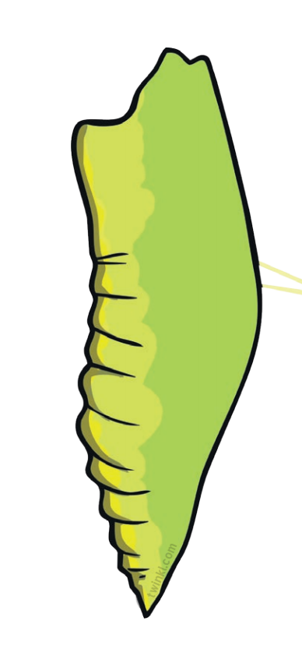
The next day she decided to stop eating her and turn herself in a chrysalis, and then she waited and waited and waited.
Week 4: Chrysalis, sleep/relaxation

Slide 7
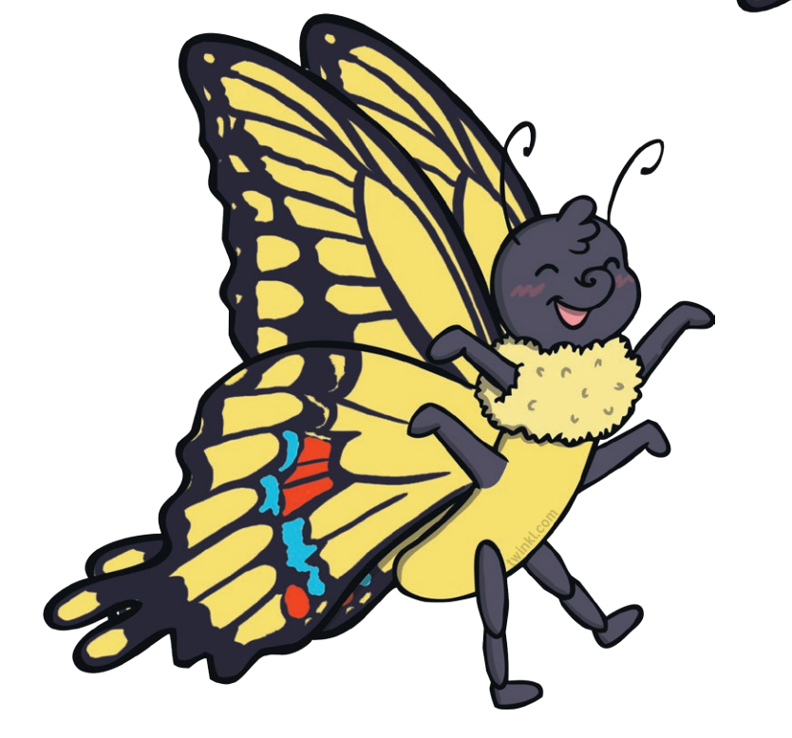
Until finally… she became a butterfly! She flew around with the ladybird, she ate nectar with the bee, and danced on her six legs with the grasshopper.
Week 6: Butterflies, recap of previous weeks

Slide 8
The end

