Slide 1
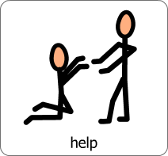
People who help us

Slide 2
Introduction

Slide 3
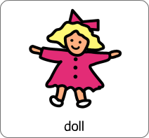
Choose a song ...

Slide 4
Fireman

Slide 5
Doctor

Slide 6
Police

Slide 7
Postman
https://www.youtube.com/watch?v=SrjEJp4dS1I&list=RDQMaGUSs1zwuyo&start_radio=1

Slide 8
5 Little Monkeys

Slide 9
Miss Polly

Slide 10
Family song
https://www.youtube.com/watch?v=ii_LtHrEiao

Slide 11
Dentist

Slide 12
The End.

