Slide 1
Happy Half Term!
Firstly, a massive well done!
You have made it through another lockdown term.
We are super proud of you all.
A big thank you to everyone at home for helping you and supporting you with your home learning.

Slide 2
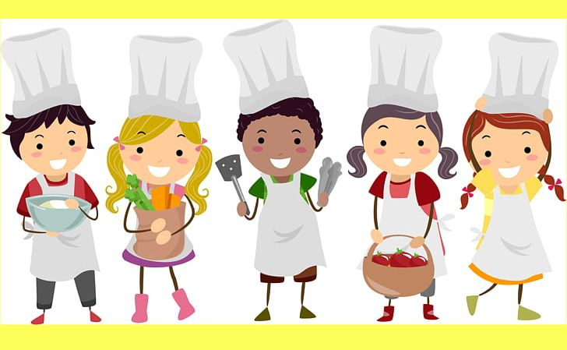
Try a new recipe
BBC Good Food
Tasty
Baking Mad
Baking with kids

Slide 3
Shrove Tuesday – Pancake Day!
Lent – What is Lent information and video
News Round
Crĕpe Recipe
Fluffy Pancake Recipe

Slide 4
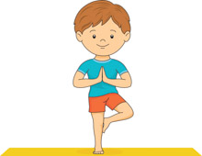
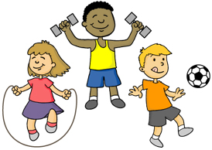
Workout What’s your favourite work out? Try our favourites
Miss Sargeant’s favourite workout: Body Combat
Mr William’s favourite workouts: cycling and hill walking
Mrs Andrew’s favourite workout: House work and walking
Miss Turner’s favourite workout: Walking and running with the dog
If you enjoy dancing you could try some African dance:
KUKUWA® African Dance 15 min: Enjoyment - YouTube

Slide 5
Super Science Experiments
Try one of these science experiments or STEM activities
*some need adult supervision

Slide 6
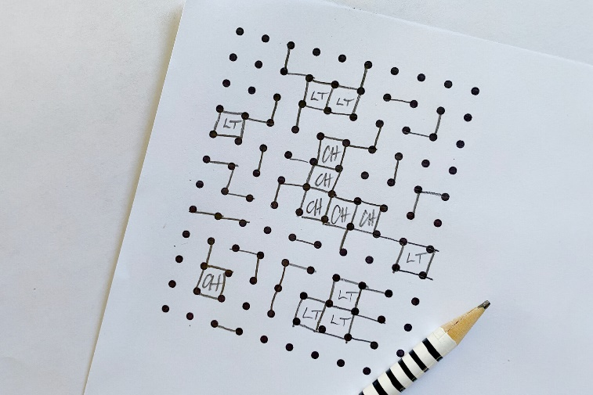
Play a game that isn’t on a device
Play a board game with your family
Mr Williams’ family will be playing
Monopoly (top tip set a time when the game
will finish)
Make a game like:
Tic-tac-toe
Dots and lines
Hangman
Battleship
Fortune Teller

Slide 7
Wildlife Trust Activities
Try out one of The Wildlife Trust Activities
I love the look of making an insect hotel and planting a wild garden!
If the weather is awful, you could watch Winterwatch on the BBC
Iplayer Winterwatch 2021 - Winterwatch 2021 - BBC

