Slide 1
“Pathway to Grade 5”
Aims
To share practical strategies to support your child
To strengthen the partnership between school, students, and families
To ensure consistency of approach between home and school
To build confidence and reduce anxiety

Slide 2
Why are we speaking to this group?
English(27): Achieving a grade 5 or above in Maths but below 5 in English
Maths(25): Achieving a grade 5 or above in English but below 5 in Maths
Both(55): Not achieving a grade 5 in either English or Maths
These are your priority focuses!
Why is English and Maths so important?

Slide 3
It’s Thursday 20th August 2026. You are getting your GCSE results. Imagine you are not happy with your grades.
What would you say to yourself if you could travel back to today, Tuesday 3rd March?

Slide 4
We are here to support you!
We all believe in every single one of you can achieve the grade they deserve in English and Maths
We will always have the highest standards and respect of you
25 lessons a week- 9 of which are English and Maths 36% of your lessons
Interventions after school
Tutor time Maths and English focus

Slide 5

Do you need to completely change?
No!
You need to take positive steps , with consistency
Attendance
Behaviour
Effort outside of the classroom

Slide 6
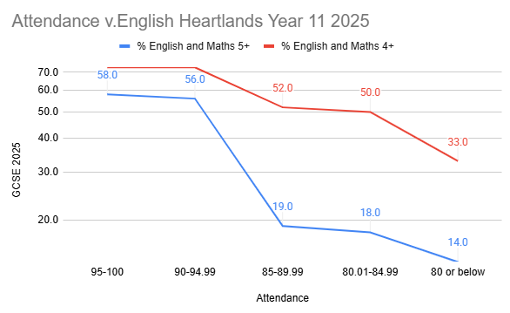
Last year, students with over 90% attendance, 56% got 5+ in English and Maths. Below 90% was 19%.

Slide 7
Creating the Right Environment
Create a quiet, consistent place to study
Remove distractions (phones, TV, gaming devices)
Encourage a regular routine (same time each day)
Ensure good sleep, nutrition, and downtime
Keep evenings calm and predictable

Slide 8
Building Effective Study Habits
Short, focused sessions (20–40 minutes)
Use a timer and regular breaks that parent/carer decides
Encourage active revision (practice questions, flashcards)
Focus on key skills in Maths and English
Use trusted resources (e.g. BBC Bitesize, past papers) Use DPR

Slide 9
Supporting Confidence & Motivation
Praise effort, not just results
Celebrate small improvements
Avoid adding pressure or comparisons
Keep communication positive and calm

Slide 10
Practical Support During Exams
Ensure punctuality and attendance every day
Support the high expectations of uniform
Prepare equipment the night before
Provide a calm start to the day
Encourage healthy routines (sleep, meals, breaks)
Be available to listen — reassurance matters

Slide 11
English

Slide 12

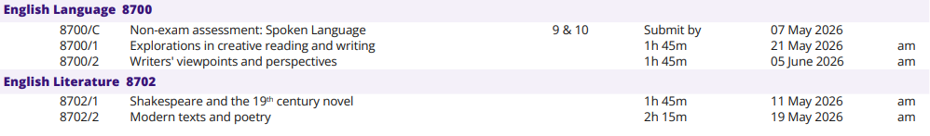


4 School weeks left until your first English exam!
Notes:
https://filestore.aqa.org.uk/admin/t_table_pdf/AQA-TT-GCSE-JUN24-CONFIRMED.PDF

Slide 13

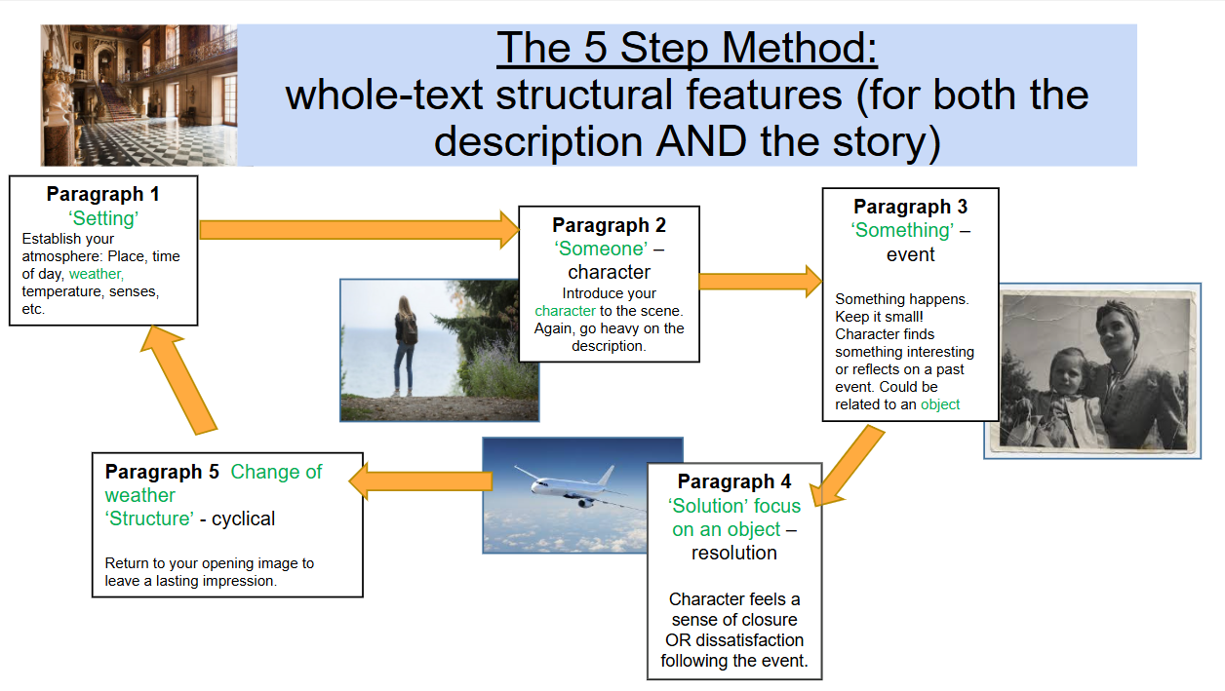
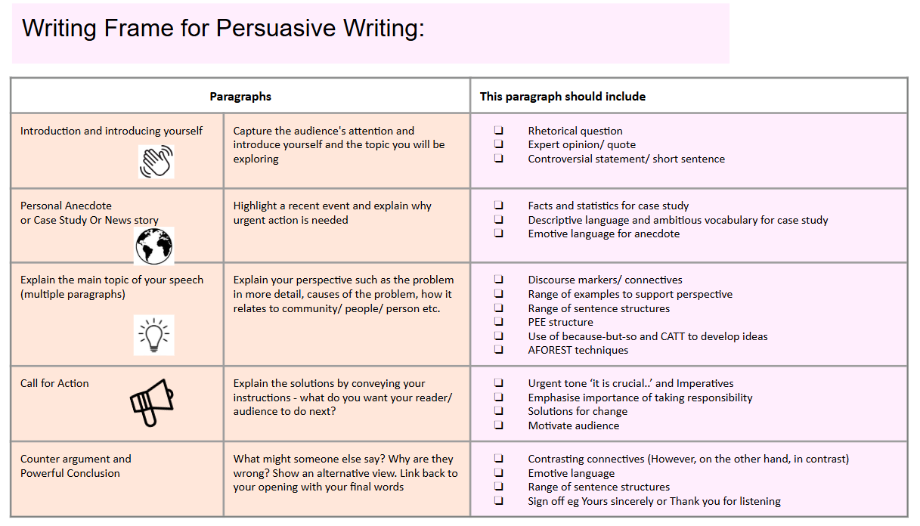
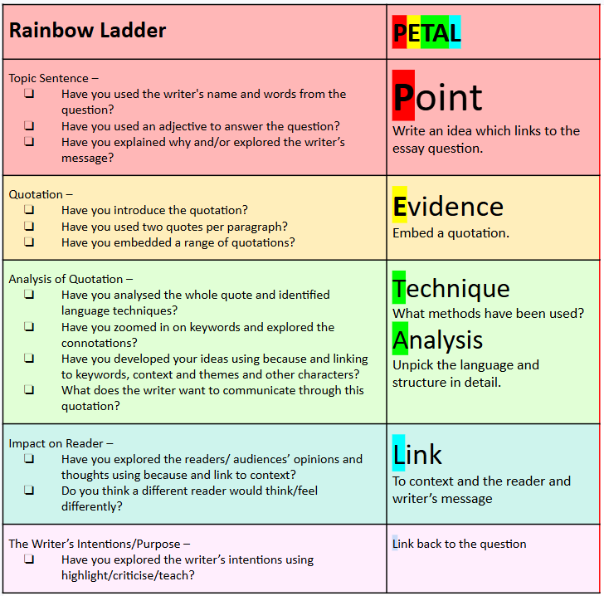
English
Core Strategies for a Grade 5 in English:
Plan Your Writing: Spend 5 minutes planning your creative or nonfiction piece (Question 5). Outline one character, one setting, one event, and a clear structure to avoid rambling.
Master the Writing Structure: PETAL, 5 Step (creative) or Persuasive Writing
Use paragraphs effectively, ensure a consistent tone, and use a range of sentence structures (e.g., using semicolons, using "Some... Others" sentence structures).
Focus on Accuracy: A Grade 5 is heavily reliant on good spelling, punctuation, and grammar (SPaG). Use varied punctuation, including commas, full stops, question marks, and exclamation marks. Alway reread your work!
Annotate the Source: During reading tasks, highlight, circle, and annotate the text to identify key ideas about characters, places, or events.
Time Management: Dedicate specific times to each question to avoid rushing. Spend roughly 5 minutes planning, 35 minutes writing, and 5 minutes editing for creative writing.

Slide 14

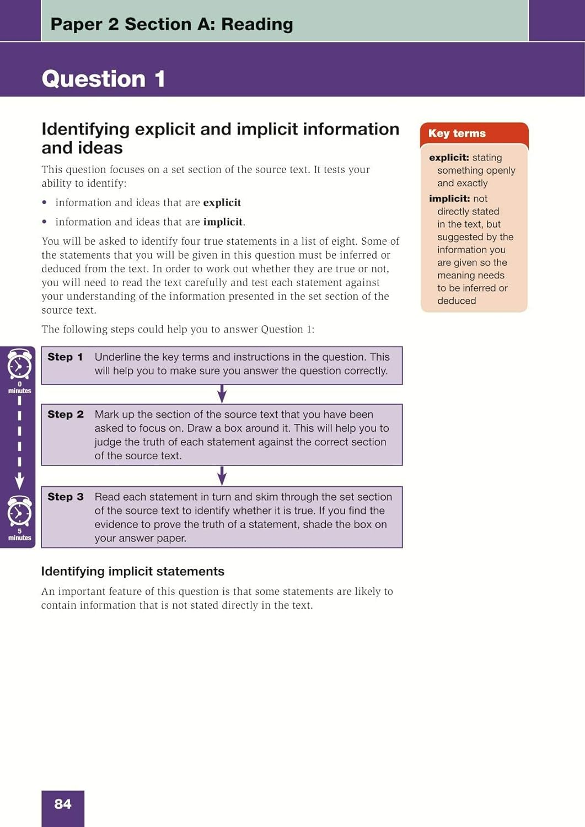
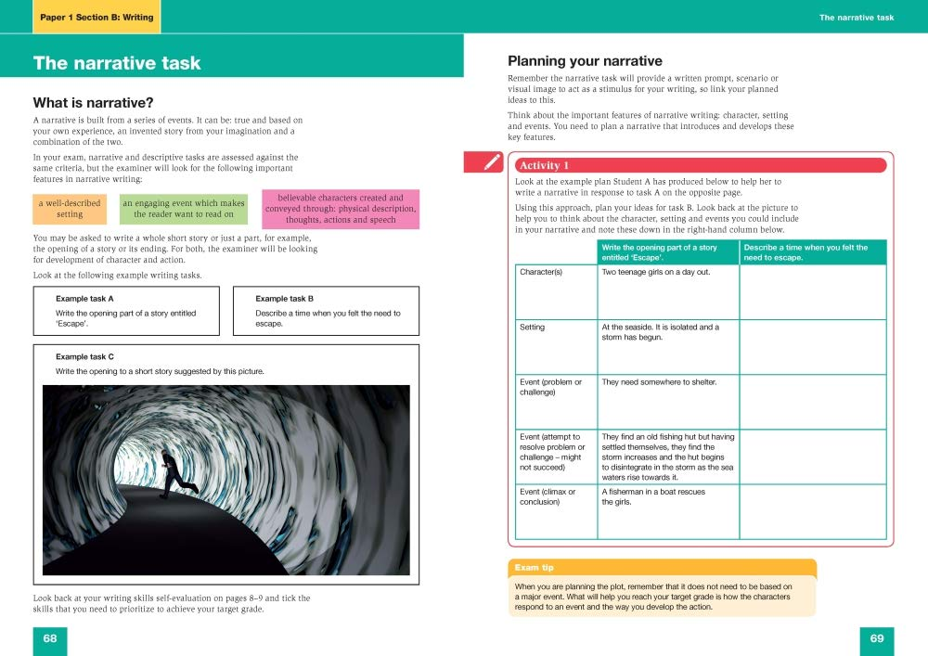
Easter English Revision
Today you will be given: ‘Targeting Grade 5’ revision guide with questions and answers for each topic

Slide 15

Easter English Revision
Year 11 Holiday Revision:
Thursday 2nd April - Language Paper 1 Q5
Friday 10th April - Language Paper 2 Q5
In previous years, Saturday intervention classes have had a big impact on final grades.
We expect all students to make 100% effort and to have the correct attitude towards their work in order to get the most out of the session.
The group will be small to enable students to get all or most of their outstanding tasks completed.
Sign up after today!

Slide 16
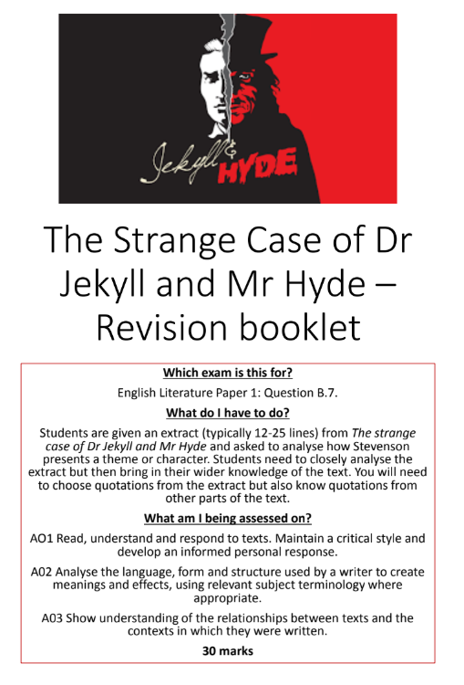
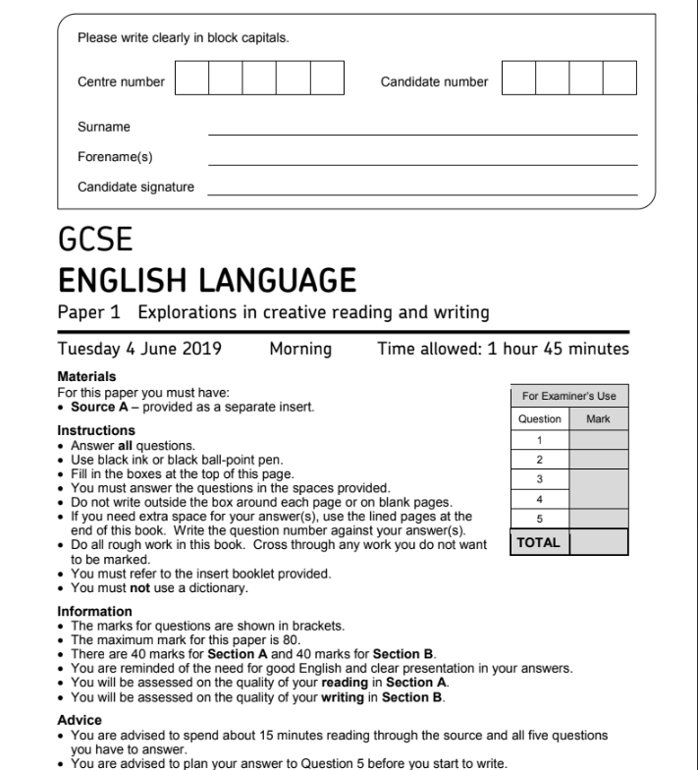




In class
How can you best prepare for your exams?
Let’s have a look at the revision resources you have already been given for holiday revision:
In class
Home Learning booklets (every half term)
Past Language Papers: Handed in class
Progress Evening
In class

Slide 17
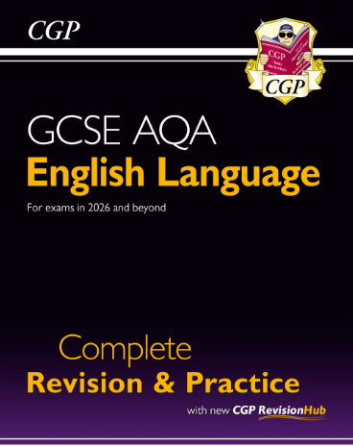

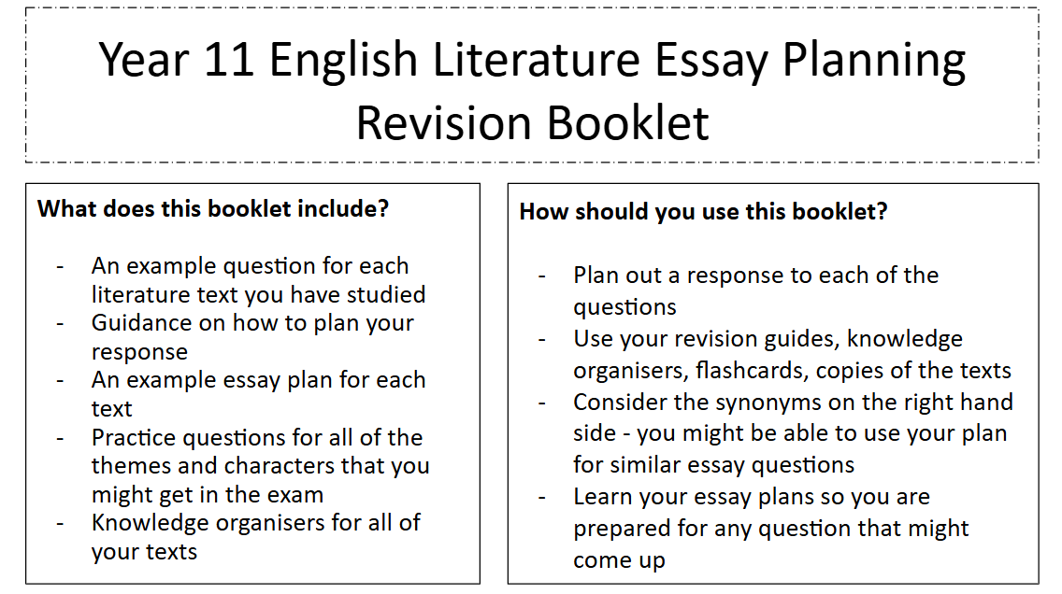

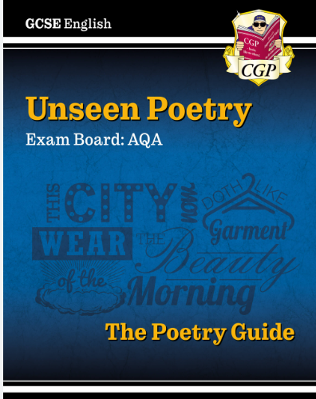

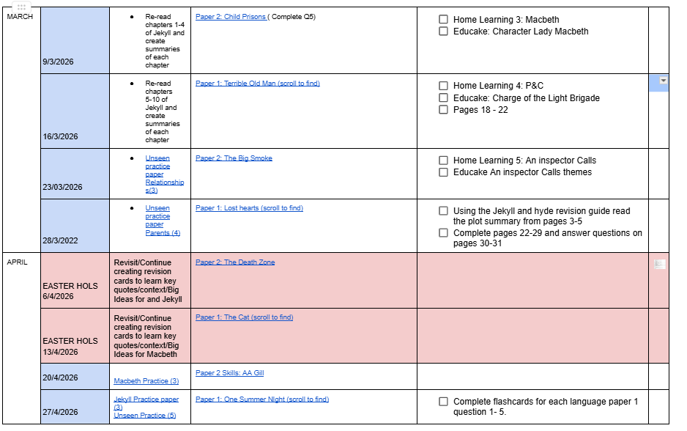
Revision resources checklist
Language:
GCSE AQA English Language CGP Guide
Year 11 Heartlands Language Paper 1 Revision Booklet
Year 11 Language Paper 2 Revision booklet
Revise Targeting Grade 5
Walking Talking Mock Papers
Literature:
GCSE English Literature Macbeth CGP Guide
GCSE English Literature Jekyll and Hyde CGP Guide
GCSE English Literature An Inspector Calls CGP Guide
GCSE English Unseen Poetry CGP guide
GCSE English Literature Power and Conflict CGP Guide
Year 11 English Literature Essay planning Booklet
English Exercise books (both language and literature)
Year 11 Exam Revision Timetable (check emails)
English literature and Language Loom links (DPR)
Literature and Language past papers from mock

Slide 18
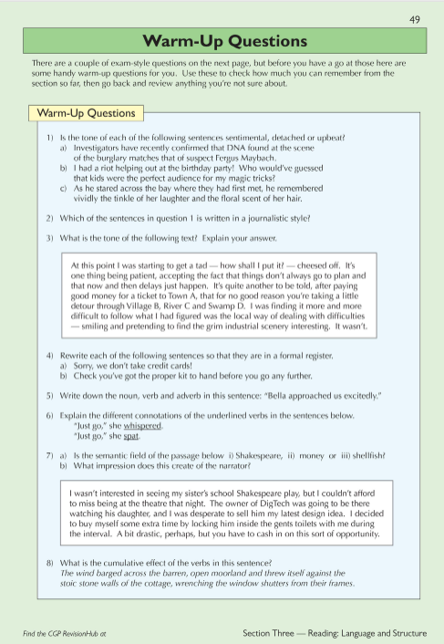
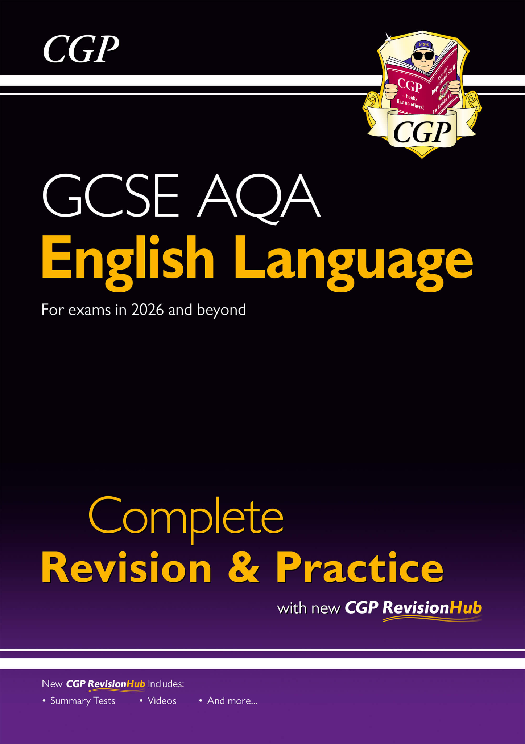
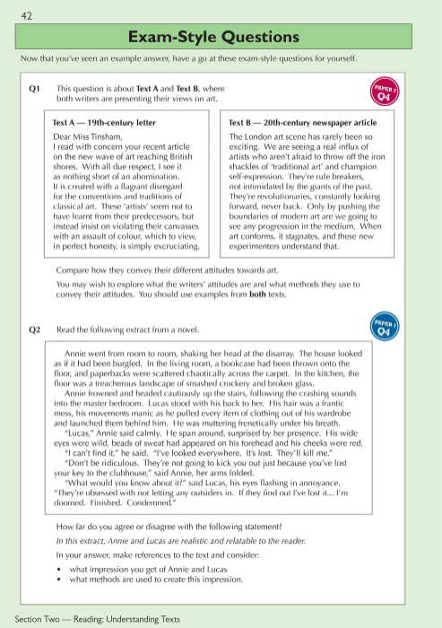
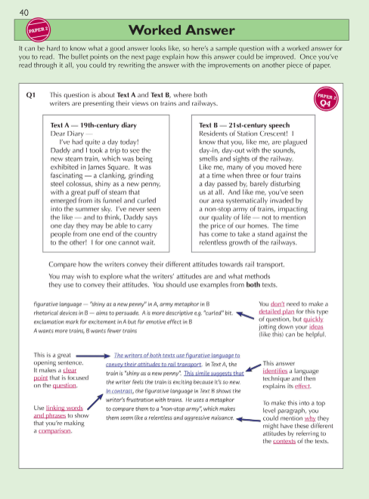
Previously:

Slide 19
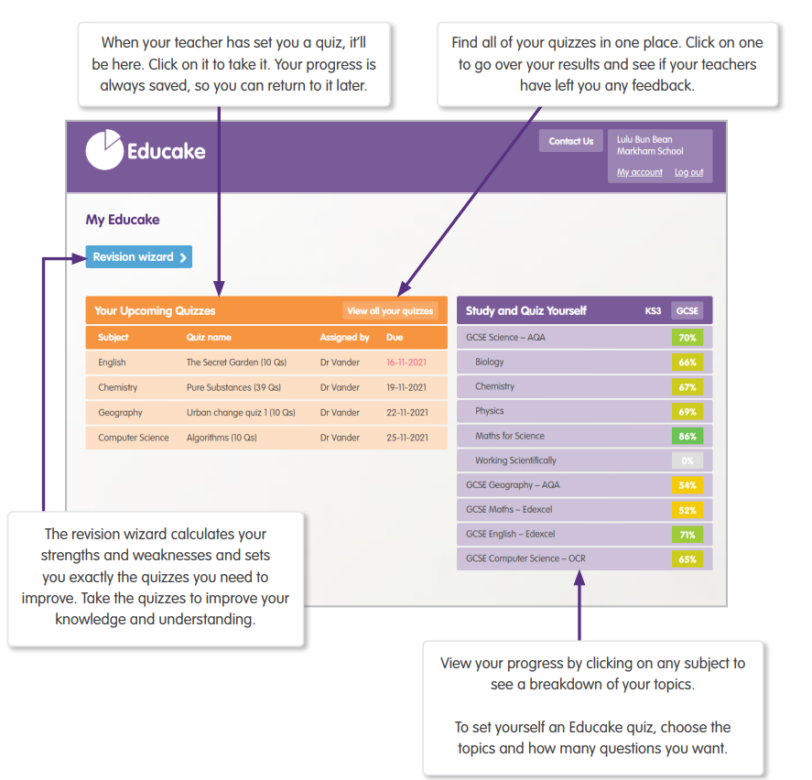

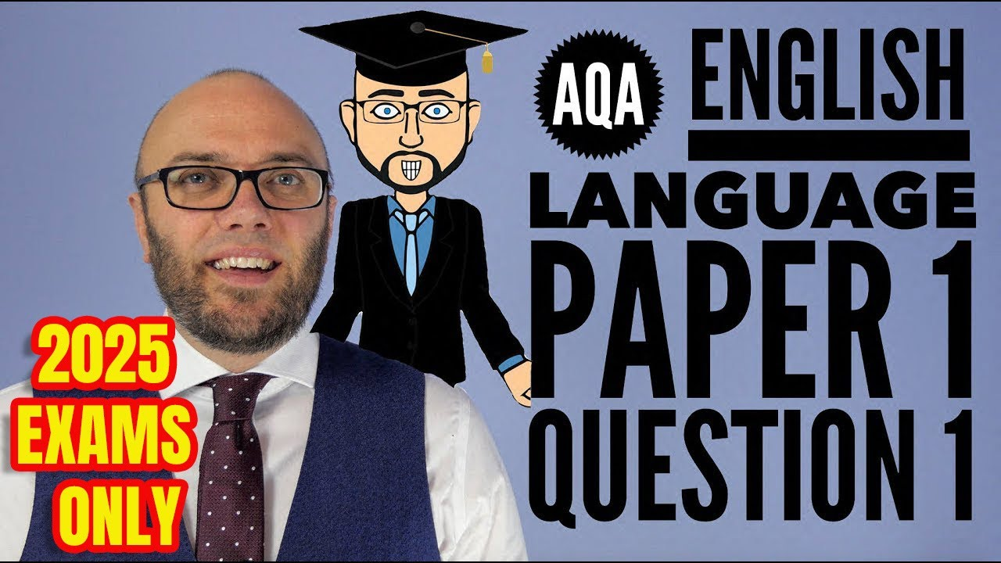
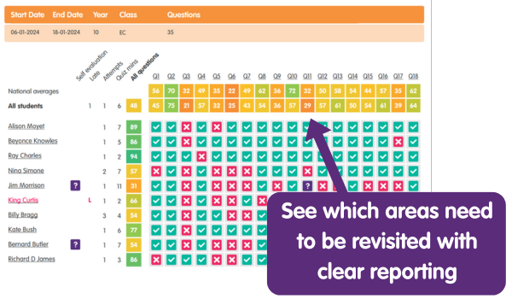
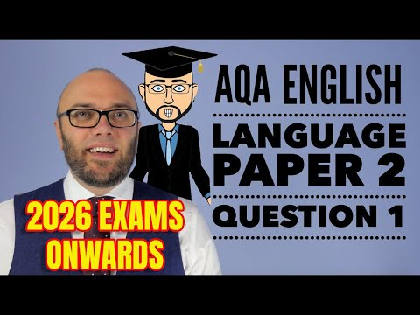
Online support:

Slide 20
Mathematics

Slide 21


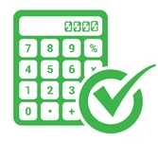
GCSE Maths
Exam Board: Edexcel
Set 1 and 2 - Higher
Set 3, 4 and 5 - Foundation
3 papers - all 1 hour 30 minutes and out of 80 marks
Paper 1: Thursday 14th May - Non-calculator
Paper 2: Wednesday 3rd June - Calculator
Paper 3: Wednesday 10th June - Calculator

Slide 22
To achieve a Grade 5 in maths, students need to:
Attend every lesson - teachers have made a lesson by lesson plan
Revise regularly and ensure maths is a priority in their revision
Complete as many past papers as possible
Currently, every Wednesday, students receive:
A GCSE maths past paper with model answers in the back of the paper
A link to a video walkthrough of the paper
Students should:
Attempt the paper independently in exam conditions
Mark their work using the model solutions and revise using these if appropriate
If there is a question they can’t do, go and watch the video
Whilst watching the video, pause the video after the first step of working out.
Try again to complete the question
Continue watching the video, making notes if still unsure

Slide 23
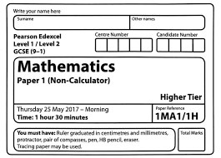
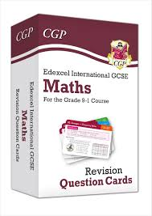


Easter maths revision
Students have already been provided with:
Edexcel revision flashcards - great for prompting and answering quick questions (use little and often)
4 x past papers - these are the priority over the easter break and it is essential that these are marked by students
A revision workbook (which you received at progress evening)
Today you will receive:
‘Aiming for grade 5’ revision guides with questions and answers for each topic
Spare revision guides and workbooks

Slide 24
What can parents/carers do to help with maths?
You don’t need to be a maths expert!
Support with a revision timetable and ensure maths is a priority within this
Help provide a quiet space to complete maths past papers and limit distractions (phones, TV etc)
Check homework is completed each week and have a look through your child's past paper to ensure it is marked and corrected where appropriate
Help test your child using flash cards and workbook provided
Prompt students to show their method - students receive marks for their method in maths exams but are often reluctant to show their working out

Slide 25

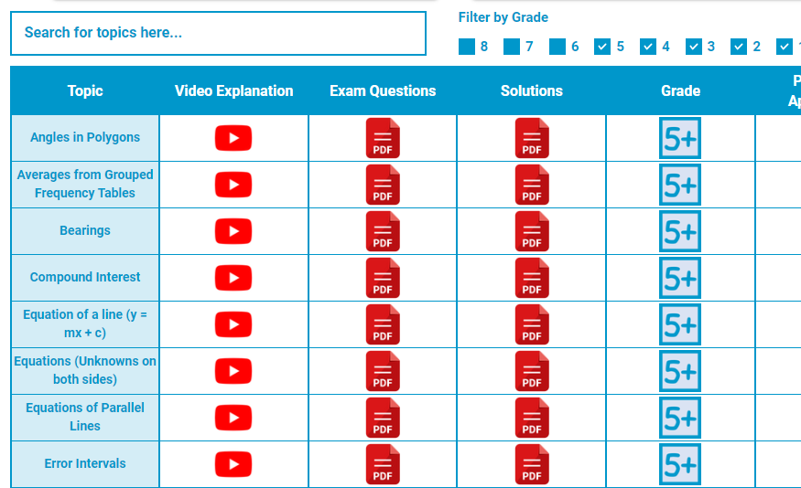
Maths revision websites
1st class maths
https://www.1stclassmaths.com/

Slide 26
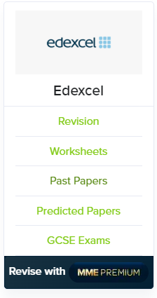
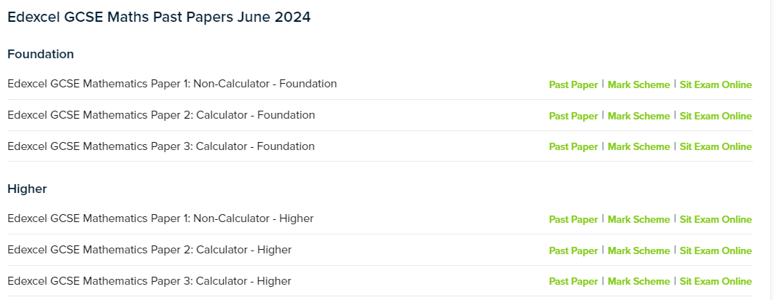
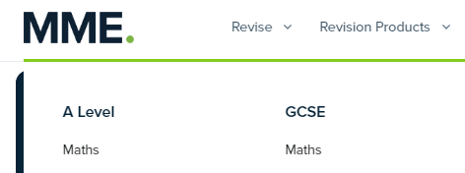
Maths made easy
https://mmerevise.co.uk/gcse-maths-revision/

Slide 27

On maths
https://www.onmaths.com/

Slide 28
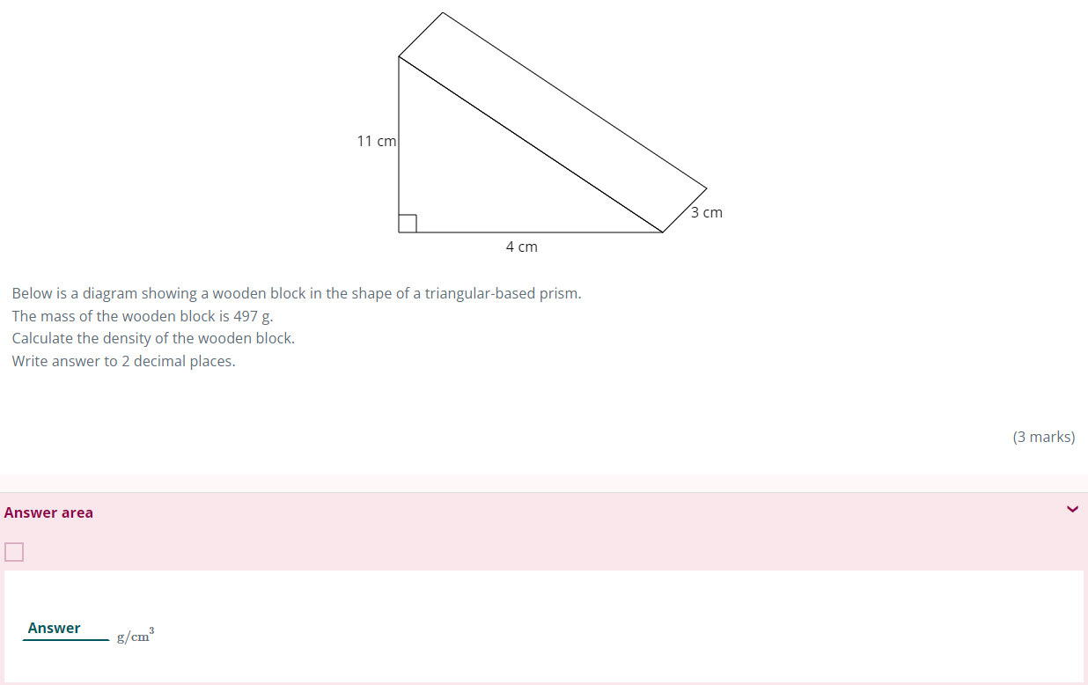
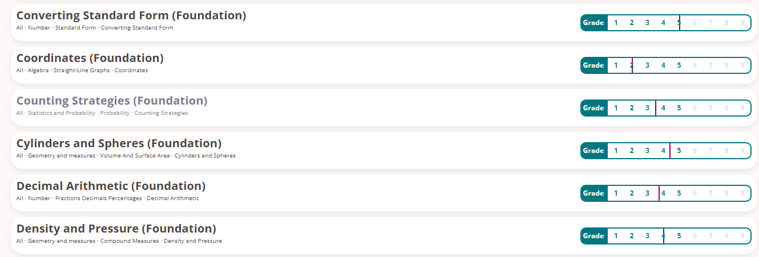
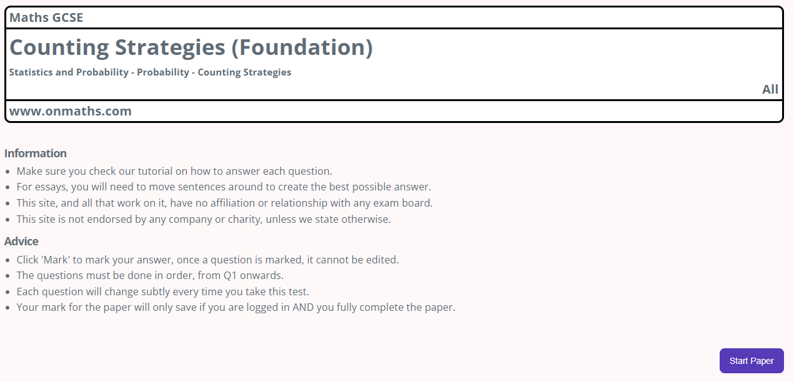

Slide 29
Pathway to grade 5 in maths
Consistency is key. Completing past exam questions regularly and addressing areas of weakness.
You can never do enough past papers - if you’ve done that paper before, there is a benefit to completing it again.
Predicted papers will be printed and given to students in time to revise before each paper.

