Slide 1
Mock Exams January 2026
Key Information
Why we have GCSE mock exams?
Preparation
Seat numbers
Mock Plan (timings, where to go, etc…)
Study leave
Line up
Equipment
Expectations
Malpractice
Lates & absences
Support
If you have any further questions after the assembly, please speak to Mr Matthews at the gate. He will share responses in an email later this afternoon, or you may email examoffice12665@heartlands.haringey.sch.uk

Slide 2
Why do we do mock exams?
Prepares you to start your revision early
Practising effective revision strategies and habits
Improve your knowledge and retention
Practising under exam conditions
Identify topics that need attention before the real exams
Build confidence
Reduce exam anxiety

Slide 3
Remember these are the Mocks!
This is a practice run, and while it’s important to take it seriously, it’s completely normal to make mistakes or forget some subject information. The key is to stay calm and not panic.
If a previous exam didn’t go as well as you hoped, try to let it go and focus your energy on the exams ahead.
Please remember that the real exams will be spread over five weeks rather than two, and it is unlikely that you will have more than one exam in a single day.

Slide 4
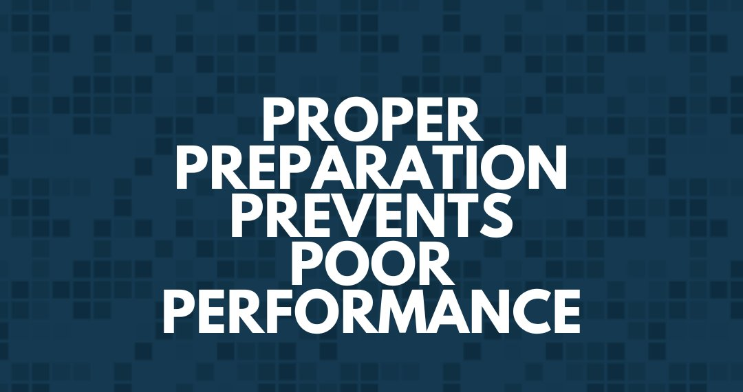
No regrets!
Make sure before Friday
you have enough revision resources from your subject teachers and plenty of past papers to complete over the 2 weeks.
you have created a revision timetable to allow you sufficient amount of time for each of your subjects and to ensure you have breaks
Do not be afraid to email your teacher if you have any questions.

Slide 5
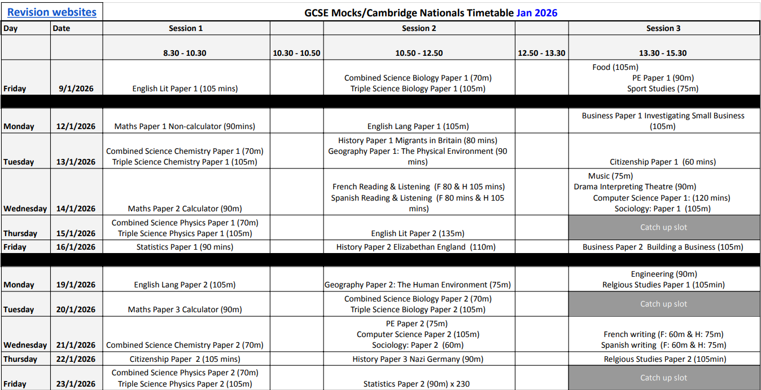

Slide 6
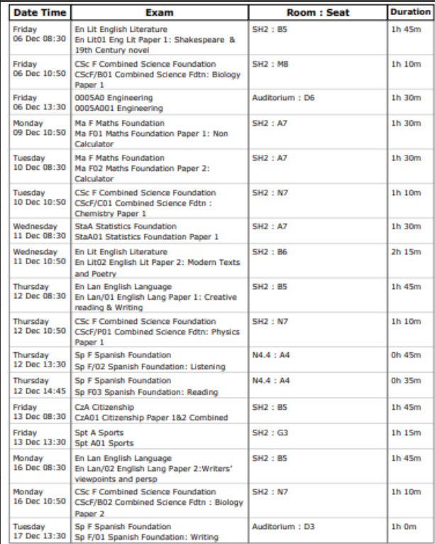
Individual timetable
You receive a 2nd (yellow) copy after the assembly. It is your responsibility to know where you should sit.
A notice board on the north playground will have the sports hall seat numbers for 2 of the 3 exams.
Access arrangements seat numbers will be displayed outside the auditorium and library.

Slide 7
GCSE Mock exams
Exams run from Friday 9th January to Friday 23rd January.
The restaurant will open at 8:10 each morning offering free breakfast.
There will be no Year 11 lessons during the exam period.
Most exams will take place in the Sports Hall.
Students with Access Arrangements will sit exams in the Auditorium or Library.
Catch up will be at 13:30 on 15th ,20th and 23rd January
Exams Officer: Mrs. Newlyn (office behind reception)
examoffice12665@heartlands.haringey.sch.uk

Slide 8
Timings
Entry Times
Morning Exam: Enter via the South gate
Any other time: Enter via the Main gate
Line-Up Times
Session 1: 8:30-8:40 Session 2: 10:50–11:10 Session 3: 13:30-13:40
Exiting Exams
Students must leave the site via the car park gate.
Students with AA will leave via the main gate
Sometimes you will finish an exam before the normal break (10:30) or lunch (12:50) time. As the rest of the school will be in lessons you will not be able to enter the building and you will be supervised on the north playground until break or lunch starts.

Slide 9
There may be occasions where you have an exam in the morning (Session 1) and another in the afternoon (Session 3), but no exam during Session 2 (10:50). In this situation, you will be expected to leave the school site after your morning exam via the car park or main gate.
You should use this time productively to return home to revise and prepare for your afternoon exam. If you live more than an hour away, you should use a local library (Alexandra Park Library or Muswell Hill Library ) or another quiet, appropriate study space to revise. During this time, you must not remain on site and should not spend time in Wood Green or other public areas. This is exam time and should be treated as part of your school day.
Appropriate use of time includes:
Revising key topics for your afternoon exam
Eating lunch and staying hydrated
Resting briefly to stay focused
Not appropriate:
Shopping or socialising
Hanging around Wood Green or other public spaces
Returning late for your afternoon exam - You must return to school by 13:15 to ensure you are ready for your afternoon exam.

Slide 10
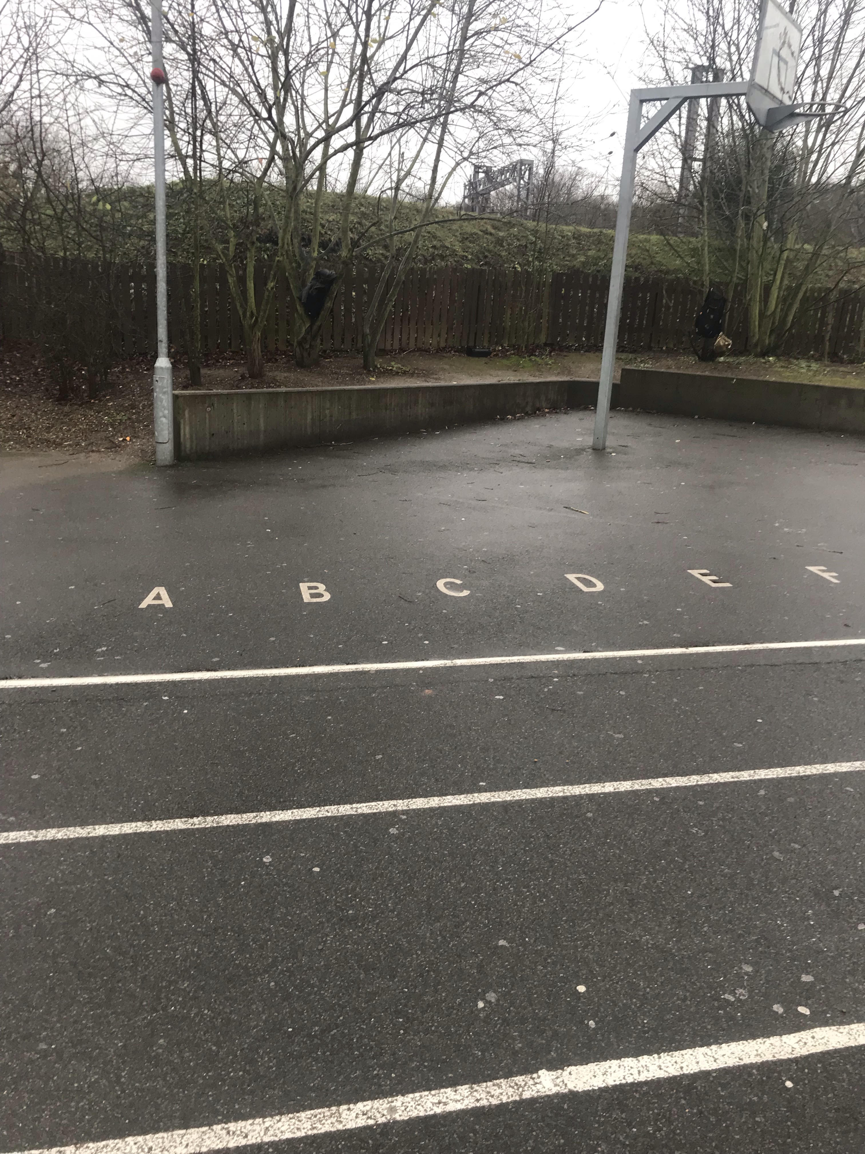
Exam Times
Session 1- Line up: 8:30
Session 2 - Line up 10:50
Session 3 - Line up: 1:30
Line up at the letter of your row
Remind yourself of your row and seat number for the exam.
Once the whistle is blown you should be in absolute silence, ensure all your revision resources, notes , phones/watches & coats are in your bag. You should just have your clear pencil case in your hand.
If you have access arrangements for your exams, you do not line up. You will go straight to the library / auditorium

Slide 11
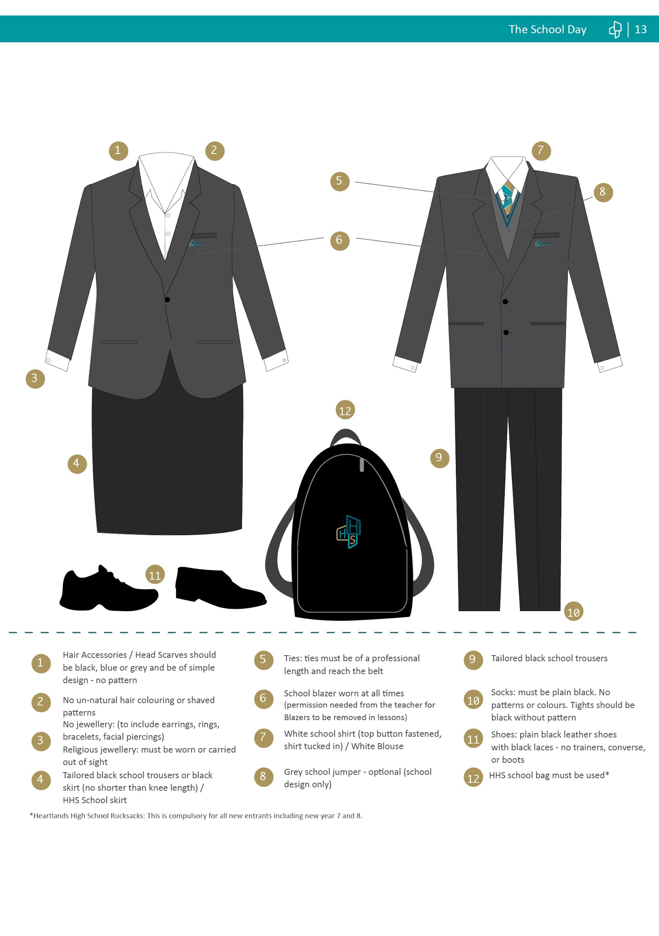
Full School Uniform

Slide 12
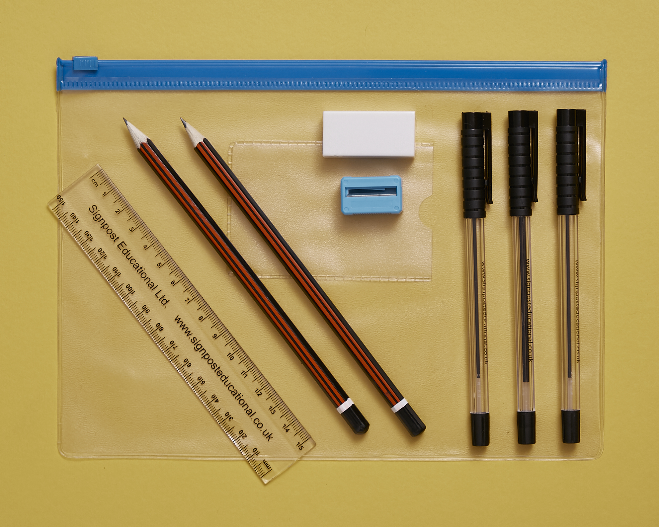
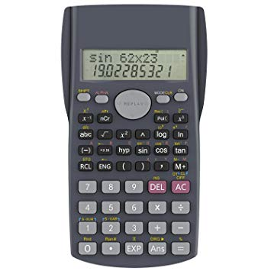
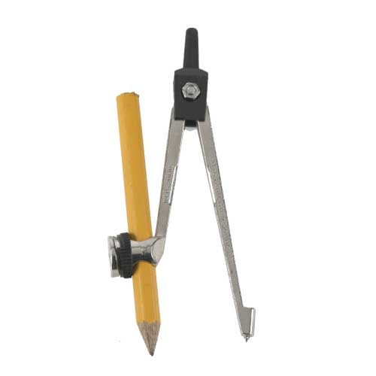
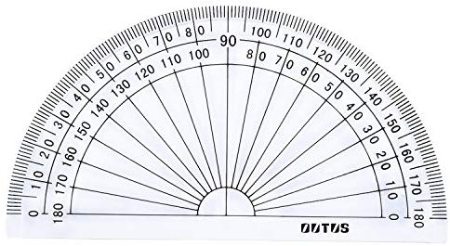
Equipment
Check that you have all the equipment that you need
3 black pens
2 pencils
Rubber
Ruler
Pencil sharpener
Compass
Protractor
Highlighters
Scientific calculator
Clear pencil case

Slide 13
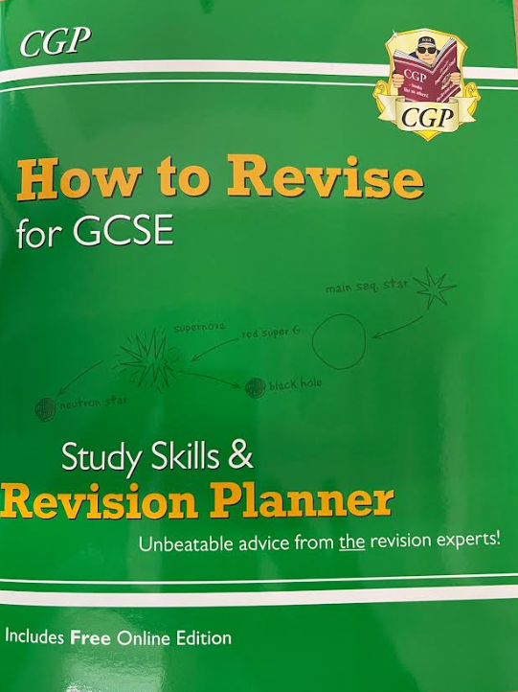

Equipment
3 black pens
2 pencils
Rubber
Ruler
Pencil sharpener
Compass
Protractor
Highlighters
Scientific calculator
Clear pencil case
Revision cards
Information booklet

Slide 14


Slide 15
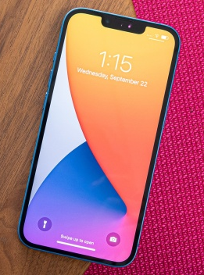
Mobile Phones/malpractice
As these assessment will be used to determine your post-16 predictions the same malpractice rules apply as in the real exams. This has been clearly stated by the JCQ.
For the mocks you should turn off your mobile phone and make sure it is in your bag. This is the same for a watches.
For the actual GCSEs we will collect your phones in.
If you have anything unauthorised on you in the exam hall or room, we have to report this to the exam boards. The outcome of that report may be that you receive a 0 in the exam, or in extreme cases, a disqualification from all exams with that exam board

Slide 16
Expectations in the exam hall
Once you are lined up, you must be in total silence until the end of the exam.
When you enter the exam hall, place your bag in the area instructed by the invigilator.
Make your way to your seat number. There are signs on the wall that show your the row and seat number
You must not write anything on your paper, even your name, until the invigilators have told you to do so.
You must stay facing forward. Do not look around when others enter
Do not communicate in any way to anyone else whilst in the exam hall - talking/whispering/gestures
If you finish your exam paper before the end of the exam, re-read all of your answers. You must remain sitting up straight with your eyes open for the remainder of the exam. Do not put your head on the desk or turn around
When the exam is finished, remain in your seat in silence until you are dismissed

Slide 17
Lates and Absences
Do not be late to your exams !!!
If you are late, you will still sit your exam and have a less of a break between exams.
Absences - parents must call in as usual. If you are absent, we will arrange a time for you to re-sit the exam in the two week period (15th , 20th & 23rd January)
All students will sit all exams

Slide 18
Remember these are the Mocks!
This is a practice run, and while it’s important to take it seriously, it’s completely normal to make mistakes or forget some subject information. The key is to stay calm and not panic.
If a previous exam didn’t go as well as you hoped, try to let it go and focus your energy on the exams ahead.
Please remember that the real exams will be spread over five weeks rather than two, and it is unlikely that you will have more than one exam in a single day.

Slide 19
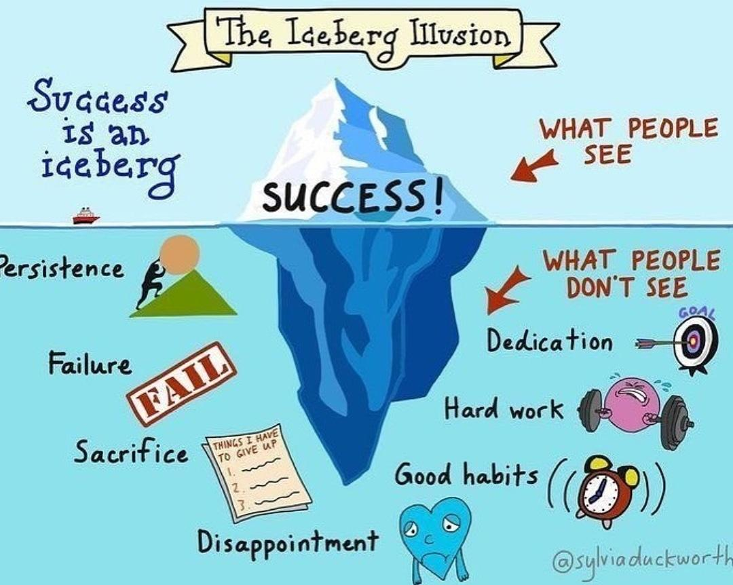

Slide 20
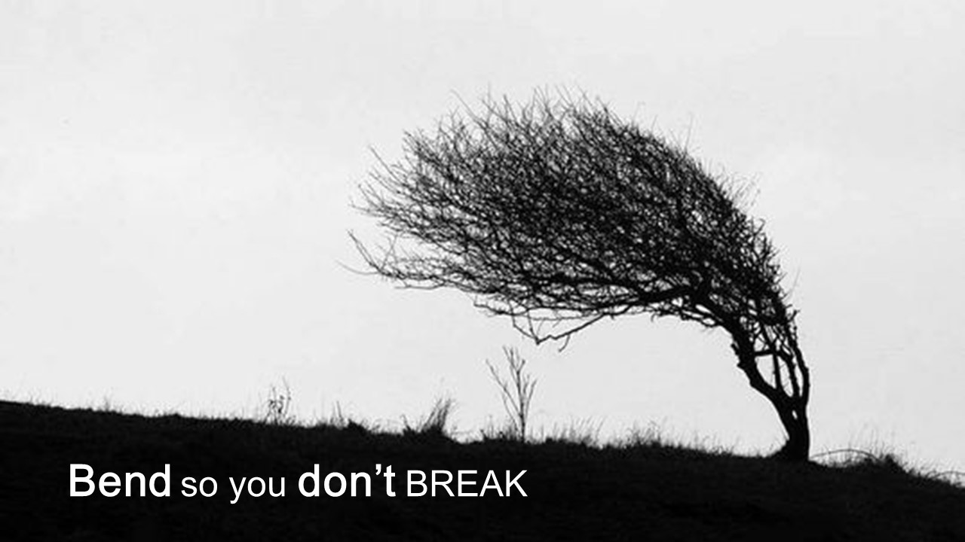

Slide 21
Support in Place
The safeguarding/pastoral team will be providing support for you!
You can find a member of the pastoral/safeguarding team at the start or end of exams.
Email : You can email a member of the pastoral/safeguarding team if you are feeling like you need further support.
Place 2 talk is available, please inform a member of staff if you wish to use this service.
Support each other! If you see a friend in need check on them or ask a member of staff if they can help.
Be kind to yourself and others.

Slide 22
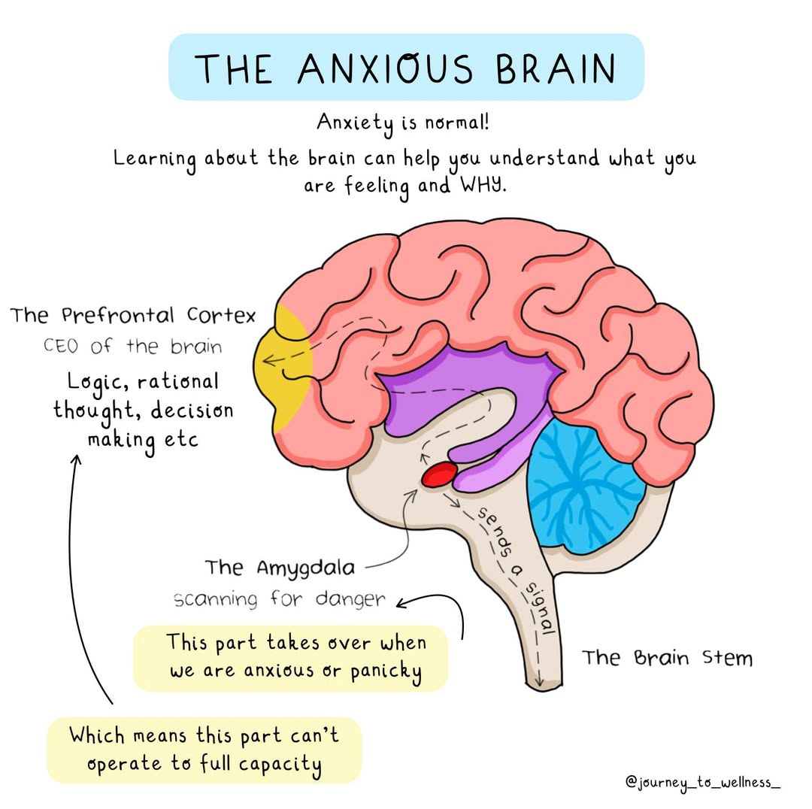

Slide 23
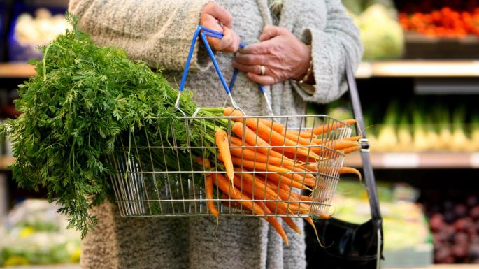
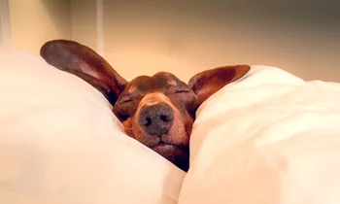
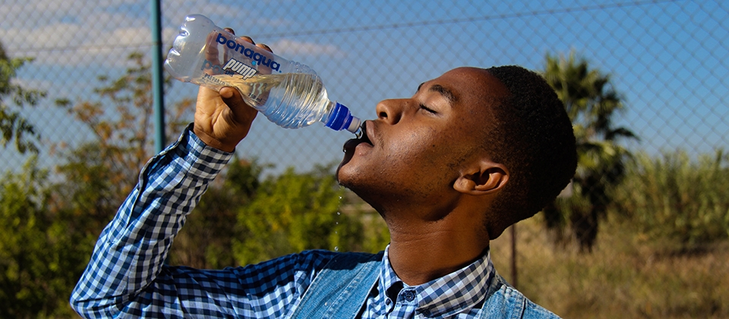
It will be a busy two weeks…..
Get enough sleep
Drink water
Eat healthily

Slide 24
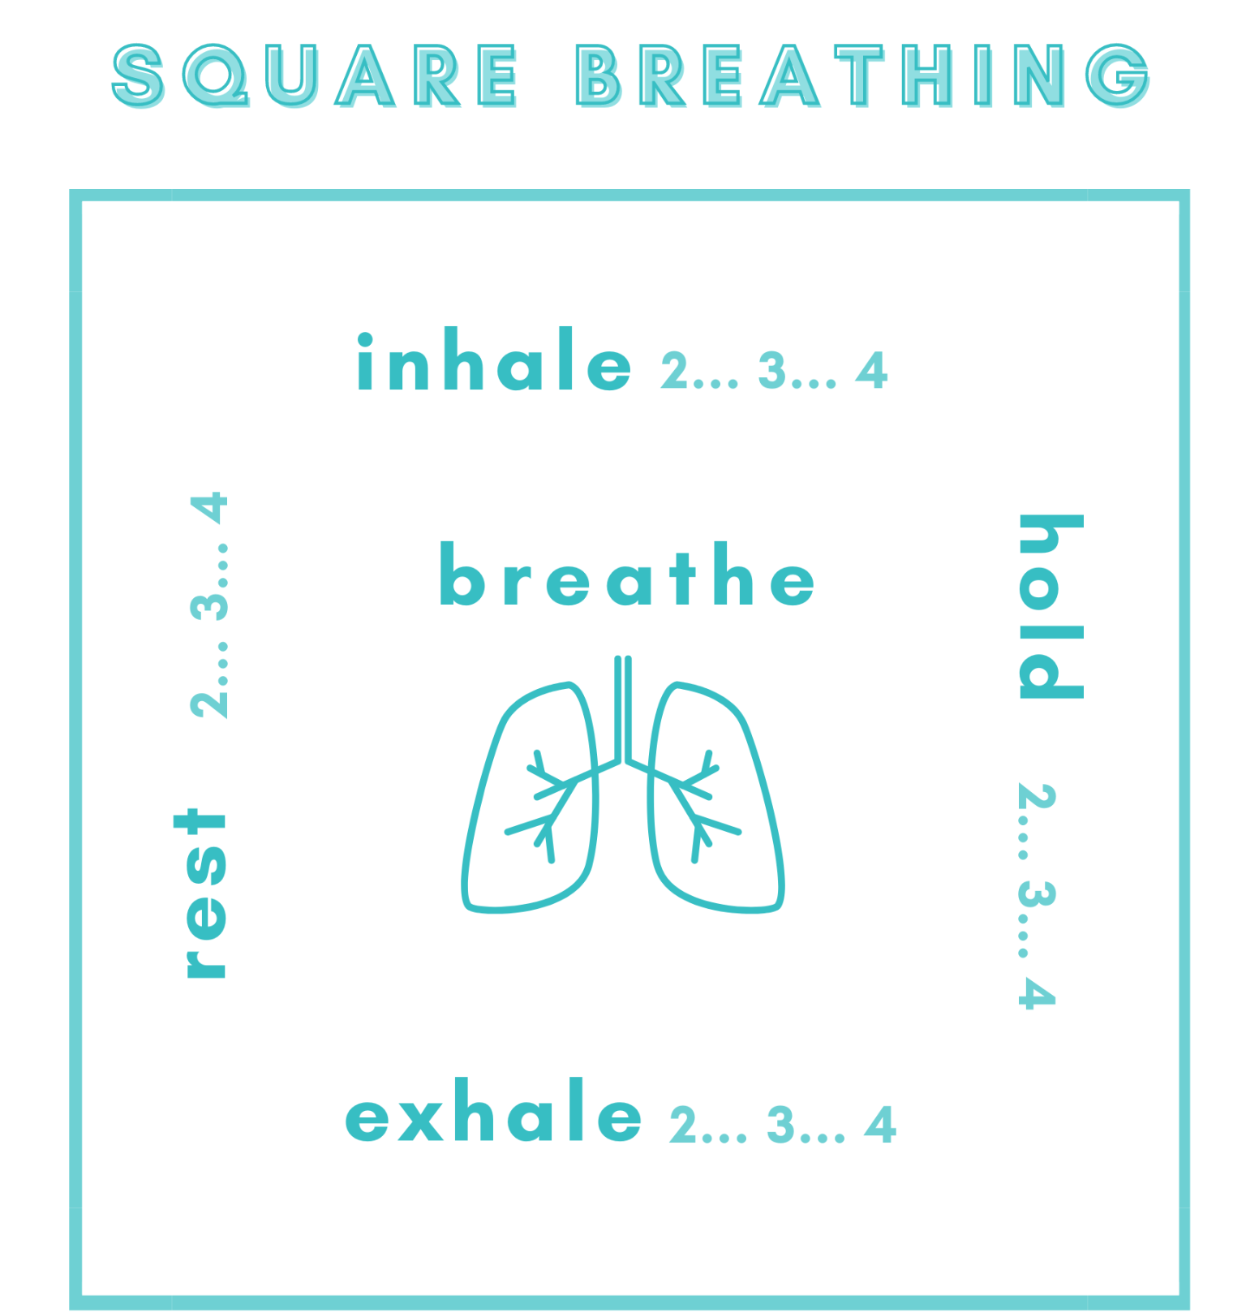
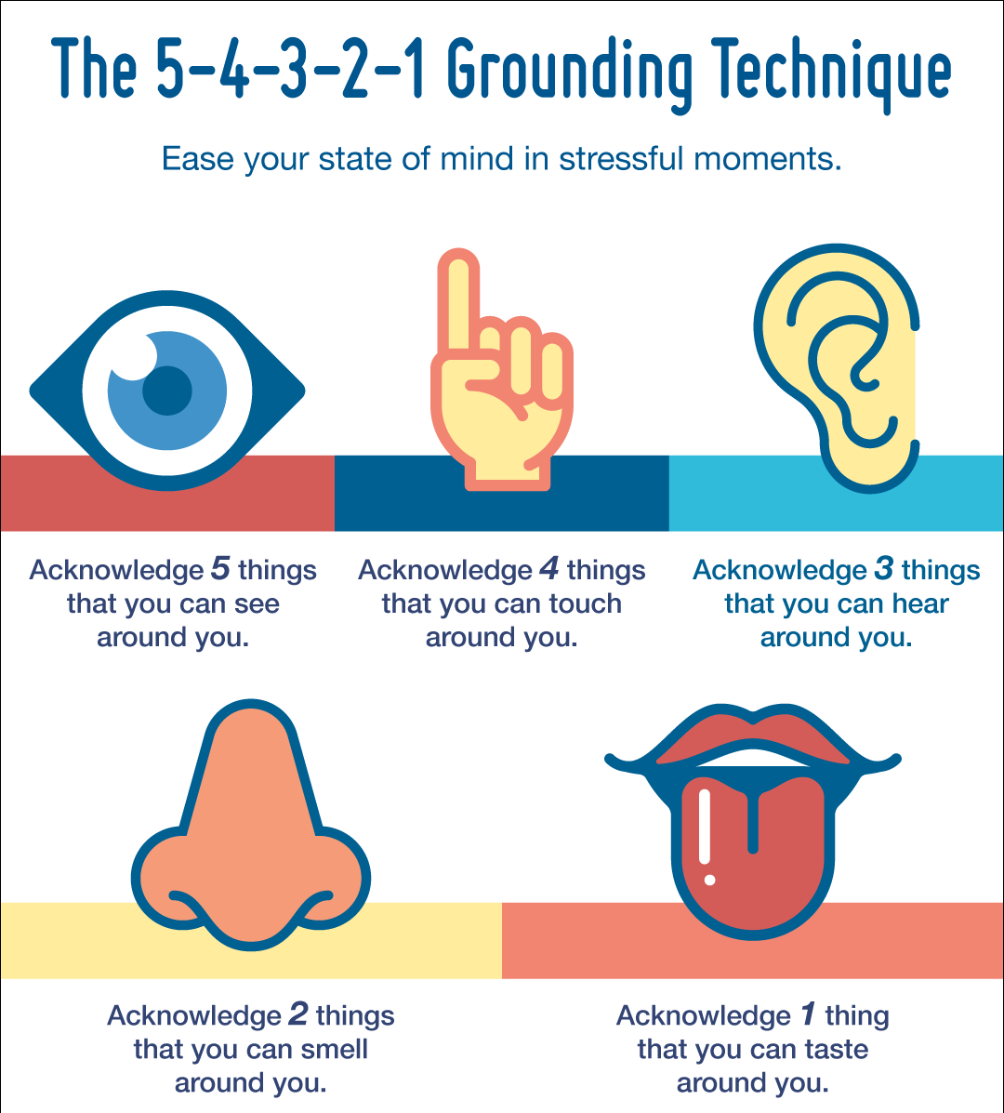
You want urgency, not panic
Control what you can control

Slide 25
What should you do if you need support?
Speak to someone. A friend, a member of staff or a family member
Drop in S4.2 Ms. Dzikunu
A member of the pastoral team
Wellbeing room S3.9 open every lunchtime
Revision room Week A - N3.6
Week B - S3.6

Slide 26


