Slide 1
WELCOME
Mrs Roberts

Slide 2
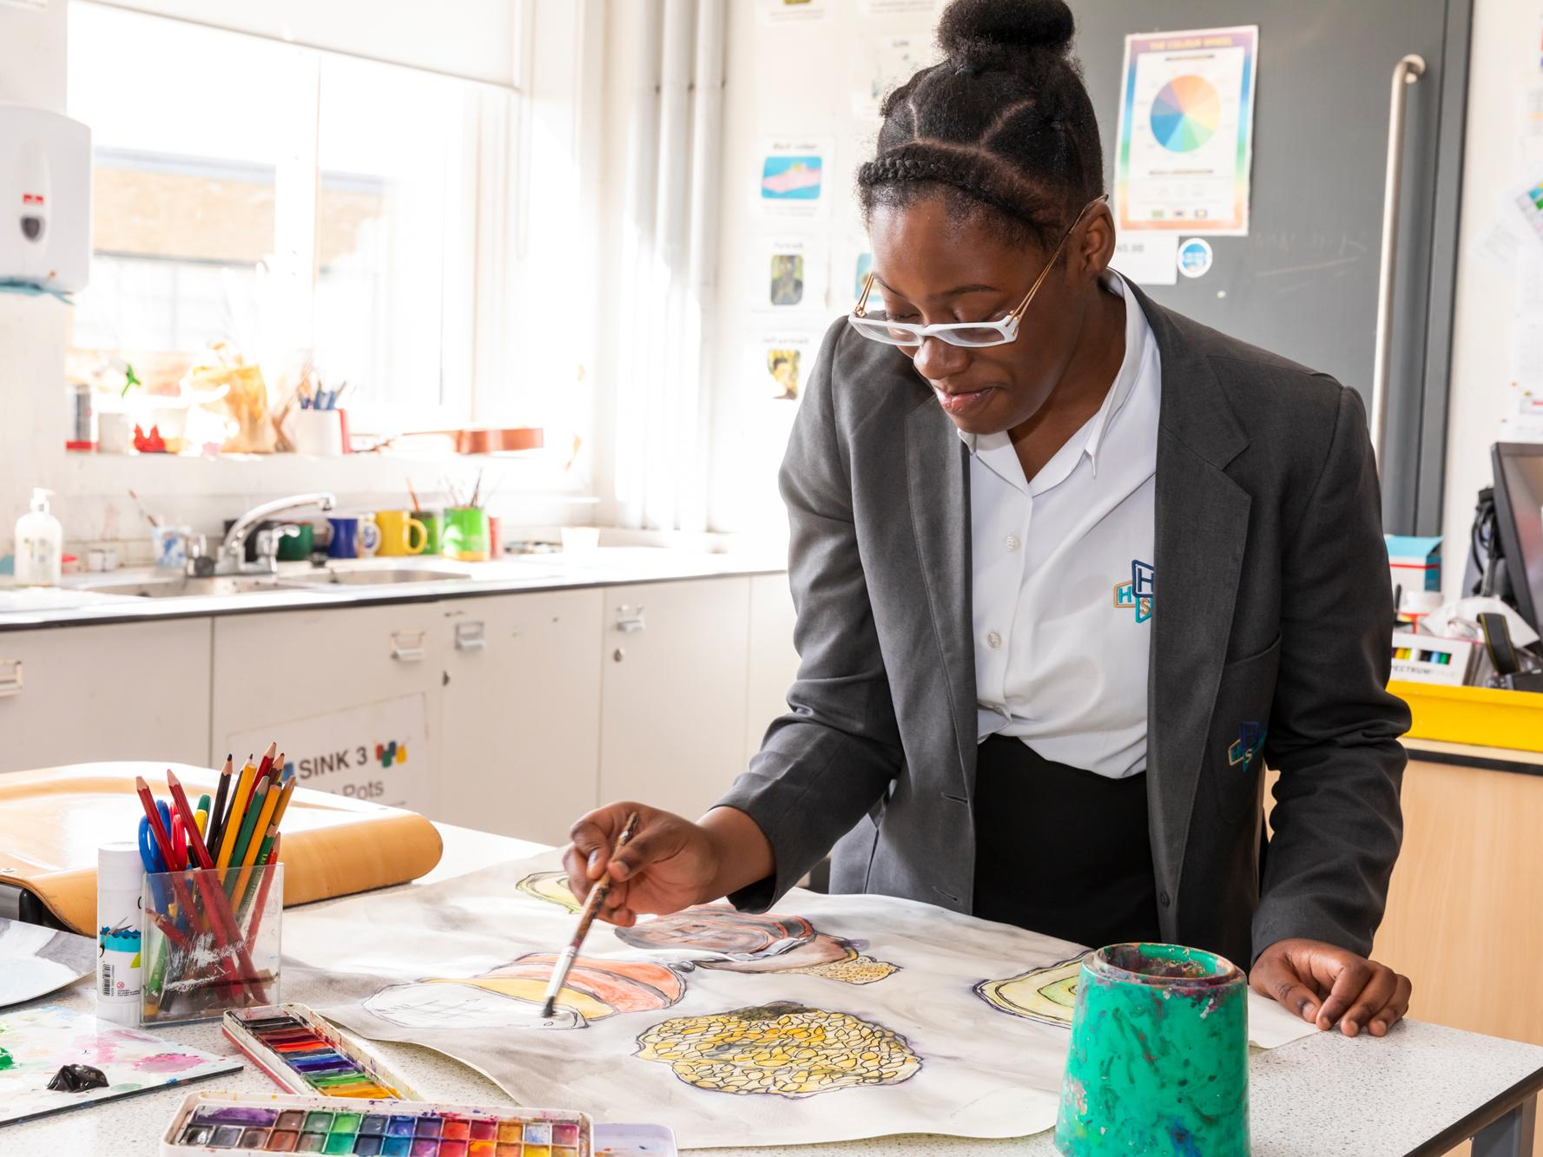
Introduction to the
GCSE Options Process
The Future & Support
Option Process & the Journeys
Key Dates
Completing the option form
Common Mistakes
FAQ’s
Community Languages
English
Maths
Science
Citizenship
This Evening

Slide 3
Further Information
Please log onto
https://heartlands.haringey.sch.uk/year-9-gcse-options/
Or go to the Heartlands High School website.
Click “Students” in the toolbar and
then click “GCSE Options”

Slide 4
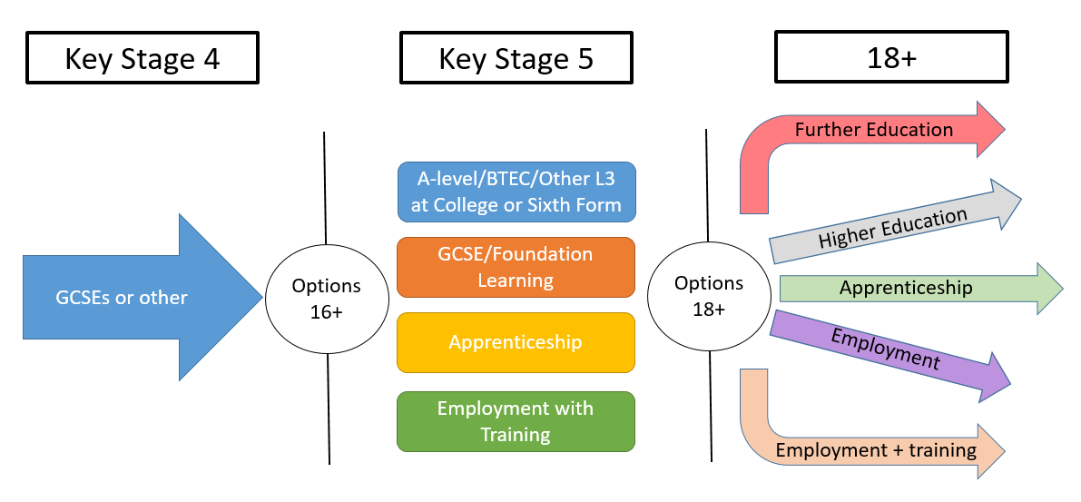
The Future & Support
Students will receive a 1-2-1 Careers interviews
1-2-1 careers interviews
10 hours of taster sessions for subjects
Year 9 have a 3 years KS3.
Students know where to look for information

Slide 5
Journeys
The school offers 2 distinct journeys: Bespoke & Heartlands.
These are recommended to students and parents, and are based on your prior and current attainment.
Bespoke journey
Heartlands journey

Slide 6
Heartlands Journey
Choose 6 subjects below. You will be allocated 2 subjects
Compulsory
Choose 1 subject
GCSE English
GCSE Mathematics
GCSE Science
GCSE Citizenship
GCSE Statistics
PE
Computing
French
Geography
History
Spanish
Art
Business Studies
Computing
Drama
Engineering
Food Technology
French
Geography
History
Music
Product Design
Physical Ed
Photography
Religious Studies
Sports studies
Sociology
Spanish

Slide 7
Options booklets

Slide 8
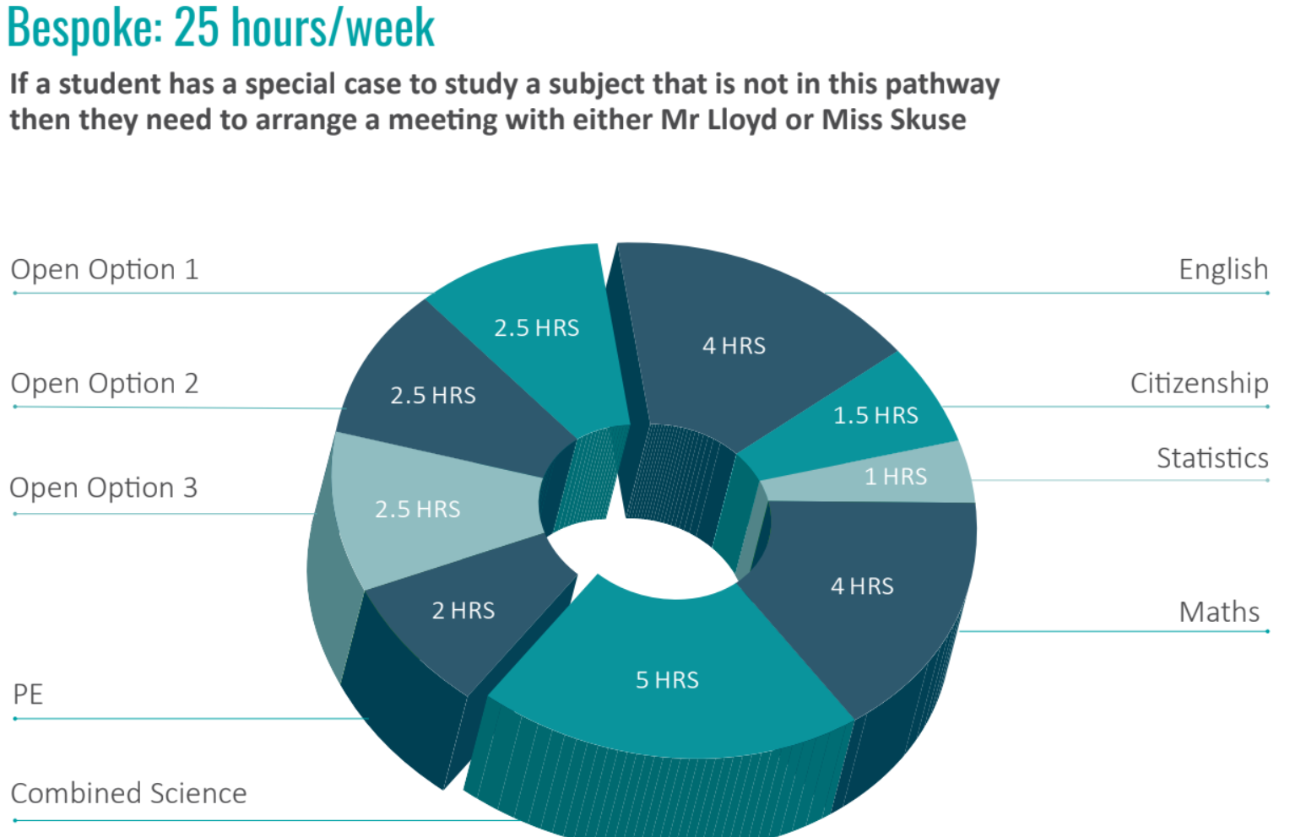

Slide 9
Key Dates
5th March - GCSE Options evening
6th March - Students will receive their option form via email
25th March - The online option form deadline.
3rd July - Students will find out their allocated option subjects

Slide 10
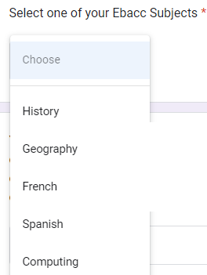
Option Form
Your option form will be sent to you via email tomorrow
Before you complete this form, it is very important that you are logged into
your HHS email address and make sure that your browser is also logged into your HHS google account.
It important that you have discussed your option choices with your parents/carers.
You will only be allowed to submit this option form once, so please take care in filling the form accurately. Once you have submitted the form you will be unable to change your option choices.
The deadline to submit this form is 25th March 2025
To complete the form follow the below steps
Once you have filled in your personal details you will then
select your choices.
You have to first choose 1 of the below subjects
History/Geography/French /Spanish / Computing

Slide 11
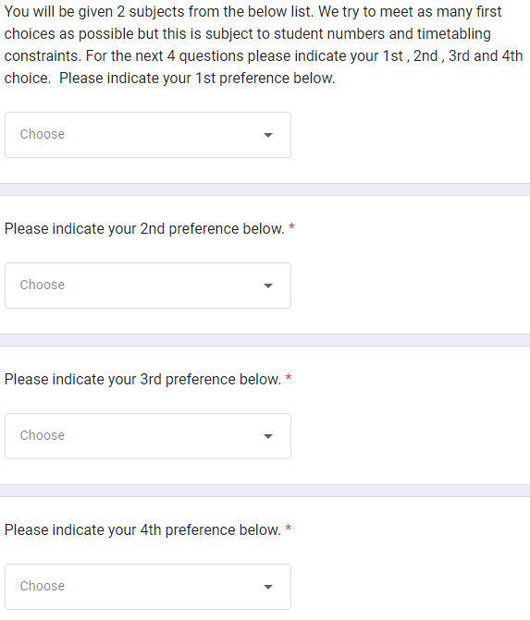
Option Form
You will then be allocated 2 subjects from list below.
Art
Business Studies
Computing
Drama
Engineering
Food Technology
French
Geography
History
Music
Product Design
Physical Ed
Photography
Religious Studies
Sports studies
Sociology
Spanish
We try to meet as many first choices as
possible but this is subject to student
numbers and timetabling constraints.
You need select your 1st, 2nd , 3rd, 4th , 5th
& 6th preferences in the correct drop
down menu.

Slide 12
Common Mistakes
Selecting subjects on the basis of what your friends have chosen
Missing the deadline – you run the risk of being assigned to subjects
Not involving your parents/carers in your decision making
Not looking ahead to the future, only thinking short term
Filling the form in wrong. Read the instructions carefully

Slide 13
The views of former HHS students on choosing
their GCSE subjects.
Do choose a subject because…
It fits your interests & abilities
It will help you meet the entry requirements for post-16.
You are good at it and think you will enjoy it.
You think you might want to continue studying it after Year 11
It links to a career you are interested in.

Slide 14
The views of former HHS students on choosing
their GCSE subjects.
Do not choose a subject because…
Your friends have chosen it
You don’t have time to research your options properly or to get any information and advice
One of your friends thinks it will be a good idea for you to do it
You think it’s a good course for a boy/girl to do
You like the teacher you have now

Slide 15
FAQ
Where can I get the option form?
The option form will be sent via email after the options evening
on 6th March
What happens if we accidently submit the wrong option choices?
Please email me andrew.matthews@heartlands.haringey.sch.uk with the correct choices.
Will I get all of my choices?
We do our best to allocate students their 1st - 3rd choices but please be aware that some subjects have a maximum number of students due to the workspace (for eg only 20 students can study Food Technology) or due to staffing.
Do I get my option choices if I submit my form in early?
No , all of the option forms will be collated on 25th March.
If you however submit your form after 25th March you may not get your option choices.

Slide 16
FAQ
Can my child change their subject in Year 10?
Changing subjects can be very disruptive for students and teachers.
We do allow students to move before the end of September. After this point , it will be up to the Heads of Subject as a number of subjects complete part of the GCSE in year 10.
Can I do a fourth option?
Unfortunately they cannot do a 4th option, as there is no time within the timetable and we feel that GCSEs are very demanding. There is an option to do a community language.

Slide 17
Community Languages
Finishing Year 11 with an additional GCSE in a language may help students secure a place in a college/6th form of their choice, as well as generate more job opportunities in the future.
Students can take a Community language GCSE in the following ing languages
Arabic , Bengali, Biblical Hebrew, Chinese, Greek, French, German, Gujarati, Italian, Japanese, Latin, Panjabi, Persian, Polish, Portuguese, Russian , Spanish, Turkish or Urdu.
All students have received a letter in the last couple of weeks with more information
Students will have to sit a preliminary writing exam in order to identify if they are capable of taking the GCSE exam.

Slide 18
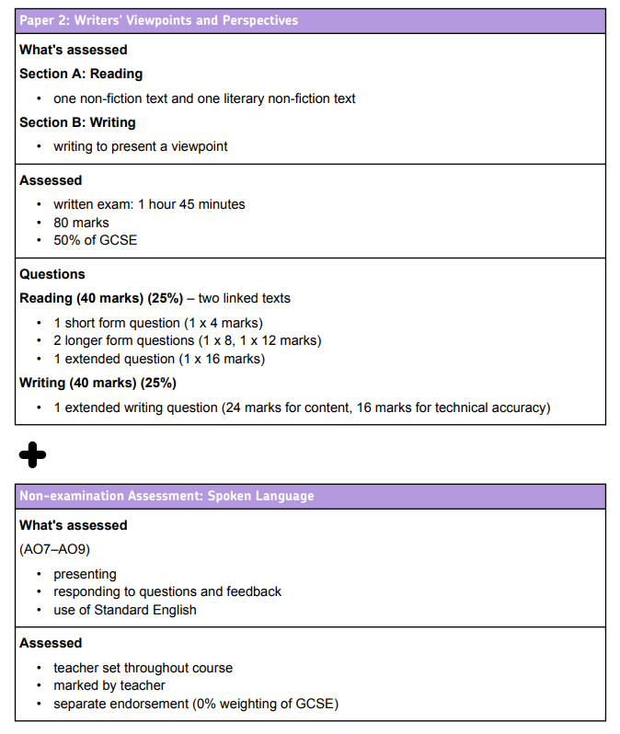
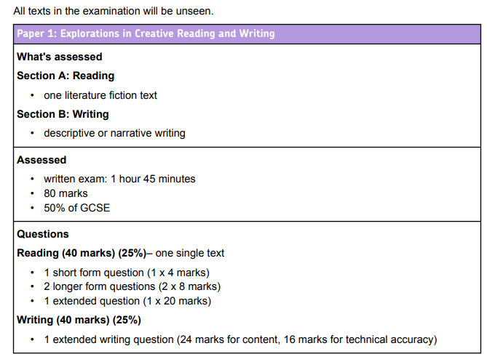
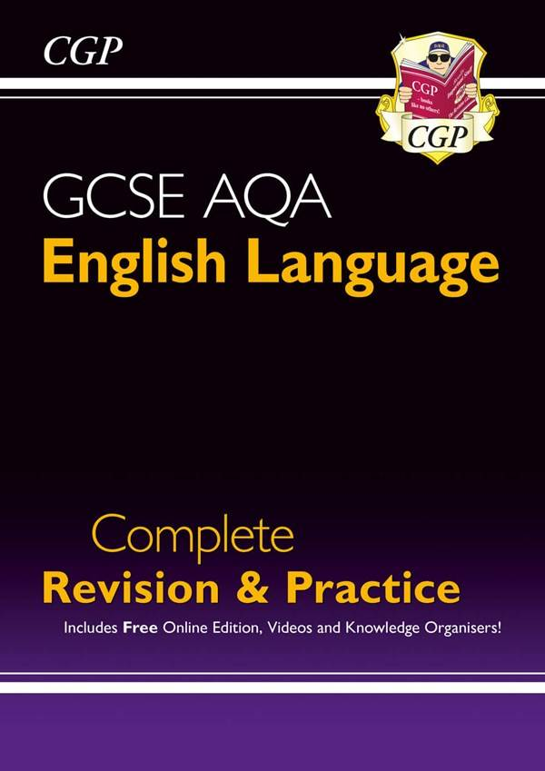
English Language
Key differences between KS3 and GCSE:
When studying GCSE English, the course is divided into two GCSE grades - English Language and English Literature.
Students will have four lessons a week, each half term they will alternate between Language and Literature.
They should be able to demonstrate a confident control of Standard English and they should be able to write grammatically correct sentences, deploy figurative language and analyse texts.
Importance of GCSE English Language:
Ensures students can read fluently and write effectively
A qualification that is held in high regard
Foundation for further education: students who want to study English at A-level or other written academic subjects
Students must achieve a grade 4 at GCSE to avoid having to retake the exam when they leave Heartlands

Slide 19
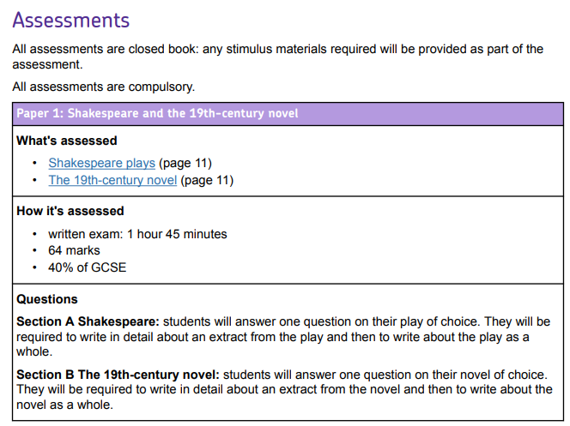
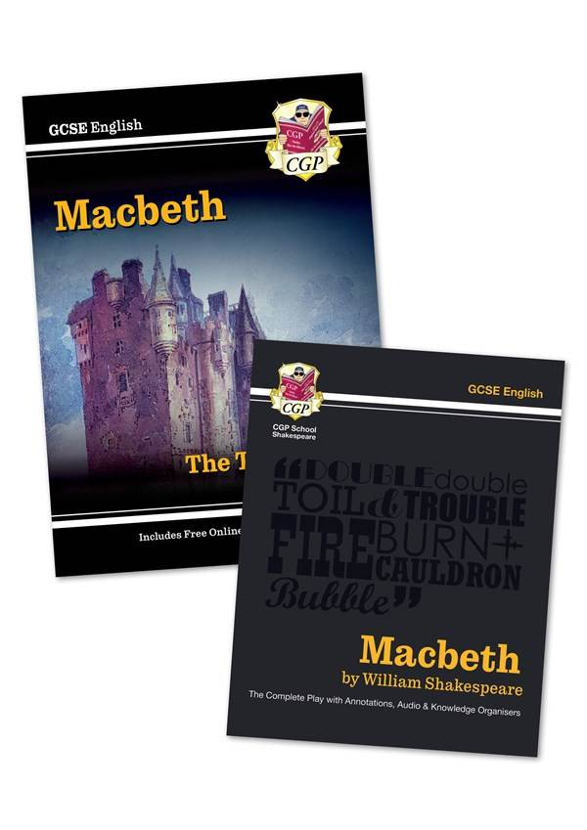
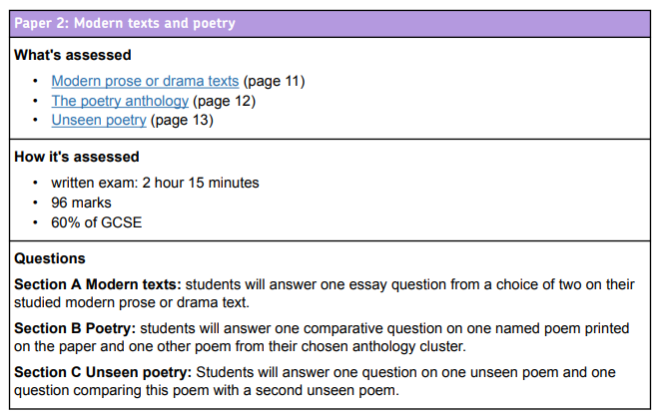
English Literature
How parents can support their child in preparing for GCSEs? Continue supporting students with reading at home. This will ensure their reading age is at the required level to access the KS4 texts. Educake - KS4 Home Learning quizzing tool.

Slide 20
Maths
KS3 maths focuses on building a solid foundation in basic mathematics and preparing for GCSE maths by covering key topics. Students start the GCSE specification in year 10 which delves deeper into more advanced topics.
Number
Algebra
Ratio and Proportion
Geometry and Measure
Probability
Statistics
From year 10 students will have 1 hour of maths or statistics every day - per week this equates to 4 hours of maths and 1 hour of statistics
Assessment - Exam Board EDEXCEL
Higher tier - sets 1 and 2 (students can achieve grades 1-9)
Foundation tier - sets 3, 4 and 5 (students can achieve grades 1-5)
3 papers - all 1 hour 30 minutes and out of 80 marks
All 3 papers are added together to give a total mark out of 240
Importance of GCSE Maths:
Develops problem-solving and analytical skills valuable in everyday life
Foundation for further education - a qualification that is held in high regard
Students must achieve a grade 4 at GCSE to avoid having to retake the exam when they leave Heartlands

Slide 21
Statistics
How can you support your child in preparing for maths and statistics
Sparx Maths - weekly home learning and use of independent learning section
MathsGenie - excellent revision website with questions from past papers for more exam focused revision
Statistics units blended into KS3 maths scheme of work. Statistics is then considered a separate subject in years 10 and 11 (1 lesson per week)
Contains a vast range of crossover topics - majority of these are taught during statistics lessons
Students in set 1 and set 2 will sit the higher tier
Students in set 3 and 4 will sit the foundation tier
Students in set 5 do not sit statistics - they have an extra maths lesson per week
Assessment - Exam Board EDEXCEL
2 papers - both 1 hour and 30 minutes and out of 80 marks
Both papers are added together to give a total mark out of 160

Slide 22
Science
KS4 Science covers the core topics in Biology, Chemistry and Physics.
Two classes study Separate Sciences (3 GCSEs). They are three separate GCSEs. These students are chosen by the school based upon their attainment.
Most students study Combined Science (2 GCSEs); Higher Tier - grade 9-9 to 4-3 or Foundation tier - grade 5-5 to 1-1.
From year 10 students will have 5 one hour lessons a week including one double lesson for extended practical work and exam skills practice.
Assessment - OCR Gateway A Science
100% exams
Separate Sciences - Biology (J247), Chemistry (J248), Physics (J249)
2 exams per subject (6 in total). 1 hour 45 minutes
Combined Science - J250
6 exams (2 for each subject). 1 hour 10 minutes
Tassomai home learning is a smart app that helps students learn the key scientific knowledge (40% of the exams) and practice multiple choice questions.

Slide 23
Citizenship
Citizenship Studies focuses on giving students an overview of law, politics and activism. Students learn key concepts and themes in KS3 and develop them in more depth at GCSE.
Key topics include:
Life in Modern Britain
The UK's role in International Organisations
The Criminal Justice System
Law in the UK
Human rights
Activism
Politics in the UK - How Parliament works
Students have 3 hours of GCSE Citizenship a fortnight. Citizenship was introduced at KS3 last year. Current Y9 students started Citizenship in Y8.
Importance of GCSE Citizenship:
Equips students with the knowledge to be informed global citizens.
Develops critical thinking and evaluative skills.
Ensures students understand their rights and responsibilities in modern society.
Develops essential written skills due to being an essay subject.
Assessment - Exam Board AQA
2 papers - both 1 hour 45 minutes and 80 marks.
Both papers are added together to give a total of 160 marks.

Slide 25
What to ask the head of departments tonight?
What content and topics do you teach?
Is your subject 100% exam?
If there is controlled assessment, what do they need to do?
What career opportunities would your subject provide?
How will your course develop my skills and knowledge?
What extracurricular activities are there? ie trips
Could I have a look at a students book or revision guide?
Notes:
G

Slide 26
Subject Map
Library SEND Support Careers Advisor Drama Studio Drama | N3.3 Computer Science | N3.5 Business Studies | N3.8 Sociology Citizenship Religious Studies
N4.3 PE & Sports Studies | N4.4 French Spanish | N4.6 Geography | N4.9 History
N5.3 Music | N5.6 Art & Photography | F5.13 Food Textiles Engineering Product Design | N5.8 EAL
Notes:
G

Slide 27
If you have any further questions
If you have any further questions , please either ask a member of staff or me.
Please could I ask anyone sitting on this half to make their way up to the N4 or N5 corridor
Please could I ask anyone sitting on this half to make their way to
the N3 corridor
Notes:
G

