Slide 1
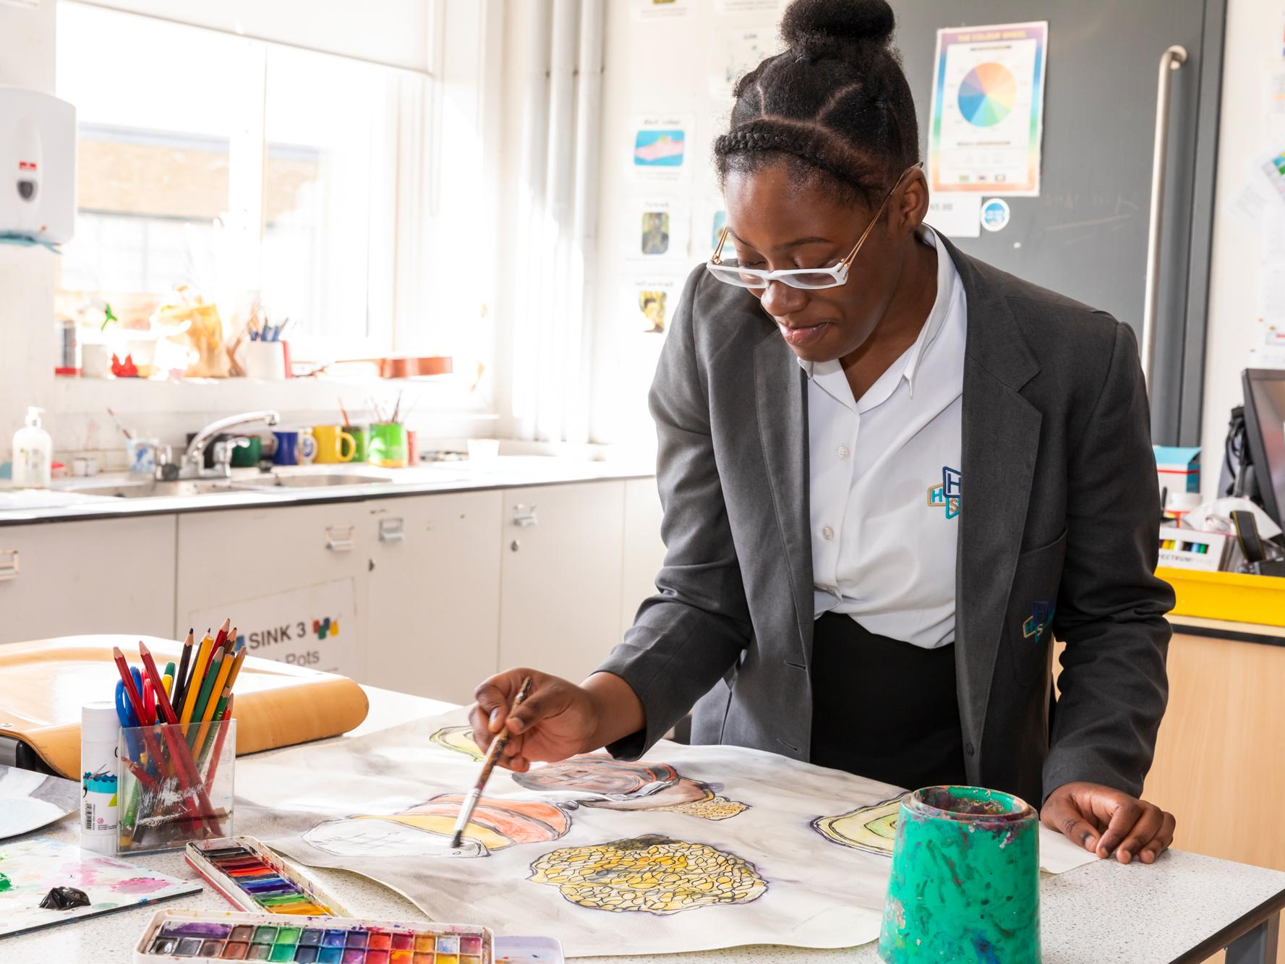
Introduction to the
GCSE Options Process
The Future & Support
Option Process & the Journeys
Key Dates
Completing the option form
Common Mistakes
FAQ’s
Community Languages
This Evening

Slide 2
Further Information
In January please log onto
https://heartlands.haringey.sch.uk/curriculum-2/year-8-9-options/
Or go to the Heartlands High School website.
Click “Students” in the toolbar and
then click “GCSE Options”

Slide 3
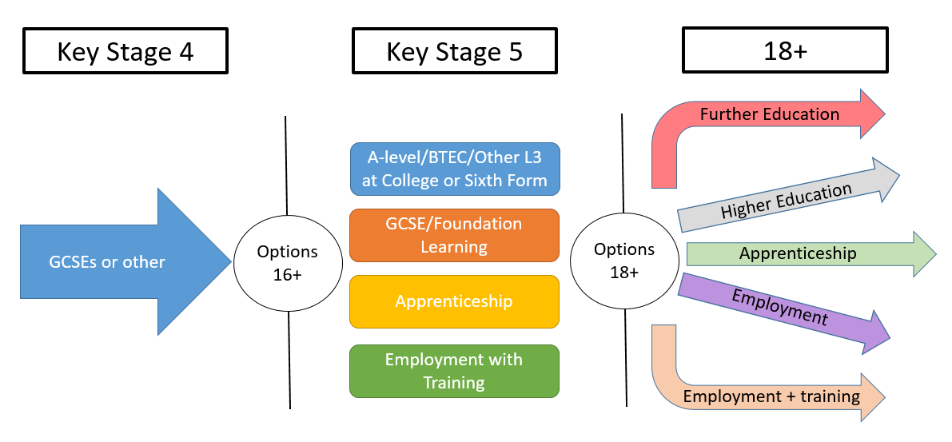
The Future & Support
Students will receive a 1-2-1 Careers interviews
1-2-1 careers interviews
10 hours of taster sessions for subjects
Year 9 have a 3 years KS3.
Students know where to look for information

Slide 4
Choices
Art
Business Studies
Computing
Drama
Engineering
Food Technology
French
Geography
History
Music
Product Design
Physical Ed
Photography
Religious Studies
Sports studies
Sociology
Spanish
Compulsory
GCSE English
GCSE Mathematics
GCSE Science
GCSE Citizenship
GCSE Statistics
PE
3 GCSE Options

Slide 5
Journeys
The school offers three distinct journeys: Bespoke, Heartlands and Extended.
These are recommended to students and parents, and are based on your prior and current attainment.
Bespoke journey
Heartlands journey
Extended journey

Slide 6
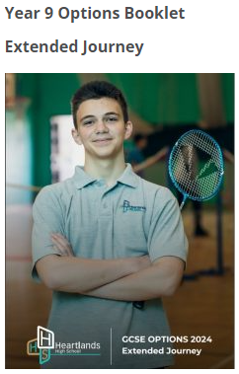
Options booklets

Slide 7
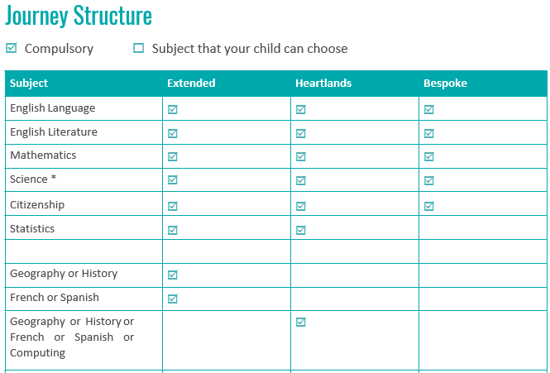

Slide 8
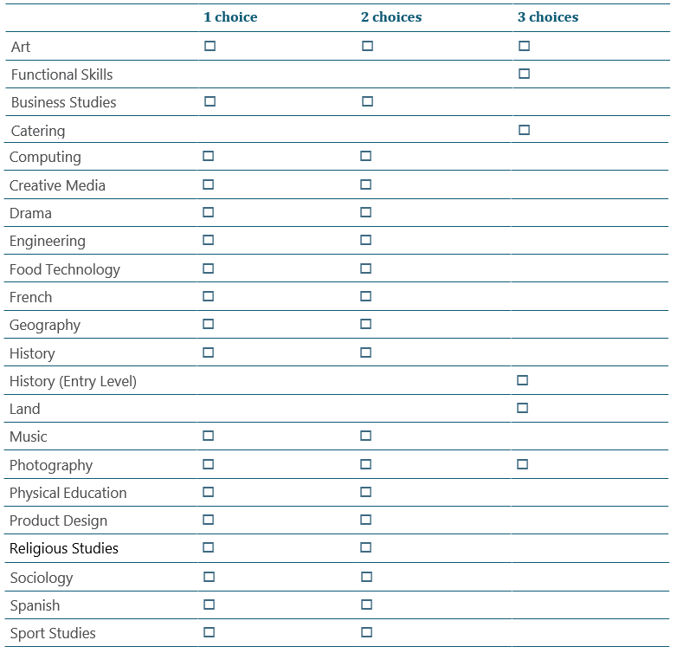

Slide 9
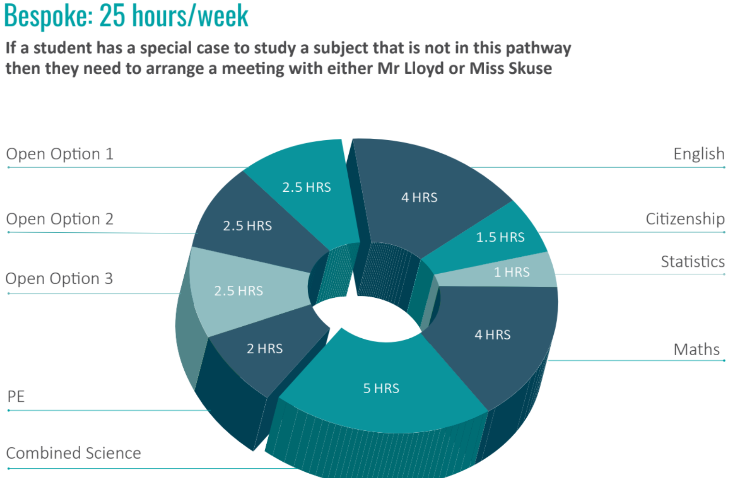

Slide 10
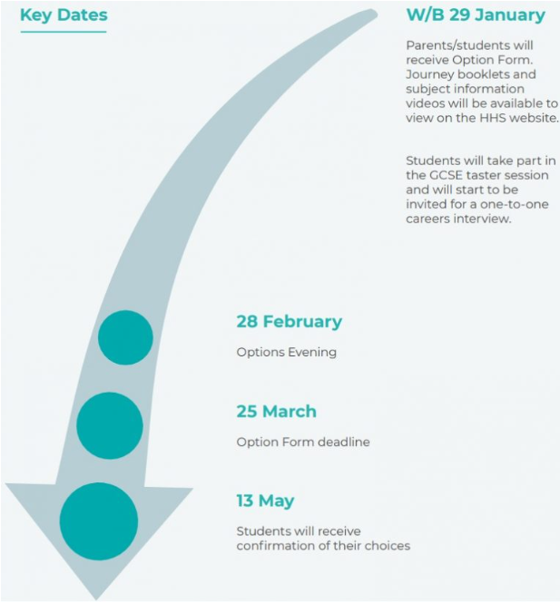
Key Dates

Slide 11
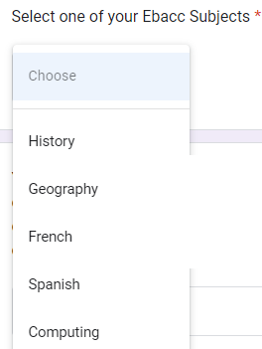
Option Form
Your option form will be sent to you via email tomorrow
Before you complete this form, it is very important that you are logged into
your HHS email address and make sure that your browser is also logged into your HHS google account.
It important that you have discussed your option choices with your parents/carers.
You will only be allowed to submit this option form once, so please take care in filling the form accurately. Once you have submitted the form you will be unable to change your option choices.
The deadline to submit this form is 25th March 2024
To complete the form follow the below steps
Once you have filled in your personal details you will then
select your choices.
The majority of you will select 1 or 2 of these subject
History/Geography/French /Spanish / Computing
depending on your journey.

Slide 12
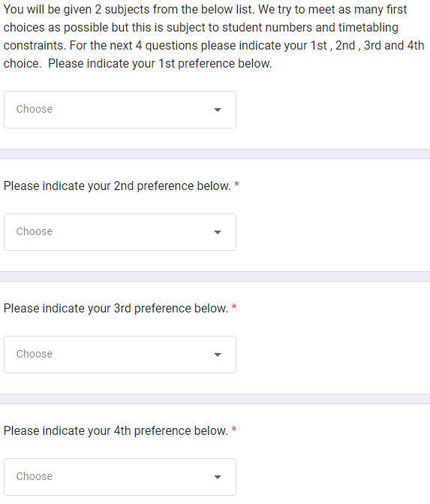
Option Form
You will then be allocated 1 or 2 subjects from list below.
Art
Business Studies
Computing
Drama
Engineering
Food Technology
French
Geography
History
Music
Product Design
Physical Ed
Photography
Religious Studies
Sports studies
Sociology
Spanish
We try to meet as many first choices as
possible but this is subject to student
numbers and timetabling constraints.
You need select your 1st, 2nd , 3rd and 4th
Preferences in the correct drop down menu.

Slide 13
Common Mistakes
Selecting subjects on the basis of what your friends have chosen
Missing the deadline – you run the risk of being assigned to subjects
Trying to change your journey – Trust our judgement on this
Not involving your parents/carers in your decision making
Not looking ahead to the future, only thinking short term
Filling the form in wrong. Read the instructions carefully

Slide 14
The views of former HHS students on choosing
their GCSE subjects.
Do choose a subject because…
It fits your interests & abilities
It will help you meet the entry requirements for post-16.
You are good at it and think you will enjoy it.
You think you might want to continue studying it after Year 11
It links to a career you are interested in.

Slide 15
The views of former HHS students on choosing
their GCSE subjects.
Do not choose a subject because…
Your friends have chosen it
You don’t have time to research your options properly or to get any information and advice
One of your friends thinks it will be a good idea for you to do it
You think it’s a good course for a boy/girl to do
You like the teacher you have now

Slide 16
FAQ
Where can I get the option form?
The option form will be sent via email after the options evening
on 28th February
What happens if we accidently submit the wrong option choices?
Please email me andrew.matthews@heartlands.haringey.sch.uk with the correct choices.
Will I get all of my choices?
97% of students were allocated their 1st - 3rd choices 2 years ago, so it is highly likely you will get all of your. Please be aware that some subjects have a maximum number of students due to the workspace (for eg only 20 students can study Food Technology)
Do I get my option choices if I submit my form in early?
No , all of the option forms will be collated on 25th March.
If you however submit your form after 25th March you may not get your option choices.

Slide 17
FAQ
Can my child change their subject in Year 10?
Changing subjects can be very disruptive for students and teachers.
We do allow students to move before the end of September. After this point , it will be up to the Heads of Subject as a number of subjects complete part of the GCSE in year 10.
Can I do a fourth option?
Unfortunately they cannot do a 4th option, as there is no time within the timetable and we feel that GCSEs are very demanding. There is an option to do a community language.

Slide 18
Community Languages
For the past 8 years, Heartlands High School has provided pupils in
Year 10 & 11 with the opportunity to complete a GCSE examination
in a Community Language.
Finishing Year 11 with an additional GCSE in a language may help students secure a place in a college/6th form of their choice, as well as generate more job opportunities in the future.
Students can take a Community language GCSE in the following ing languages
Arabic , Bengali, Biblical Hebrew, Chinese, Greek, French, German, Gujarati, Italian, Japanese, Latin, Panjabi, Persian, Polish, Portuguese, Russian , Spanish, Turkish or Urdu.
All students will receive a letter in the next couple of weeks with more information
Students will have to sit a preliminary writing and reading exam in order to identify if they are capable of taking the GCSE exam.

Slide 20
What to ask the head of departments tonight?
What content and topics do you teach?
Is your subject 100% exam?
If there is controlled assessment, what do they need to do?
What career opportunities would your subject provide?
How will your course develop my skills and knowledge?
What extracurricular activities are there? ie trips
Could I have a look at a students book or revision guide?
Notes:
G

Slide 21
Subject Map
Library SEND Support Careers Advisor Drama Studio Drama | N3.3 Computer Science | N3.5 Business Studies | N3.8 Sociology Citizenship Religious Studies
N4.3 PE & Sports Studies | N4.4 French Spanish | N4.6 Geography | N4.9 History
N5.5 Music | N5.6 Art & Photography | F5.13 Food Textiles Engineering Product Design | N5.8 EAL
Notes:
G

Slide 22
If you have any further questions
If you have any further questions , please either ask a member of staff or me.
Please could I ask anyone sitting on this half to make their way up to the N4 or N5 corridor
Please could I ask anyone sitting on this half to make their way to
the N3 corridor
Notes:
G

