Slide 1
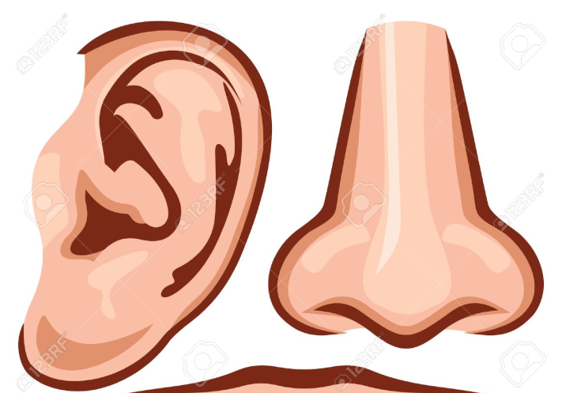
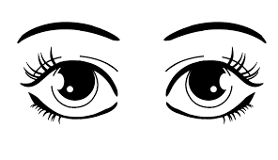
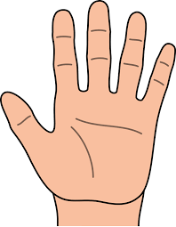
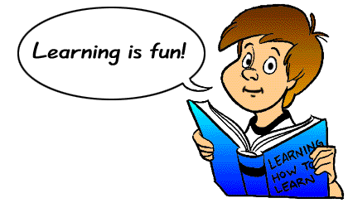
Active revision
Active revision means involving your; eyes, ears and
hands in different ways
Active methods of revision includes:
Writing notes & rewriting notes
Reading notes aloud
Recording key notes onto your phone
Discussing topics with friends
Testing yourself & getting others to test you
Trying past exams papers & using revision websites

Slide 2
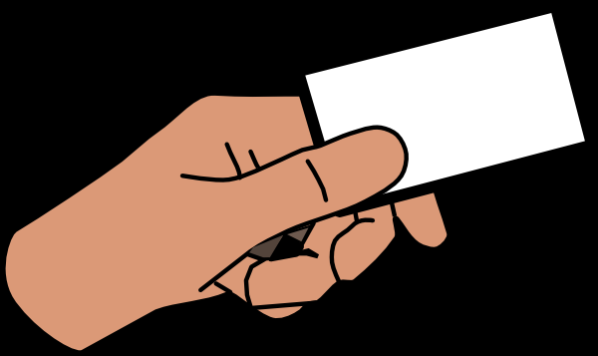
Traditional revision notes
Look at “bite-size” chunks of work instead of working with large information at a time
Use your OWN words
Make sure your notes are well spaced out and cram too much onto a page
Use large writing and even better use CAPITAL LETTERS
Make your revision notes interesting by using; colour, boxes, circles, underlining, abbreviations and so on
Revision cards
Carry revision cards with you, you can read them on the bus, in the car, during lunch time or break
Cards covering the same topic should be kept together. You can do this by using a piece of string or elastic band tied through a hole in the left corner of the cards
Patterned notes
Patterned notes give an overview of a topic and show links and connections
Patterned notes can be; mind maps, spider diagram, brain storm, learning map or concept map

Slide 3
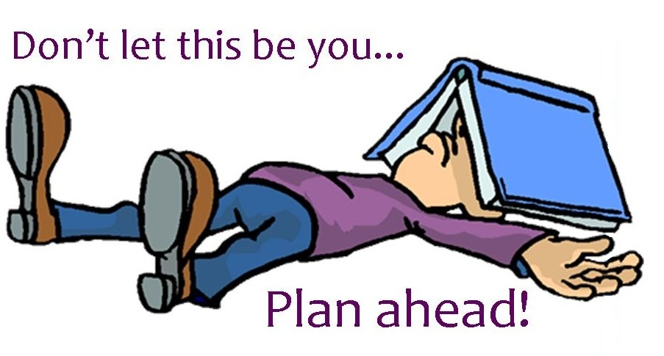
Revision timetable
There are many good reasons for using revision timetables
To avoid last min rush the night before an exam
To set up a routine and discipline yourself
To get the right balance between revision and leisure time
To avoid wasting time trying to decide what to do for each revision session
Before you start your revision draw up a chart showing the dates and times of all your exams and work out how many weeks until your first exam
You should start serious revision at least 8 weeks before your first exam
Drawing up your next timetable
when you come to the end of each week, carry out a quick review and draw up a timetable for the next week
Repeat this cycle until your exam
Always stick your timetables where you can see them!

Slide 4
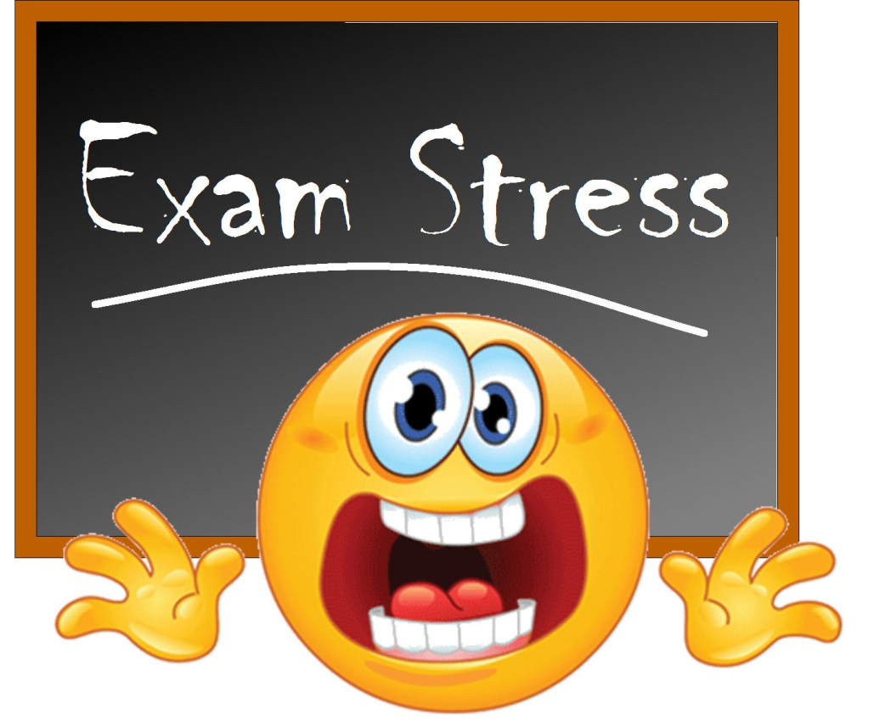
Coping with your STRESS
Talk about
Your listeners can be friends, family and teachers
Asking for help is not a sign of weakness
Take time out to have fun
Give yourself time to do the things that relax you and take your mind off your studies
Do some exercise
One of the best ways of dealing with stress is exercise
Exercise helps clear your mind
Think positively
Thinking makes you worry more and makes you less enthusiastic about working hard
Relax your muscles
Eat well
Eating well reduces the overall stress on the body and can also make you feel good about yourself
Use mental imagery
Breathing technique – try this
Sit comfortably and close your eyes
Breath in slowly though your nose to the count of ten
Hold this breath while you count to ten again
Now let out your breath slowly and count to ten once more
Repeat this three times

