Slide 2
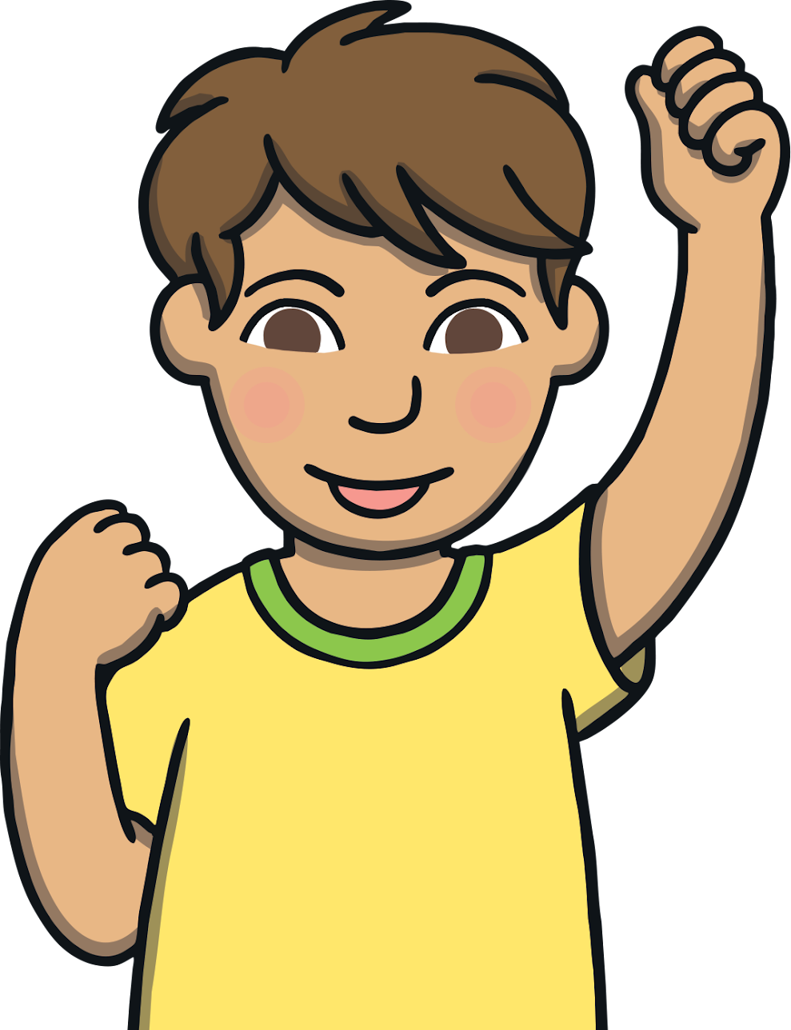
Teach
We are going to learn to spell some new tricky words.

Slide 3
Teach
poor
live

Slide 4
Teach
door
give

Slide 5
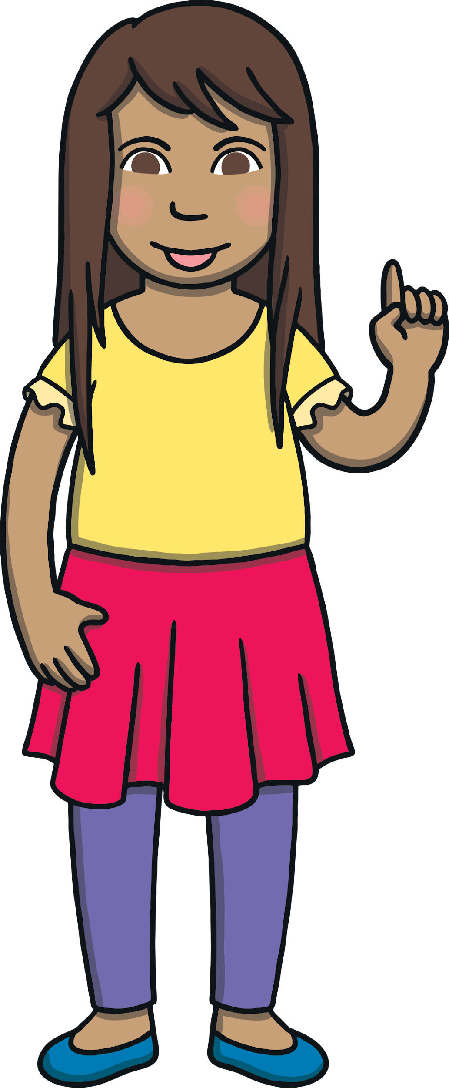
Teach
Today, we are learning to read words containing
y saying /igh/

Slide 6

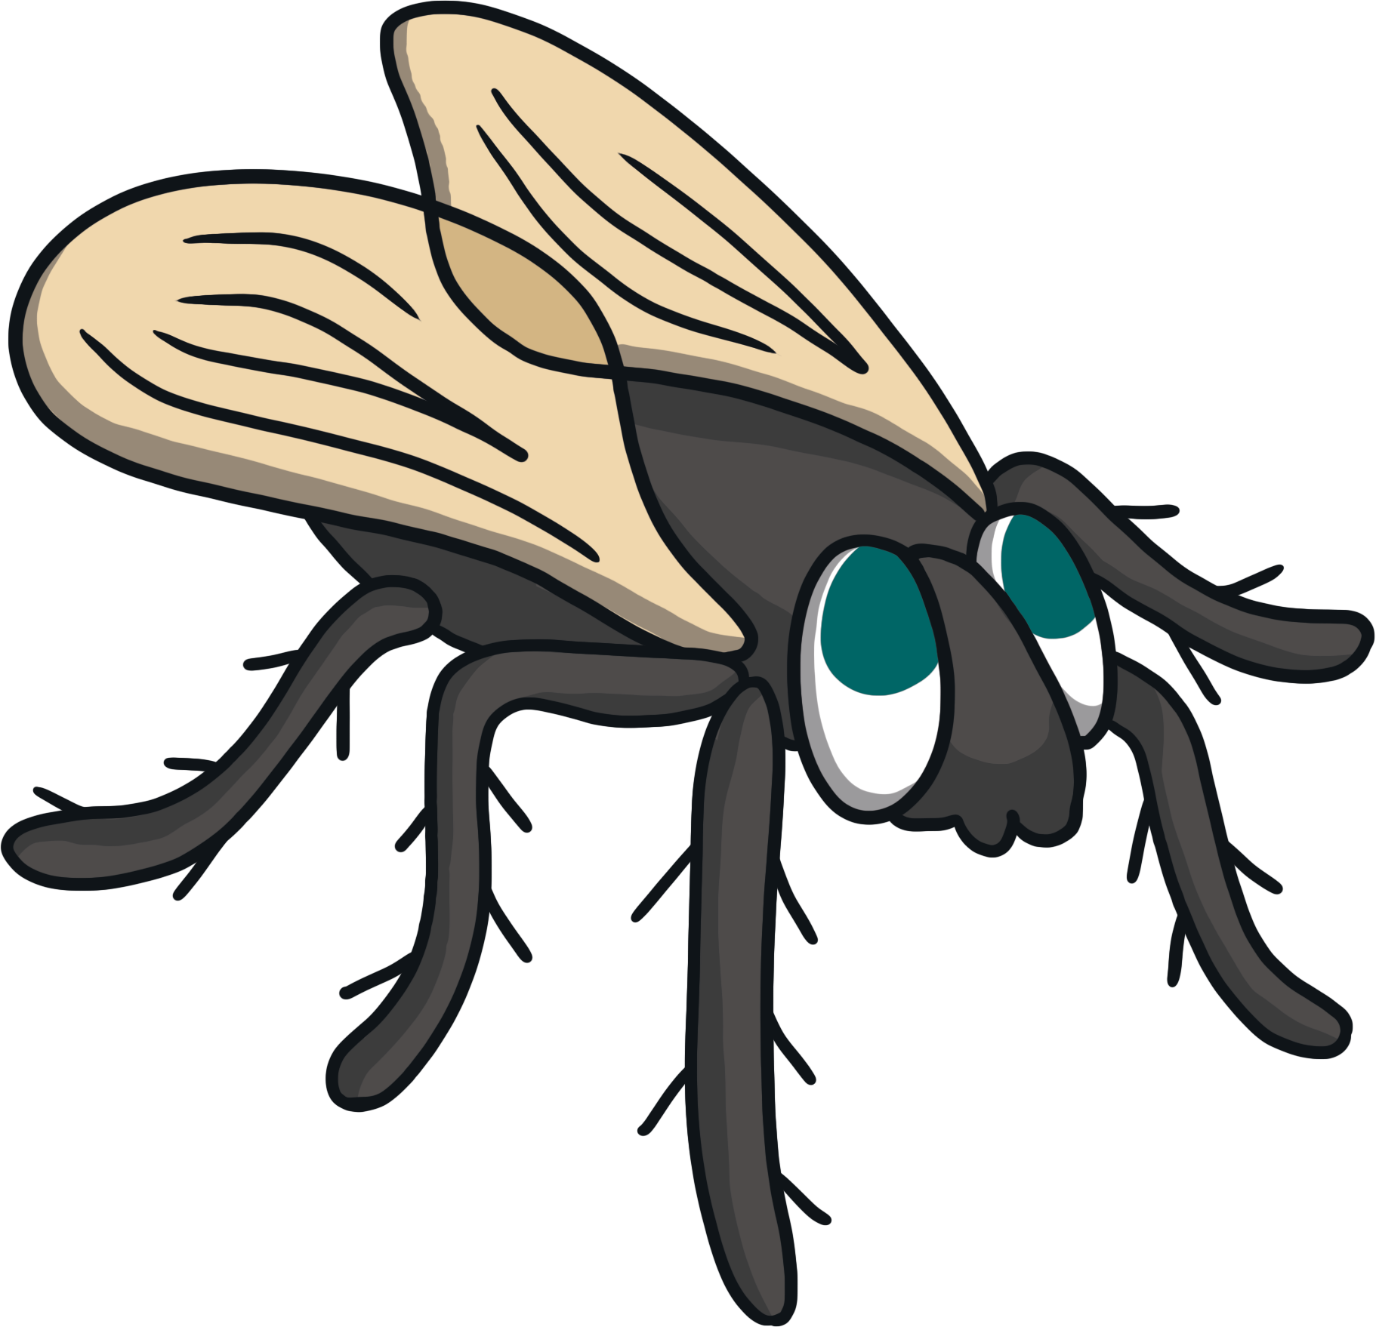
Teach
y
fly

Slide 7
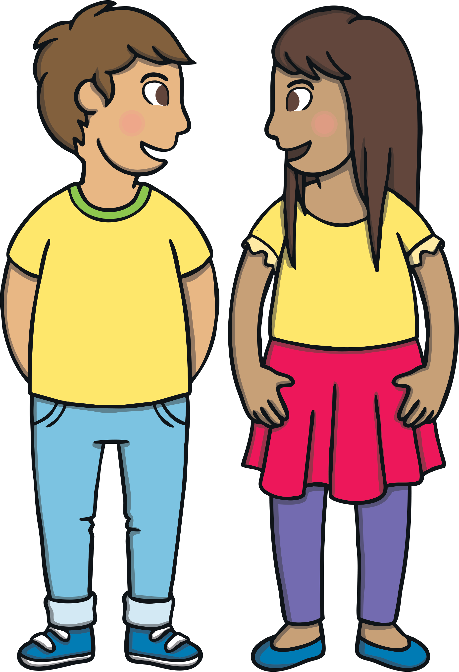
Teach
In lots of short words and some other words, the y makes the /igh/ sound.
by
my
try
Can you and your talk partner think of another
word that might have y saying /igh/ in it?

Slide 8

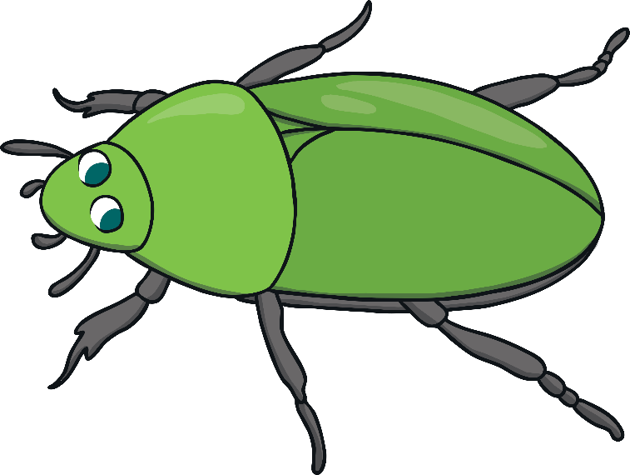
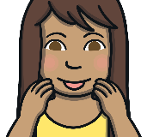
Teach
Kit and Sam are watching insects. Can you read the words containing y saying /igh/?
Click on the insects to reveal a word to read.
Start

Slide 9

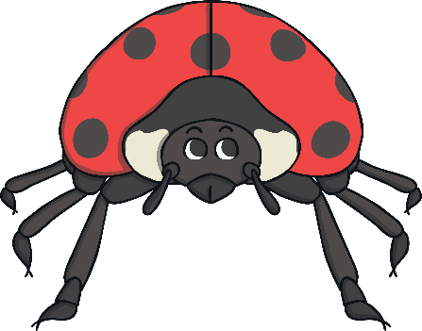
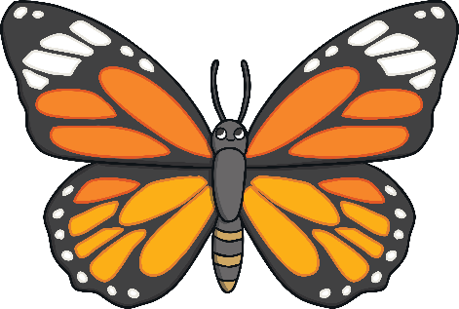
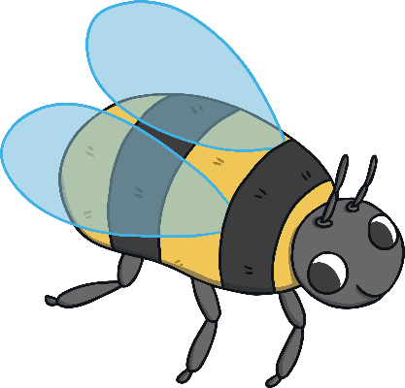
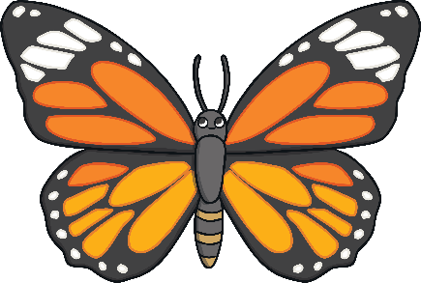
Teach
Click on the insects to make them move.
Can you read the words hidden behind the insects?
pylon
spy
pylon
python
spy
python
fry
fry
sky
why
sky
why
y makes the /igh/ sound at the end of words with one syllable and sometimes in the middle of words with more than one syllable.
What do you notice about where the
/igh/ sound is in these words?
Check
Next

Slide 10
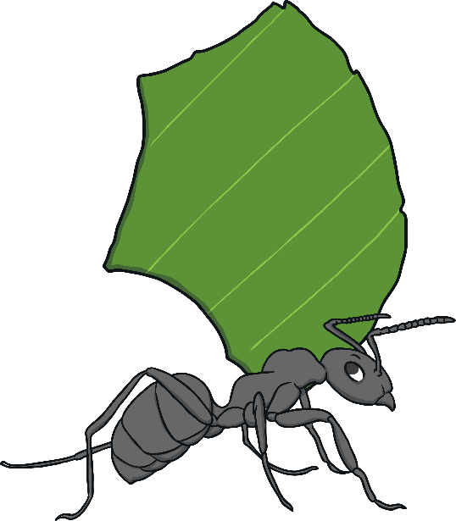
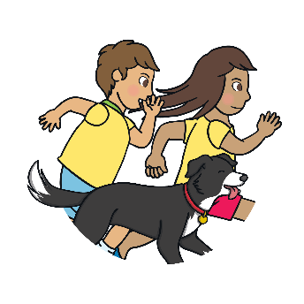
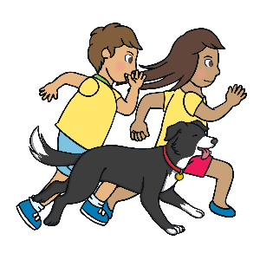
Practise
Ants and Leaves
Help each ant to find their correct leaf. Show which ant should get the leaf by writing the number or showing it on your fingers.
You can do this activity more physically by numbering the corners of your room and getting children to move to the corner that matches their answer.
X
Click us for Physically Active Phonics tips!

Slide 11
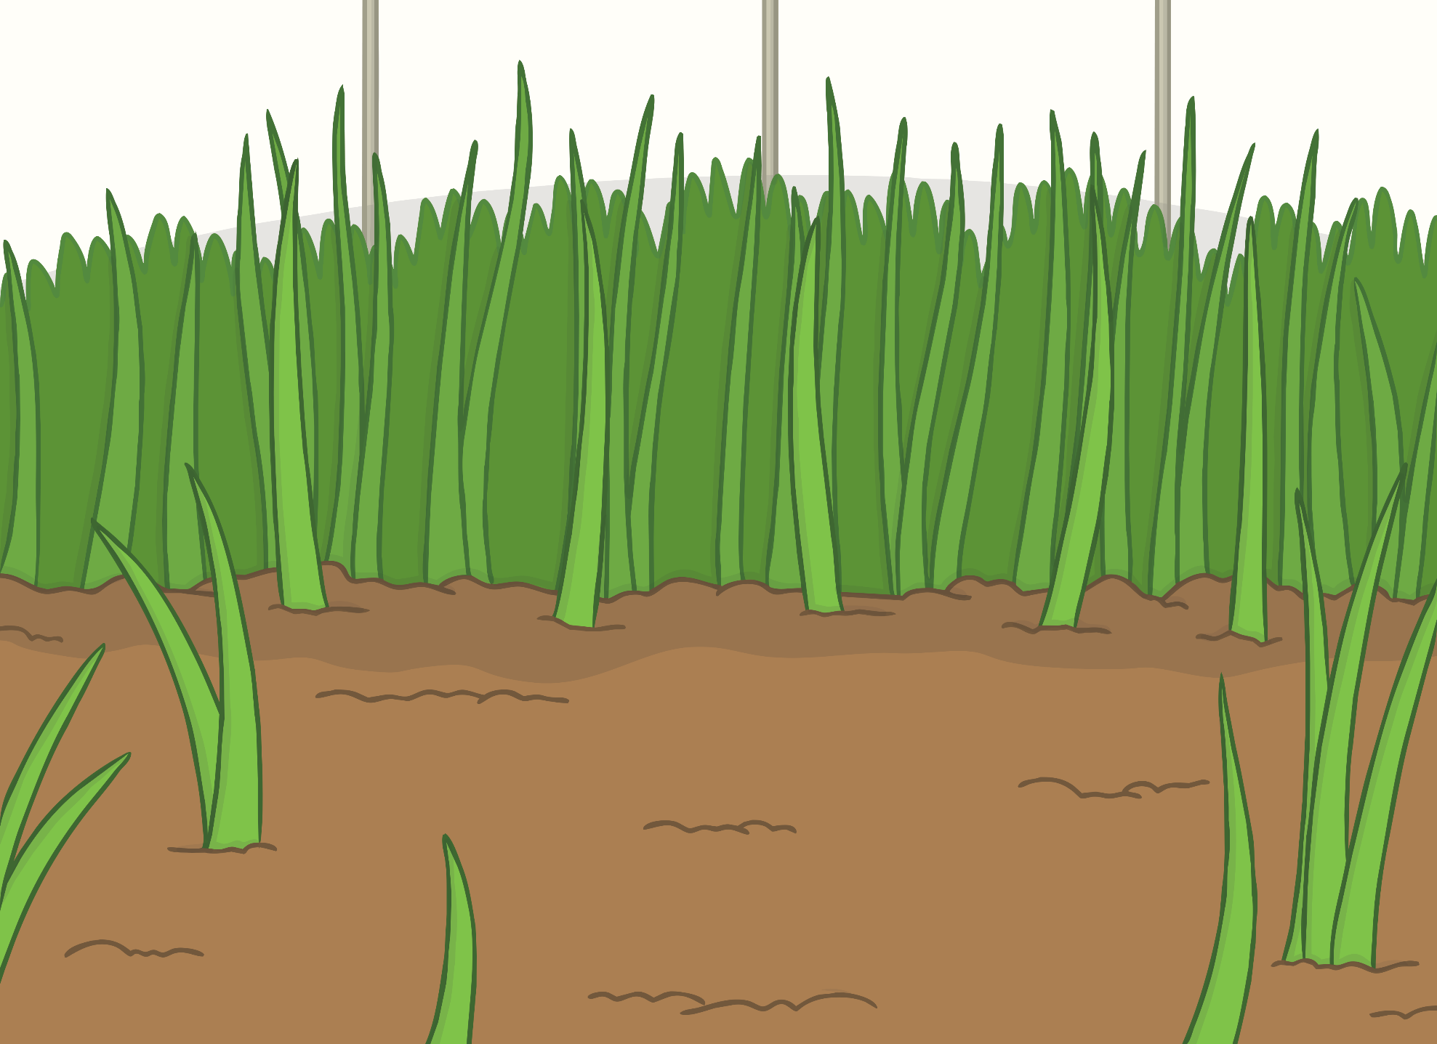
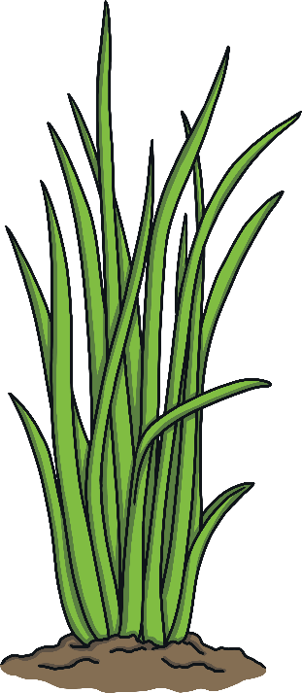

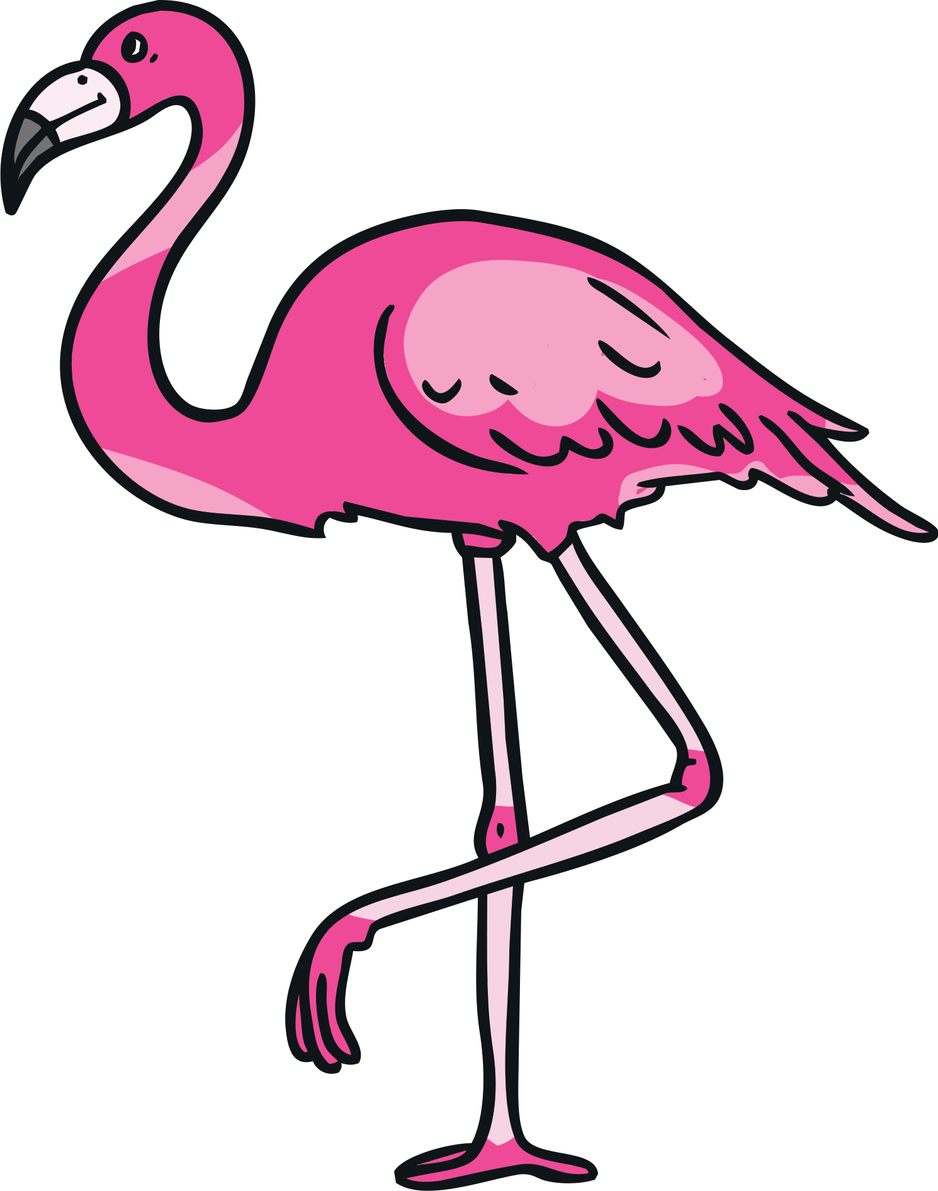
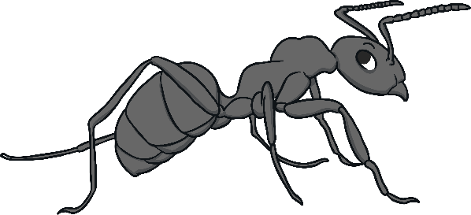

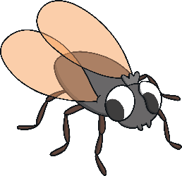
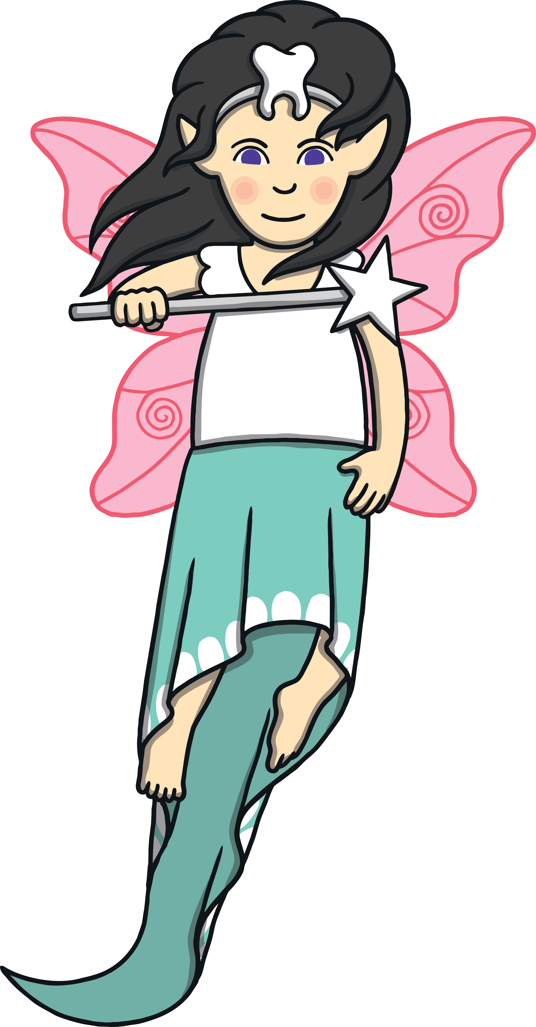
Practise
fly
1
2
3
4

Slide 12

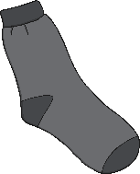
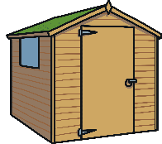
Practise
sky
2
1
4
3

Slide 13
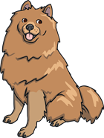

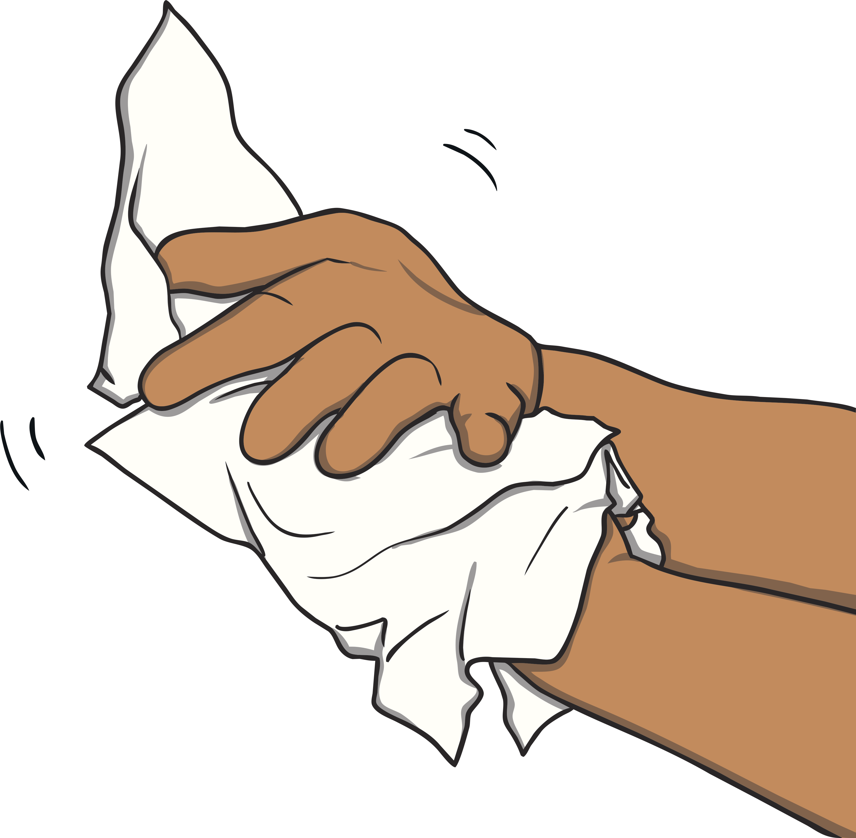

Practise
dry
2
1
3
4

Slide 14
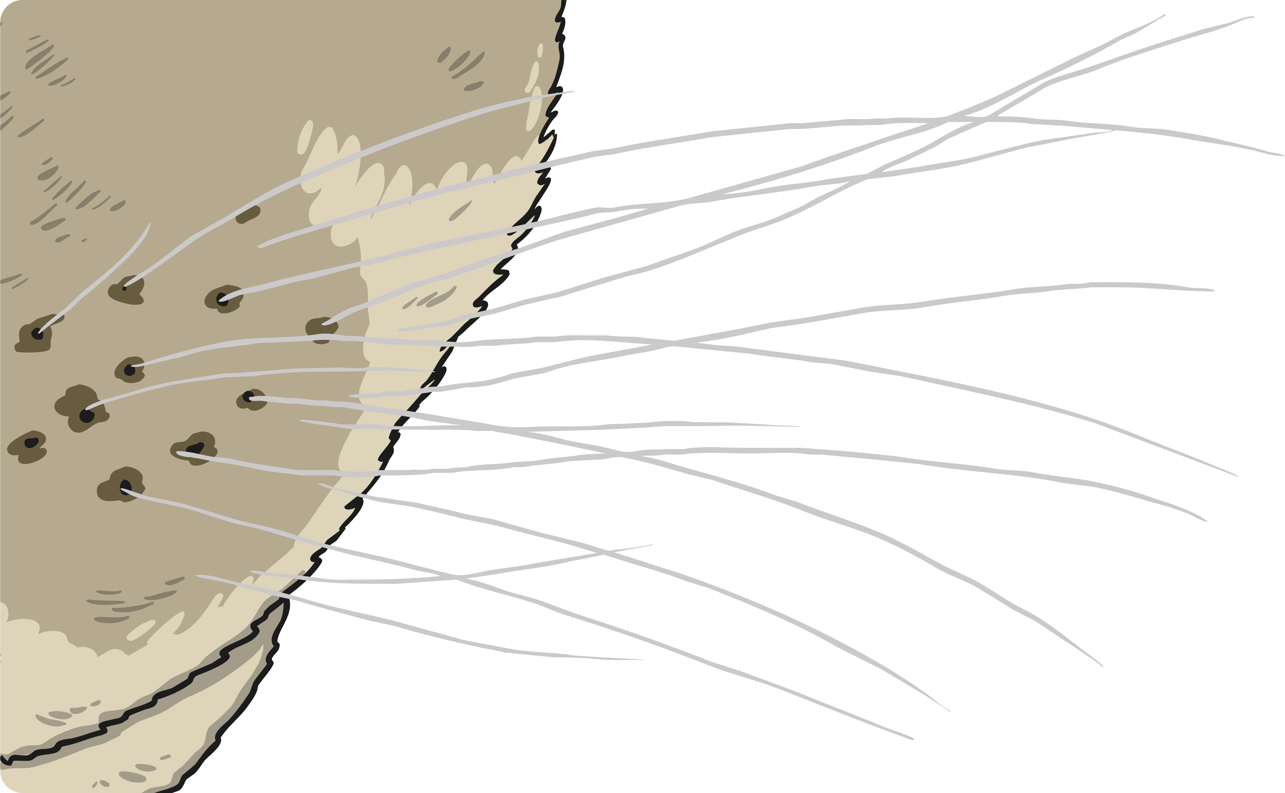


Practise
why
2
1
?
3
4

Slide 15


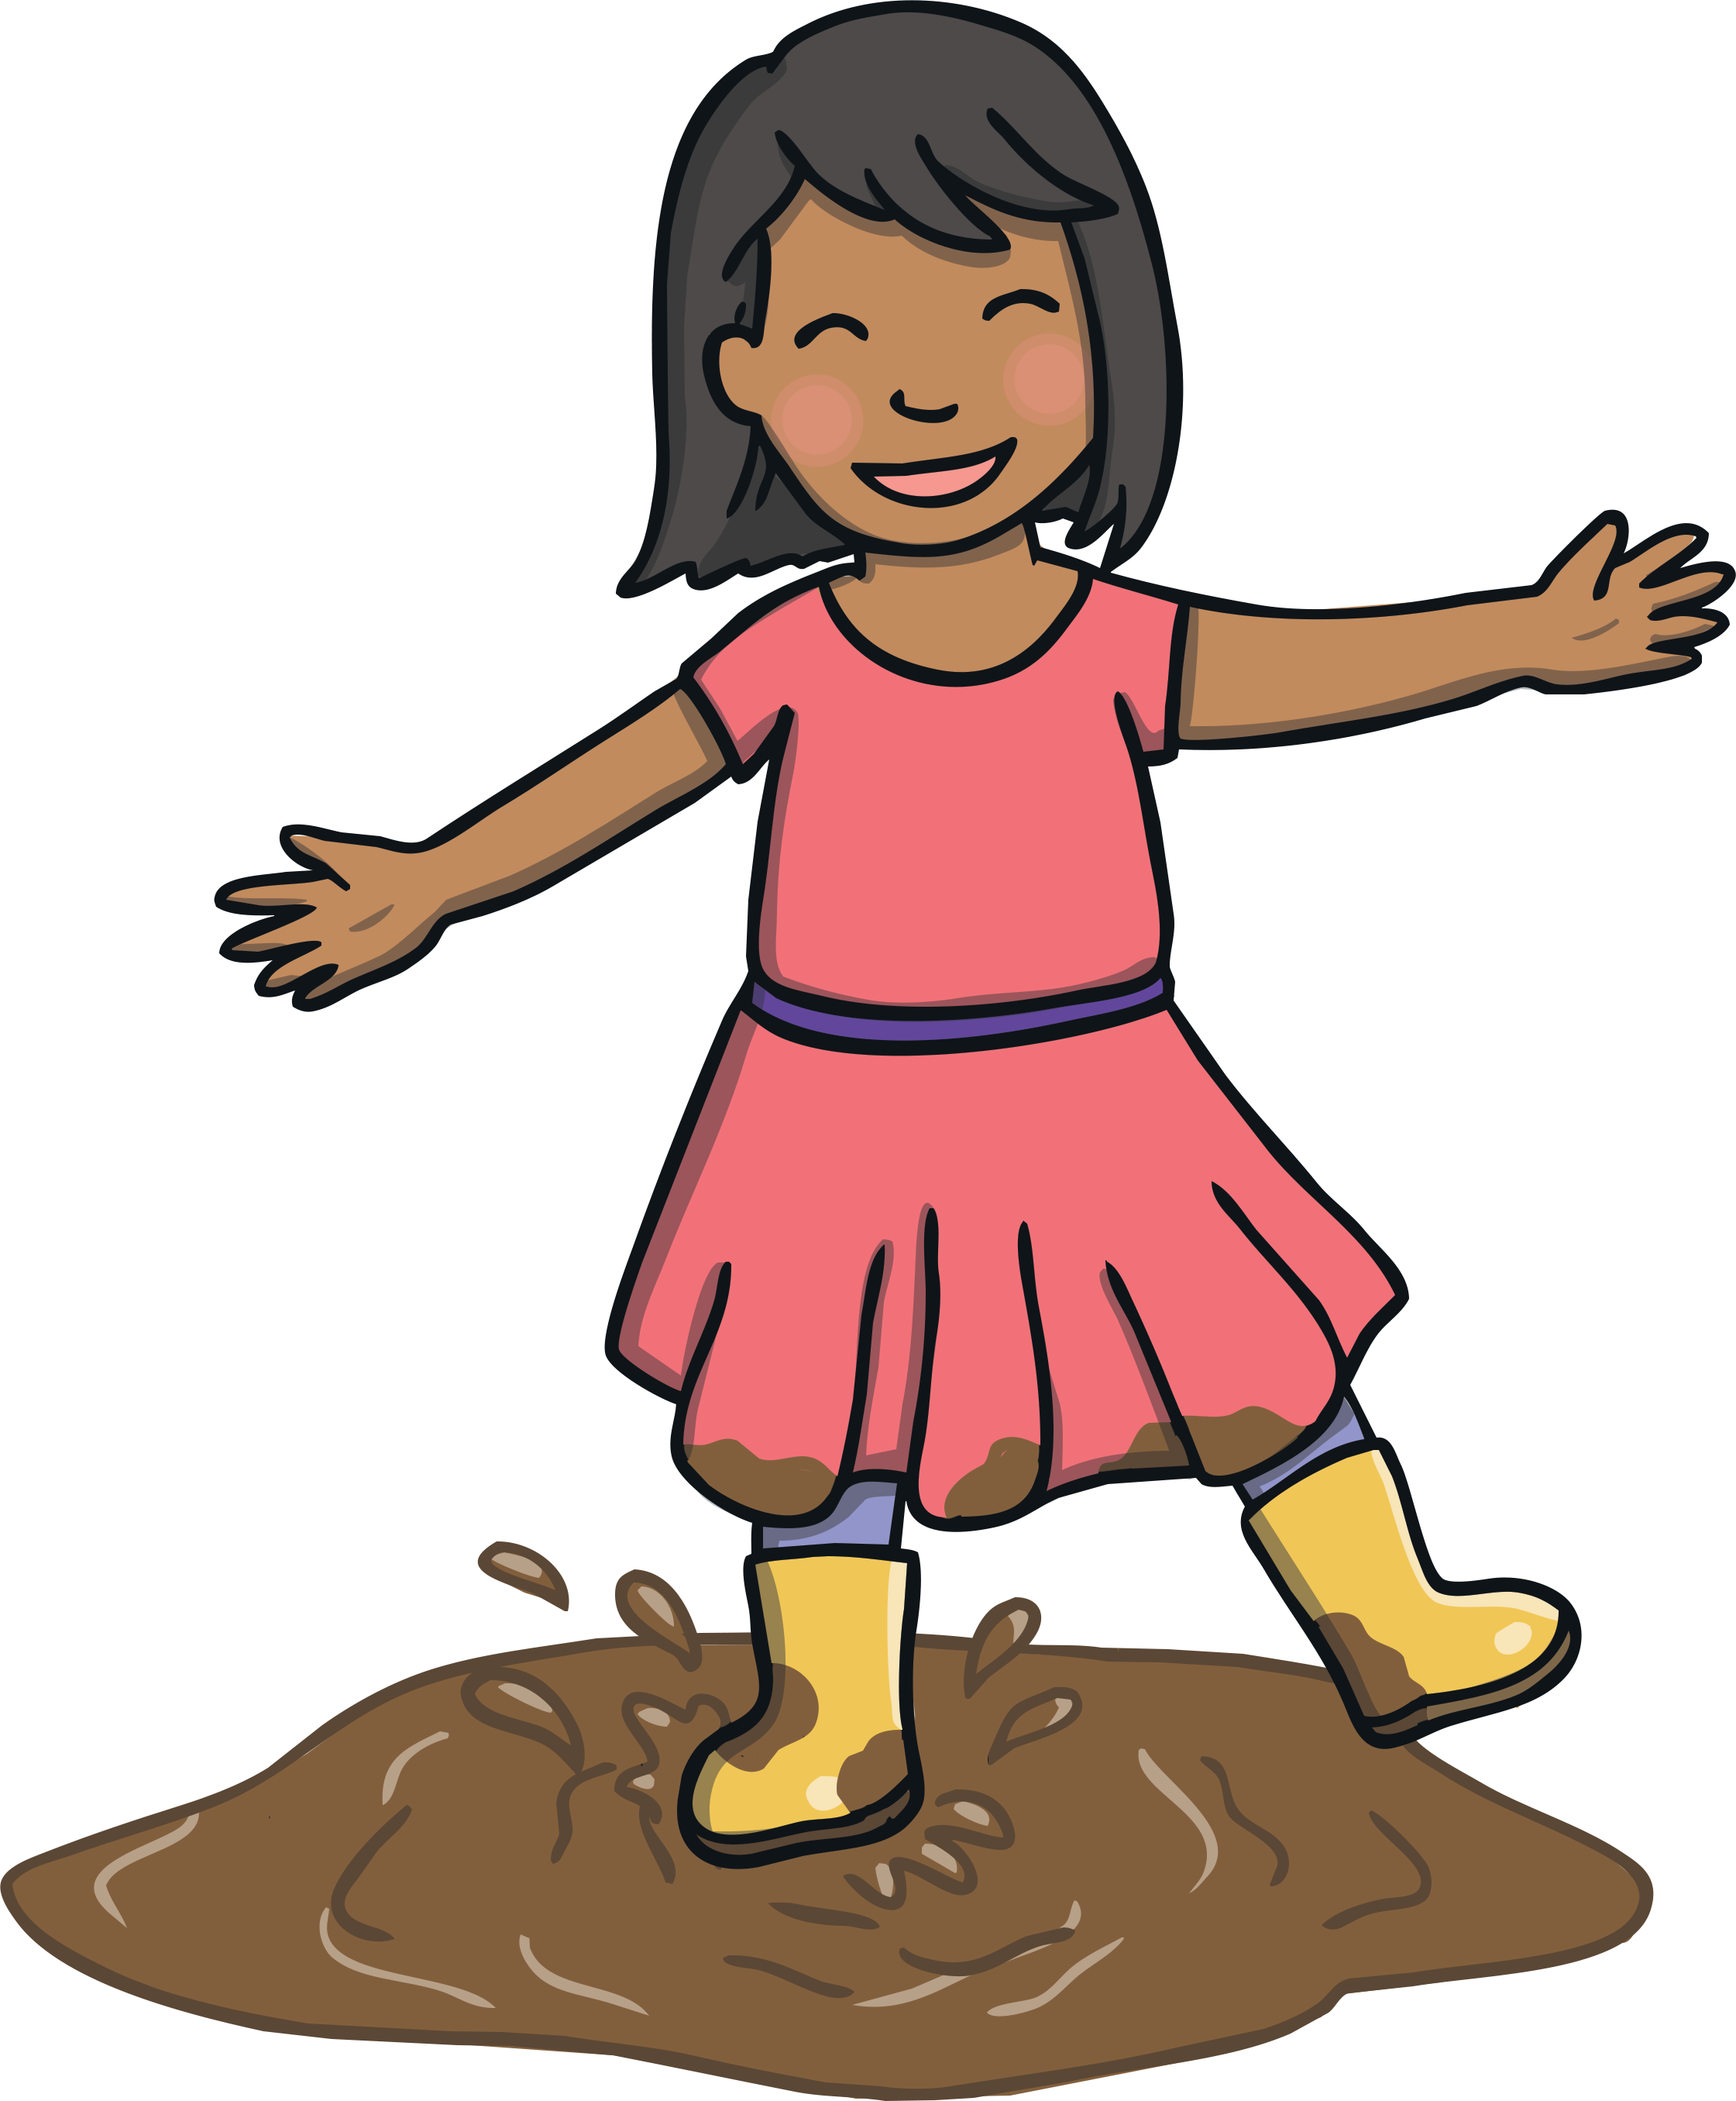

Practise
spy
2
1
3
4

Slide 16
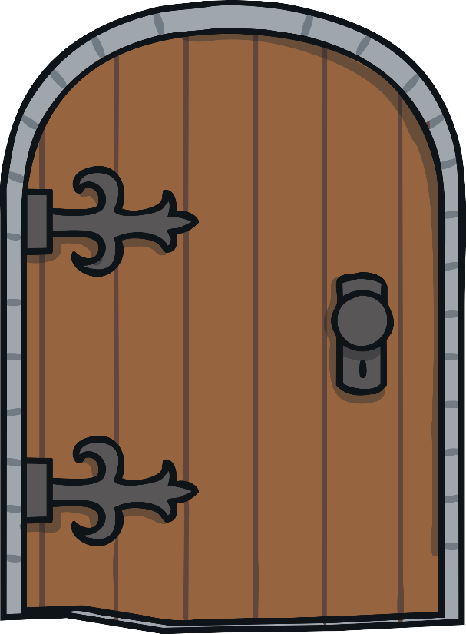


Apply
Sign Spotters
Can you and your talk partner read the sign and spot any y saying
/igh/ words?
X
As an extra challenge, you could ask the children to write the ‘y’ saying /igh/ words on their whiteboards.
Click me for Kit’s teaching tips!

Slide 17


Apply
Why
Why not come inside the door
And see what you can spy?
Some of us are on the ground
And some are in the sky.
Some of us are big and brave
And others are quite shy,
But try to spot us where you can,
Perhaps you’ll learn to fly!
spy
sky
shy
try
fly

Slide 18
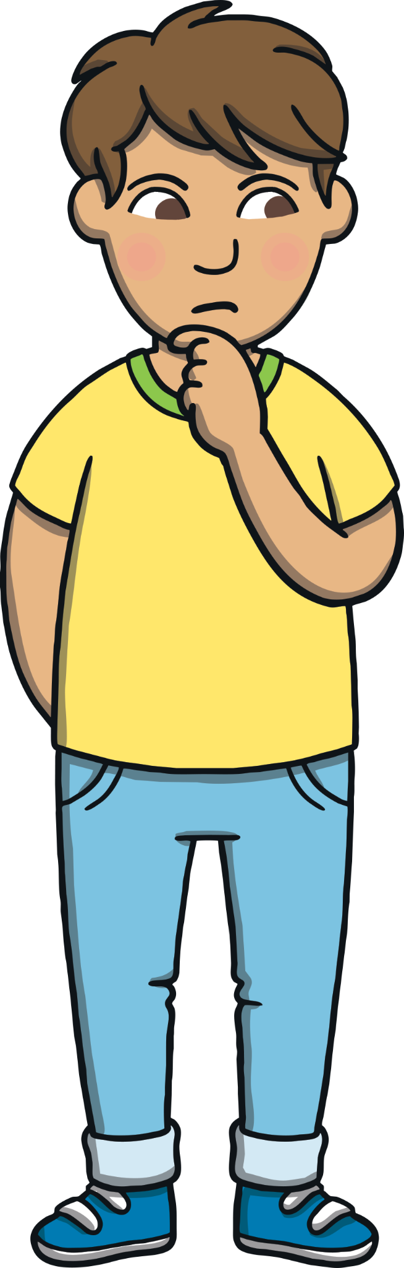
Today, we have learnt…
y
saying /igh/
X
Now ask the children to help add this alternative spelling to the growing sound display and to look out for it on their sound mat.
The adventure continues next lesson!
Click me for Kit’s teaching tips!

