Slide 2

Teach
Let’s recap our new tricky words:
live
give

Slide 3




g
Teach
i, g and h are a team. They say /igh/.
i
h
X
‘igh’ is a vowel trigraph. Vowel trigraphs are three letters that make one sound, where at least one is a vowel. 'igh' is usually used when the /igh/ sound is in the middle of a word. Sometimes it is used at the end of a word.
Click me for Kit’s teaching tips!
Play

Slide 4

Teach
igh

Slide 5



Muddled Shields
Practise
Kit and Sam have found a stall where they can make their own shields. Can you help them put the right parts together by reading the word on the shield and clicking on the picture to match?
X
Remember to use the sound buttons to robot-talk the word and then blend to read the whole word.
Click me for Robot Rick’s learning tips!

Slide 6






Practise
night
Next

Slide 7

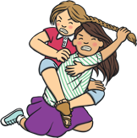


Practise
light
Next

Slide 8


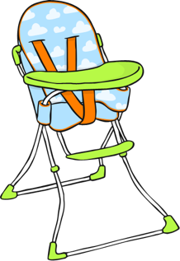
Practise
high
Next

Slide 9





Practise
right
Next

Slide 10



Practise
fight
Next

Slide 11




Practise
sighing
Finish

Slide 12

Sentence Time
Apply
What does the knight need Kit and Sam to do? Read the sentence then click ‘Show’ to reveal the answer!
X
Click ‘Sound Buttons On/Off’ to select whether you want to show sound buttons under the sentence.
Click me for Kit’s teaching tips!

Slide 13
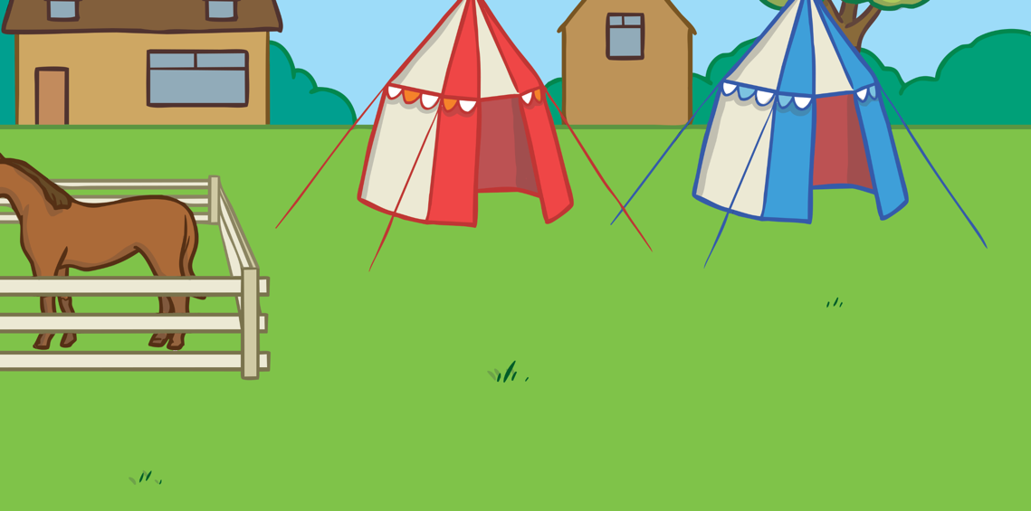

Apply
Go to the right and fight the bad king.
Sound Buttons On/Off
Show

Slide 14


Today, we have learnt…
igh
X
Now ask the children to add this sound to the growing sounds display and look out for it on their sound mats.
Click me for Kit’s teaching tips!

