Slide 2

Hear It, Write It
Revisit and Review
Listen to the sound of one of the phonemes you have learnt so far. Can you recall the grapheme and write it down? Try to keep it hidden until you hear, ‘Show me!’

Slide 3
Revisit and Review
Let’s revisit the new tricky words we learnt to read this week.
like
have
X

Slide 4

Teach
Teach
Today, we are learning to spell words that contain
ea saying /ee/.

Slide 5
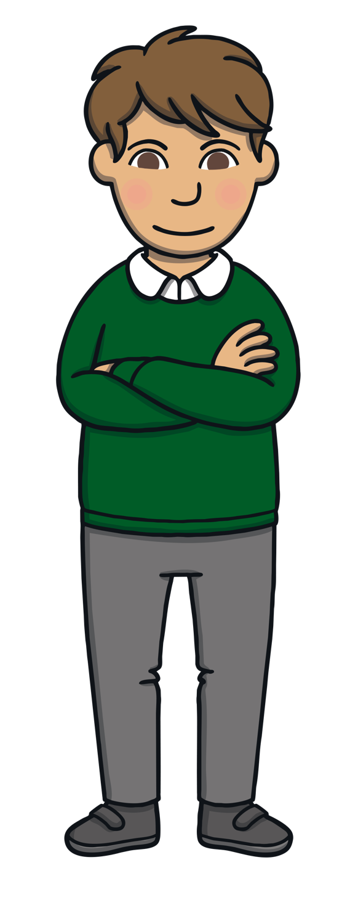



Teach
Let’s practise spelling some of this week’s focus words that contain the ea grapheme.
meat
Press the play button to listen to the word. Sound the
word out and then write it down. Click the seal to
check if you have spelt the word correctly.

Slide 6
Teach
heap

Slide 7
Teach
treat

Slide 8
Teach
least

Slide 9
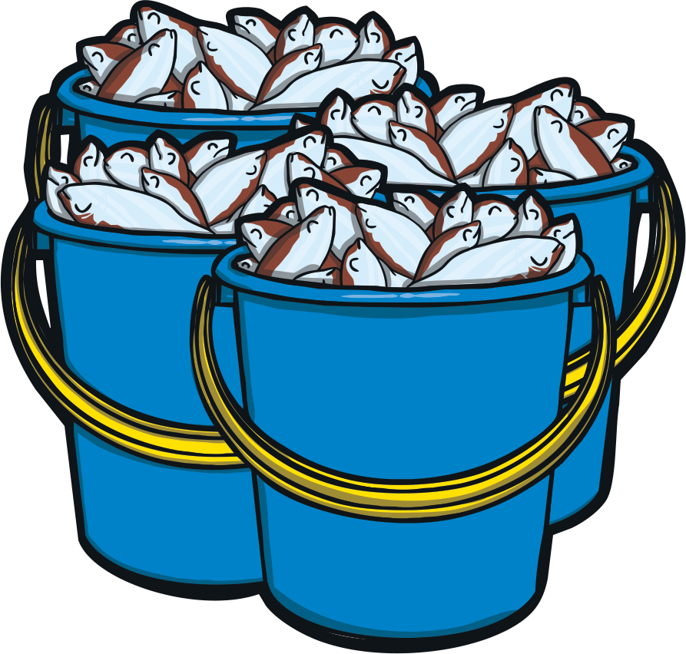
Practise
Seal Feed
On each bucket is a word, but some of the letters have been rubbed off. Can you help Kit and Sam use the ea sound to work out what the words should be? Write down what you think and read them out loud to check.

Slide 10
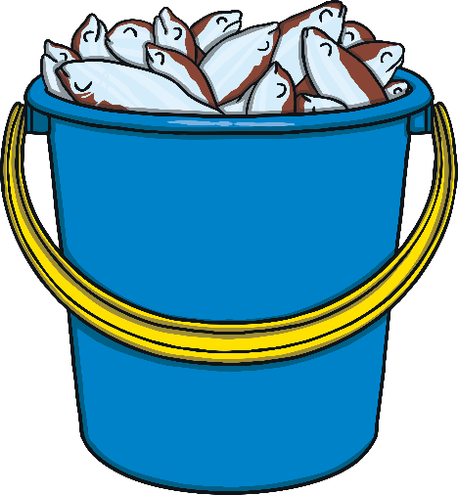
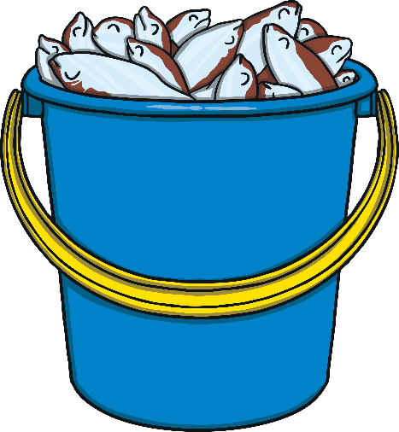

Practise
s l
h p
m t
tr t
seal
heap
meat
treat
Show

Slide 11
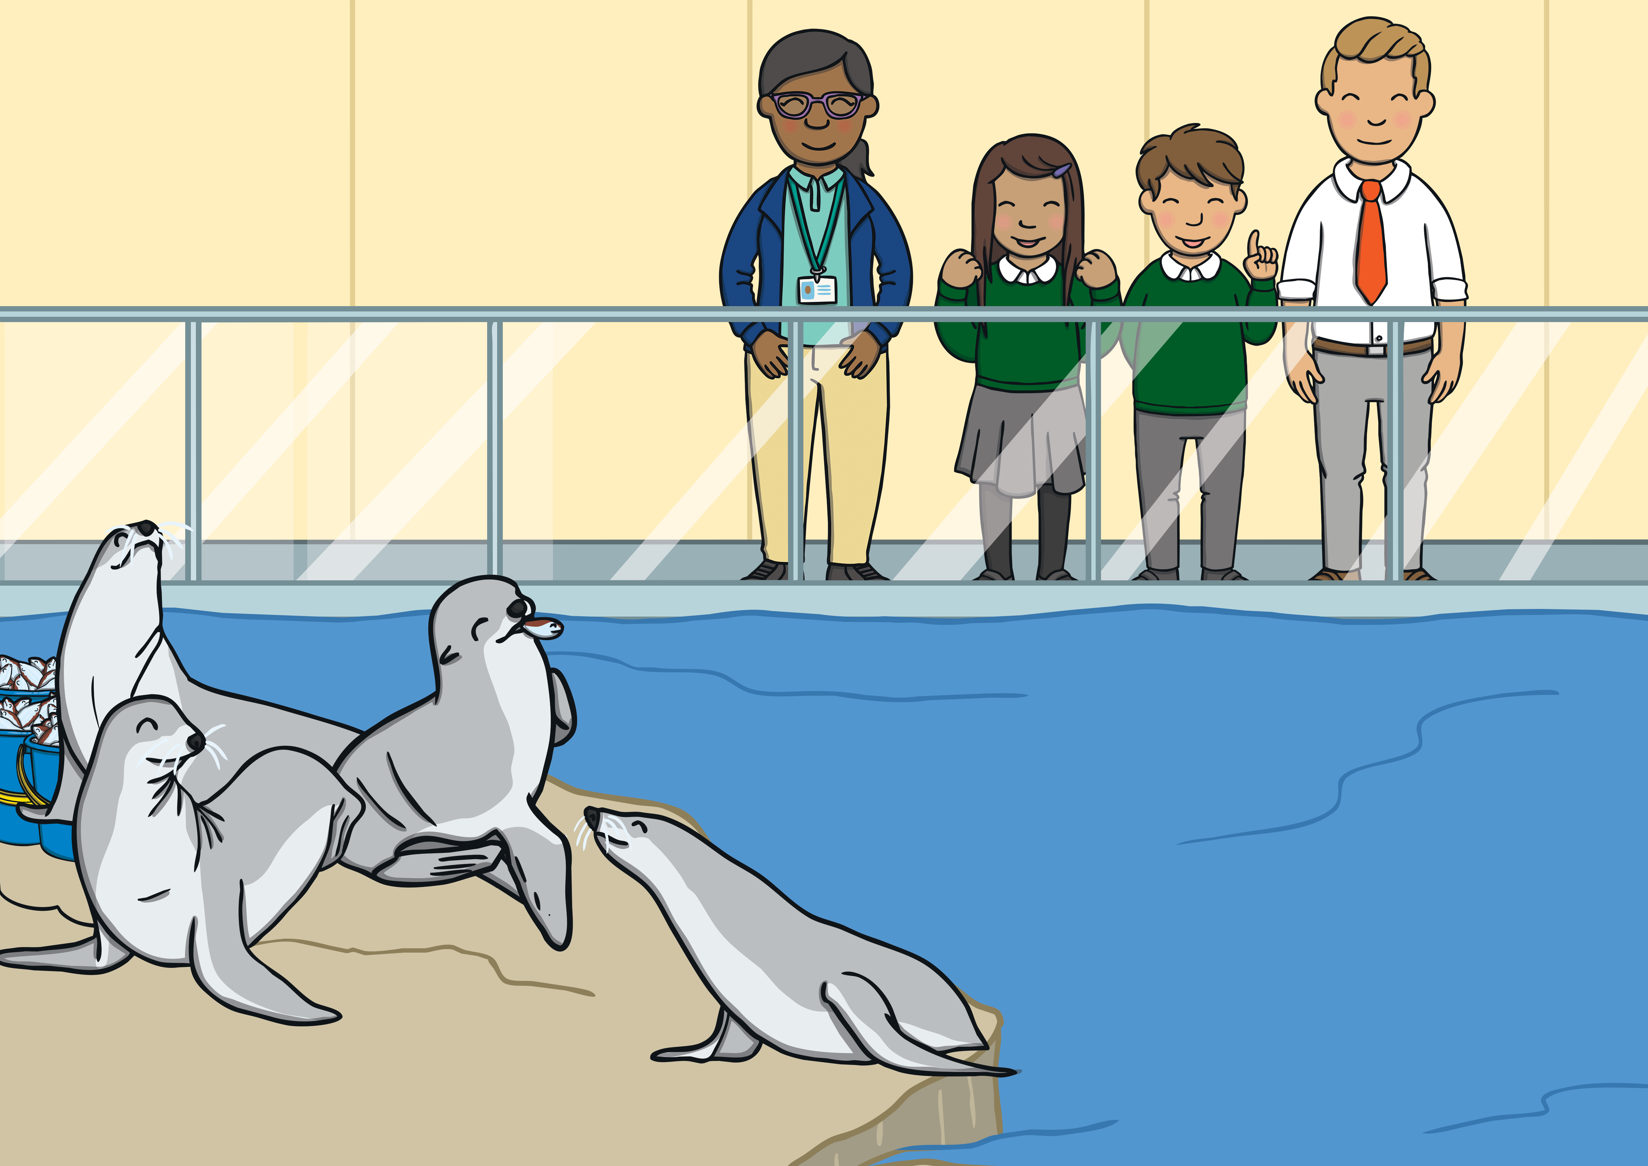

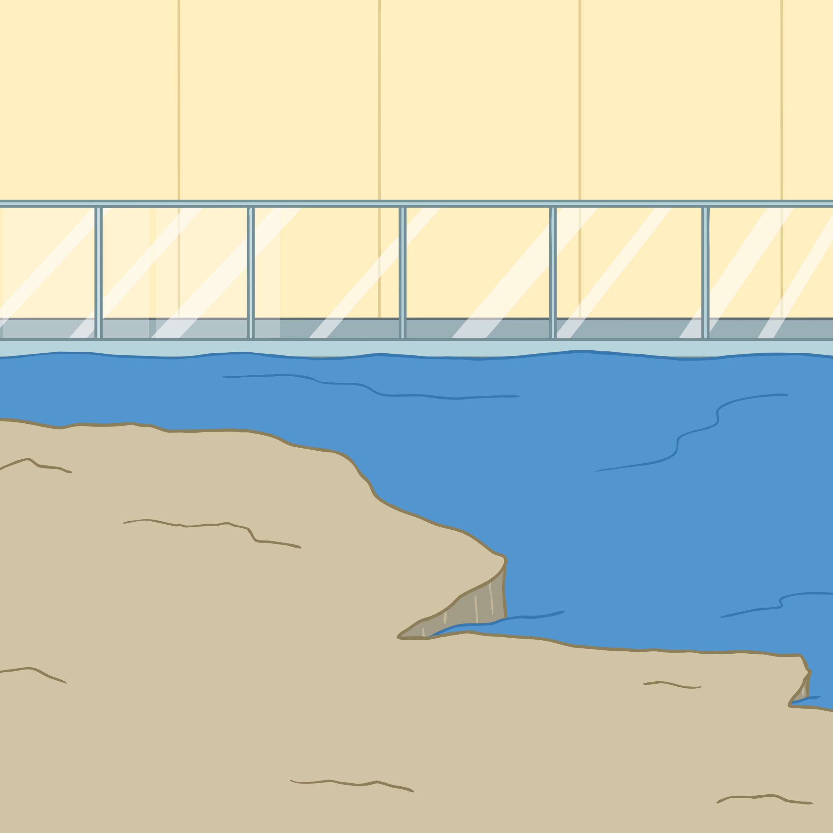




Apply
“Look, there it is!” Sam exclaimed. A baby seal jumped out of the water with a splash and helped itself to some tasty fish.

Slide 12

Sentence Time
Apply
What was the seal pup doing? Write a sentence to match.
X
Challenge the children to include a word containing ‘ea’ saying /ee/ or a common exception word. Some children may be able to write their own sentence(s); others may need to use the audio buttons for ideas and attempt to spell the words using their sounds.
Click me for Kit’s teaching tips!

Slide 13



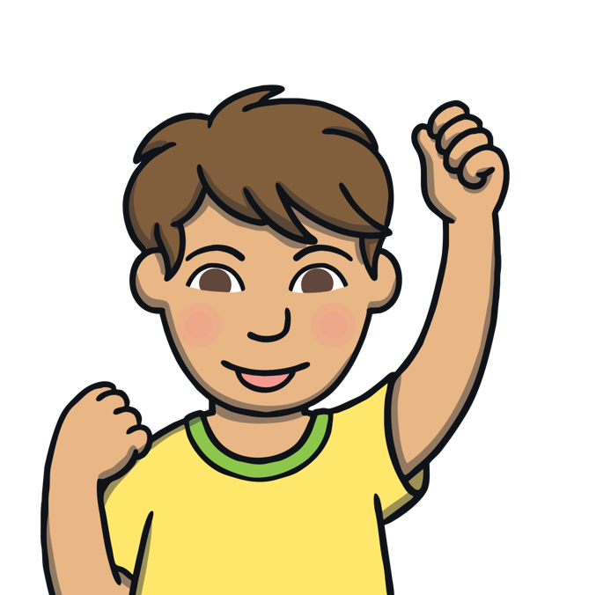
The seal pup likes to eat fish.
1
X
Click Kit's icon to hear suggested sentences for this picture and click Sam's icon to see the written versions. Remind the children to think back to our grammar focus and use the actions to help them structure their sentence(s).
There were lots of fish to feast on.
2
Click me for Kit’s teaching tips!

Slide 14
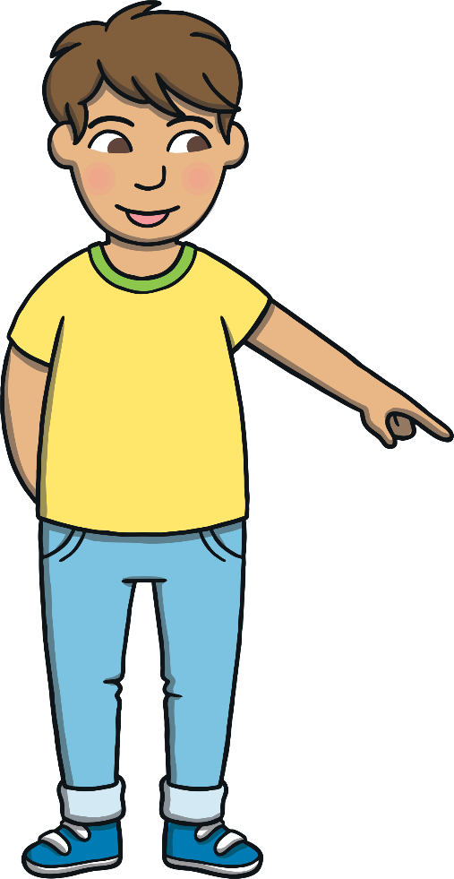
Today, we have practised spelling words that contain:
ea
saying /ee/

