Slide 2
Revisit and Review
Let’s revisit the new tricky words we learnt to spell yesterday.
like
have

Slide 3
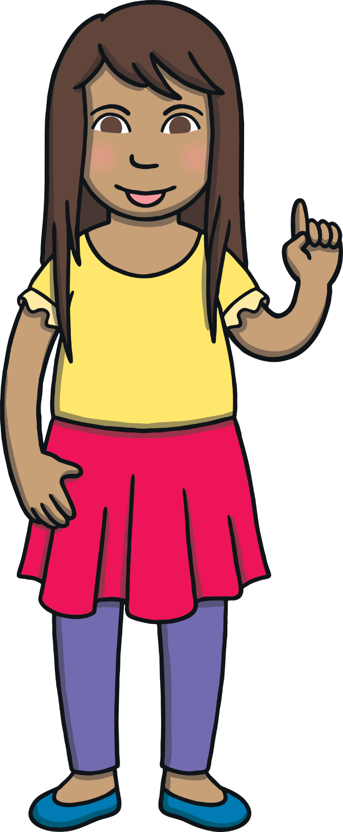
Teach
Today, we are learning to spell words that contain ea.

Slide 4

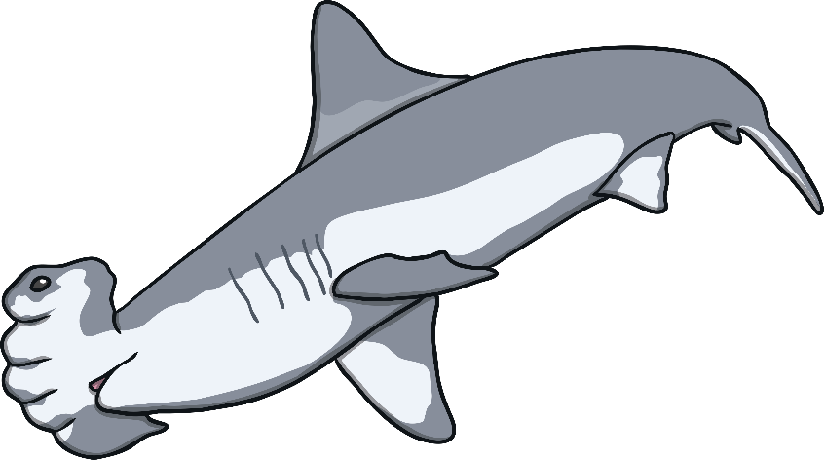

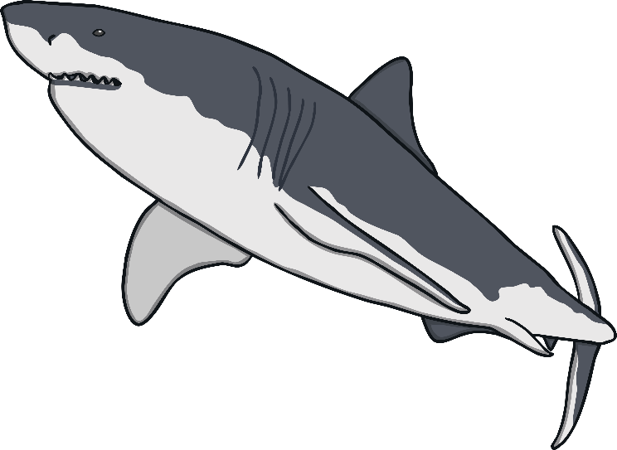
Practise
ea and ee Shark Sort
Kit and Sam notice that the sharks are all huddled together. Help sort them into two groups. Write a list of the sharks that belong in each group.

Slide 5
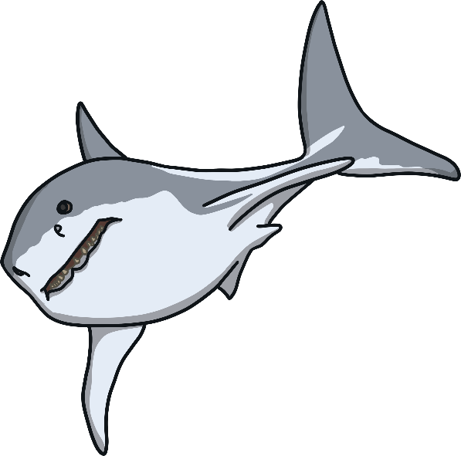

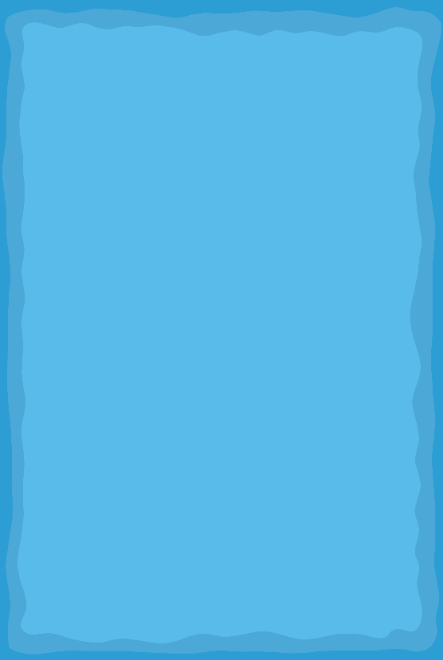
Practise
ea
ee
sea
sea

Slide 6

Practise
ea
ee
sea
see
see

Slide 7

Practise
ea
ee
sea
see
peach
peach

Slide 8

Practise
ea
ee
sea
see
leaf
peach
leaf

Slide 9
Practise
ea
ee
sea
see
meet
peach
meet
leaf

Slide 10
Practise
ea
ee
sea
see
peach
beach
meet
leaf
beach

Slide 11

Practise
ea
ee
sea
see
week
meet
peach
leaf
week
beach

Slide 12

Practise
ea
ee
sea
see
seem
peach
meet
leaf
week
beach
seem

Slide 13
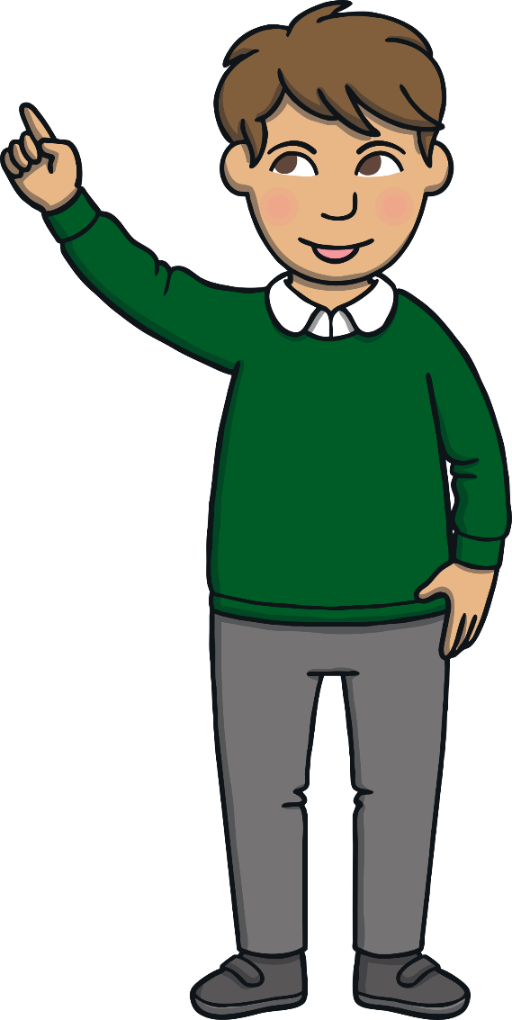
Apply
Today, we have practised spelling words containing...
ea
saying /ee/
The adventure continues next lesson!

