Slide 3
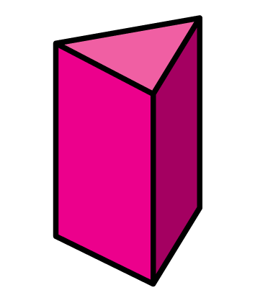
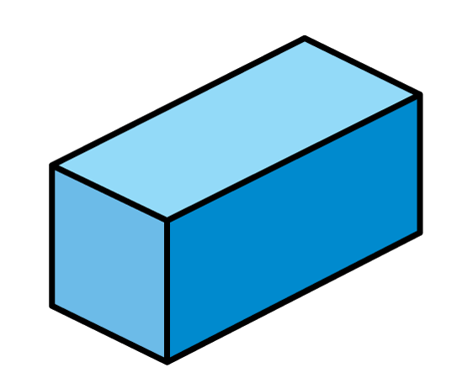
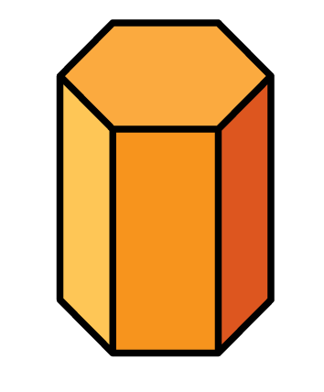
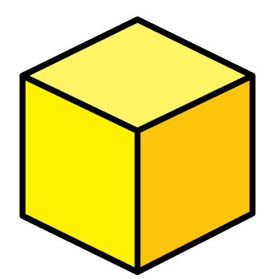
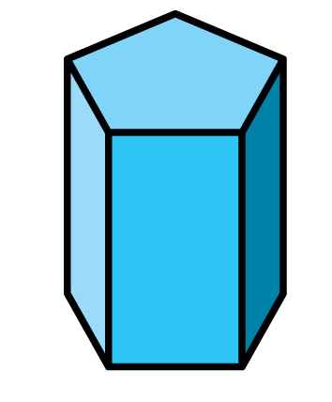
Which shapes have 12 edges?

Slide 4
Which shapes have 12 edges?
9
12
15
18

Slide 6
Which cube has its vertices shown?
What is a vertex?
Have a think

Slide 7
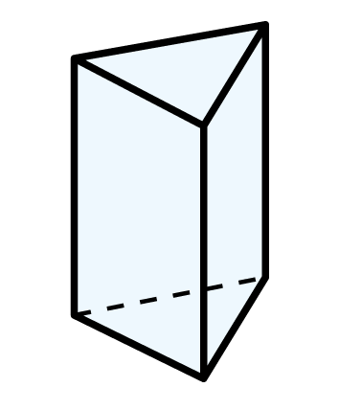
Eva is counting the vertices of this shape.
A triangular prism has 6 vertices.
Eva
How could Eva count the vertices?
Do you think Eva’s method is a good idea?
Have a think

Slide 8
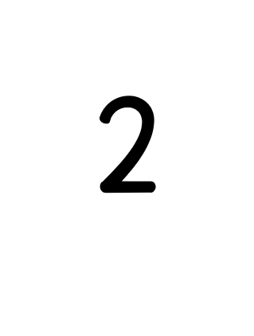
Ron is counting how many vertices a cube has.
Sometimes, I miss a vertex.
I will use stickers to help me count.
Ron
Faces 6
Edges 12
Vertices 8

Slide 9
Tiny is counting the vertices of a cuboid.
A cube has 8 vertices, so a cuboid must also have 8 vertices.
I already know how many vertices a cuboid has.
How does Tiny know this?
Have a think
Vertices
Faces
Edges
?
6
12
8

Slide 10
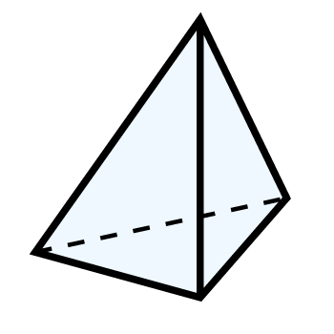
Use an efficient method to count the vertices of this pyramid.
A triangular-based pyramid has ___ vertices.
4
Will all pyramids have 4 vertices?
Have a think

Slide 11
How many vertices do these shapes have?
Both shapes have 0 vertices.
Why do they not have any vertices?
Have a think

Slide 12
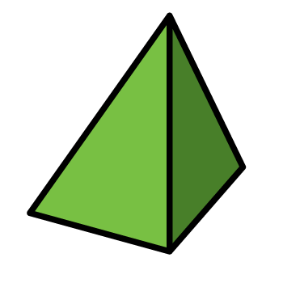
Which shape is in the wrong place?
I wonder if there is more than one answer?
The shapes are now in order of number of vertices.
The shapes are also in order of number of faces and edges.
Why has this happened?
Have a think

Slide 13
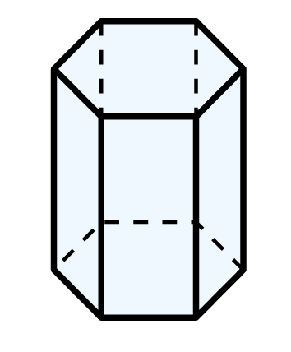
Dora is counting the vertices of these shapes.
A pentagonal prism has 10 vertices.
A hexagon has one more side than a pentagon.
So, a hexagonal prism must have 11 vertices.
Dora
Do you agree with Dora?
A hexagonal prism has 12 vertices.
Have a think

