Slide 3
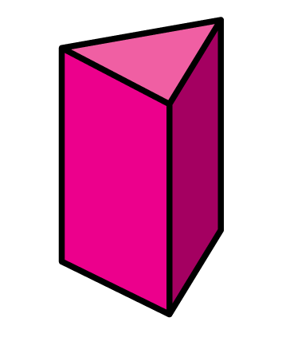
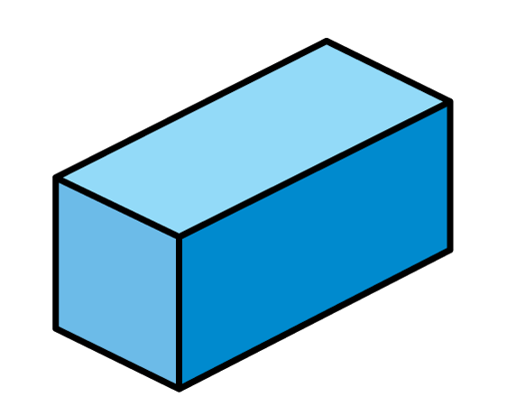
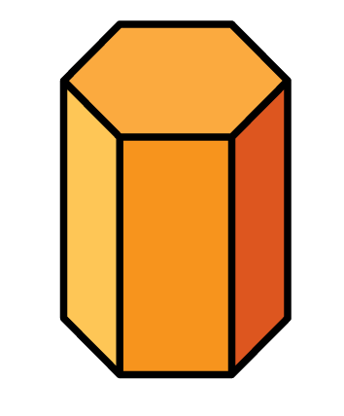
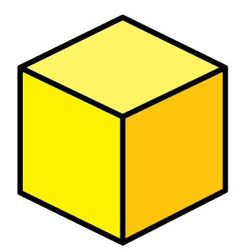
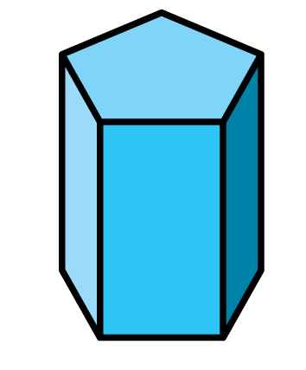
Which shapes have 6 faces?

Slide 4
Which shapes have 6 faces?
5
7
8

Slide 6
Which cube has its edges shown?
What is an edge?
Have a think

Slide 7
Amir runs his finger along the edges of his board game.
Board Game
Do you think Amir has counted all the edges?
Have a think

Slide 8
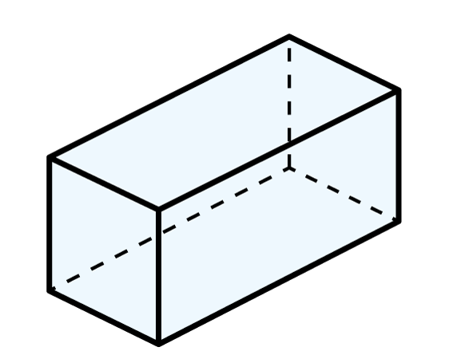
Dora is counting edges on a cuboid.
I think a good idea would be to work from the top down
Dora
Faces
6
Edges
12
?

Slide 9
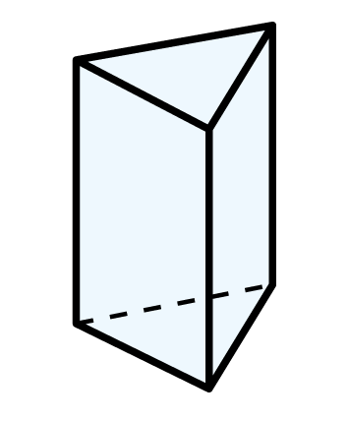
Mo is counting the edges of this shape.
I will use stickers so I do not miss any edges.
Mo
A ____________ has
__ edges.
triangular prism
9
Have a think

Slide 10
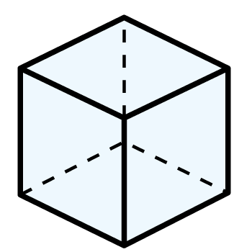
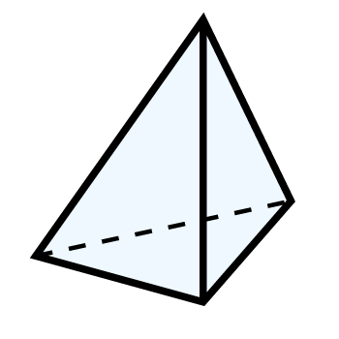
Use your favourite method to complete the table.
Shape | Name of shape | Number of edges
 | cube
12
triangular- based pyramid
6
Have a think

Slide 11
How many edges does a sphere have?
0
I thought all 3-D shapes would have 1 or more edges.
Why do you think Tiny thought this?
Have a think

Slide 12
Are the statements true or false?
All 3-D shapes have a different number of edges.
All 3-D shapes have an even number of edges.
Have a think

Slide 13
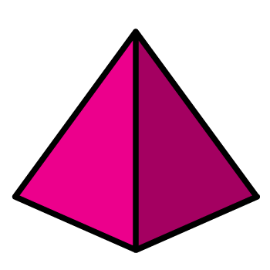
Are the statements true or false?
All 3-D shapes have a different number of edges.
False – a cube and a cuboid have the same number of edges.

Slide 14
Are the statements true or false?
All 3-D shapes have an even number of edges.
False – a pentagonal prism has 15 edges.
What other shapes have an odd number of edges?

Slide 15
Put the shapes in order of number of edges.
Start with the smallest.
How did you work this out?
Have a think

