Slide 3
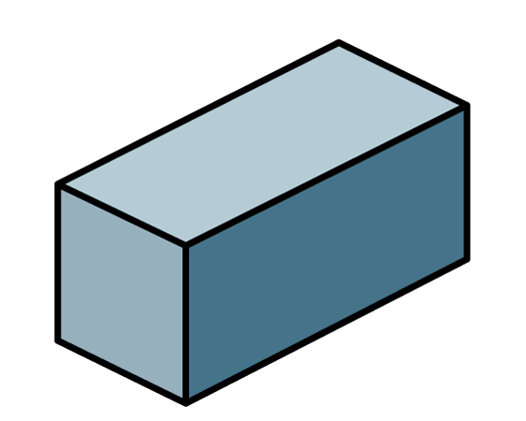
1) Which is a hexagon?
2) Which is a cube?
3) How many sides does a pentagon have?
4) How many sides does this shape have?

Slide 4
1) Which is a hexagon?
2) Which is a cube?
3) How many sides does a pentagon have?
4) How many sides does this shape have?
5
5

Slide 6
Which cube has its faces shown?
What is a face?
Have a think

Slide 7
Here is a cuboid.
Have a think
1
1
5
2
6
2
5
6
3
3
4
4
What do you notice?
What 2-D shapes do you see?

Slide 8
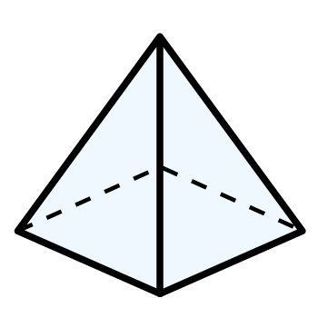
What is the same? What is different?
2
3
1
5
4
1
5
2
6
3
4
Have a think

Slide 9
Which 2-D shape is a face of each 3-D shape?
Which other 2-D shapes can you see?
Have a think

Slide 10
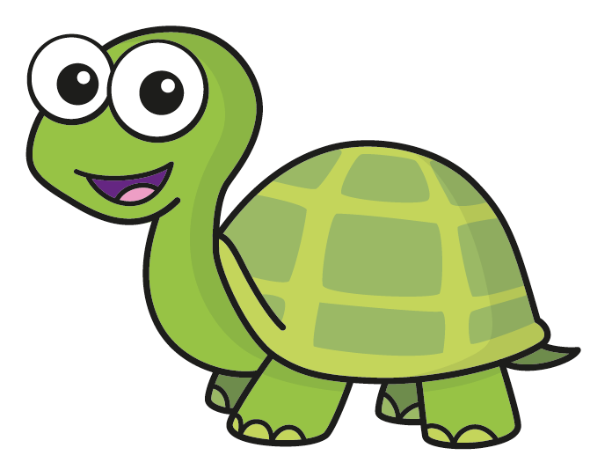
Tiny is counting how many faces a cube has.
1
A cube has 3 faces.
2
Do you agree with Tiny?
No, a cube has 6 faces.
Have a think

Slide 11
Mo is counting the faces of these shapes.
I know a cube has 6 faces.
I already know how many faces a cuboid has.
Mo
How does Mo know this?
A cube and cuboid have the same number of faces.
Have a think

Slide 12
Tiny has been counting faces on 3-D shapes.
I keep losing count of the faces I have counted.
What methods could Tiny use to be more accurate?
Have a think

Slide 13
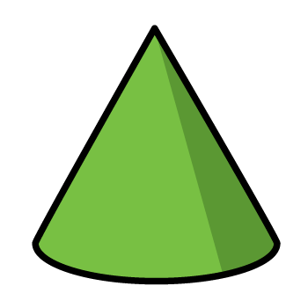
All of these shapes have a curved surface.
What do you think a curved surface is?
Have a think

Slide 14
Which shape matches the description?
1 curved surface
1 circular face
How did you work this out?
Have a think

Slide 15
Dexter has some shapes.
In total, my shapes have 18 faces.
Dexter
What shapes could Dexter have?
Have a think

Slide 16
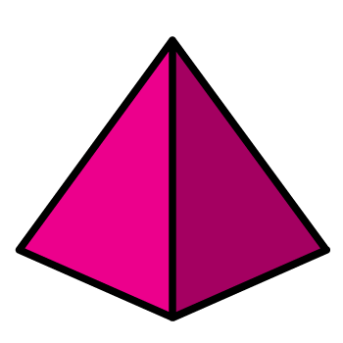
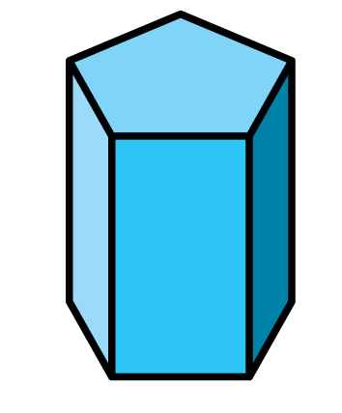
Dexter has some shapes.
I have one cube.
I have no cuboids.
Dexter
What shapes could Dexter have?
Are there any other possible answers?
Have a think

