Slide 1
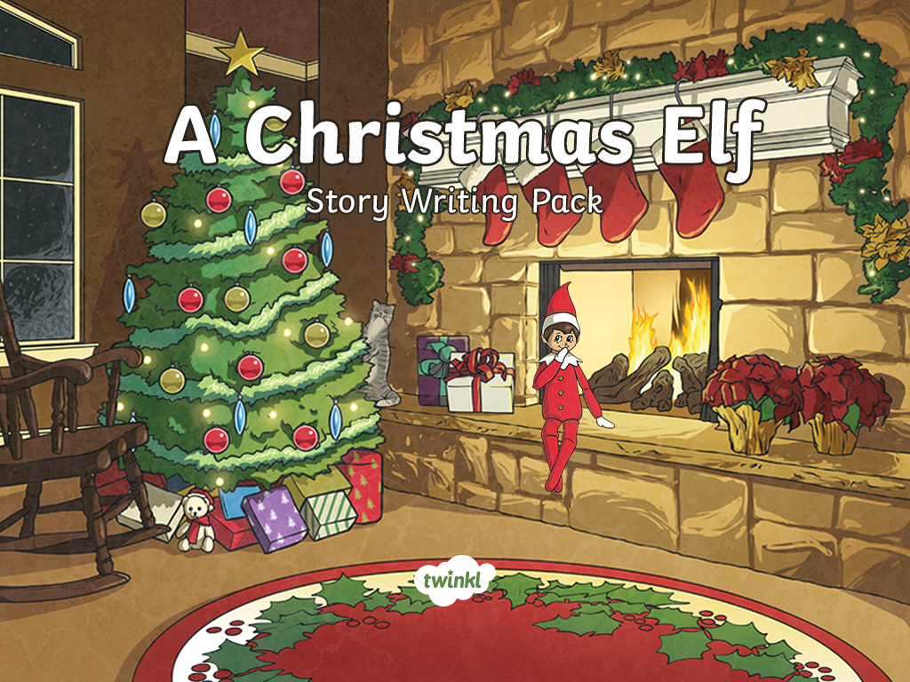

Slide 2
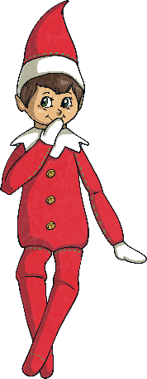
Writing a Great Story
Great stories are exciting and make your audience want to carry on reading. They might do this by including lots of amazing descriptions and vocabulary, creating tension or by adding in some unmissable action that makes it impossible to stop reading.
Today, you’re going to be finishing a story all about a mischievous Christmas elf named Socks.
While you’re writing, think carefully about your reader. How are you going to keep them hooked?

Slide 3
Describing Characters
When you’re writing a story, you’ll need to describe your characters to your reader. You might do this by using some exciting adjectives or by showing their personality through the way they move or act.
Socks the elf is…
creative
A week ago, Socks made an entire igloo out of only marshmallows.
fearless
Socks has no problem with heights, pets or dangerous appliances and will happily climb in or on to any of them.
messy
Last night, Socks covered the kitchen counter in flour and made ‘snow’ angels.
remorseful
Although often messy, Socks does try to put things right. However, this can sometimes lead to the situation becoming a lot worse.
mischievous
Despite being warned by the family, Socks still finds a way to climb down from the shelf each night.
How will you show your reader Socks’s personality in your writing?

Slide 4
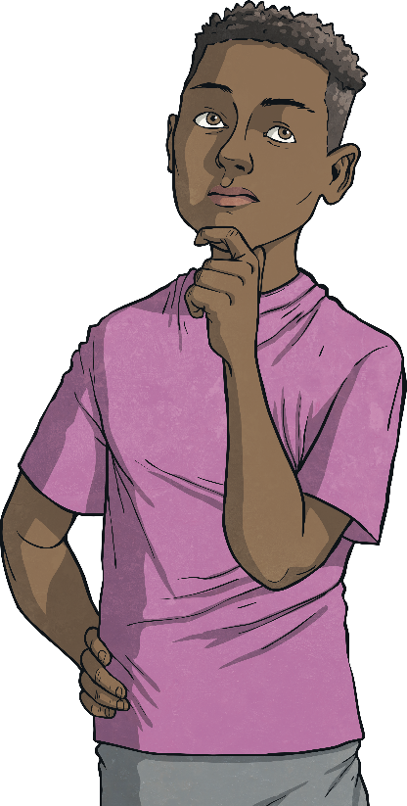
The Beginning of the Story
What do you think Socks the elf will do next?

Slide 5
Deciding on a Problem
To successfully continue the story of Socks the elf, you’ll need to think of a believable but interesting problem.
First, think of something believable which could be in the living room.
This could be something like a Christmas tree or a fireplace.
Next, think about Socks’s character. What might they do with that item?
We know they’re fearless so they might start to climb up high.
Finally, think about something believable that could go wrong.
Socks could fall and get stuck somewhere out of sight.

Slide 6
Creating a Believable Solution
To successfully continue the story of Socks the elf, you’ll need to think of a believable but interesting problem.
The Christmas tree could be decorated with some colourful tinsel.
First, think about what believable items might be near Socks.
Socks could tie the tinsel around themselves and use it to become unstuck.
Next, think of a believable way that Socks could solve the problem.
Socks could try and tidy up the mess or write an apology letter to the family.
Finally, bring the story to a conclusion.

Slide 7
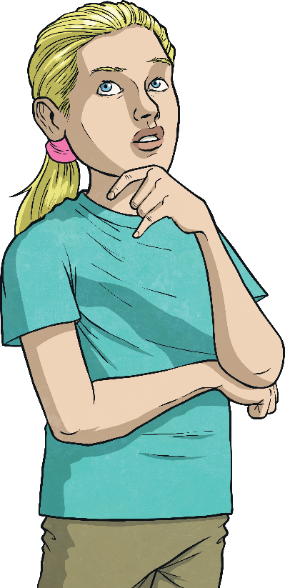
Things to Remember
Make sure that the problem and solution are believable but interesting.
Use lots of exciting adjectives and vary your sentence starters to keep your reader interested.
Describe Socks’s character by showing your reader how they behave.
Bring your story to an end by concluding Socks’s adventures.

Slide 8
Story Writing Checklist
Use this checklist to help you remember what you need to include within your story.

