Slide 2
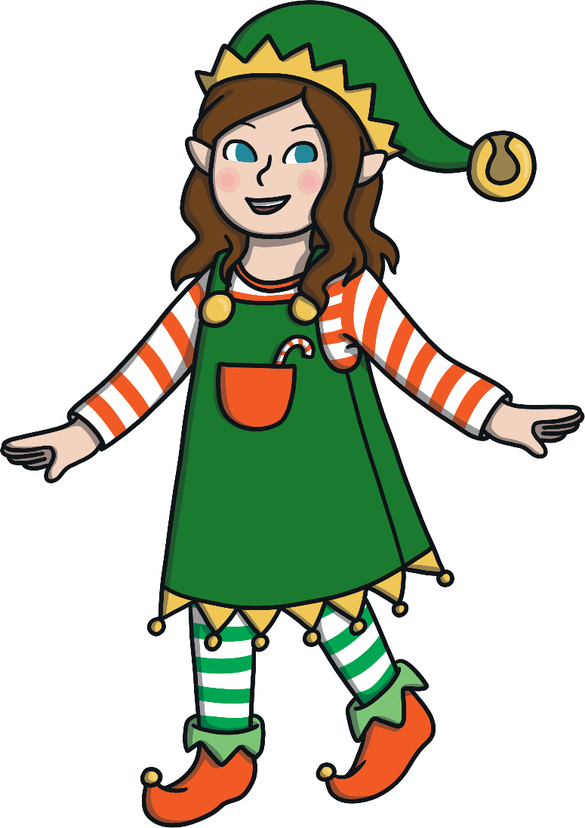
Hello! I’m Rose Elf. I help Santa in his workshop to sort all the wonderful presents. Can you help me?
Yes!

Slide 3
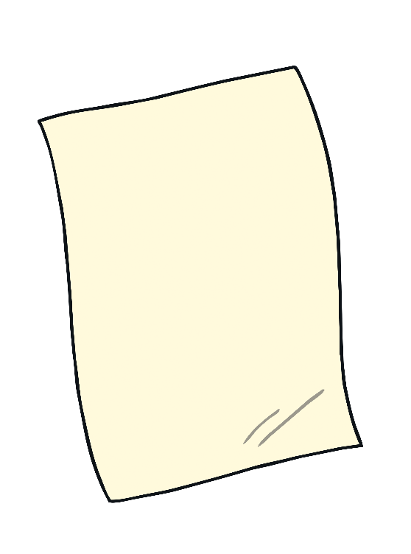
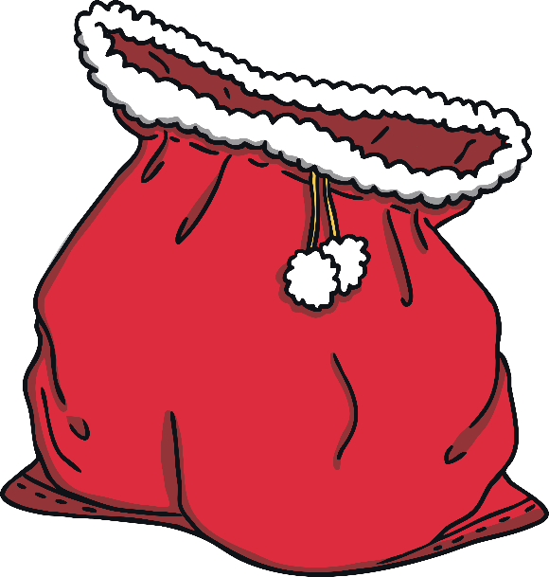
Rose Elf looked at Santa’s notebook. Can you help her to choose the correct present?
Try again.
Can you choose the red present to go in the sack?
Well done!
Next

Slide 4
Rose Elf looked at Santa’s notebook. Can you help her to choose the correct present?
Try again.
Well done!
Can you choose the biggest present?
Next

Slide 5
Rose Elf looked at Santa’s notebook. Can you help her to choose the correct present?
Try again.
Can you choose the present that is on the shelf?
Well done!
Next

Slide 6
Rose Elf looked at Santa’s notebook. Can you help her to choose the correct present?
Can you choose the lightest present? Click the balance scales to check.
Try again.
Well done!
Next

Slide 7
Rose Elf looked at Santa’s notebook. Can you help her to choose the correct present?
Can you choose the present that is under the Christmas tree?
Try again.
Well done!
Next

Slide 8
Rose Elf looked at Santa’s notebook. Can you help her to choose the correct present?
Try again.
Well done!
Can you choose the smallest present?
Next

Slide 9
Rose Elf looked at Santa’s notebook. Can you help her to choose the correct present?
Can you choose the heaviest present? Click the balance scales to check.
Try again.
Well done!
Next

Slide 10
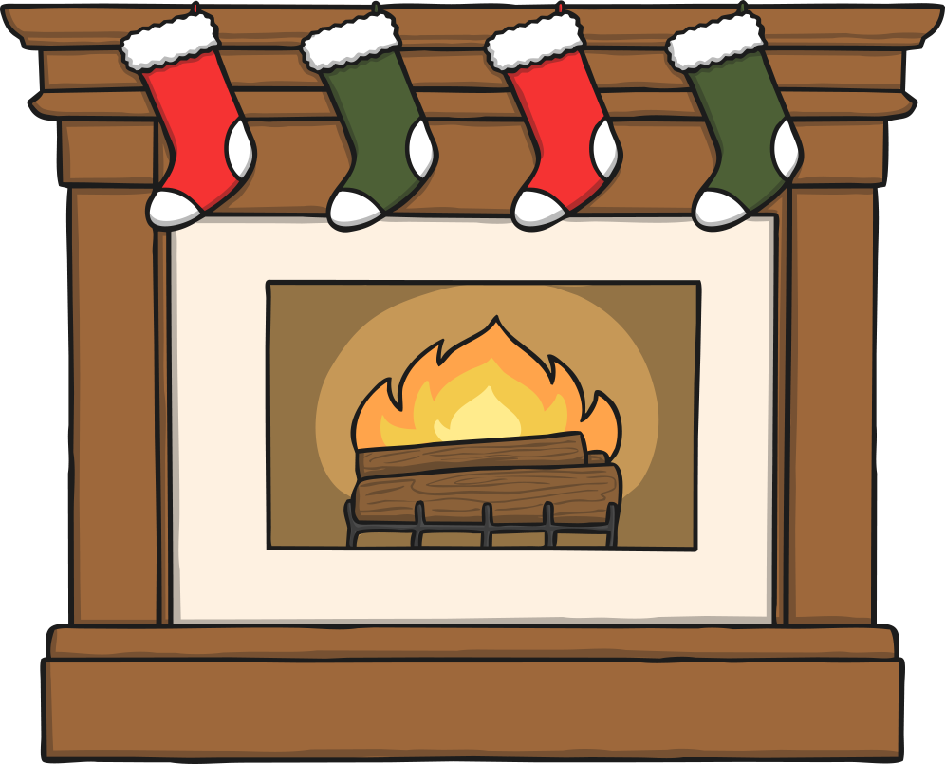
Rose Elf looked at Santa’s notebook. Can you help her to choose the correct present?
Can you choose the present that is next to the fireplace?
Try again.
Well done!
Next

Slide 11
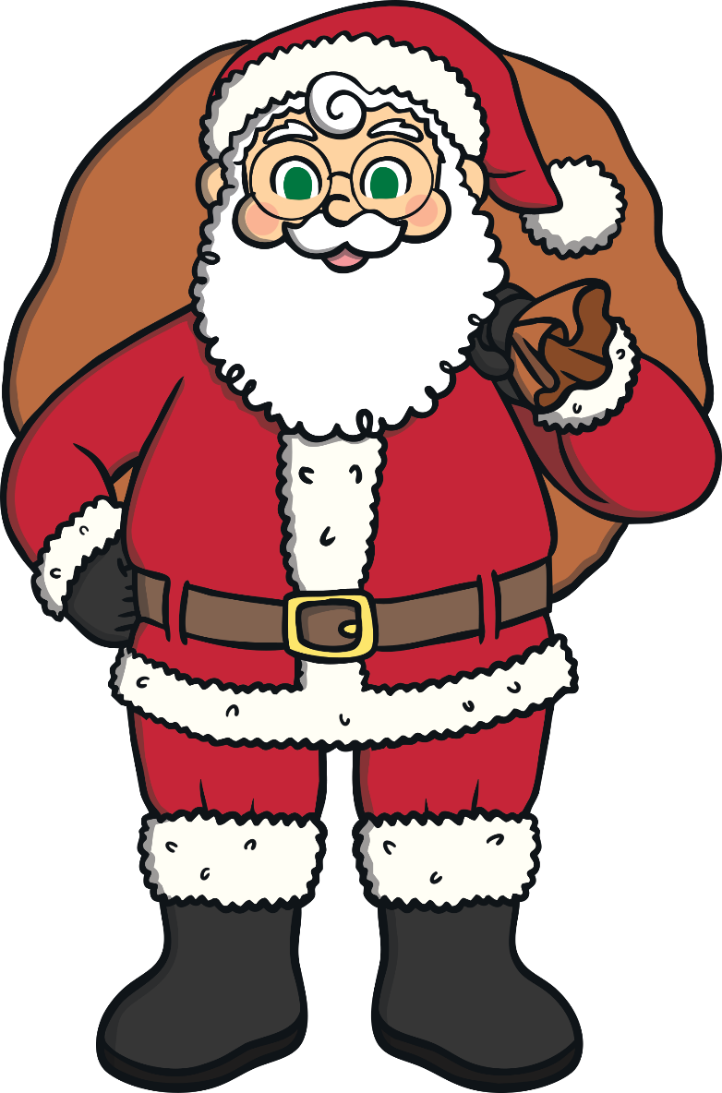
Ho! Ho! Ho! Thank you for helping my elf, Rose to sort all the presents!

