Slide 2
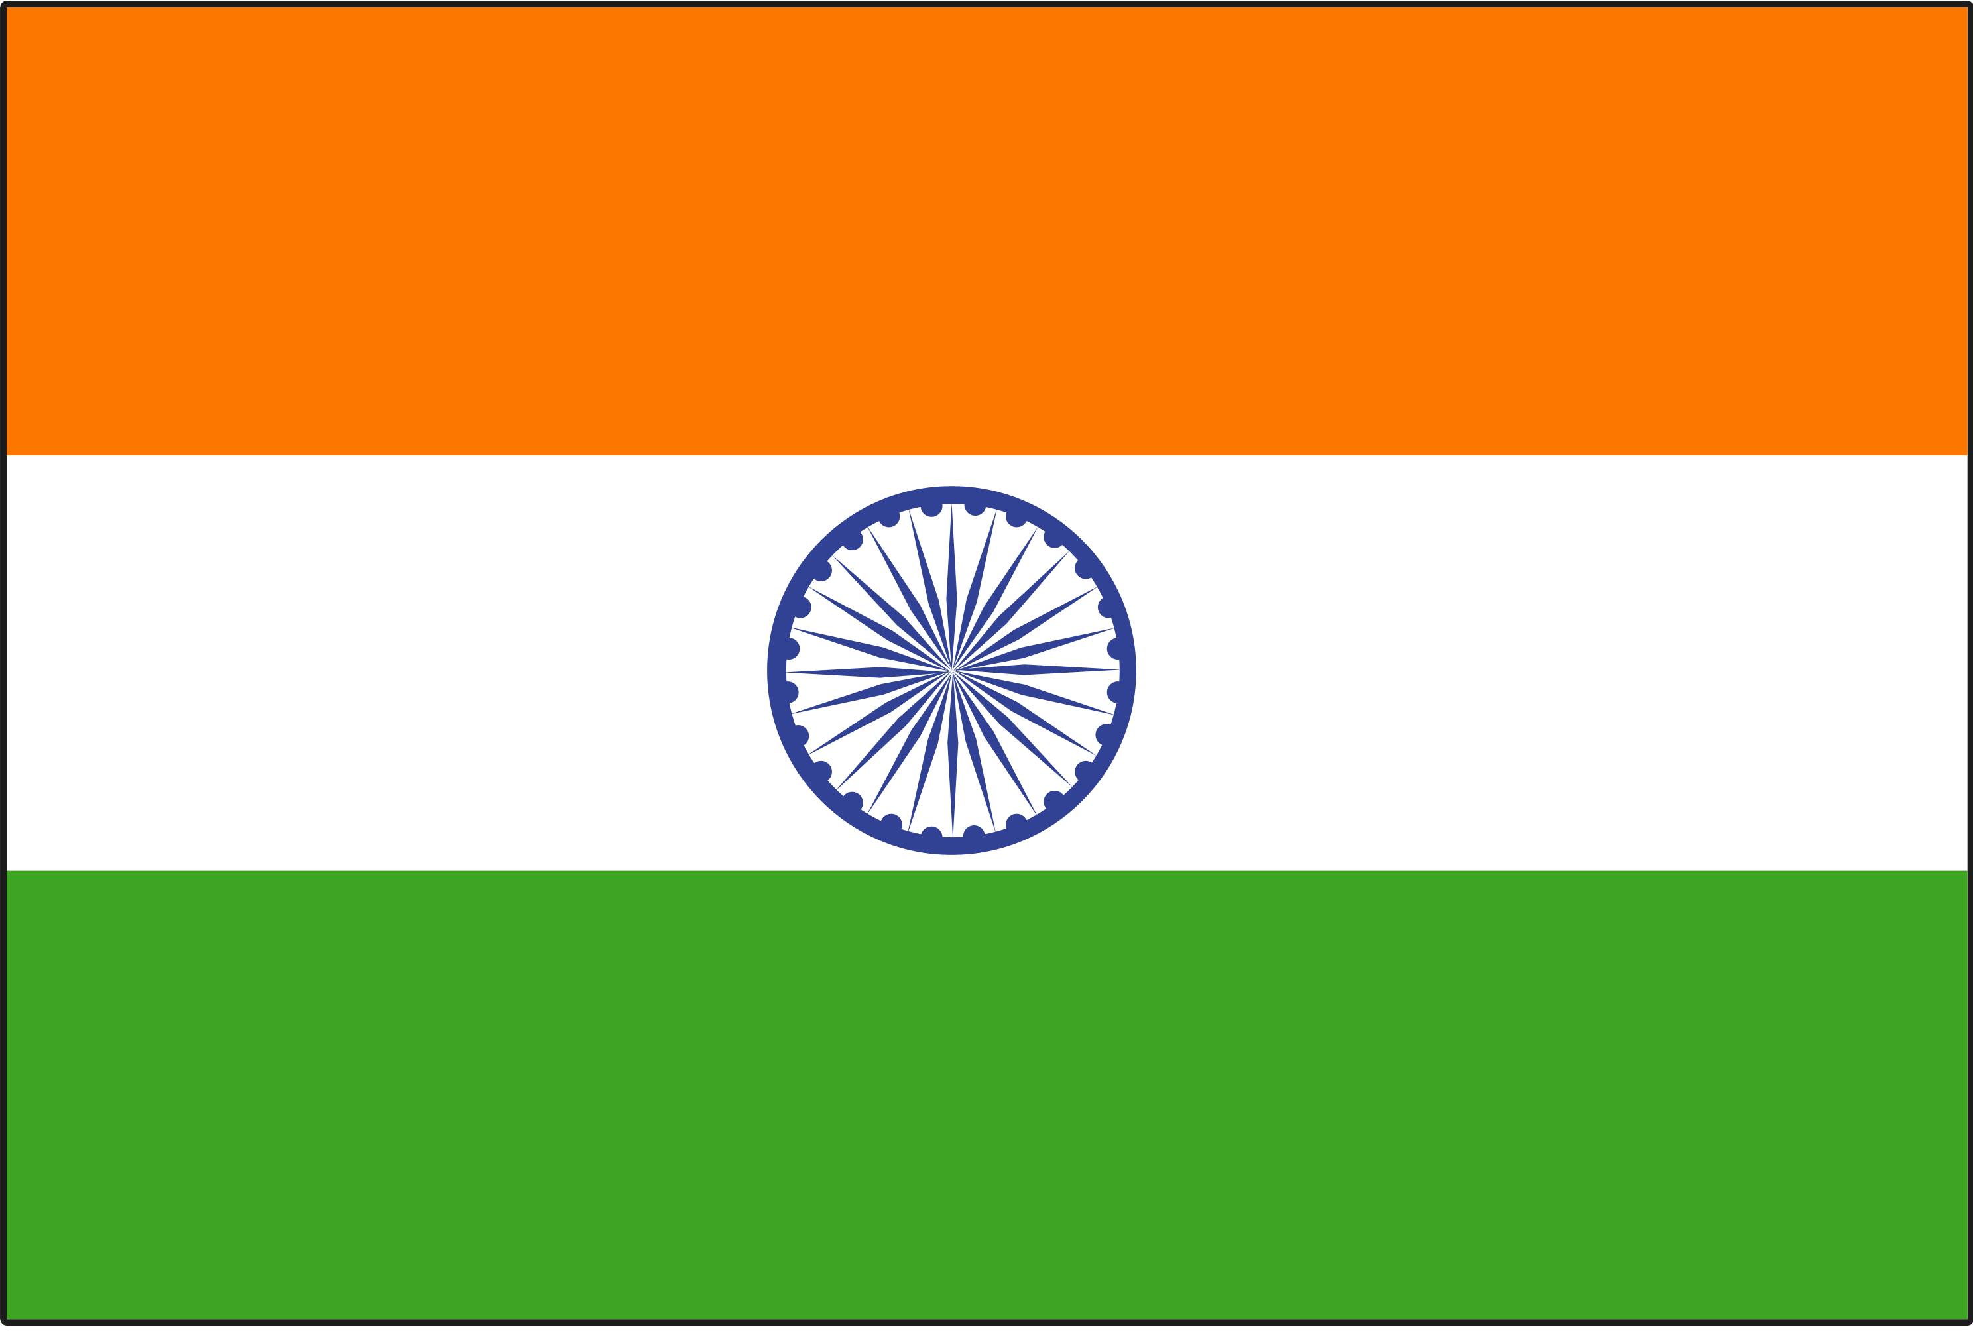
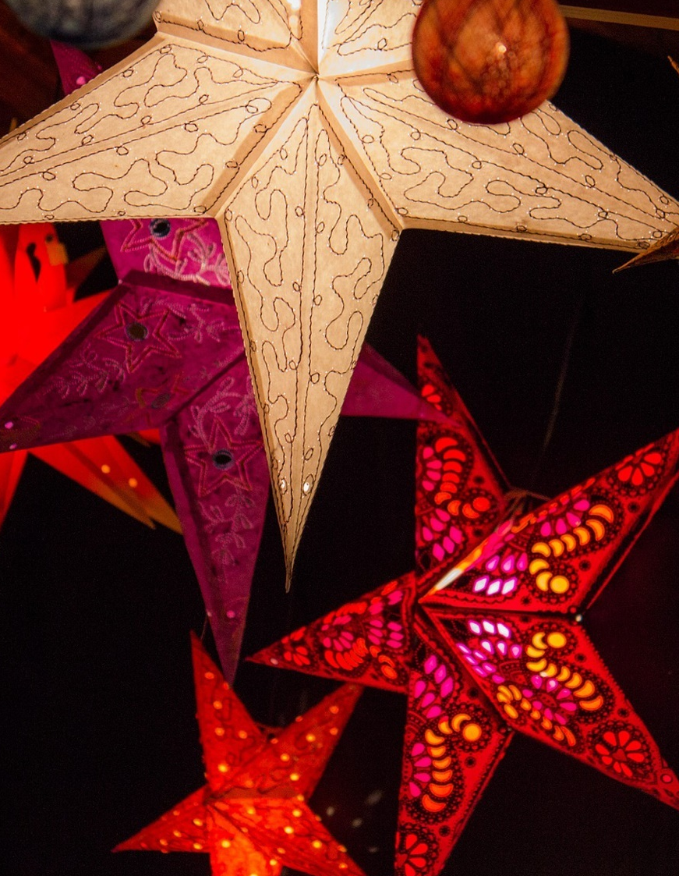
India
In India, people like to decorate their houses and streets with colourful, folded paper stars.

Slide 3
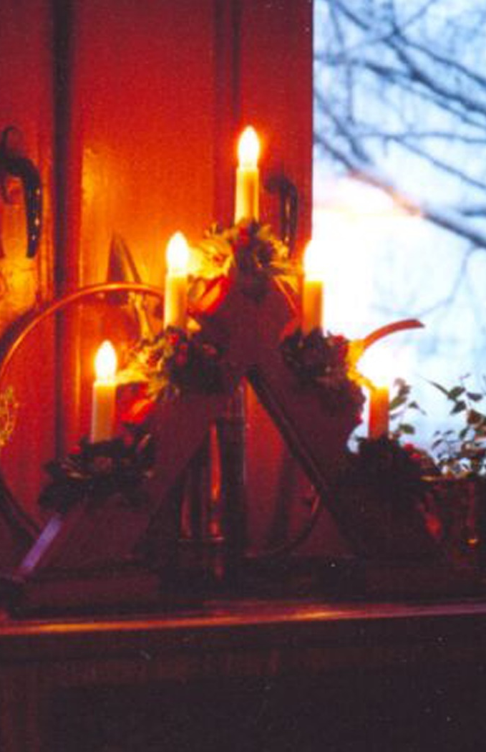
Ireland
In Ireland, people like to light candles in the windows of their homes to act as a guide for Joseph and Mary to travel to their resting place.

Slide 4
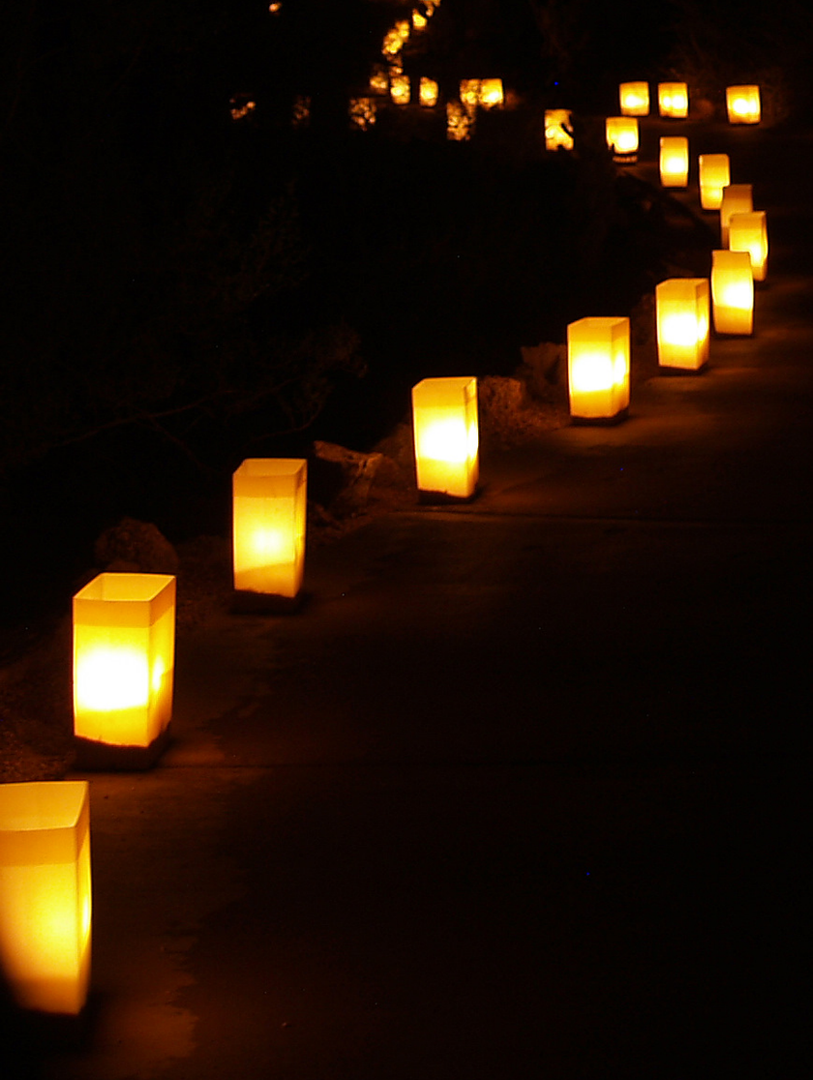
New Mexico, USA
In the south-west USA, people display ‘luminarias’ or ‘farolitos’ to celebrate the birth of Jesus.
These are small, paper lanterns with a candle inside.

Slide 5
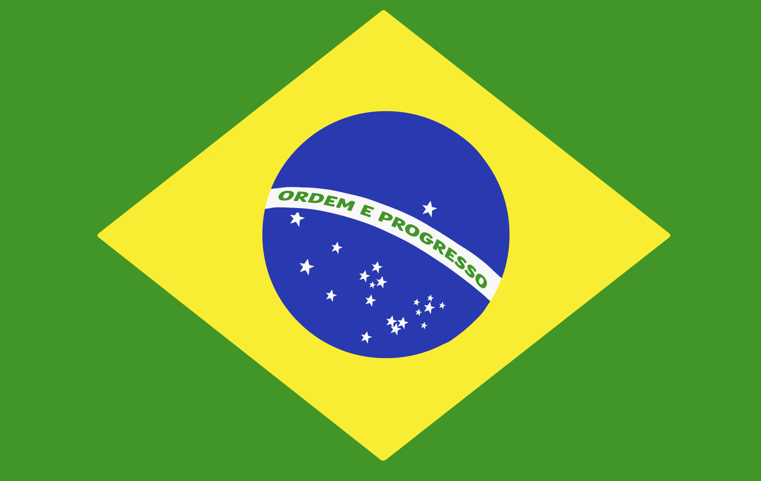
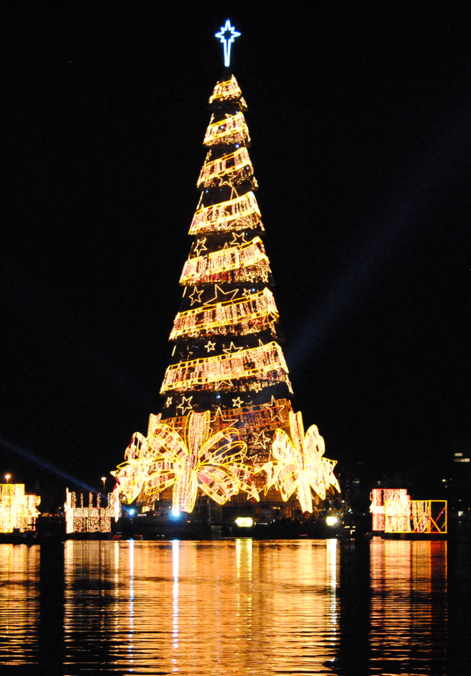
Brazil
Each Christmas, thousands of people go to see the world’s tallest floating Christmas tree in a lagoon in Rio de Janeiro.
It is 85 metres tall and contains 3.1 million bulbs.

Slide 6
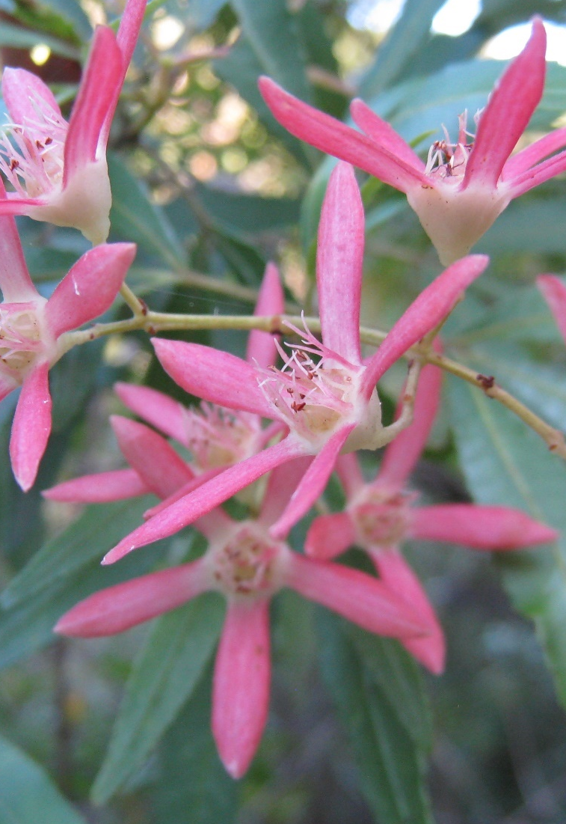
Australia
As well as Christmas trees and other decorations, Australians decorate their houses with ‘Christmas Bush’.
This is an Australian plant with white flowers that turn a deep, shiny red at Christmas time.

Slide 7
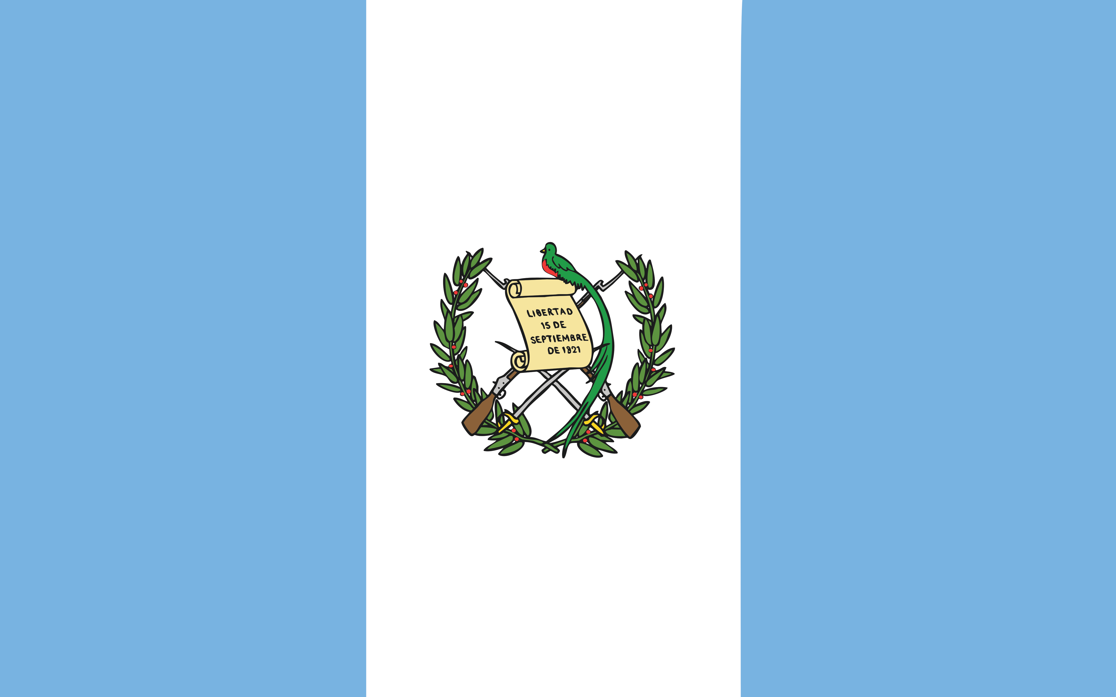
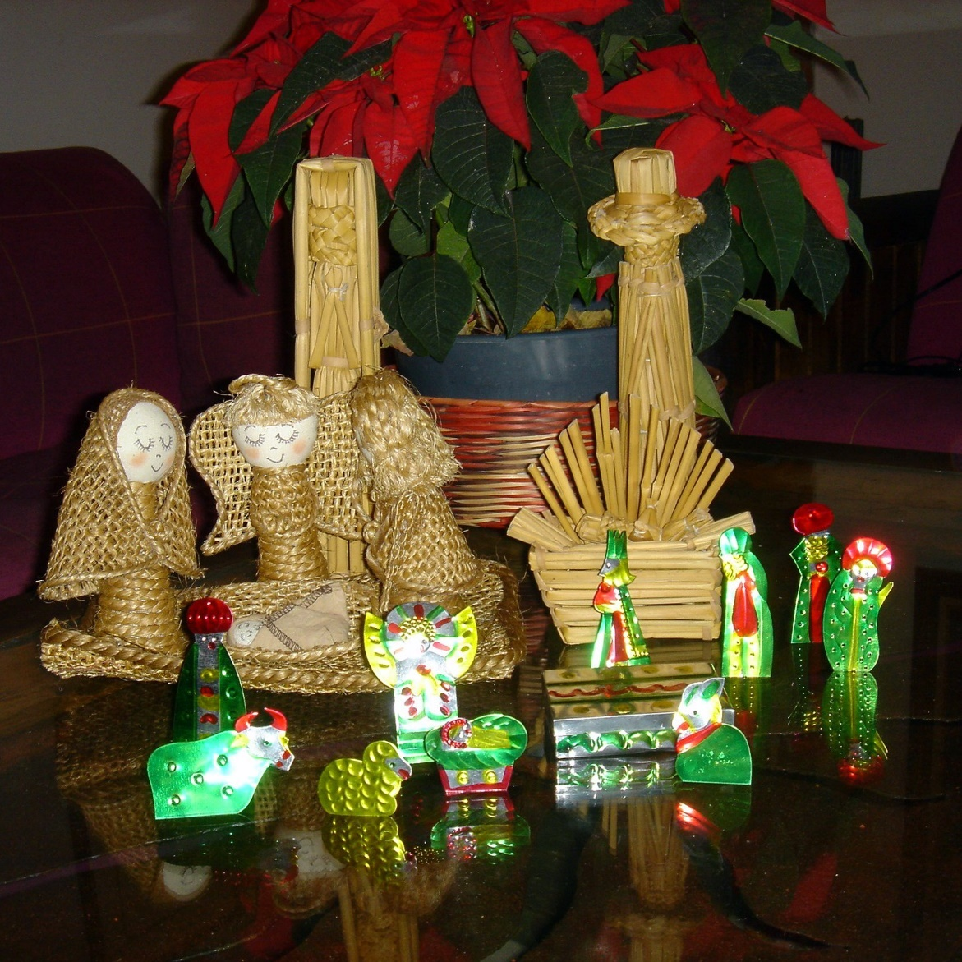
Guatemala
Most Guatemalans plan and build a Nativity scene with their family.
The Nativity scene is called a ‘Nacimiento’.

Slide 8
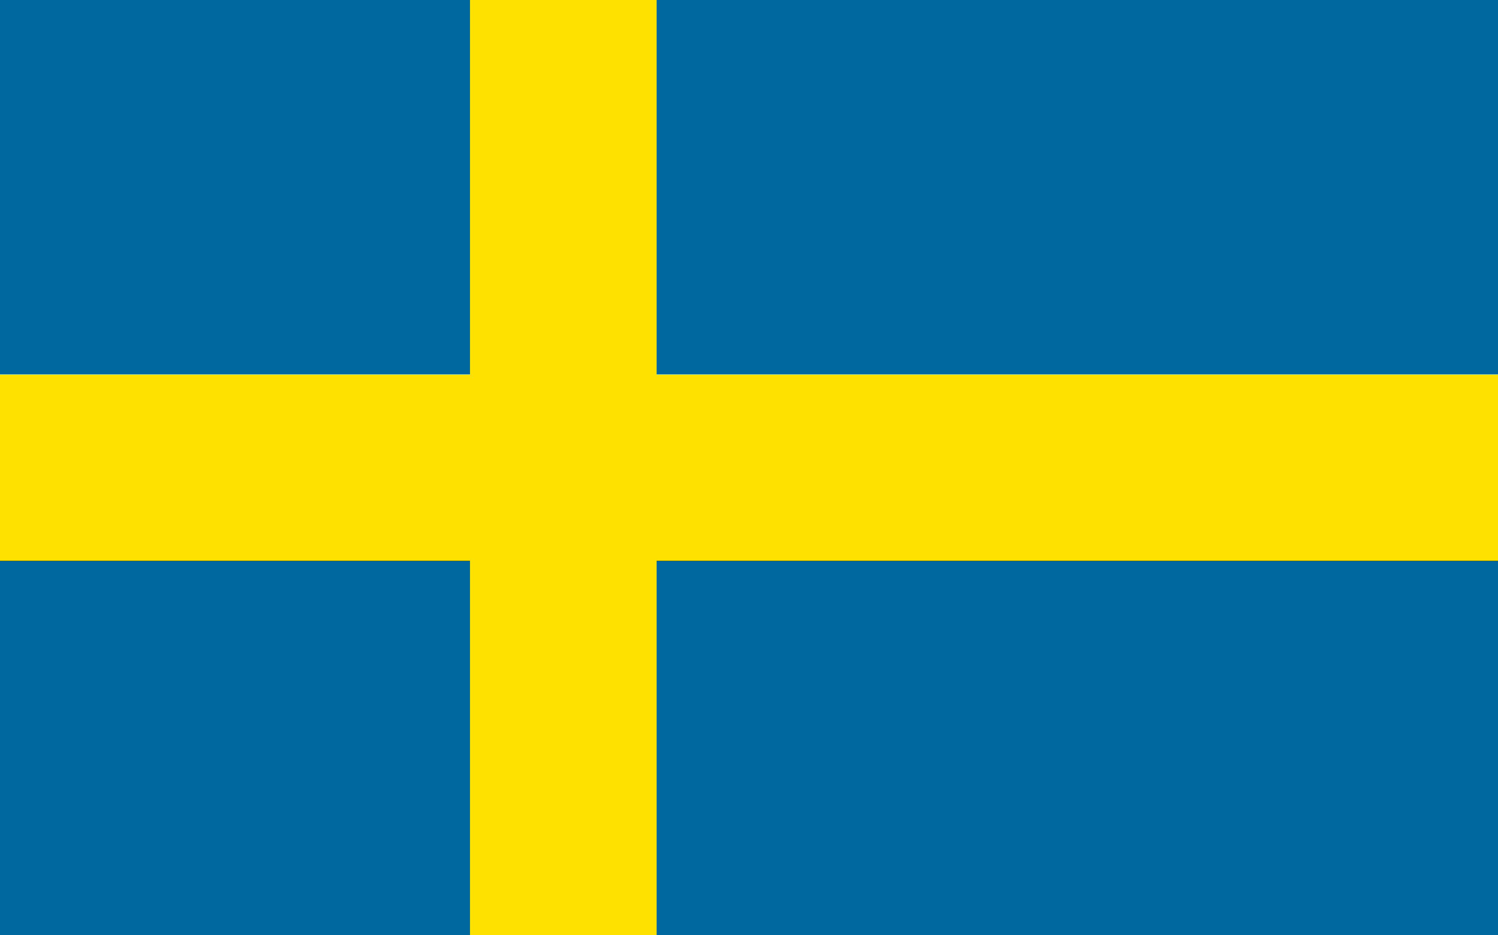
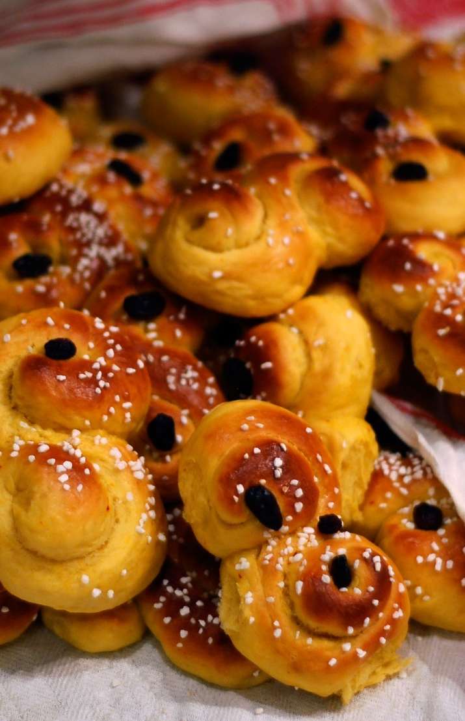
Sweden
In Sweden, one of the biggest celebrations around Christmas time is St. Lucia Day, which is on December 13th.
A girl is dressed up in a white dress with a red sash around her waist and a crown of candles on her head.
A popular food eaten for breakfast on St. Lucia Day is a saffron bun called ‘Lussekatt’, which means ‘Lucia cat’.

Slide 9
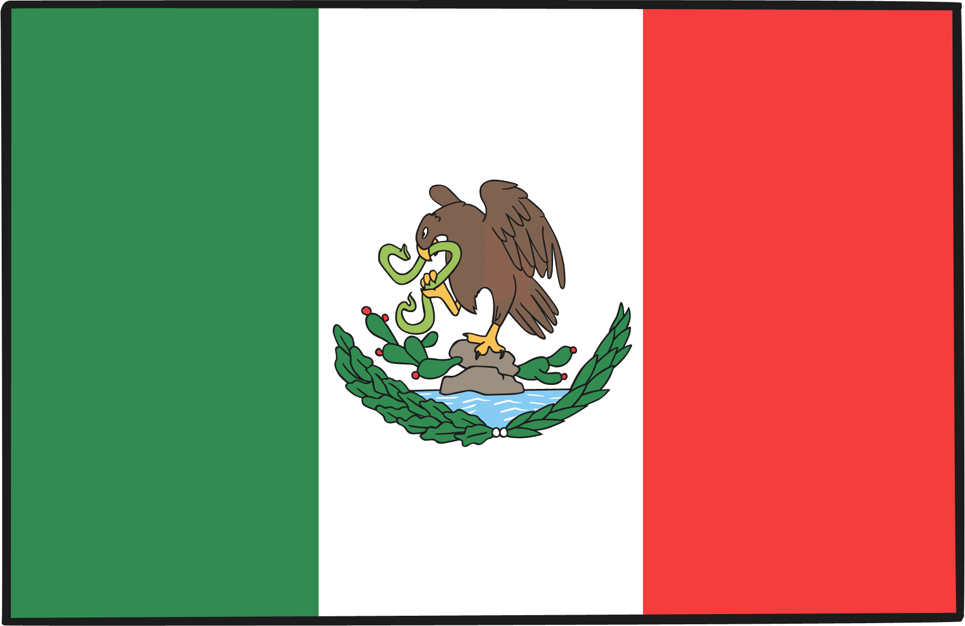
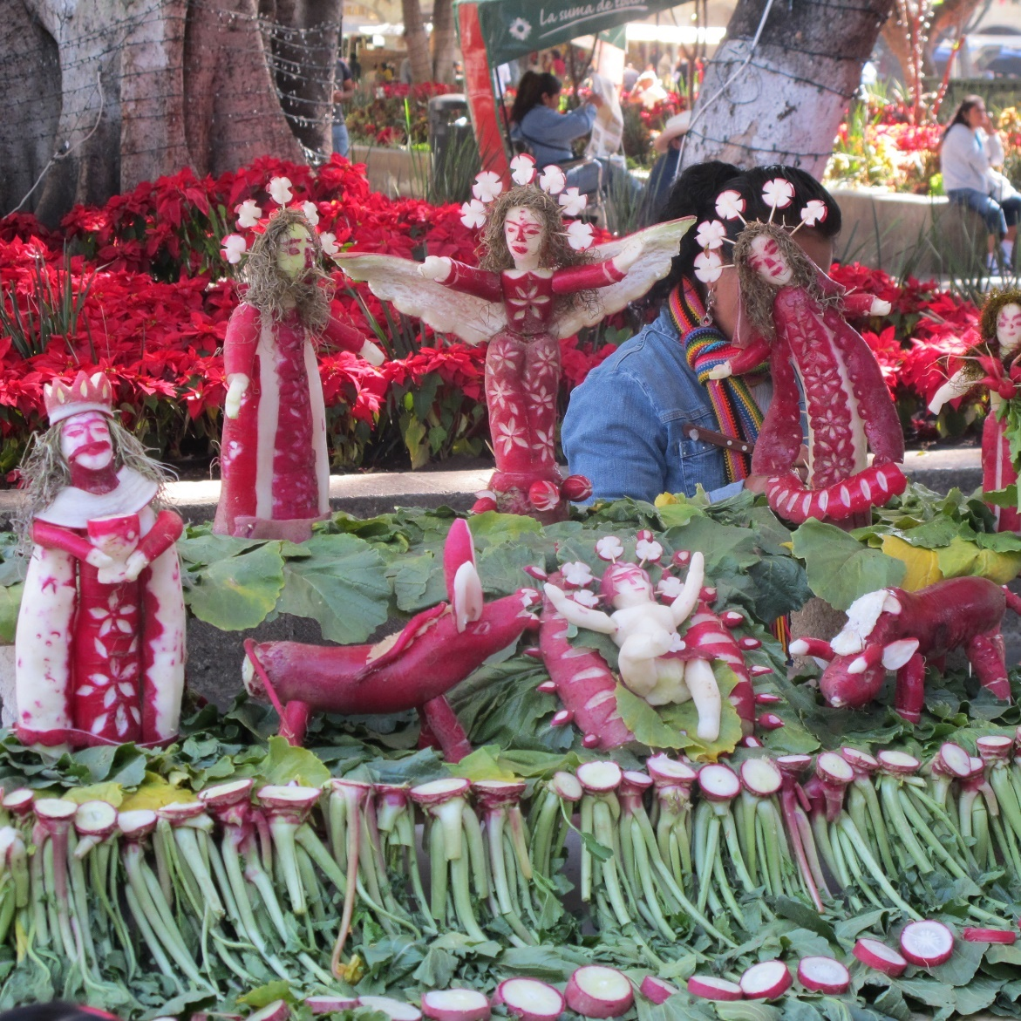
Mexico
Just before Christmas, during the ‘Festival of Radishes’, Mexican farmers carve radishes to make Nativity scenes.

Slide 10
Nigeria
The Christmas meal in Nigeria is usually roasted goat meat and chicken with rice.
Special events and dances take place. There are masquerade displays where dancers perform wearing masks.
There is a festive atmosphere with lots of sparklers and fireworks to celebrate the day.

Slide 11
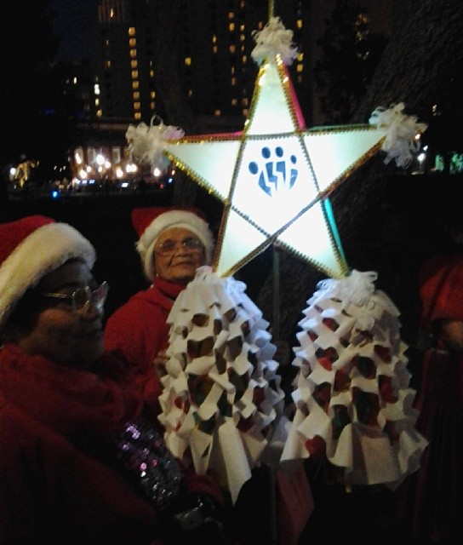
The Philippines
The Christmas season begins in September.
Many people decorate their homes with lights and a lantern ornament called a ‘parol’. Parols are more often star-shaped but they can come in lots of different shapes and sizes.
People usually eat their Christmas meal with their family on Christmas Eve. They call this Noche Buena.
“More Parol lanterns” by [Gary Stevens] is licensed under CC BY 2.0

Slide 12
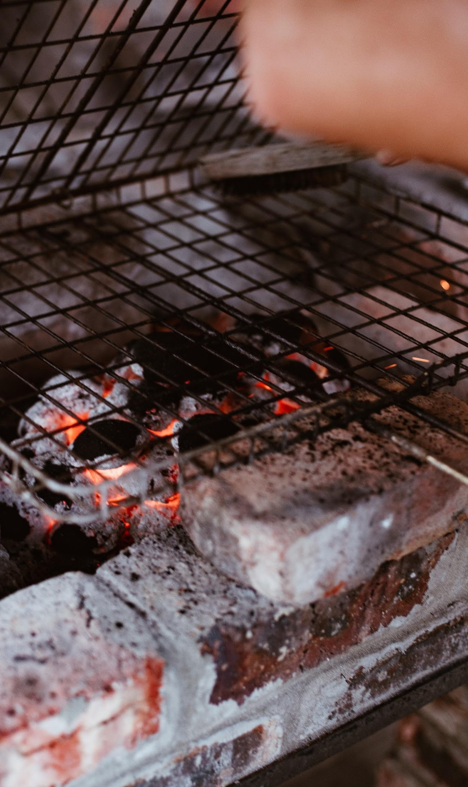
Botswana
Many people in Botswana travel to spend Christmas with their families.
Seswaa is a stew made with beef or goat meat that is very traditional at Christmas. Barbecues or braai are also becoming more popular.
People share their feasts with the whole family or sometimes even the whole village.

Slide 13
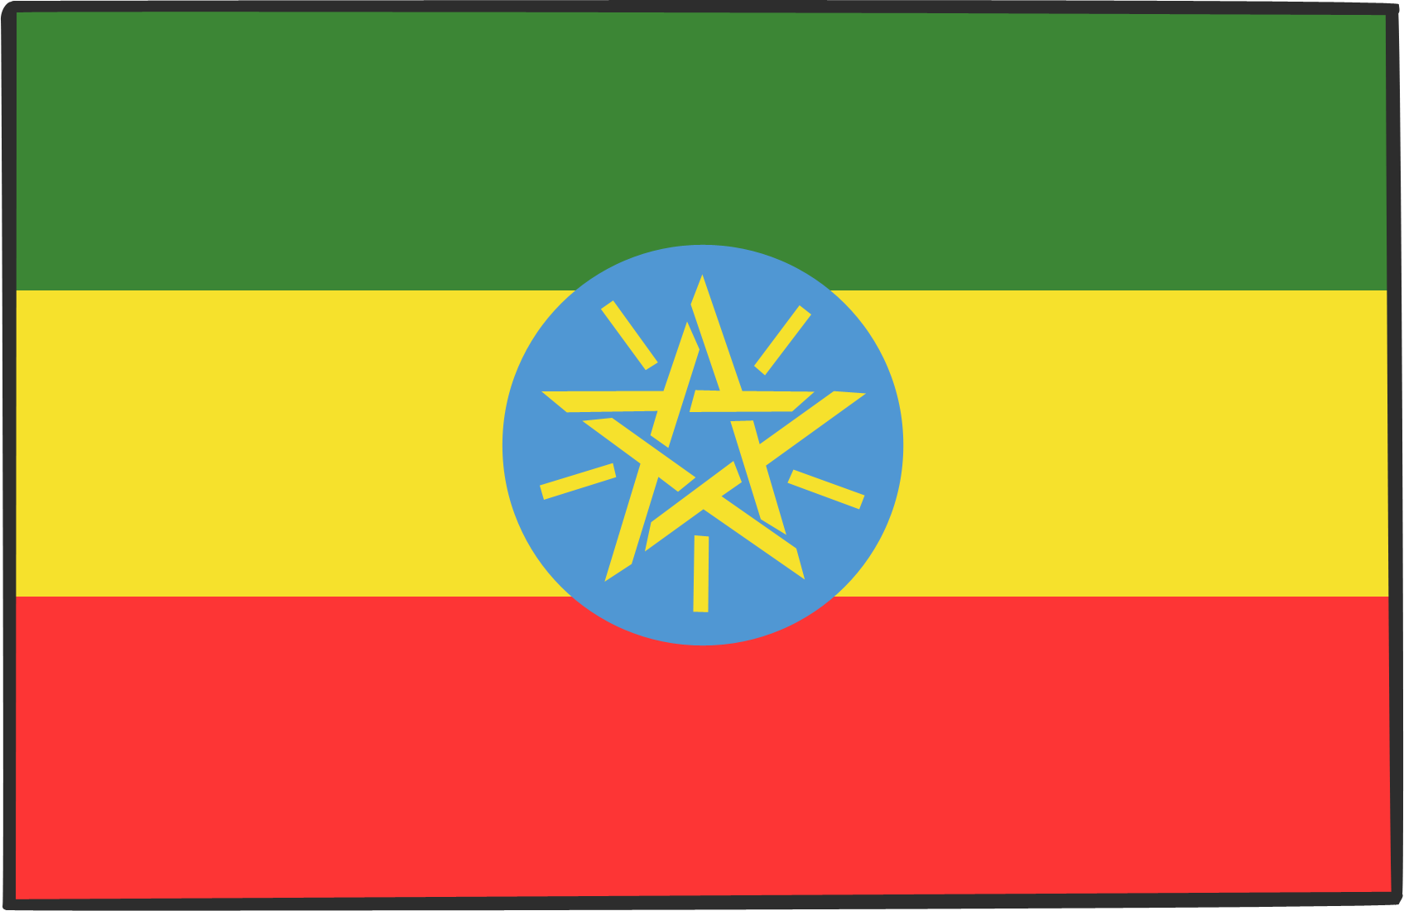
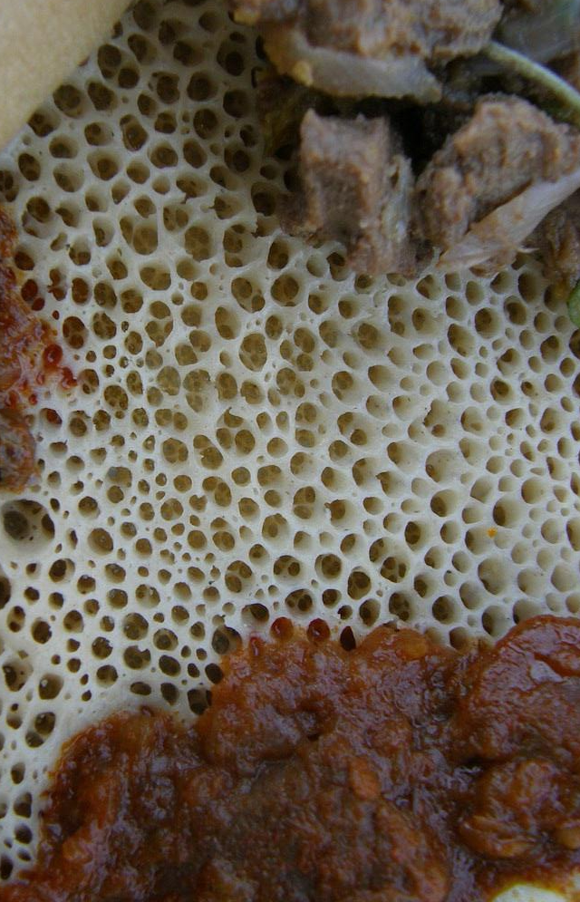
Ethiopia
Christmas is celebrated on 7th January in the Ethiopian Orthodox Church. It is called Ganna or Genna.
Many Christians fast for up to 44 days before Christmas. During this time, they don’t eat meat, fat, eggs and dairy products. They break their fast with the Christmas feast.
The Christmas feast often includes injera (a traditional Ethiopian flatbread) and w’et, a stew made with chicken, beef, lamb or other meat, plus vegetables and peas or lentils.
“Injera” by [Malcom Manners] is licensed under CC BY 2.0

Slide 14
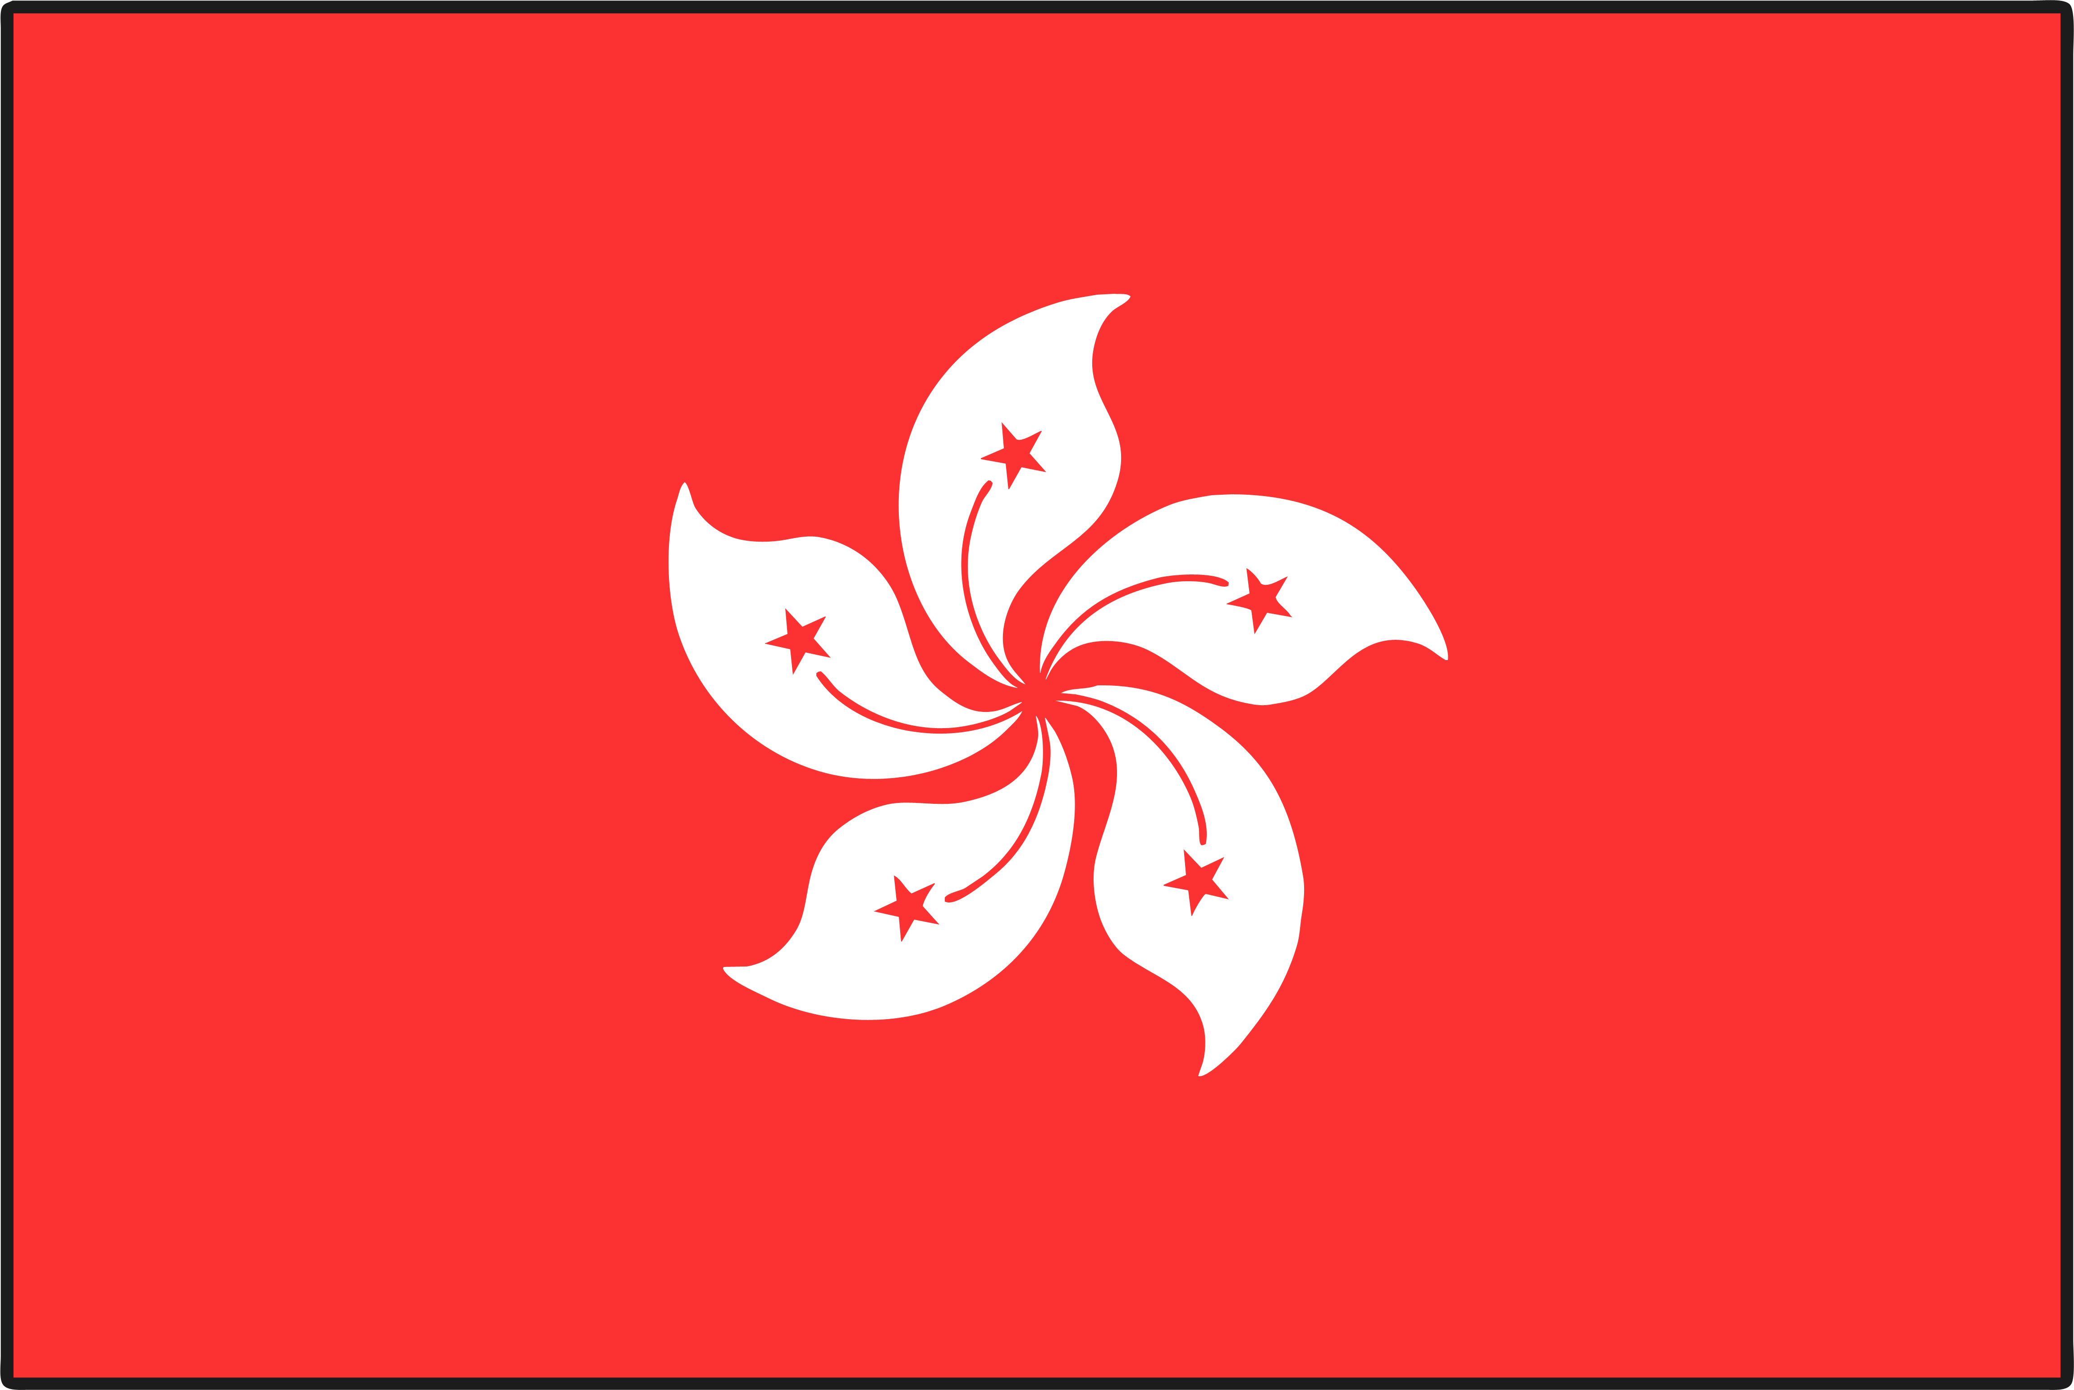
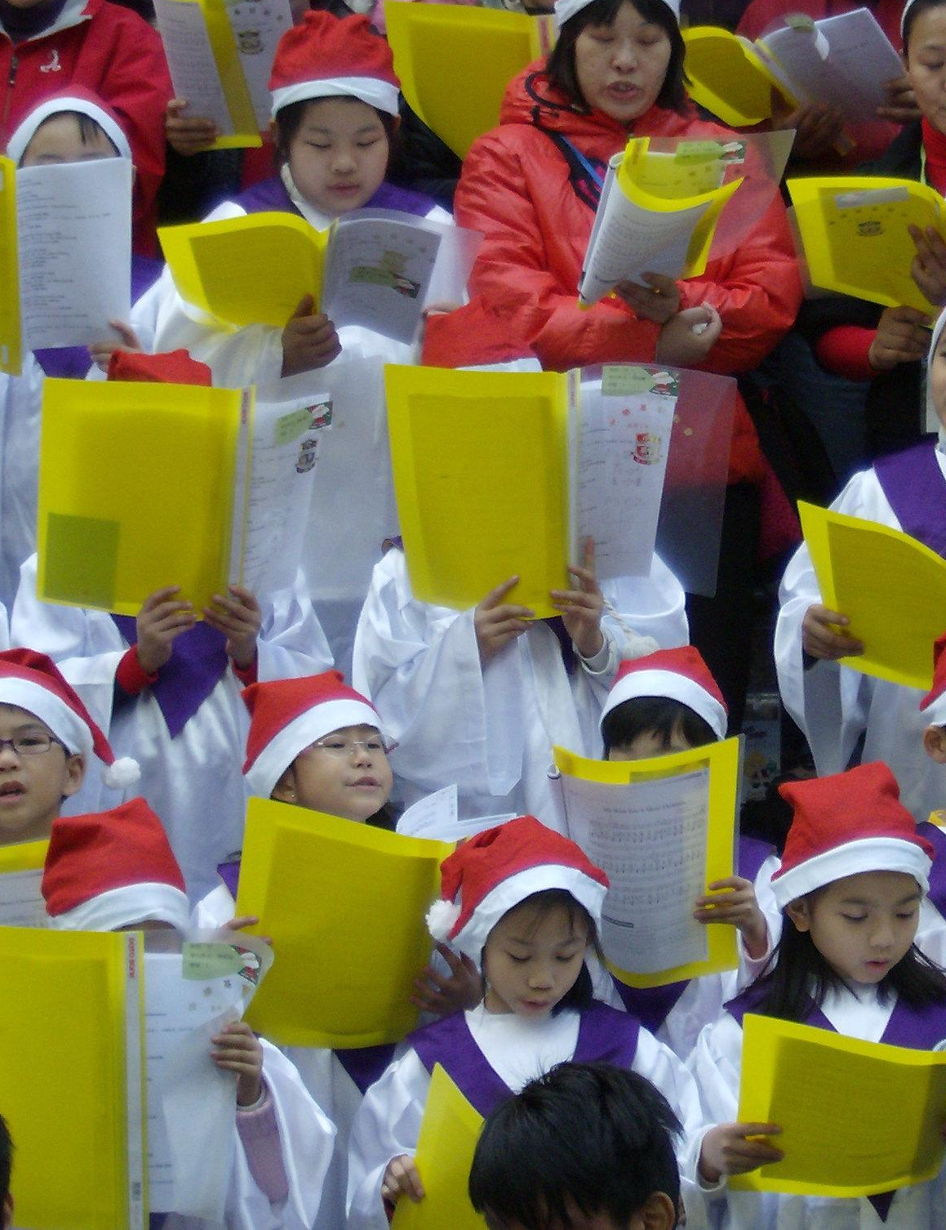
Hong Kong
Christmas services are held at the cathedral and other churches. Some services are in Cantonese and some are in English.
Hong Kong is decorated with lots of lights and decorations. Shops and attractions take part in a big celebration called ‘Winterfest’.
Boxing Day is a public holiday in Hong Kong.
“CHRISTMAS CAROLERS ON NATHAN ROAD” by [Michael] is licensed under CC BY 2.0

Slide 15
Poland
The festive period begins on 6th December with The Day of Saint Nicholas. Children will receive small gifts on this day.
In Poland, Christmas is mostly a time for religion and for family.
During Advent, people bake Christmas piernik (gingerbread).
On Christmas Eve, people in Poland watch for the first star to appear in the sky. This is when they are allowed to begin their Wigilia, the Christmas Eve supper.
“Pierniki” by [Kris Duda] is licensed under CC BY 2.0

Slide 16
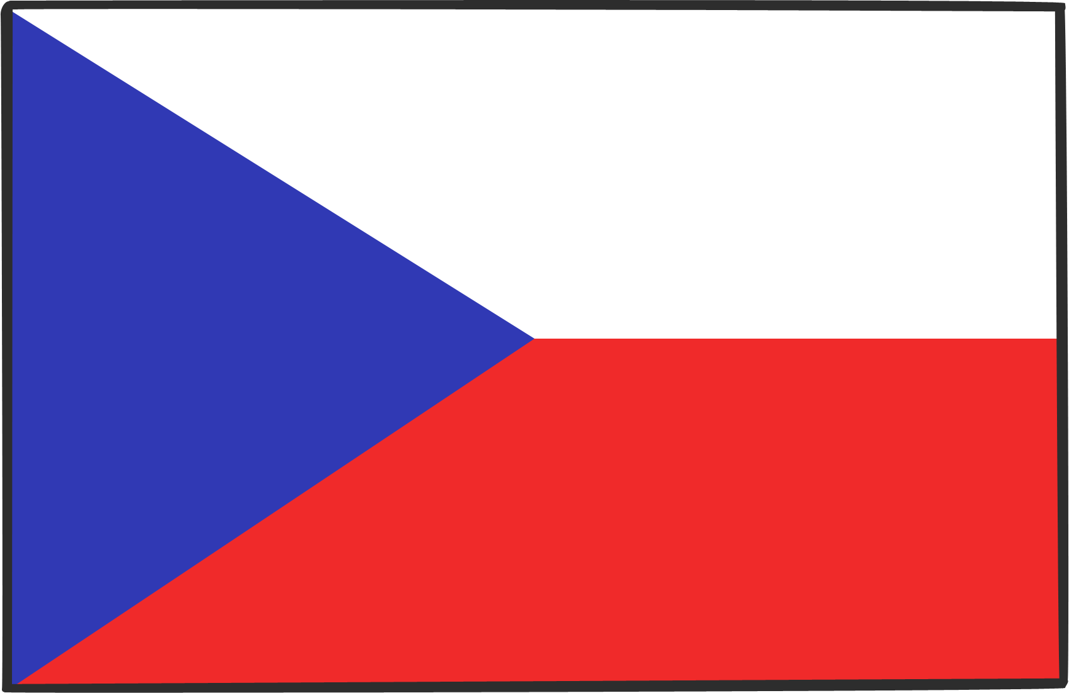
Czech Republic
St Nicholas Day is celebrated every year on 5th December. This is when children hope that Svatý Mikuláš (St Nicholas) will arrive and give them presents. He is accompanied by an angel and a devil.
It is traditional to eat carp for Christmas dinner.
Baby Jesus (Ježíšek) brings the Christmas presents on Christmas Eve when none of the children are looking!
“Christmas Old Town Square Prague 2007” by [Pazuzu] is licensed under CC BY 2.0

Slide 17
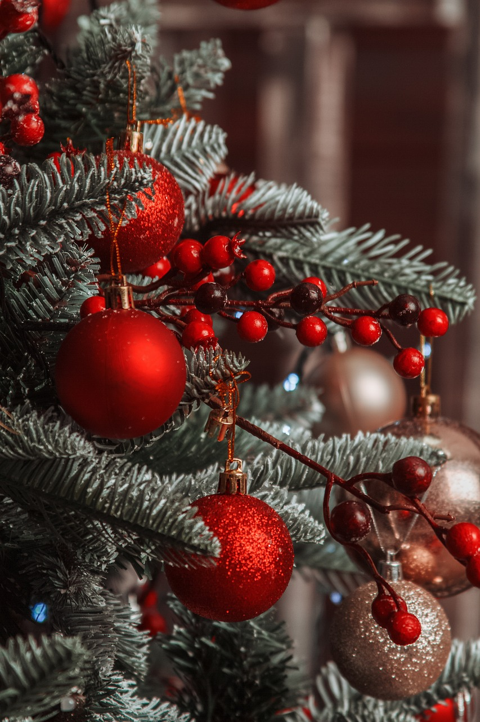
Romania
6th December is Sfantul Nicolae's (St Nicholas) Day. The day before, children leave their boots out in the hope that they will get filled with small presents.
Christmas trees are decorated on Christmas Eve.
Carol singing is a very important tradition. Children sing and dance and may receive some sweets or fruit.

Slide 18
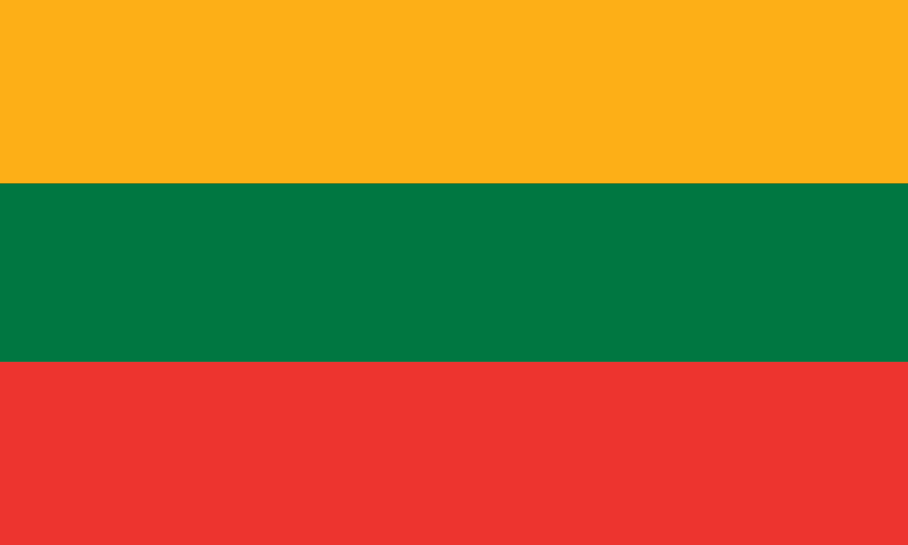
Lithuania
Christmas Eve (Kūčios) is the most important day of the celebrations. In the evening, families celebrate with a feast.
The feast is traditionally made up of 12 courses – none of which include meat.
Straw is used for decorating to symbolise Baby Jesus lying in a manger surrounded by straw.

