Slide 2
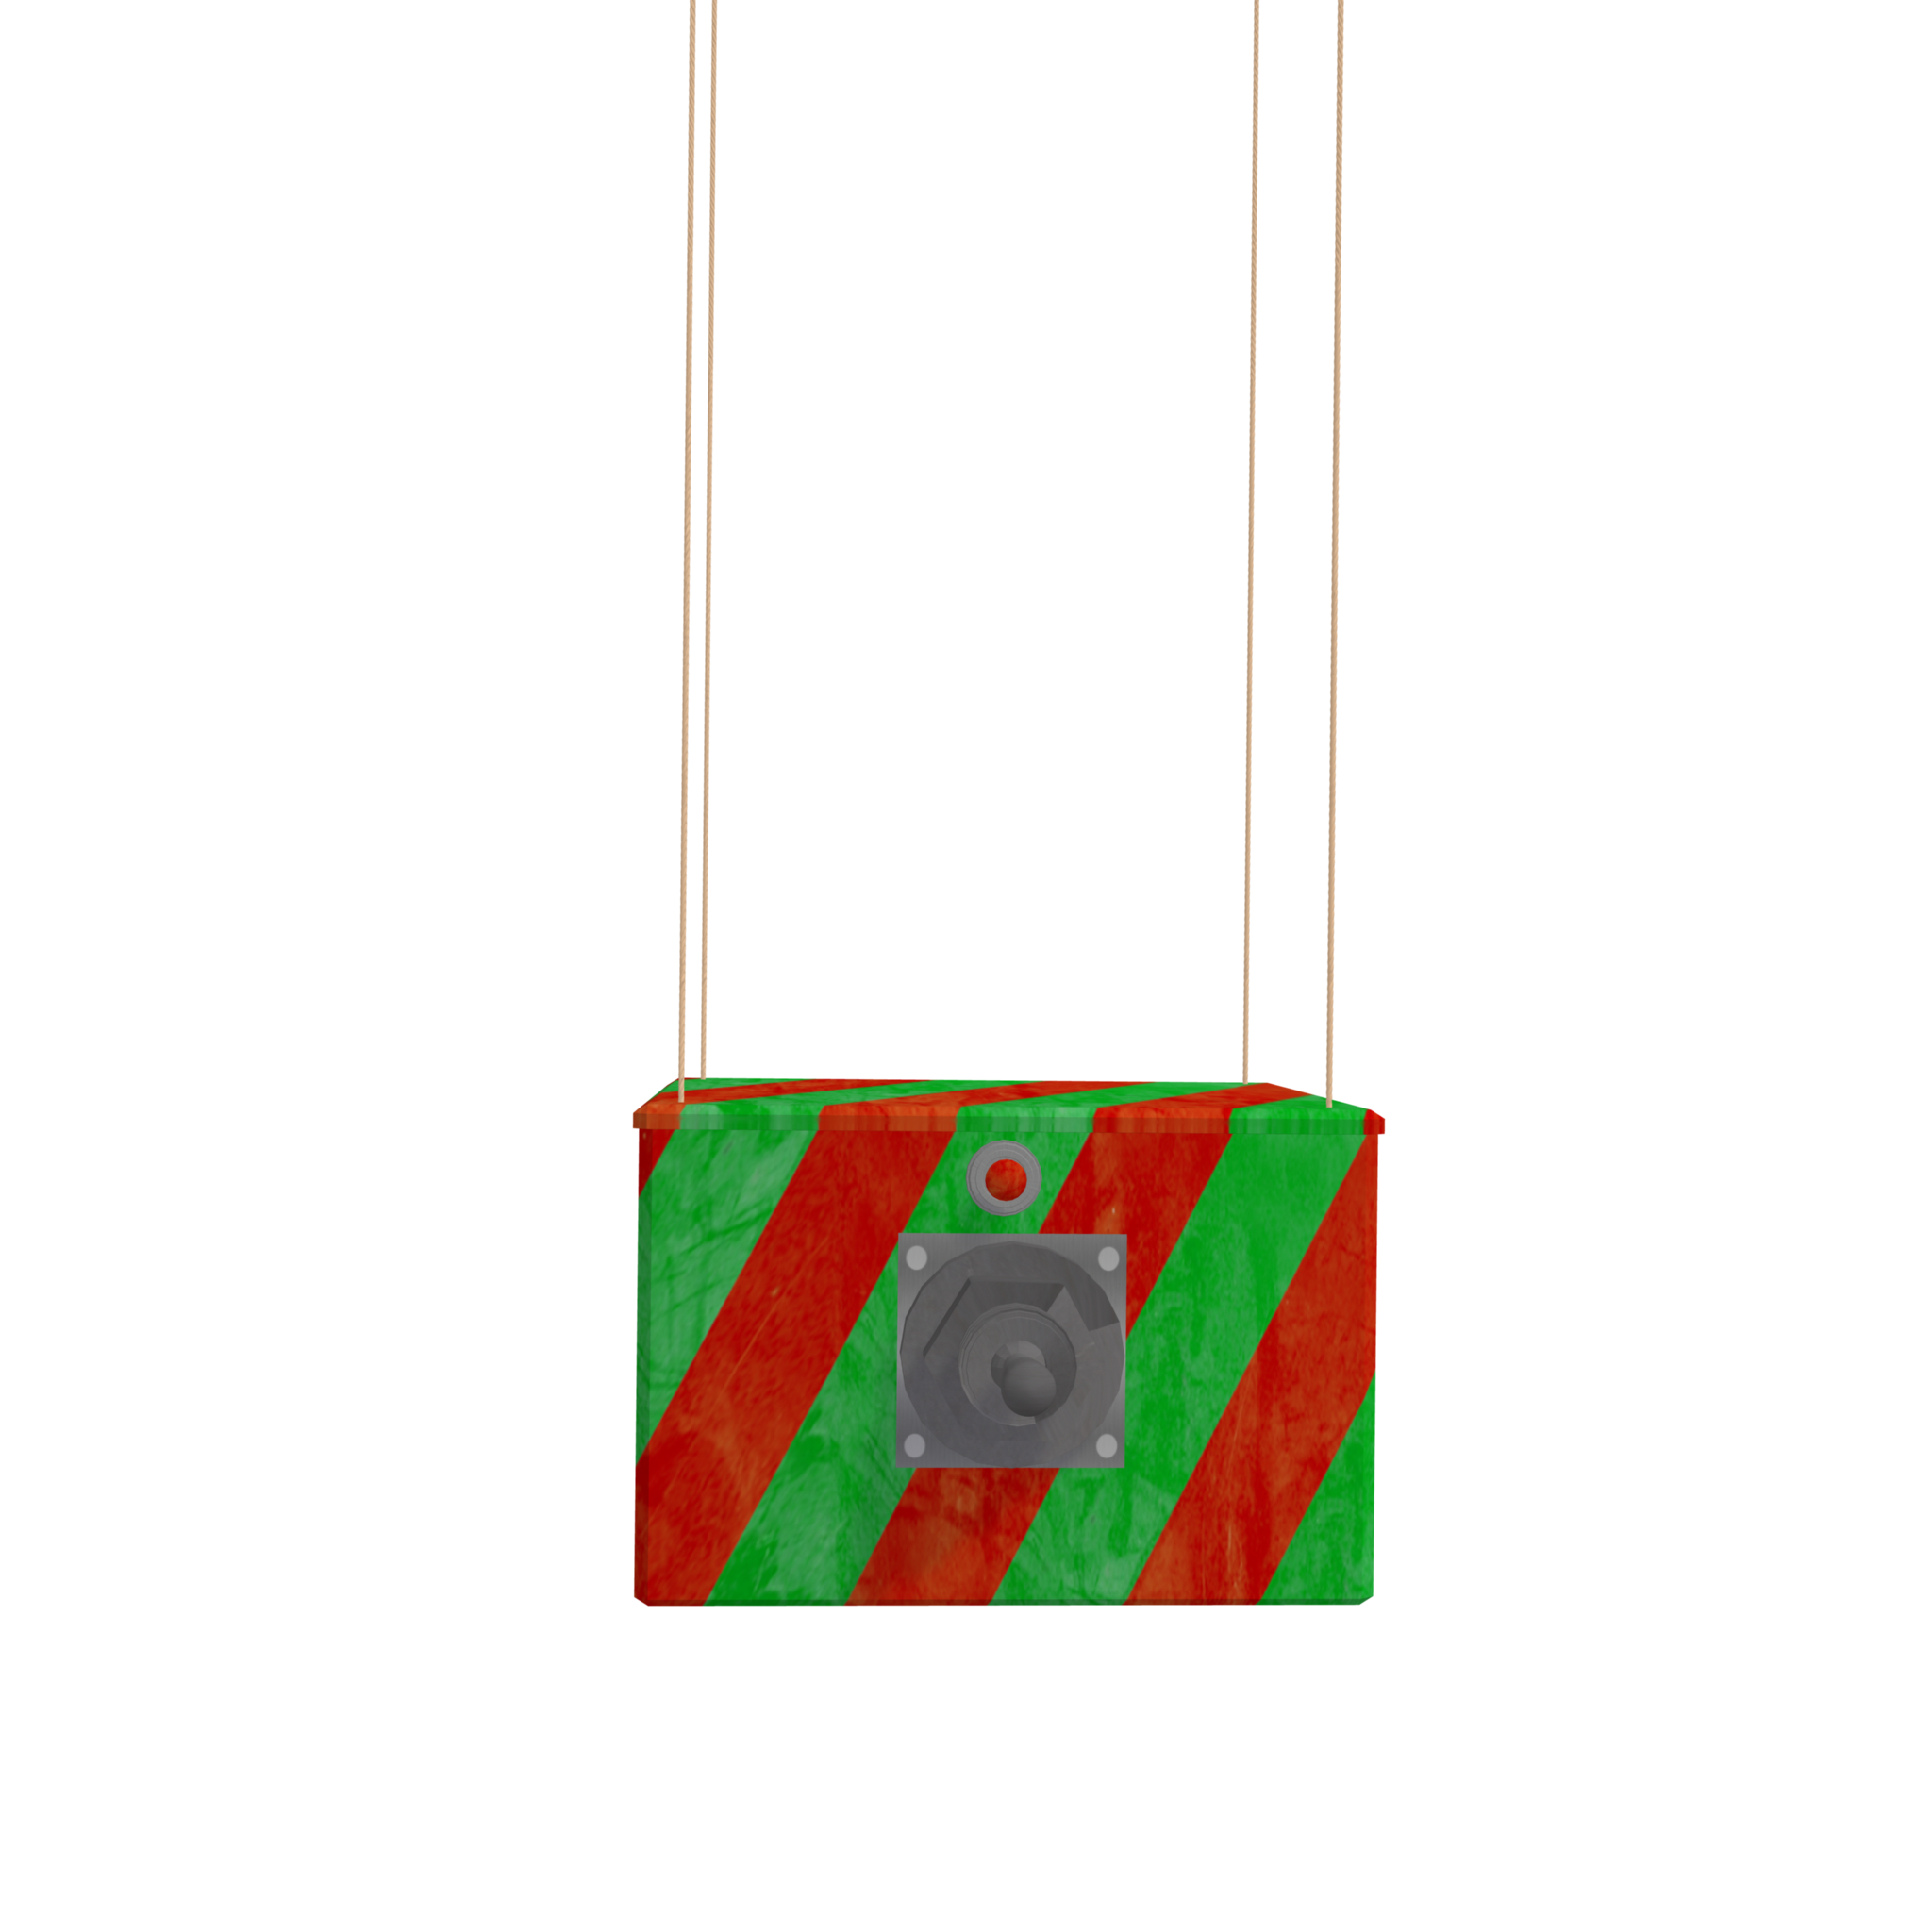

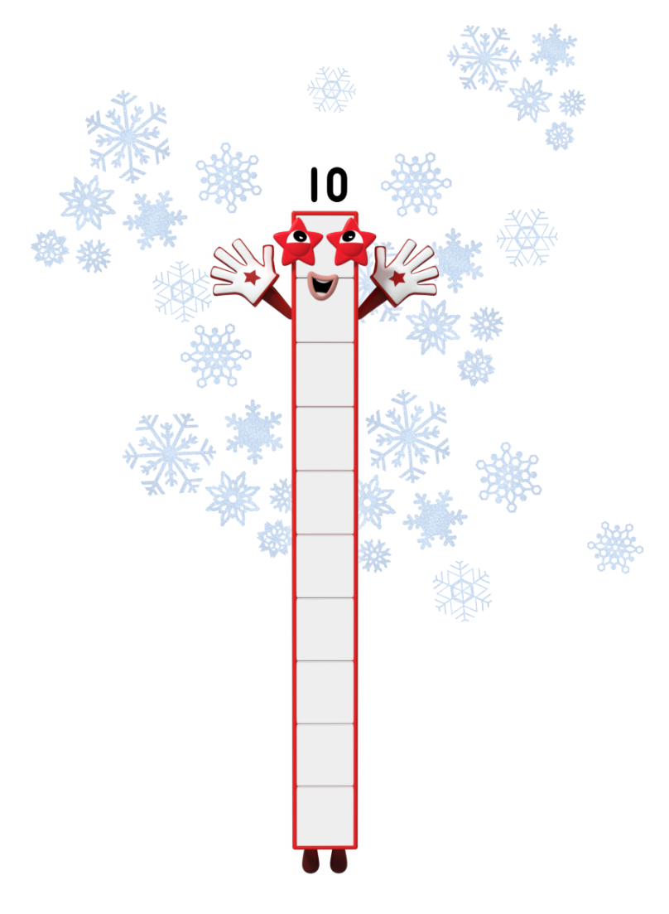
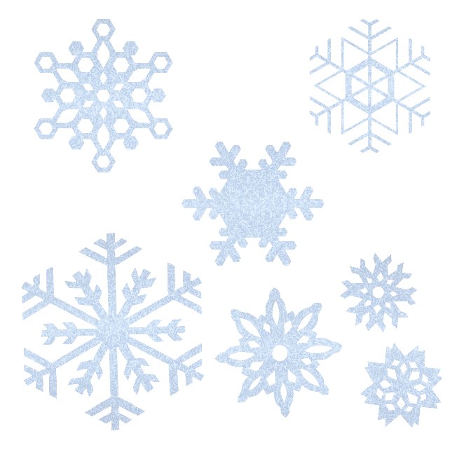
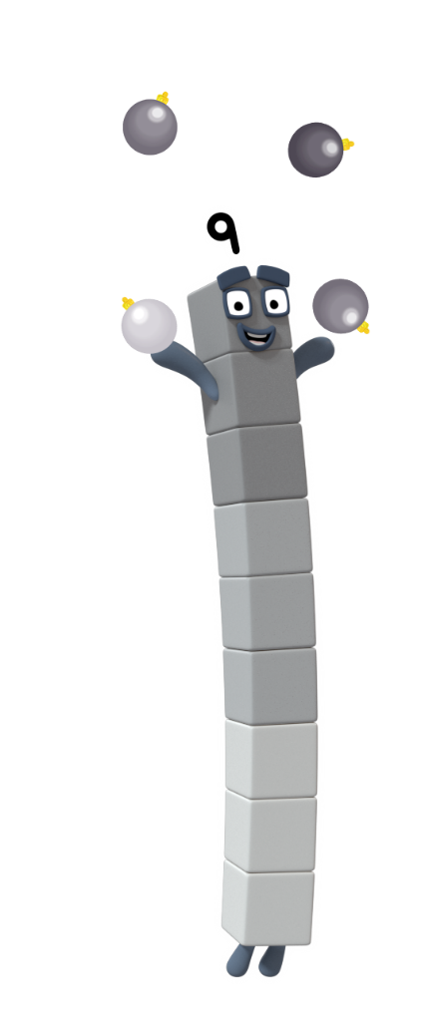
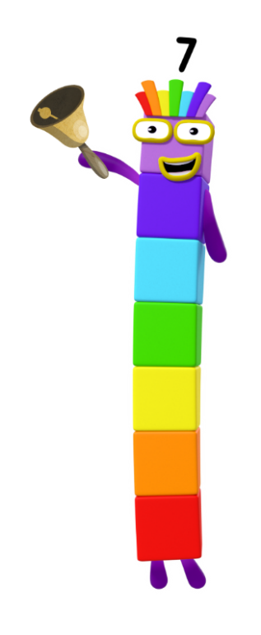
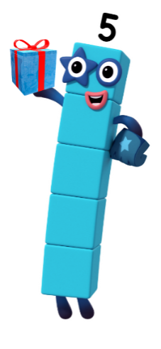
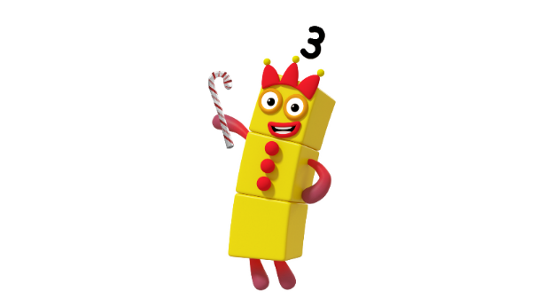
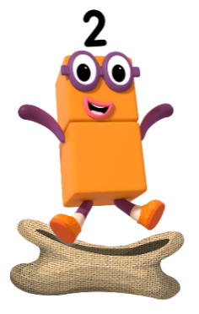
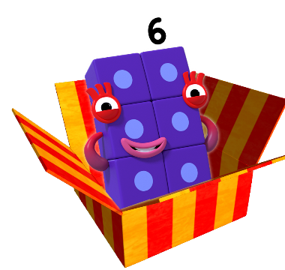
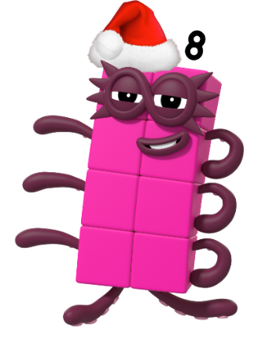
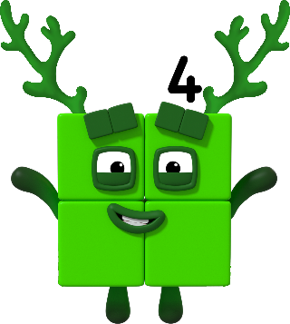
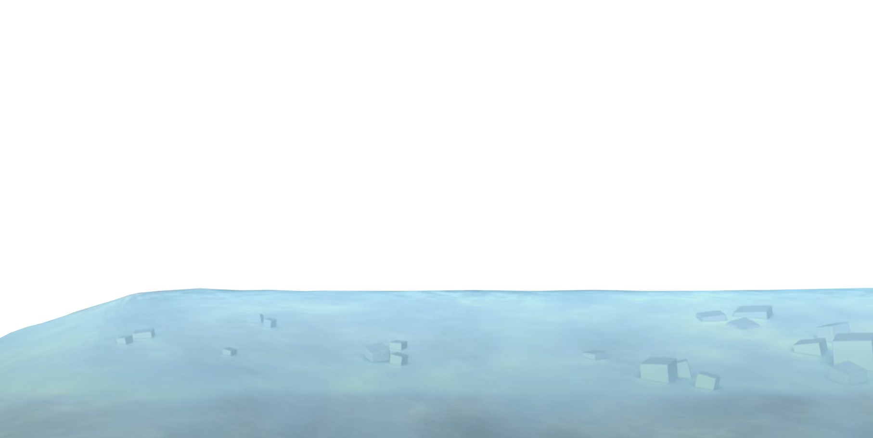

next
The Numberblocks are busy getting ready for Christmas. Can you work out which Numberblock has been doing each task?

Slide 3

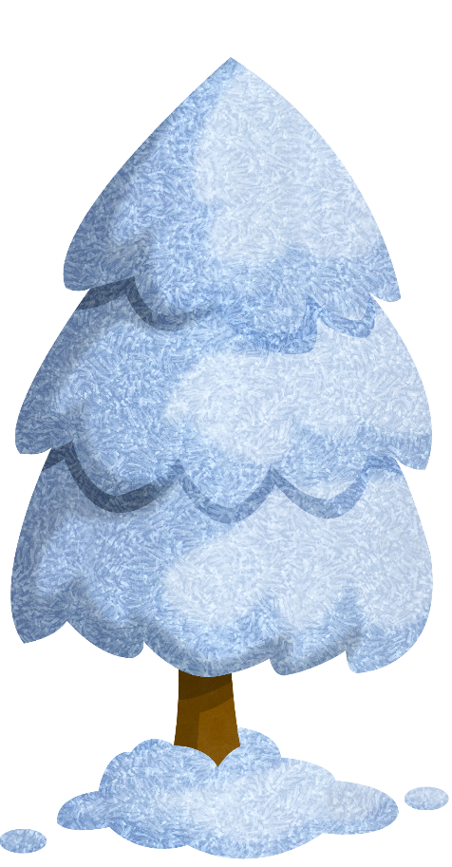

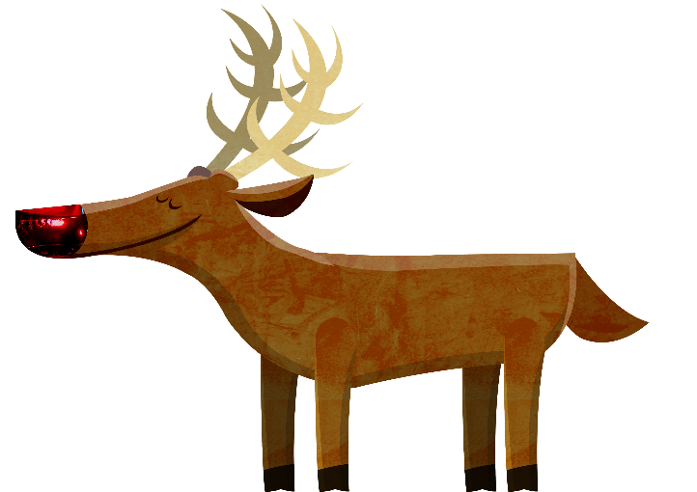
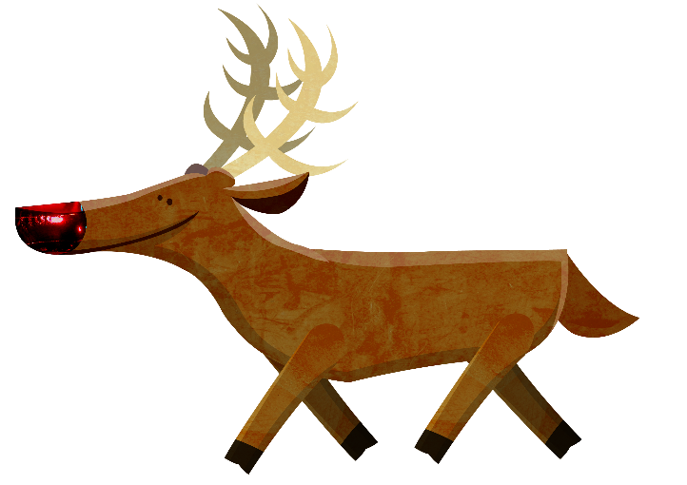
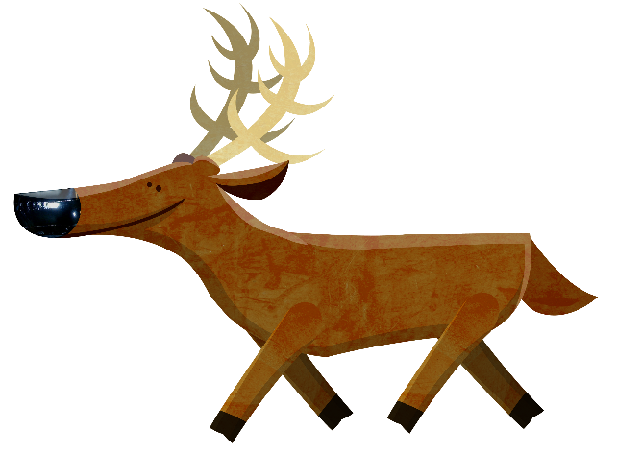
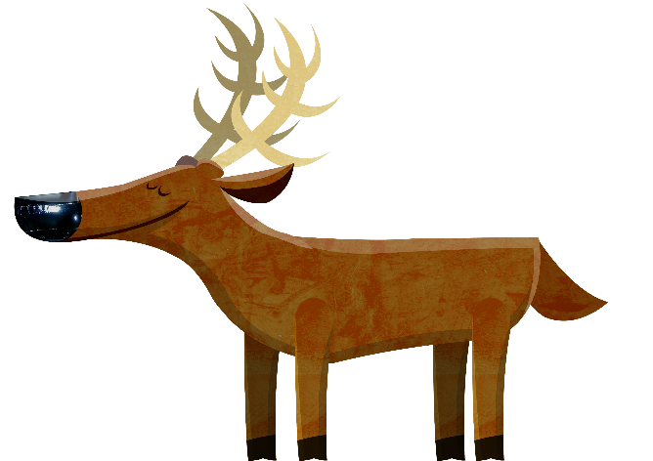
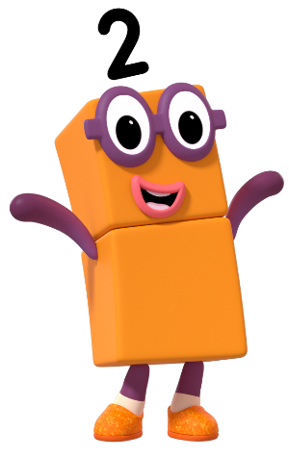

Which Numberblock do you think has been busy looking after the reindeer?
Try again.
Try again.

Slide 4
next
That’s right! I have been looking after the reindeer. There are 2. How did you know? Click me to count them.
What do you notice about the reindeer?
1
2

Slide 5

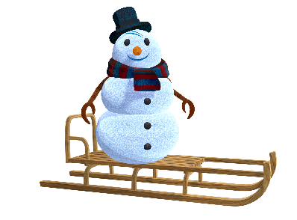





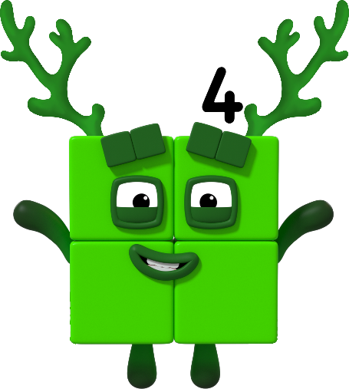
Which Numberblock has been pushing the snowman on the sledge? Click the sledge and watch it go!
Try again.
Try again.

Slide 6
next
That’s right! I pushed the snowman on the sledge 5 times. Can you show me 5 on your fingers?

Slide 7
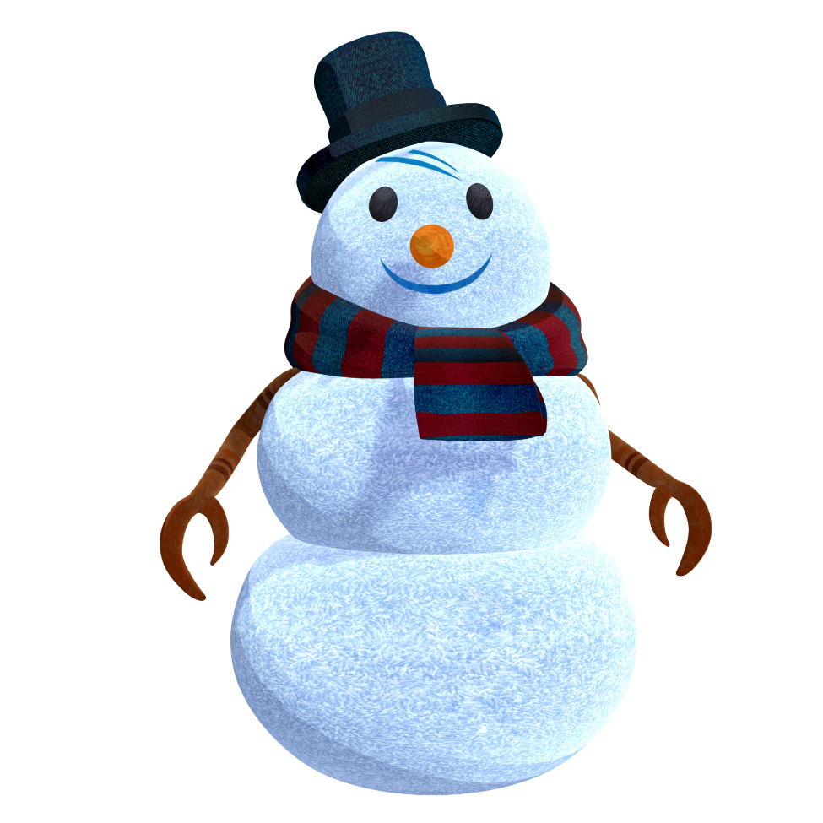
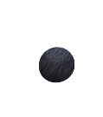

Which Numberblock do you think has been putting buttons on the snowman?
Try again.
Try again.

Slide 8
next
That’s right! I put 3 buttons on the snowman. Can you count the buttons with me? Click the snowman.

Slide 9
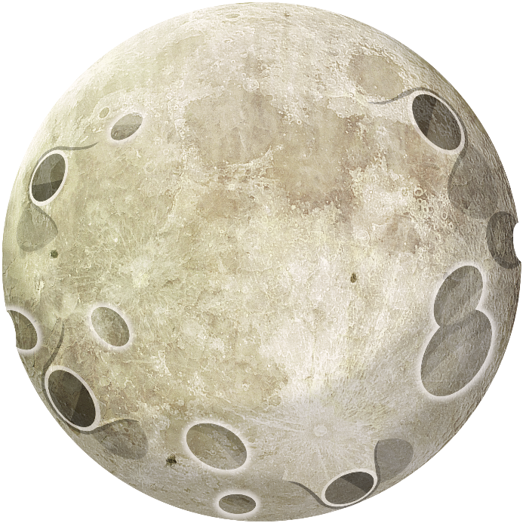

A Numberblock has been checking the sky for the bright, glowing moon. Which Numberblock do you think it is?
Try again.
Try again.

Slide 10
next
That’s right! I saw 1 moon in the sky. What other ways can you see 1 on this slide?

Slide 11

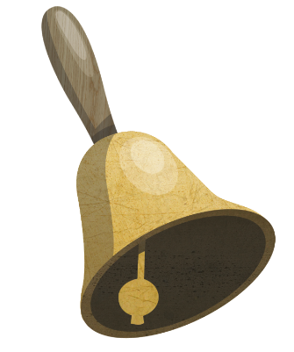

A Numberblock has been ringing the bell. Click the bell to work out who it is.
Try again.
Try again.

Slide 12
next
That’s right! I rang the bell 4 times. Can you clap your hands 4 times?

Slide 13



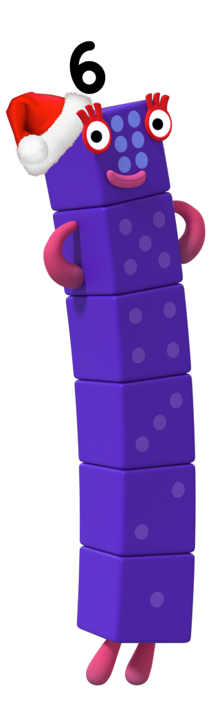


Can you work out which Numberblock has been counting the snowflakes falling from the sky? Click the sky to watch them fall!
Try again.
Try again.

Slide 14



next
That’s right! There were 7 snowflakes. Can you tell a partner how you knew that?

Slide 15

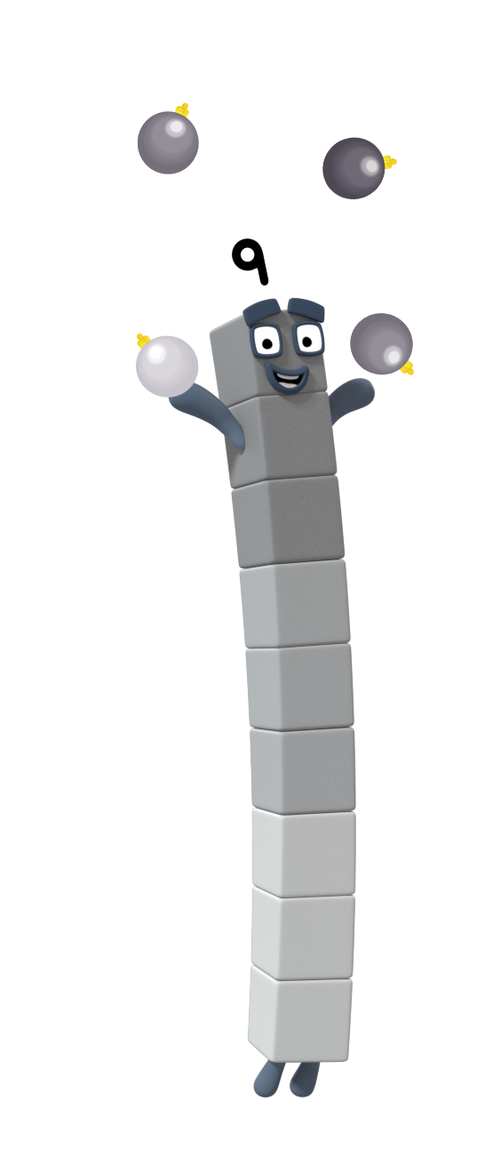

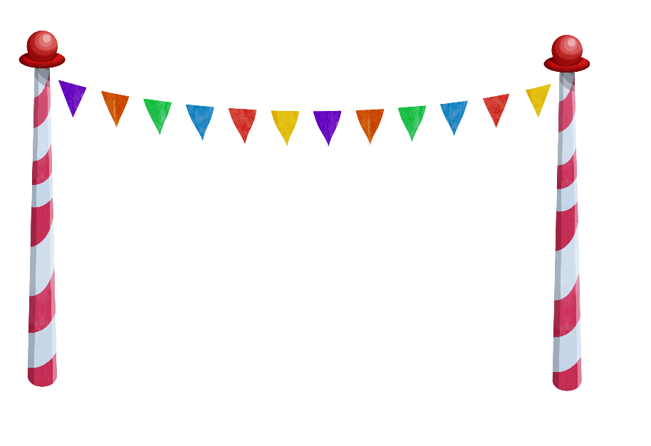
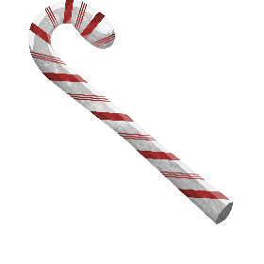
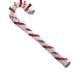

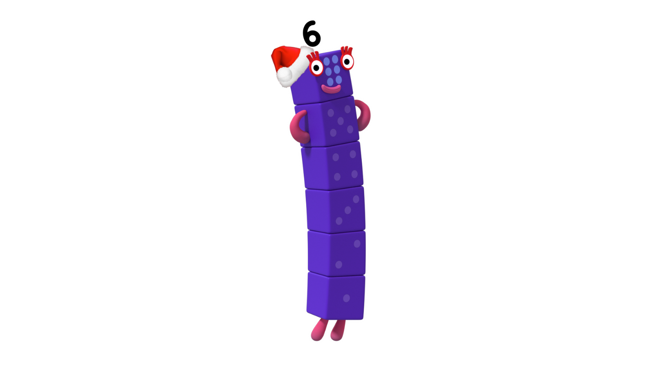
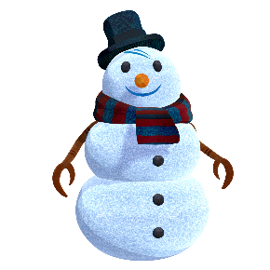




Somebody has been hiding candy canes for the other Numberblocks to find! Who is it?
Try again.
Try again.

Slide 16

next
That’s right! It was me – Octoblock. I hid 8 candy canes. Can you click on me to count them and check?

Slide 17
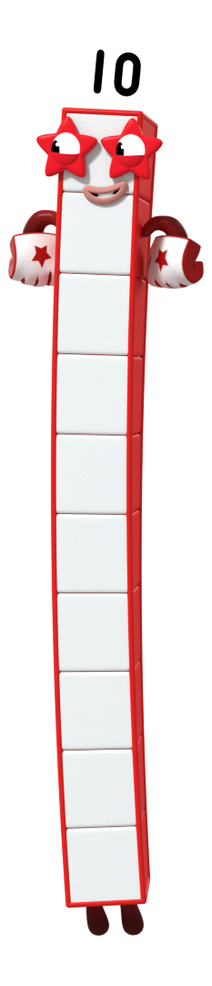
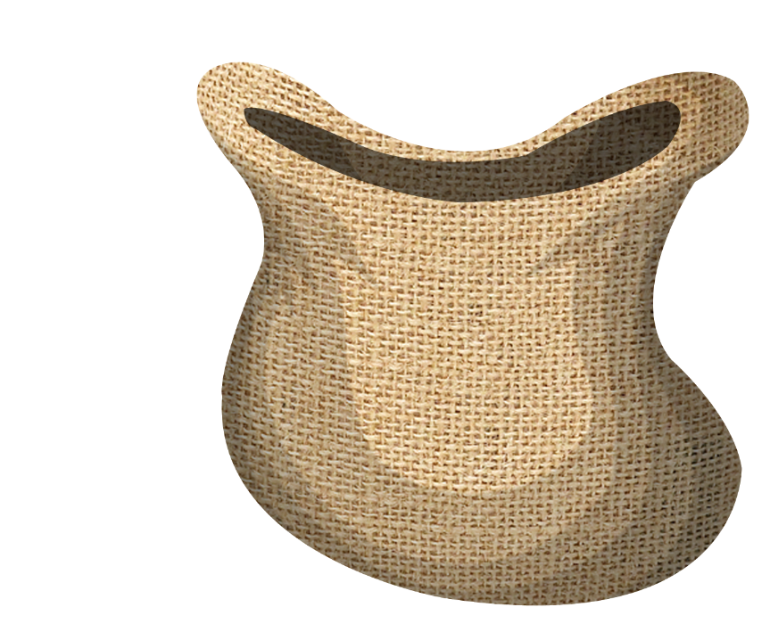
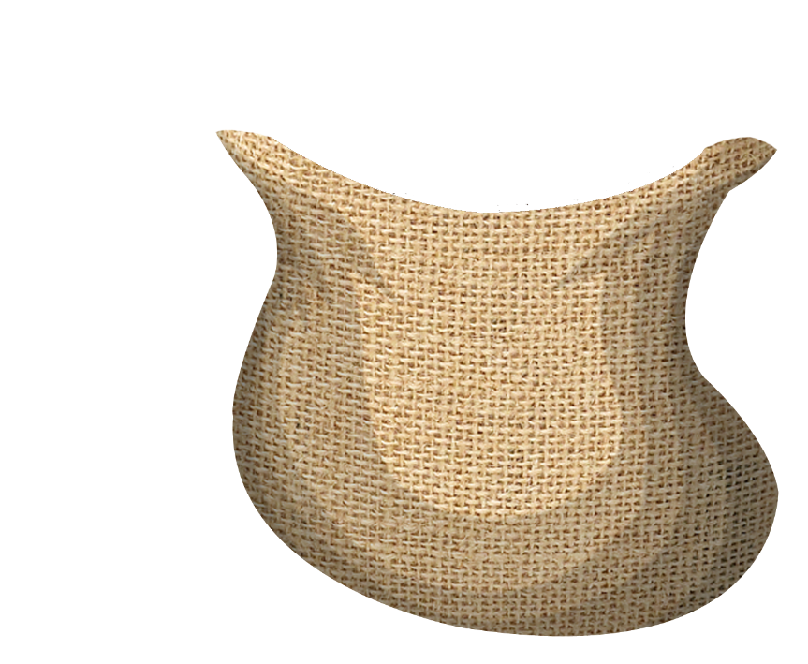
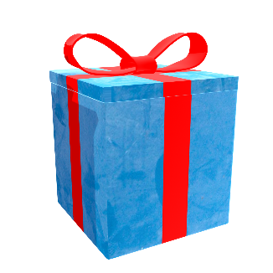
A Numberblock has been sorting the presents into the sack. Who is it?
Click the sack to sort the presents!
Try again.
Try again.

Slide 18
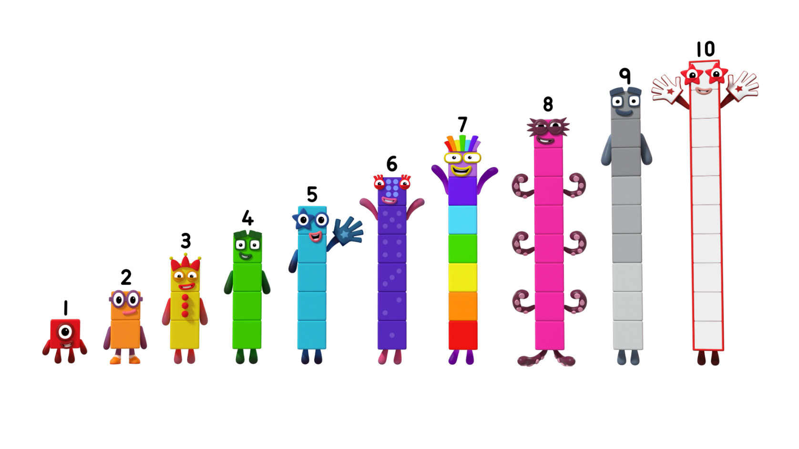


next
That’s right! I have put 10 presents in the sack. Are there enough presents for each Numberblock? Click me to check!

Slide 19
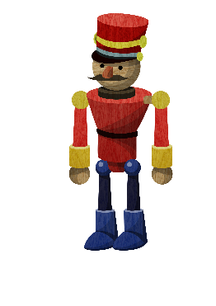
A Numberblock has been playing with the toy soldiers. Can you work out who it is? How many soldiers can you count? Click the snow to count!
Try again.
Try again.

Slide 20
next
That’s right! I played with 6 toy soldiers.

Slide 21
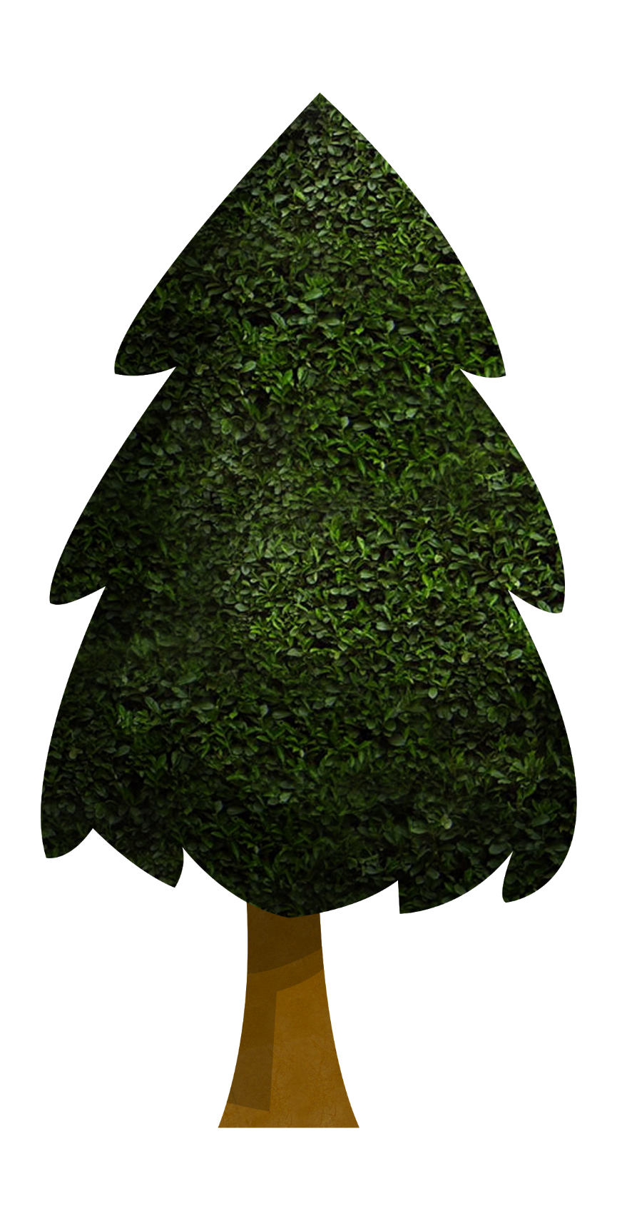
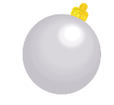
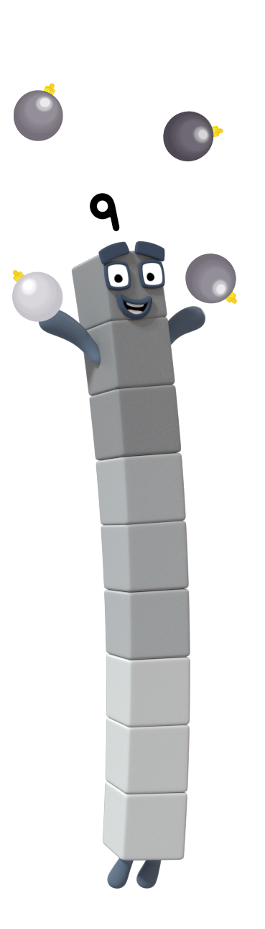
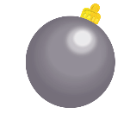
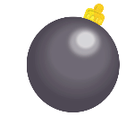
Which Numberblock do you think has been decorating the Christmas tree? Click the tree to count!
Try again.
Try again.

Slide 22




next
That’s right! I added 9 baubles to the tree. How did you know? Can you help me check?

Slide 23
Let’s count to 10!

Slide 24
Season’s Greetings!
For more number fun, head on down to learningblocks.tv!

